Slide 1
Capstone
File created on: 6/18/2020 9:01:34 PM

Slide 2
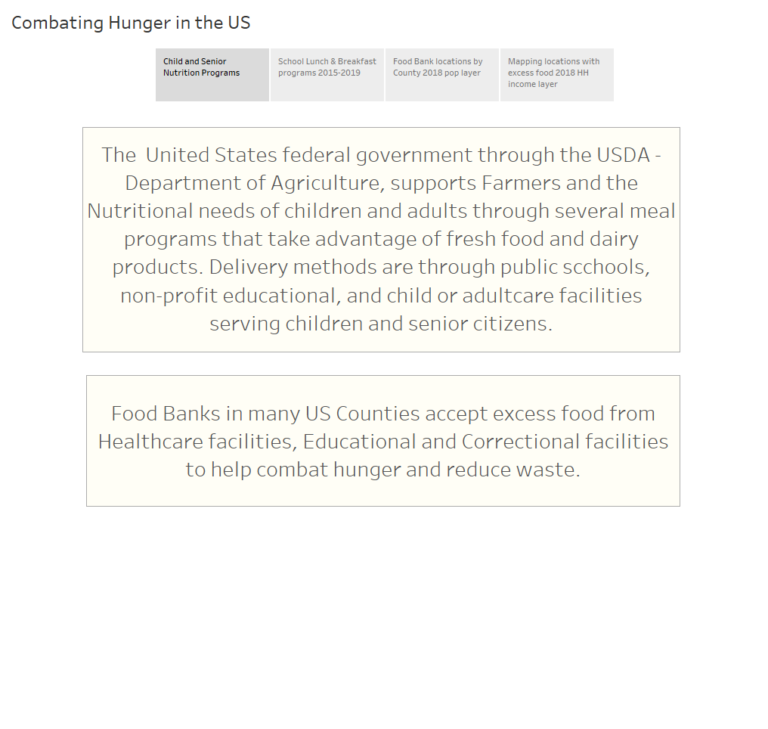

Slide 3
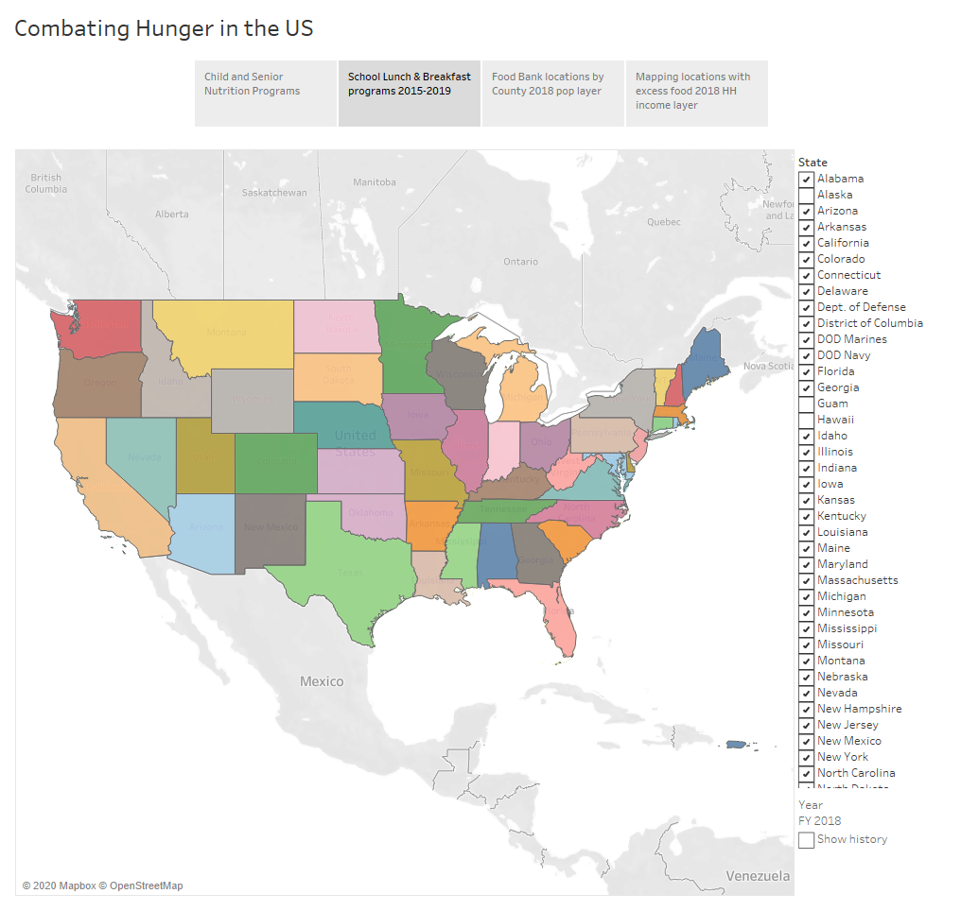

Slide 4
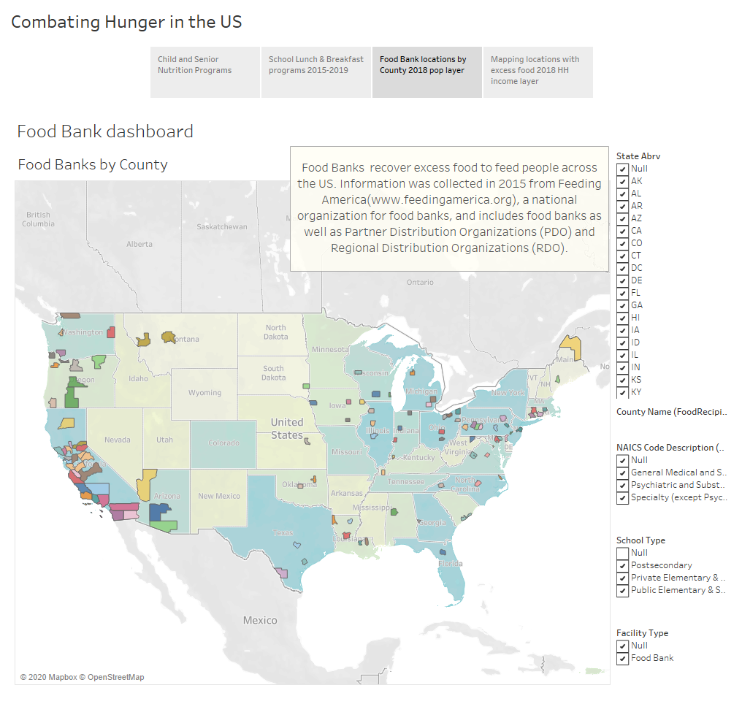

Slide 5
