Slide 1
REAL-TIME CONNECT 4 GAME USING PYTHON
Submitted by:
Aiswarya Biju-233242210748
Ann Rose Paul -233242210753
Date: 29-10-2024

Slide 2
CONTENTS
Introduction...........................................................................................................3
Abstract.................................................................................................................4
Existing and proposed system...............................................................................5
System Requirement Specification.......................................................................6
Module description...............................................................................................7
Project design........................................................................................................8
Data Flow Diagram...............................................................................................9
Activity Diagram..................................................................................................10-11
Class Diagram.......................................................................................................12

Slide 3
INTRODUCTION
Connect Four is a board game that is played by exactly two players, players
in it are assigned to different colors and then take turns dropping colored discs
into the suspended grid. The game’s grid has Five columns and Five rows. The
pieces fall according to gravity.

Slide 4
ABSTRACT
This project consisted of creating a pygame using python for the game Connect4.
We created code that set up a 5 by 5 board.
Two players play against each other: PLAYER-1 v/s PLAYER-2
The player hovers the mouse over the board and then clicks on any column and their chip will fall to the appropriate row. This means that if there are no chips in that column, it will fall to the row directly occupying the lower, upper ,left or right available space.

Slide 5
EXISTING AND PROPOSED SYSTEM
EXISTING SYSYTEM :
Player input: A method for players to select columns
Disc dropping Mechanism: A system to place discs in the selected column
Win Condition Check: A mechanism to detect when a player has four consecutive discs in a row, column, or diagonal.
Game Over Handling: A system to end the game and declare a winner or a draw.
PROSPOSED SYSTEM :
Implementing a 5x5 grid.
Adding game modes (e.g. simple ,complex )
Enhancing the user interface.
Improving game performance.
Integrating with external services such as themes, sound.

Slide 6
System Requirement Specification
Software Specifications :
Windows 10 or high.
Libraries and frameworks: pygame
Programming Language: Python (version 3)
Hardware Specifications:
Processor-core i5
Hard Disk-160 GB
Memory-1GB RAM
Monitor

Slide 7
MODULE DESCRIPTION
ADMIN MODULE:
This module provides administrator related functionalities. Administrator can change the game modes..
The admin is required to keep all the player's information and not compromising the data to unauthorized access.
USER MODULE:
This module is about users of this portal.
By using this module user, the player can given with the option to choose the game modes(i.e simple or complex) and player must be registered with the system. So that the player can check their status.

Slide 8
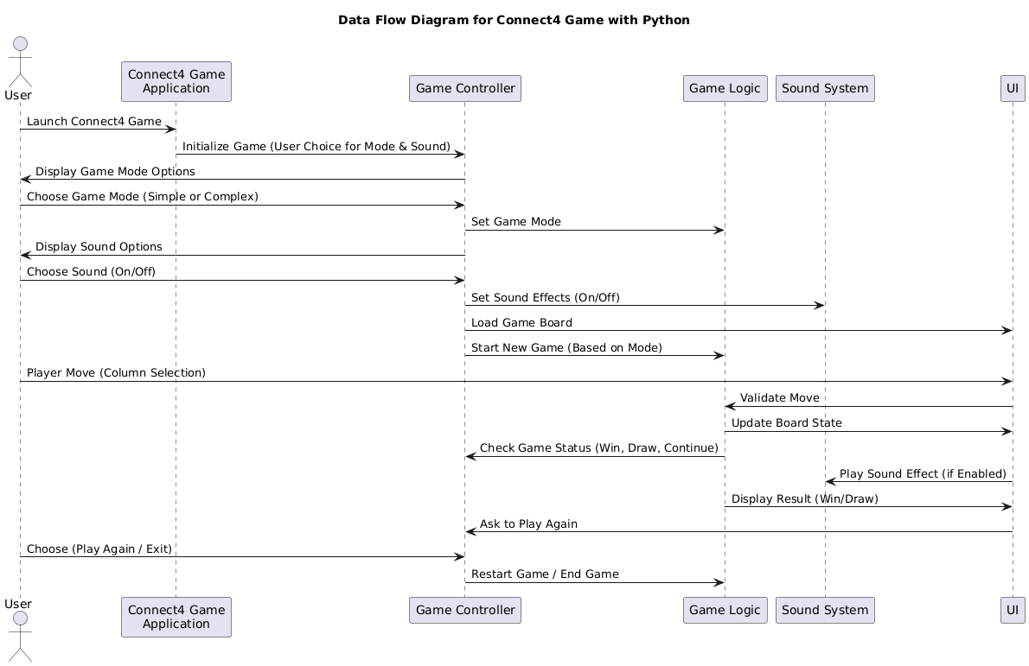
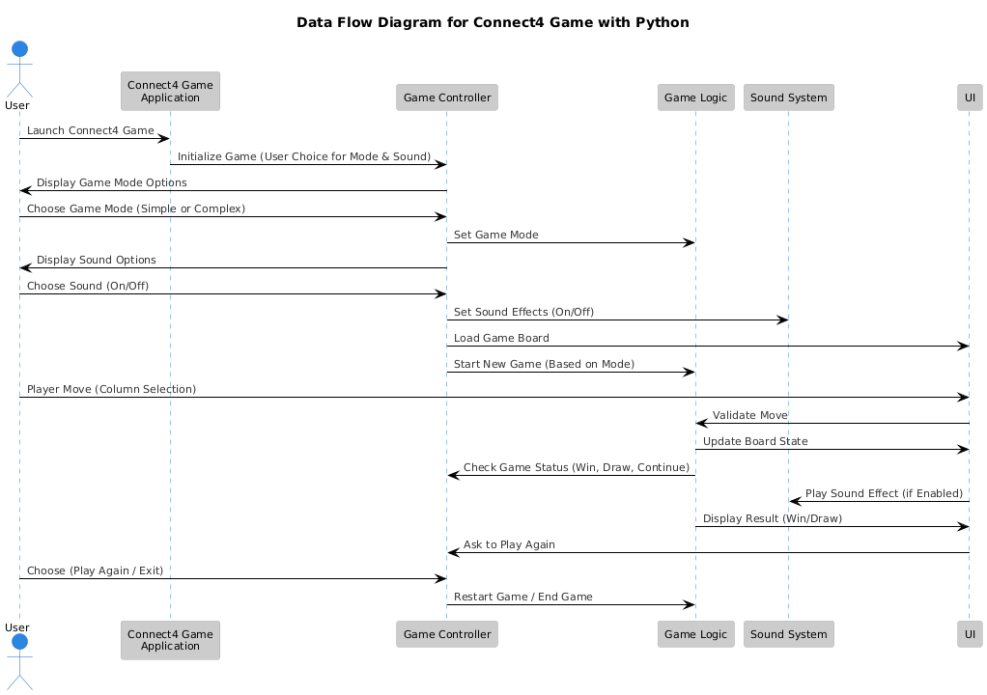
SEQUENCE DIAGRAM

Slide 9
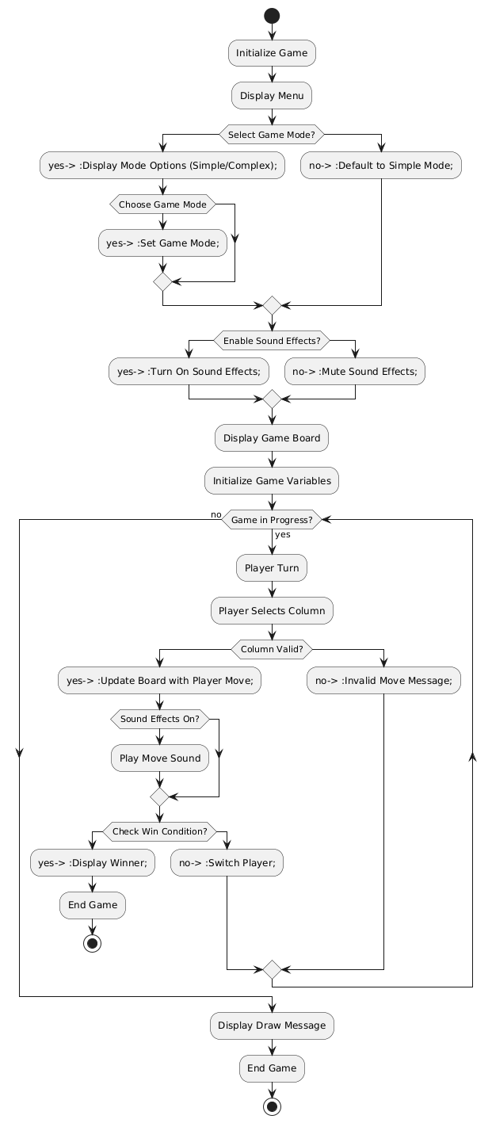
ACTIVITY DIAGRAM

Slide 11
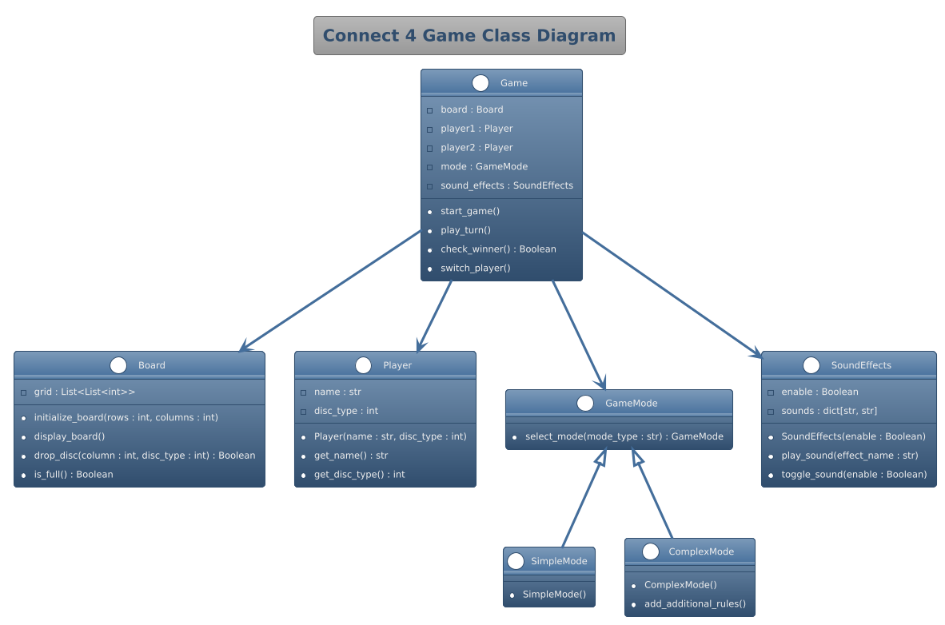
CLASS DIAGRAM

Slide 12
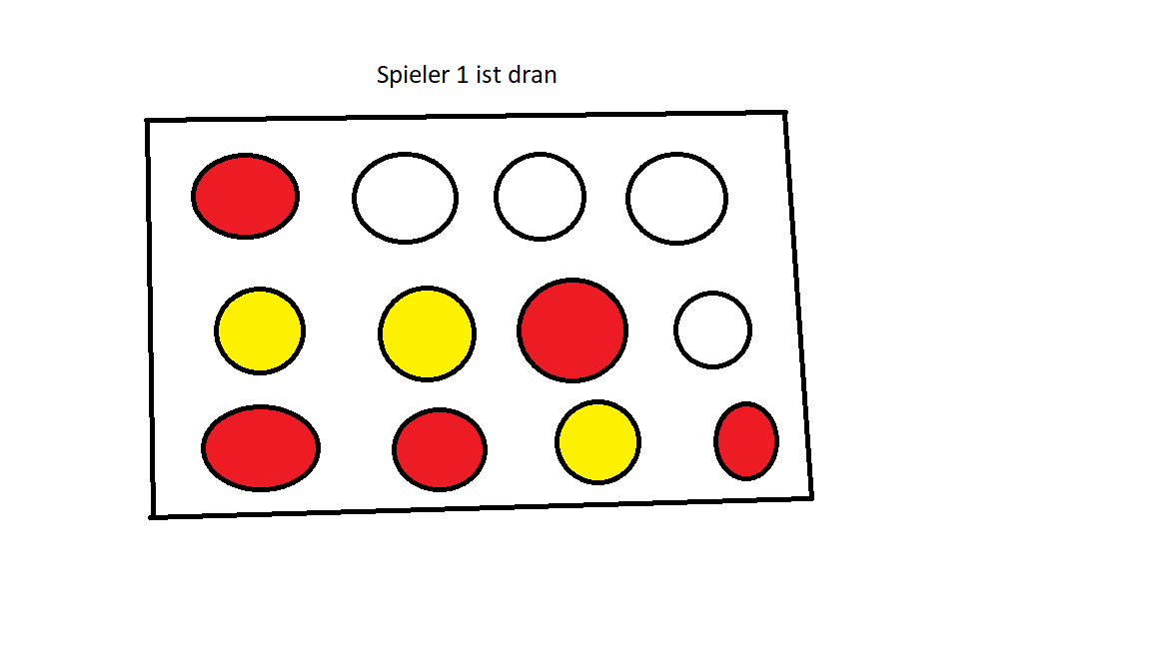
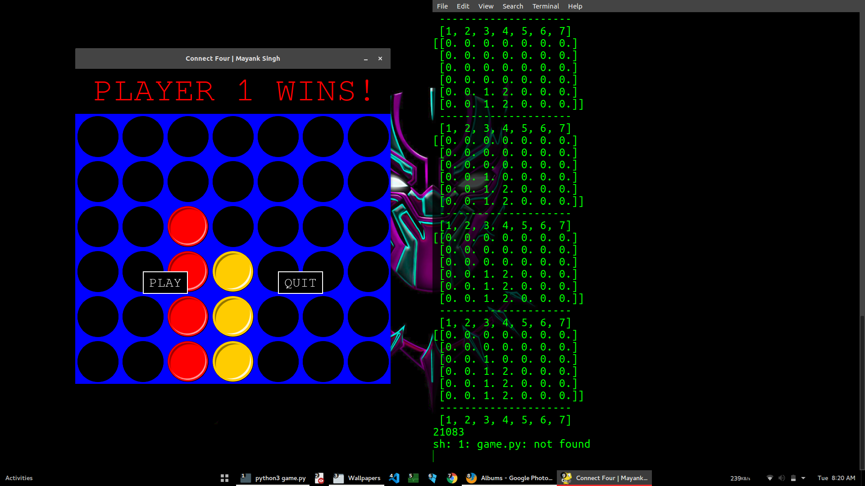
PROJECT DESIGN
TESTING
PLAYER 1 PLAYING

Slide 13
THANK YOU

