Slide 1
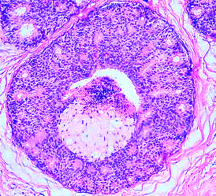
Breast Cancer image detection
Convolutional Neural Network Modelling
Project by: Ann Sam

Slide 2
Motivation
Prior Studies
In Canada, 1 in 8 women will be diagnosed with breast cancer
Mortality rate of breast cancer is 20%
Statistics emphasize the importance of early detection
Mammograms imaging are the most efficient diagnostic method for early detection
Mammography is images taken using low-dose x-ray imaging of the breast
Radiologist are required to professionally assess Mammograms
Studies related to diagnostic decision making for breast cancer dates as far back as 1997 using Bayesian network model called MammoNet
Introduction of image classification over machine learning attribute classification arose in the 2000s
Use of neural networks architectures such as ANN, ResNet, VGGNet
Proving the use of deep learning modelling aides in the diagnosis process relieving the workload on the radiology department

Slide 3
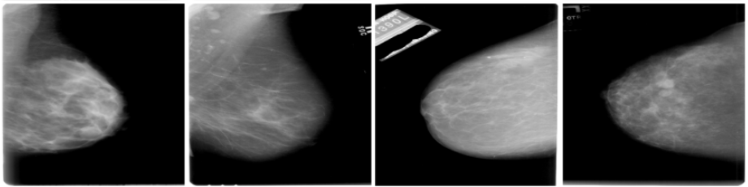
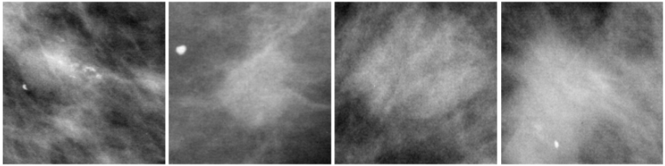
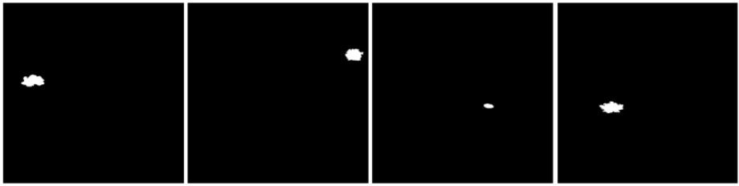
CBIS-DDSM Curated Breast Imaging Sub-set of the Digital Database for Screening Mammography
6,775 study cases
1,566 patients
10,239 images
Related DICOM information
Classification labels:
Binary Classification:
Benign/Malignant
Multi-Class Classification
Undetermined, well differentiated, moderately differentiated, poorly differentiated, undifferentiated
Full Mammograms
Cropped Images
Region of Interest Mask

Slide 4
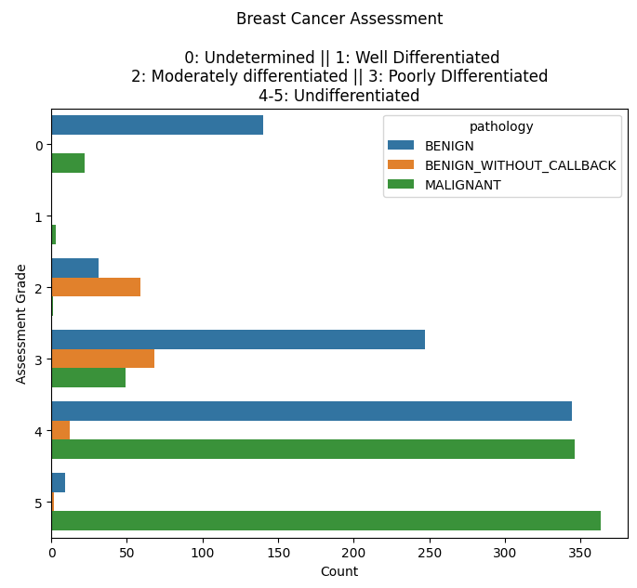
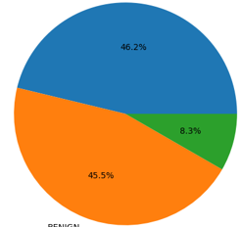
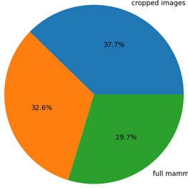
Data preprocessing
Breast Cancer Pathology Types
Image Types
Malignant
Cropped
Images
RIO Masks
Benign
Without
Call back
Benign
Full
Mammograms
3 Cancer mass types: malignant, benign, and benign without call back (all benign categories were combined)
5 Cancer assessment types: was not used due to the imbalance of data points across the categories
3 Cancer mammogram image types
Other data preprocessing completed was preparing the image path for ingestion
Image enhancement to remove noise from mammography images

Slide 5
Convolutional neural networks
Simple CNN
Convolutional Layer(s)
Pooling Layer(s)
Fully Connected Layers(s)
Regularization
Sigmoid
ResNet50
50 Layers
Max Pooling Layer
Average Pooling Layer
Additional Fully Connected Layers
Regularization
Sigmoid
VGG16
16 Layers
Hidden Layers
Pooling Layers
Fully Connected Layer(s)
Regularization
Softmax

Slide 6
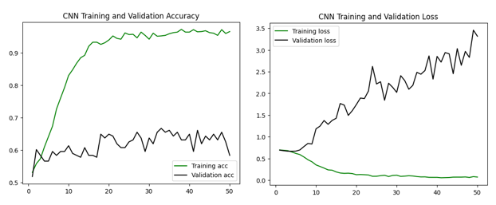
SIMPLE CNN
model0 = models.Sequential()
model0.add(layers.Conv2D(32, (3, 3), activation='relu', input_shape=(224, 224, 3)))
model0.add(layers.MaxPooling2D((2, 2)))
model0.add(layers.Conv2D(64, (3, 3), activation='relu'))
model0.add(layers.MaxPooling2D((2, 2)))
model0.add(layers.Conv2D(128, (3, 3), activation='relu'))
model0.add(layers.MaxPooling2D((2, 2)))
model0.add(layers.Flatten())
model0.add(layers.Dense(32, activation='relu'))
model0.add(layers.Dropout(0.5))
model0.add(layers.Dense(1, activation='sigmoid'))
Accuracy:
0.633

Slide 7
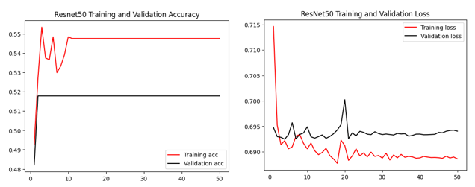
Resnet50
resnet50_model = ResNet50(weights='imagenet', include_top=False, input_shape=(224, 224, 3))
for layer in resnet50_model.layers:
layer.trainable = False
model2 = models.Sequential()
model2.add(resnet50_model)
model2.add(layers.GlobalAveragePooling2D())
model2.add(layers.Dense(256, activation='relu'))
model2.add(layers.Dense(128, activation='relu'))
model2.add(layers.Dense(64, activation='relu'))
model2.add(layers.Dropout(0.5))
model2.add(layers.Dense(2, activation='sigmoid'))
Accuracy:
0.513

Slide 8
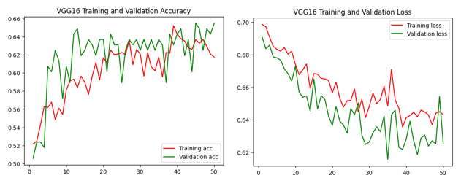
VGG16
vgg16_model = tf.keras.applications.vgg16.VGG16(weights = 'imagenet’,
include_top = False, input_shape = (224, 224, 3))
for layer in vgg16_model.layers:
layer.trainable = False
model4 = tf.keras.Sequential()
model4.add(vgg16_model)
model4.add(tf.keras.layers.GlobalAveragePooling2D())
model4.add(tf.keras.layers.Dropout(0.5))
model4.add(tf.keras.layers.Dense(256, activation = 'relu'))
model4.add(tf.keras.layers.Dense(128, activation = 'relu'))
model4.add(tf.keras.layers.Dense(64, activation = 'relu'))
model4.add(tf.keras.layers.Dense(2, activation = 'softmax'))
Accuracy 1st iteration:
0.660

Slide 9
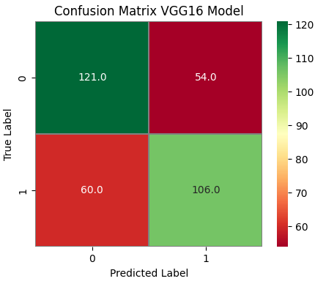
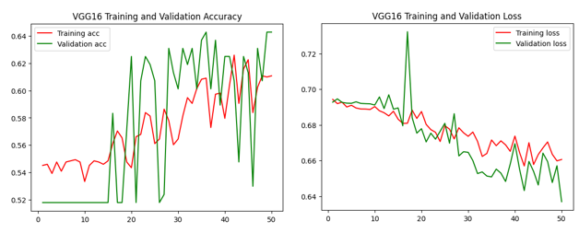
VGG16
vgg16_model = tf.keras.applications.vgg16.VGG16(weights = 'imagenet’,
include_top = False, input_shape = (224, 224, 3))
for layer in vgg16_model.layers:
layer.trainable = False
model5 = tf.keras.Sequential()
model5.add(vgg16_model)
model5.add(tf.keras.layers.GlobalAveragePooling2D())
model5.add(tf.keras.layers.Dropout(0.5))
model5.add(tf.keras.layers.Dense(256, activation = 'relu'))
model5.add(tf.keras.layers.Dense(128, activation='relu'))
model5.add(tf.keras.layers.Dense(64, activation='relu'))
model5.add(tf.keras.layers.Dense(32, activation='relu'))
model5.add(tf.keras.layers.Dense(16, activation='relu'))
model5.add(tf.keras.layers.Dense(2, activation = 'sigmoid'))
Accuracy 2nd iteration:
0.667

Slide 10
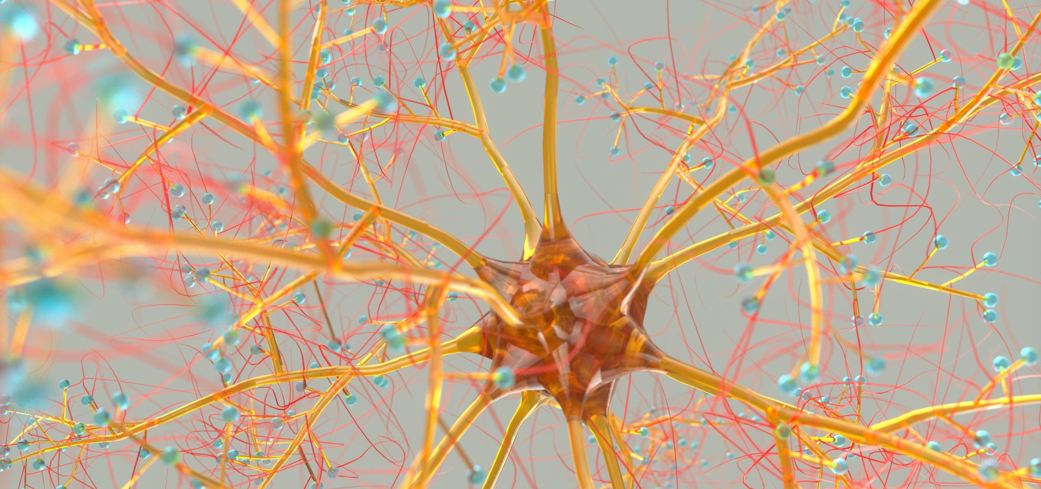
Conclusion & Recommendations
Best Performing Model:
VGG16
Test accuracy: 0.667
RECOMMEDATIONS
Image Preprocessing
Additional Image Enhancement
Image augmentation
Data shuffling
ResNet50 preprocess_input to preprocess the images to resolve plateauing issue
Computational Power
Feature extraction (from another learning approach)
Fine tuning on VGG16 architecture
Larger epoch and batch sizes

Slide 11
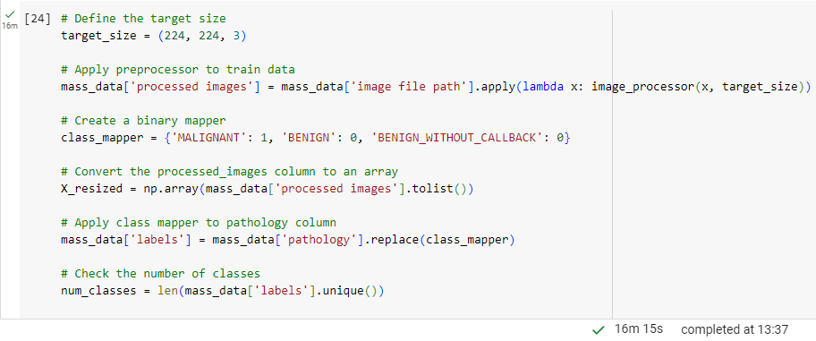
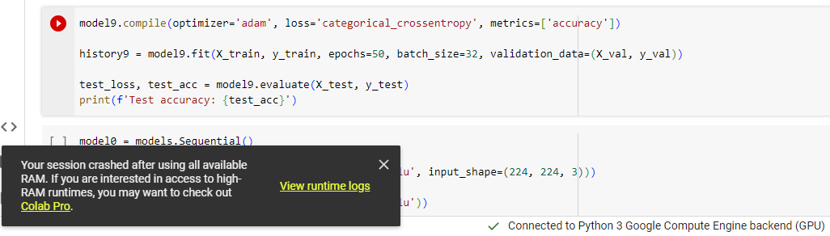
Difficulties

