Slide 1
BIOCON
Balancing Innovation, Access & Sustainability
An analysis on the products, challenges and market impact of an Indian biopharmaceutical company with a market reach of 120+ countries
A Presentation on Biotechnology Innovation, Applications, Challenges & Market Impact
01

Slide 2
COMPANY OVERVIEW
A Research-Led Biopharma, Aiming for Global Reach
Founded in 1978 by Kiran Mazumdar-Shaw, in Bengaluru, Biocon grew from an industrial enzymes company into a fully integrated biopharmaceutical group spanning novel biologics, biosimilars, generic APIs/formulations and contract research (via Syngene). Its vision is to “enhance global healthcare through innovative and affordable biopharmaceuticals for patients, partners and healthcare systems across the globe."
BUSINESS MIX (FY26)
Biosimilars
~60% of revenue — diabetes, oncology, immunology, ophthalmology, bone health
Generics
APIs & formulations — anti-diabetics, immunosuppressants, cardiovascular
1500+
120+
$1,806M
Novel Biologics & CRDMO
Patents approved
Countries worldwide
In Revenues (FY25)
Syngene research services + pipeline biologics
02

Slide 3
CATEGORIES
Biocon – Products and Services
Biosimilars
Novel Biologics
Lower-cost versions of costly biologics: insulins, oncology and immunology drugs, plus recent denosumab, aflibercept and ustekinumab launches.
Nimotuzumab & Itolizumab are novel monoclonal antibodies produced to tackle cancer and autoimmune conditions
Generics and APIs
Research Services
Statins and immunosuppressants supplied to drug makers worldwide; generic liraglutide launched in the US.
Syngene provides contract research and manufacturing; about 17% of the revenue mix.
03

Slide 4
THE CORE INNOVATION
Biosimilars
Biocon's foundational innovation is proprietary recombinant fermentation technology — using microbial hosts such as Pichia pastoris yeast to manufacture complex human proteins at industrial scale and lower cost than legacy processes. This platform underpins its entire biosimilars business. It now makes up more that 60% of the total revenue.
1
2
3
4
Global Regulatory Approval
Affordable Global Access
Lab-to-Patient Model with Global Scale
Committed to Sustainability
Spans research, development, manufacturing and commercialization. Uniquely equipped to consistently and reliably deliver high-quality medicines worldwide.
Files with USFDA, EMA and other agencies, demonstrating no clinically meaningful difference from the reference product.
Manufacture and distribute at scale, cutting treatment cost for patients across 120+ countries.
Among the top 15% of biotechnology companies worldwide with strong Environmental, Social and Governance (ESG) practices.
04

Slide 5
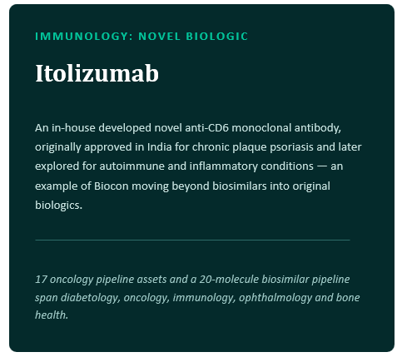
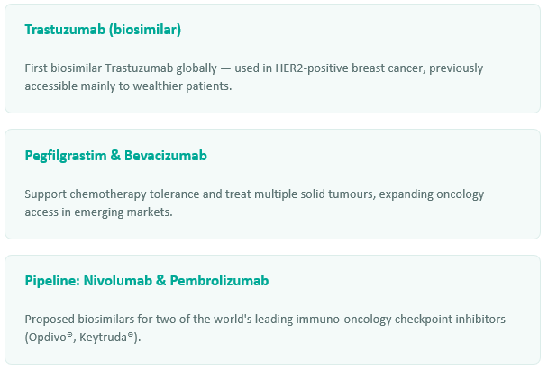
APPLICATIONS I
Widening Access to Advanced HealthCare
Biocon Biologics is the only company globally offering both biosimilar insulins and generic GLP-1 peptides — positioning it to serve patients across the entire diabetes and obesity care pathway, from first-line insulin therapy to next-generation weight-management drugs.
Oncology and Immunology:
05

Slide 6
MARKET IMPACT
A Global Player with Complex Sustainability Footprint
Biocon's rapid expansion—particularly the 2022 USD 3.3B acquisition of Viatris' biosimilars business—has created a large, geographically dispersed operation with significant manufacturing, supply-chain and resource demands. The company now operates 12 commercialized biosimilars across 120+ countries, serving 6.5M+ patients annually, while managing intense pressure to reduce costs and maintain profitability.
FY26 Revenue
Long-term Debt
Operating Presence
Workforce
~₹17,600 Cr
₹14,300+ Cr
India, Malaysia, US, EU
~12,000+
60% from biosimilars
from Viatris acquisition
Plus 120+ market footprint
Across multiple regions
06

Slide 7
MARKET IMPACT
Full Ownership Turned Into Revenue Growth
Since bringing the acquired Viatris biosimilars business fully in-house, Biocon's biosimilars segment has roughly tripled in revenue, now contributing the majority of group revenue at healthy margins.
FY26 AT A GLANCE
~60%
of consolidated revenue from biosimilars
~26%
biosimilars segment EBITDA margin
~16%
YoY biosimilars revenue growth
6.5M+
patients served annually
07

Slide 8
CHALLENGE 1
Environmental: Water, Waste & Carbon Intensity
Biopharmaceutical manufacturing is water and energy-intensive. Biocon's operations produce significant wastewater filled with pharmaceutical residues, requiring advanced treatment. It is a significant challenge for the company to reduce freshwater consumption, manage effluent responsibly, and cut greenhouse gas emissions, while maintaining production capacity to serve growing global demand.
KEY CHALLENGES
BIOCON'S RESPONSE
Bioreactor manufacturing consumes high volumes of freshwater for cooling, purification & processing
₹80M investment in 600 KLD zero liquid discharge (ZLD) plant in Bengaluru (2022)
Wastewater treatment and ZLD (zero liquid discharge) systems require significant capital & ongoing OpEx
Target: 25% freshwater reduction by FY29 (from FY23 baseline)
Scope 1 & 2 GHG emissions driven by energy-intensive fermentation and cooling systems
Target: 25% GHG emission reduction (Scope 1&2) by FY29 (from FY20 baseline)
Pharmaceutical residues in discharge require rigorous treatment to meet environmental standards
100% circular waste by FY29; renewable energy transition underway
08

Slide 9
CHALLENGE 1
Climate Risks: Extreme Weather, Scarcity & Regulations
Heat Stress & Water Scarcity
Rising temperatures in India and Southeast Asia increase cooling demands and water competition. Droughts can disrupt bioreactor operations.
Diversify water sources; invest in rainwater harvesting; relocate or dual-site critical facilities.
Supply Chain Disruption
Geopolitical tensions, pandemics or extreme weather can sever logistics for cold-chain inputs, biologic materials and finished goods.
Strengthen supplier diversification; pre-position inventory; enhance supply-chain visibility.
Evolving Regulations
Stricter climate and environmental regulations (EU Green Deal, India water-quality laws) increase compliance costs and operational overhead.
Proactive engagement with policymakers; integrate climate risk into strategic planning; sustainability certifications.
💡 Insight: Biocon's S&P Global CDP Climate Change score improved to A- (from B in 2024), reflecting progress. However, water security remains a medium-term vulnerability, especially given manufacturing expansion in water-stressed regions.
09

Slide 10
CHALLENGE 2
Social: Workforce Equity, Safety & Community
Biocon employs 12,000+ across multiple countries with varying labor standards and geographies. Challenges include: ensuring fair wages and safe working conditions across manufacturing and R&D; building genuine diversity and inclusion (especially gender parity in scientific roles); and navigating community expectations in water-stressed regions where the company extracts significant freshwater.
KEY CHALLENGES
BIOCON'S INITIATIVES
ONGOING GAPS
Gender underrepresentation in scientific & leadership roles
BioWin forum for women empowerment & work-life balance
Gender parity in STEM remains below peer averages (target setting needed)
Ensuring safe work & zero-accident culture across global sites
ISO 45001 certification; zero-accident safety programs
Supply chain labor practices less transparent than direct workforce
Fair compensation in emerging markets vs. developed economies
Competitive benefits & career development programs
Community engagement on water rights/allocation remains nascent
Community relations amid water extraction pressures
Biocon Foundation CSR (20 yrs): healthcare, education, rural dev
Pay equity audits & public disclosure not yet standard
10

Slide 11
ESG PROGRESS
Measuring Progress: ESG Ratings & Certifications
Biocon has made measurable ESG progress, evidenced by improved ratings. However, transparency gaps remain in supply-chain labor practices, community consultation on water rights, and long-term sustainability pathway clarity.
CERTIFICATIONS & TARGETS
Environmental
Social
Governance
DJSI & S&P Global
Featured in Sustainability Yearbook 2026 (4th consecutive year)
CDP Climate
76/100
74/100
62/100
A- score (2024); Water Security: B
FY29 Targets
ISO 45001
Syngene IAEC
Institutional Animal Ethics Committee & biosafety
25% GHG reduction; 25% freshwater reduction; 100% circular waste
S&P Global
S&P Global
S&P Global
Occupational Health & Safety certification
2024
2024
2024
98th Percentile Among Biotech Peers
11

Slide 12
OUTLOOK
What's Next:
In December 2025, Biocon moved to fully integrate its biosimilars arm, Biocon Biologics, as a wholly owned subsidiary — simplifying its corporate structure and sharpening focus on diabetes, oncology and immunology, therapeutic areas that together account for roughly 40% of global pharmaceutical spend.
Diabetes & Obesity
Oncology Expansion
Immunology & Beyond
Full-spectrum care combining biosimilar insulins with generic GLP-1 peptides amid rising global diabetes and obesity burden.
17 pipeline assets, including proposed biosimilars for Nivolumab (Opdivo®) and Pembrolizumab (Keytruda®).
20-molecule biosimilar pipeline spanning ophthalmology, bone health and other non-communicable diseases.
12

Slide 13
Key Takeaway
Profitability +
Sustainability +
Access
Biocon proves scaling, innovation, and sustainability thrive together. By embedding ESG and mastering scalable manufacturing across various sectors(biosimilars, generics, services), they are transforming expensive biologics into accessible medicines. True innovation is building the resilient, transparent infrastructure required to make global healthcare affordable.
The following PPT template has been generated by Claude AI. References include: Biocon_Integrated_Annual_Report_2026.pdf, Products - Generics, Biosimilars, Branded Formulations, Novel Biologics
13

