Slide 1
Elegant Education
Pack for Students
Here is where your presentation begins

Slide 2
Table of contents
01
03
05
02
04
06
Backgrounds
Reminder
Homework
You can describe the topic of the section here
You can describe the topic of the section here
You can describe the topic of the section here
Avatars
Planning
Others
You can describe the topic of the section here
You can describe the topic of the section here
You can describe the topic of the section here

Slide 3
Change your background in Google Meet
To help limit distractions or make video calls more fun, you can now blur your background or replace your background with an image

Slide 4
Change your background in Zoom
Change your backgrounds easily and make your Zoom video calls more fun and original

Slide 5
01
Backgrounds
Menu
For teachers
For students

Slide 10
02
Avatars
Menu

Slide 11
03
Reminder
Menu

Slide 12
Do not forget
Tasks
Subjects
Translate text
Paint mural
Do spelling homework
Do exercises 4 and 5
English
Art
Language
Maths

Slide 13
What materials must I bring to class?
Notes
Eraser
Rounded scissors
Pencils
Stapler
Calculator
Markers

Slide 14
Student Attending | M | T | W | T | F
Student 1
Student 2
Student 3
Student 4
Student 5

Slide 15
Activities
Ask lesson
Correct homework
Send homework for tomorrow

Slide 16
Ask homework to:
Student 1
Student 2
Student 3
Student 4
Student 5

Slide 17
Today’s Tasks
Do science exercises
Paint mural
Do spelling homework

Slide 18
04
Planning
Menu

Slide 19
Weekly planning
Monday
Tuesday
Wednesday
08:00 | Go to class
17:00 | Study for Friday
10:30 | Relax time
16:30 | Do homework
18:00 | Maths class
19:00 | Piano Lesson
Thursday
Friday
Saturday
08:00 | Breakfast
07:30 | Review for exam
11:00 | Do homework
09:30 | Music class
11:30 | Science test
Sunday
13:30 | Lunch with mum
17:30 | Go to Sarah’s
10:00 | Plan next week

Slide 20
First semester 2021
January
Mo | Tu | We | Th | Fr | Sa | Su
 |  |  |  | 1 | 2 | 3
4 | 5 | 6 | 7 | 8 | 9 | 10
11 | 12 | 13 | 14 | 15 | 16 | 17
18 | 19 | 20 | 21 | 22 | 23 | 24
25 | 26 | 27 | 28 | 29 | 30 | 31
February
Mo | Tu | We | Th | Fr | Sa | Su
1 | 2 | 3 | 4 | 5 | 6 | 2
7 | 8 | 9 | 10 | 11 | 12 | 9
13 | 14 | 15 | 16 | 17 | 18 | 16
19 | 20 | 21 | 22 | 23 | 24 | 23
25 | 26 | 27 | 28
March
Mo | Tu | We | Th | Fr | Sa | Su
1 | 2 | 3 | 4 | 5 | 6 | 7
8 | 9 | 10 | 11 | 12 | 13 | 14
15 | 16 | 17 | 18 | 19 | 20 | 21
22 | 23 | 24 | 25 | 26 | 27 | 28
29 | 30 | 31
April
Mo | Tu | We | Th | Fr | Sa | Su
 |  |  | 1 | 2 | 3 | 4
5 | 6 | 7 | 8 | 9 | 10 | 11
12 | 13 | 14 | 15 | 16 | 17 | 18
19 | 20 | 21 | 22 | 23 | 24 | 25
26 | 27 | 28 | 29 | 30
May
Mo | Tu | We | Th | Fr | Sa | Su
 |  |  |  |  | 1 | 2
3 | 4 | 5 | 6 | 7 | 8 | 9
10 | 11 | 12 | 13 | 14 | 15 | 16
17 | 18 | 19 | 20 | 21 | 22 | 23
24 | 25 | 26 | 27 | 28 | 29 | 30
31
June
Mo | Tu | We | Th | Fr | Sa | Su
 | 1 | 2 | 3 | 4 | 5 | 6
7 | 8 | 9 | 10 | 11 | 12 | 13
14 | 15 | 16 | 17 | 18 | 19 | 20
21 | 22 | 23 | 24 | 25 | 26 | 27
28 | 29 | 30

Slide 21
05
Homework
Menu

Slide 22
Write your homework
Monday - 5th april, 2021
Science | Do science homework
Maths
Music
Art | Draw a mural

Slide 23
Timetable
 | Mon | Tue | Wed | Thu | Fri
8:00 - 8:30 | Music | Science | Language | English | Science
8:30 - 9:00 | Art | English | Maths | Music | Art
9:00 - 10:00 | Language | Maths | Science | Art | Language
10:00 - 10:45 | Lunch
11:30 - 12:30 | Maths | Art | Music | Language | Music
12:30 - 13:30 | Science | Music | Art | Maths | Maths

Slide 24
06
Others
Menu

Slide 25
Infographic
Mars
Jupiter
Saturn
Neptune
Despite being
red, Mars is a
cold place
Jupiter is a gas giant and the biggest planet
It’s composed
of hydrogen
and helium
Neptune is the farthest planet from the Sun

Slide 26
The slide title goes here!
Do you know what helps you make your point clear? Lists like this:
They’re simple
You can organize your ideas
You’ll never forget to buy milk!
And the audience won’t miss the point of your presentation

Slide 27

A picture always reinforces the concept
Images reveal large amounts of data, so remember: use an image instead of long texts

Slide 28
Awesome Words

Slide 29
3,450
Big numbers catch your audience’s attention

Slide 30
Percentages
32%
60%
88%
Mercury
Neptune
Saturn
Mercury is the closest to the Sun
Neptune is the farthest from the Sun
Saturn is a gas giant and has several rings

Slide 31
333,00000
24h 37m 23s
386,000km
Earths is the Sun’s mass
is Jupiter’s rotation period
is a very long distance

Slide 32
—Someone Famous
“This is a quote, words full of wisdom that someone important said and can make the reader get inspired”

Slide 33
Whoa!
This can be the part of the presentation where you can tell a funny anecdote

Slide 34
Conclusions
Mercury
Venus
Mars
Mercury is the closest to the Sun
Venus is the second planet from the Sun
Despite being red, Mars is a cold place

Slide 35
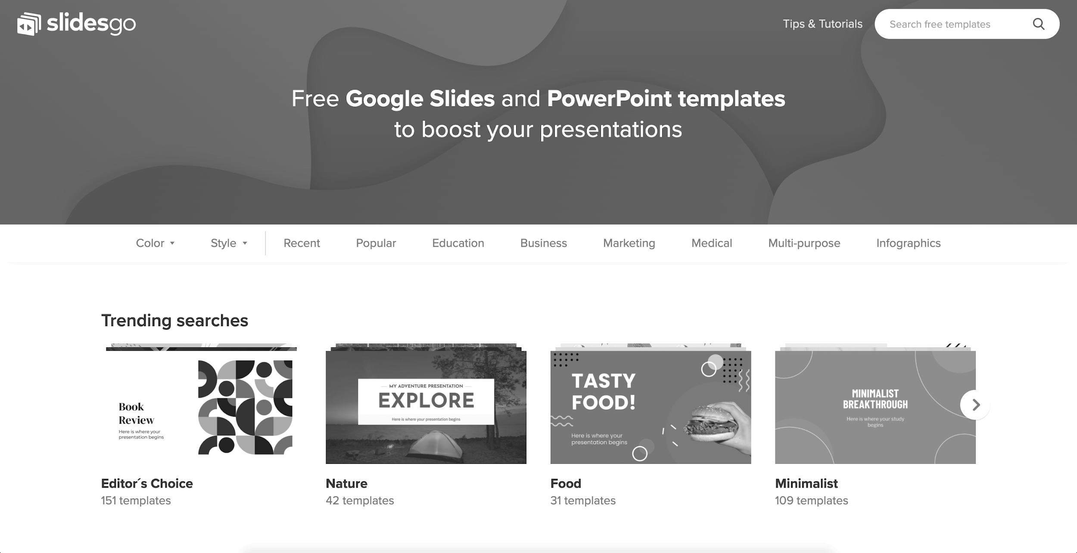
Desktop software
You can replace the image on the screen with your own work. Just delete this one, add yours and center it properly

Slide 36
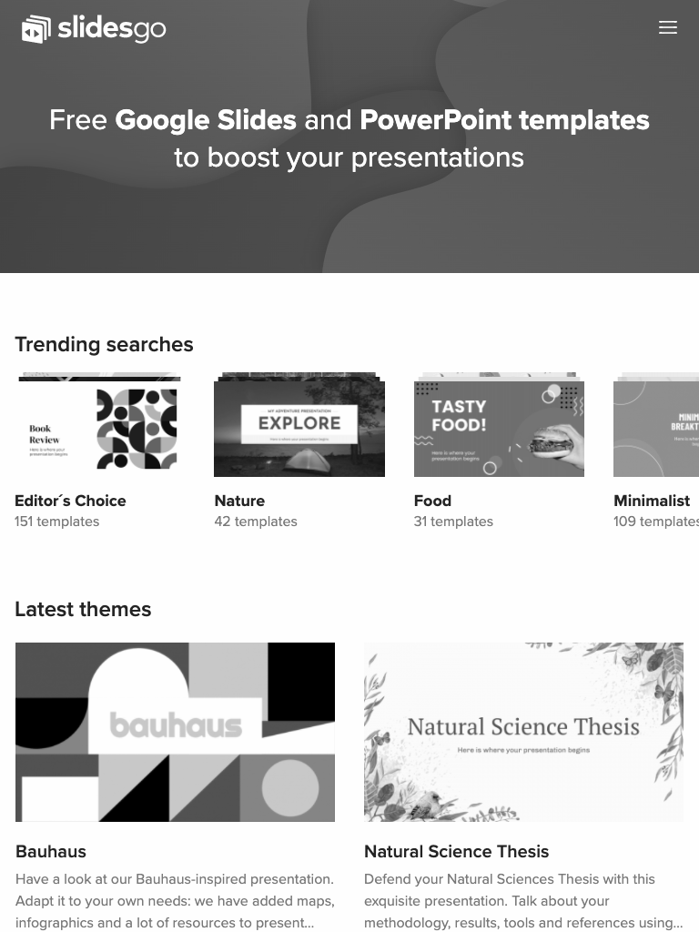
Tablet app
You can replace the image on the screen with your own work. Just delete this one, add yours and center it properly

Slide 37
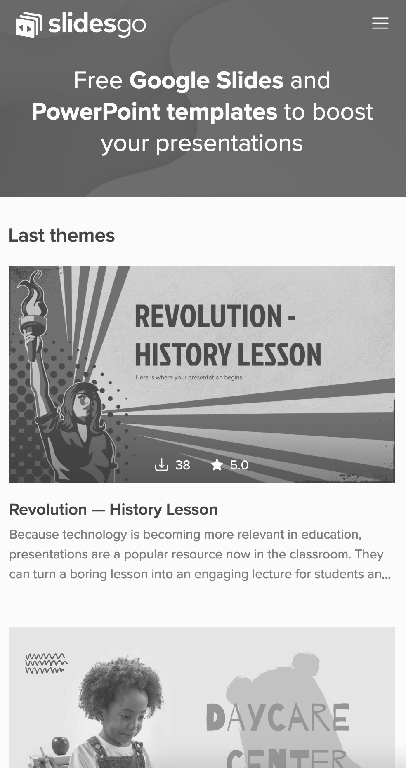
Mobile web
You can replace the image on the screen with your own work. Just delete this one, add yours and center it properly

Slide 38
Thanks
Do you have any questions?
addyouremail@freepik.com | +91 620 421 838 | yourcompany.com
CREDITS: This presentation template was created by Slidesgo, including icons by Flaticon, infographics & images by Freepik
Please, keep this slide for the attribution

Slide 39
Alternative resources
Vectors:
Wedding facebook cover template
Wedding planner facebook cover template
Photos:
Front view composition with different books
Full shot student with books floor
Creative composition with books flower
Front view stack books with vase flowers
Medium shot smiley woman reading bed
Creative assortment world book day

Slide 40
Alternative resources

Slide 41
Alternative resources

Slide 42
Resources
Vectors:
Wedding planner facebook cover template
Covers collection with organic shapes
Hand drawn people avatar collection
Collection illustrated people avatars
Flat design back school background
Photos:
Front view stack books with one open
Top view books with copy space
Friends attending online class together
Front view science elements with chemicals assortment

