Slide 1

RING-LWE CRYPTOGRAPHY FOR FINGERPRINT AUTHENTICATION SECURITY
Submitted by: Anubhav Singh (15/ICS/012)
Supervised by: Dr. Pradeep Tomar
DEPARTMENT OF COMPUTER SCIENCE AND ENGINEERING
SCHOOL OF INFORMATION AND COMMUNICATION TECHNOLOGY
GAUTAM BUDDHA UNIVERSITY

Slide 2
Introduction
Protecting Fingerprints from unauthorized access is a high priority to prevent misuse
The fingerprint details sent by the stations to the server need to be protected from attackers
Li and Kot presented a method which includes combining details from multiple fingerprints for security
Need for a cryptography algorithm is needed for better security and protection of the fingerprint data

Slide 3
Homomorphic Encryption And Ring-LWE
Computes the encrypted data directly, while looking like as if the operation is performed on the decrypted data.
Returns a function F such that: Dec(F(Enc(x))) = f(x).
Ring-LWE asks to recover secret s from a noisy system such as a0(x)s(x) + e0(x) = b0(x) modq R , a1(x)s(x) + e1(x) = b1(x) modq R ....
Here q is a prime, R is Z[x]/(xn + 1), n is a power of 2.

Slide 4
Ring-LWE Cryptography
Polynomials a(x) and s(x) are selected uniformly from a ring, Rq = Zq[x]/f(x) ,where f(x) is an irreducible polynomial of degree n
Error polynomials ei(x) of degree n are sampled from error distribution χ, which is usually a discrete Gaussian distribution.
Key generation: Generate the private key r2 and the public key (a,p) such that p←r1−a×r2
Encryption: Encrypt the input message m into the ciphertext (c1,c2). (c1,c2)←(a×e1+e2,p×e1+e3+me).
Decryption: Decrypt the cipher-text to get the original message m. md ←c1×r2+c2

Slide 5
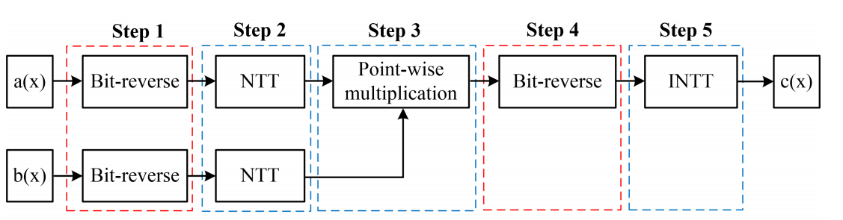
Number Theoretic Transform Multiplier
Using NTT and Inverse NTT in calculations makes the algorithm much faster.

Slide 6

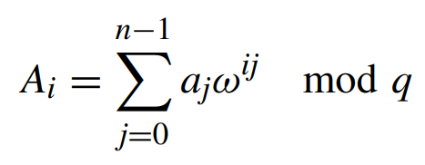
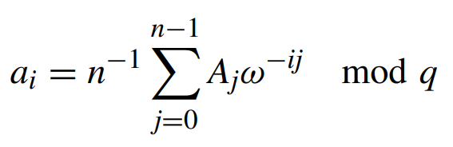
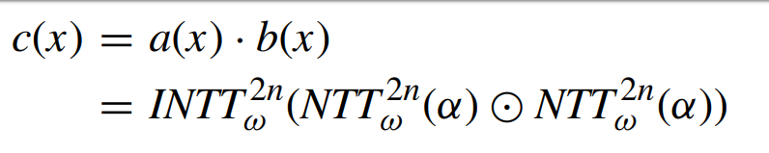
NTT Formulas
Let
Then NTT is given as
Inverse NTT is
Product is

Slide 7
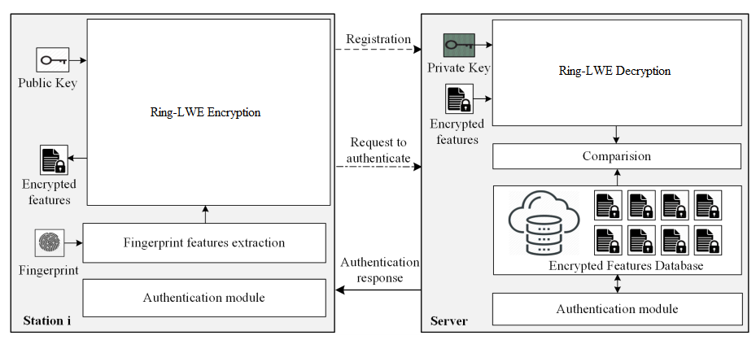
Ring-LWE in Fingerprint Authentication
Notes:
Gaussian Sampler : e1,e2,e3
c1 = a.e1+e2
c2 = p.e1+e3+me

Slide 8
High-Secure Fingerprint Authentication System Using Ring-LWE Cryptography
Proposed by Tuy Nguyen Tan and Hanho Lee
Publication on February 14, 2019 in IEEE Access, vol. 7
A ring-LWE cryptography scheme using low latency number theoretic transform (NTT) polynomial multiplications is deployed
Encryption faster 46% Decryption 44%
Can be further improved by using parallel processes.

Slide 9
Securing fingerprint templates using fused structures
Proposed by Mulagal Sandhya and Munaga V.N.K. Prasad
Published in 2017, in IET Biometrics, vol. 6
Protection method for fingerprint templates by using fused structures at the feature level
The authors computed two transformed features from minutiae points: namely, local structure and distant structure
Can be cracked by quantum computers

Slide 10
Cancelable Fingerprint Cryptosystem Using Multiple Spiral Curves and Fuzzy Commitment Scheme
Proposed by Mulagal Sandhya and Munaga V.N.K. Prasad
Published in 2017, in International Journal of Pattern Recognition and Artificial Intelligence
The author proposed a cancelable fingerprint cryptosystem using multiple spiral curves and fuzzy commitment scheme
Combines cancelable biometrics and biometric cryptosystems
Can be cracked by quantum computers
Notes:
In a conventional scheme, a commitment must be opened using a unique witness, which acts, essentially, as a decryption key. By contrast, our scheme is fuzzy in the sense that it accepts a witness that is close to the original encrypting witness in a suitable metric, but not necessarily identical. Cancelable biometrics refers to the intentional and systematically repeatable distortion of biometric features in order to protect sensitive user-specific data. If a cancelable feature is compromised, the distortion characteristics are changed, and the same biometrics is mapped to a new template, which is used subsequently.

Slide 11
Biometric cryptosystems: a new biometric key binding and its implementation for fingerprint minutiae-based representation
Proposed by Jin et al.
Published in 2016, in Pattern Recognition Journal. Publisher is ScienceDirect.
Proposed an Error Correcting Code (ECC)-free key binding scheme along with cancelable transforms for minutiae-based fingerprint biometrics
Experiments conducted on FVC2002 and FVC2004
Notes:
Forward error correction (FEC) is a process of adding redundant data such as an error-correcting code (ECC) to a message so that it can be recovered by a receiver even when a number of errors (up to the capability of the code being used) were introduced, either during the process of transmission, or on storage.

Slide 12
References
[1] T. N. Tan and H. Lee, "High-Secure Fingerprint Authentication System Using Ring-LWE Cryptography," in IEEE Access, vol. 7, pp. 23379-23387, 2019.
[2] S. Li and A. C. Kot, ‘‘Fingerprint Combination for Privacy Protection,’’ IEEE Trans. Inf. Forensics Security, vol. 8, no. 2, pp. 350–360, Feb. 2013
[3] M. Sandhya and M. V. N. K. Prasad, "Securing fingerprint templates using fused structures," in IET Biometrics, vol. 6, no. 3, pp. 173-182, 5 2017.
[4] Sandhya, M., Prasad, Munaga V.N.K.: ‘Cancelable fingerprint cryptosystem using multiple spiral curves and fuzzy commitment scheme’, Int. J. Pattern Recognit. Artif. Intell., 2016
[5] Jin, Z., Teoh, A.B.J., Goi, B.-M., et al.: ‘Biometric cryptosystems: a new biometric key binding and its implementation for fingerprint minutiae-based representation’, Pattern Recognit., 2016, 56, pp. 50–62

