Slide 1
git and github

Slide 2
contents
What is git?
Git basics.
Git branching
What is github?

Slide 3
git
Git is a tool control versions
Git is a distributed system

Slide 4
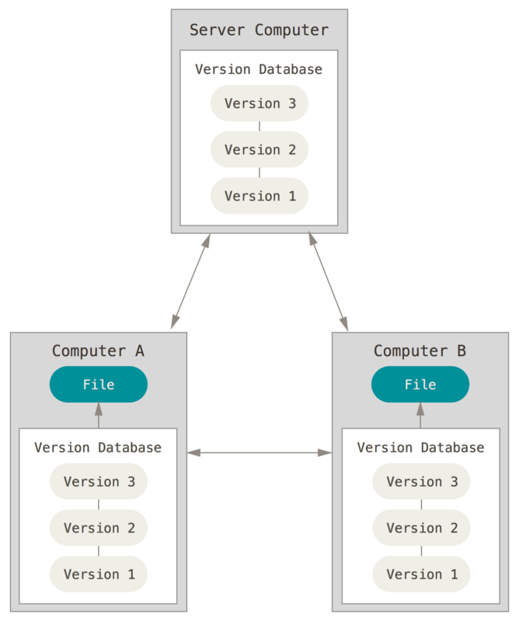
Distributed Version Control Systems

Slide 5
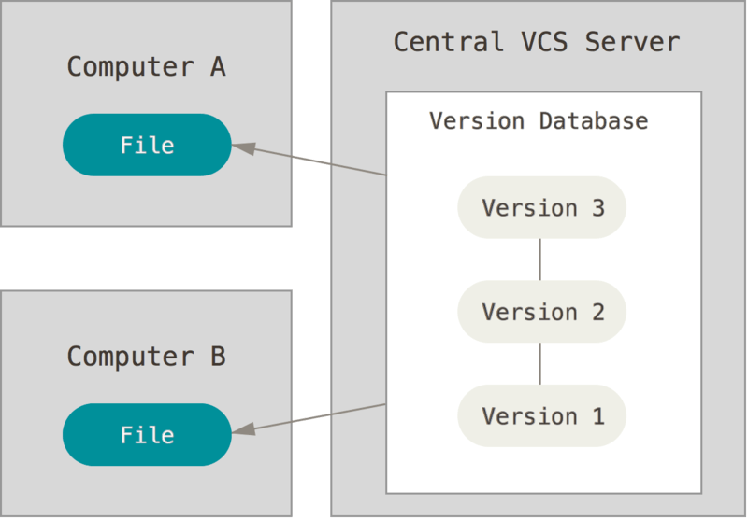
Centralized Version Control Systems

Slide 6

Local Version Control Systems

Slide 7
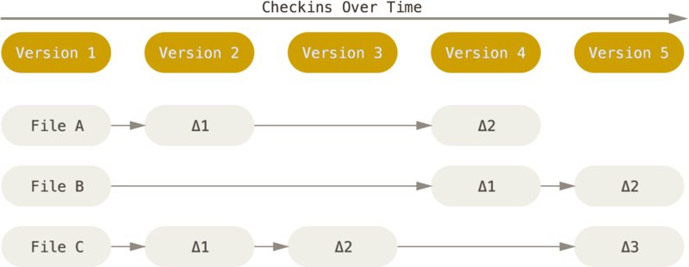
Snapshots, Not Differences

Slide 8
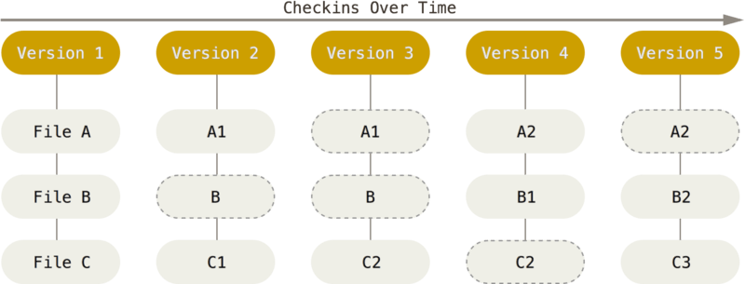
Snapshots, Not Differences

Slide 9
Nearly Every Operation Is Local
Most operations in Git only need local files and resources to operate
If you get on an airplane or a train and want to do a little work, you can commit happily until you get to a network connection to upload

Slide 10
Git branching
Git thinks about it’s data: a series of snapshots

Slide 11
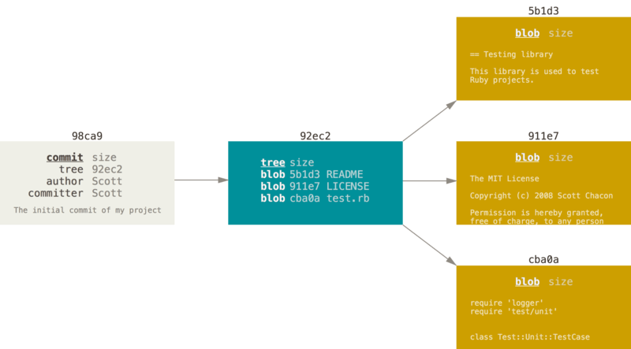
Git branching
Notes:
one blob for the contents of each of your three files, one tree that lists the contents of the directory and specifies which file names are stored as which blobs, and one commit with the pointer to that root tree and all the commit metadata.

Slide 12
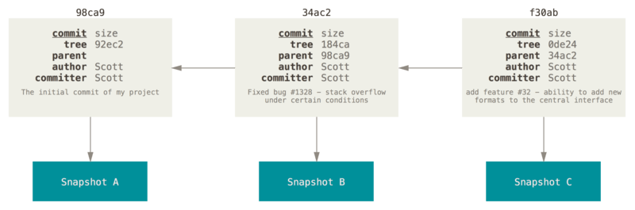
Git branching

Slide 13
Git branching
Stop advanced concepts here. Go to the example

Slide 14
Scerano in project
Initialize git repository
Add some files
First commit
Add remote repository
Push contents to remote repository on branch master

Slide 15
GitHub Desktop

Slide 16
I. About GitHub Desktop
GitHub Desktop is a part of GitHub.
A desktop application.
Full features of GitHub
Easy to use
Simple UI

Slide 17
II. How to use 1. Install
First, you must have a GitHub account. Register at https://github.com/
Download GitHub Desktop at https://desktop.github.com/
Run setup file

Slide 18
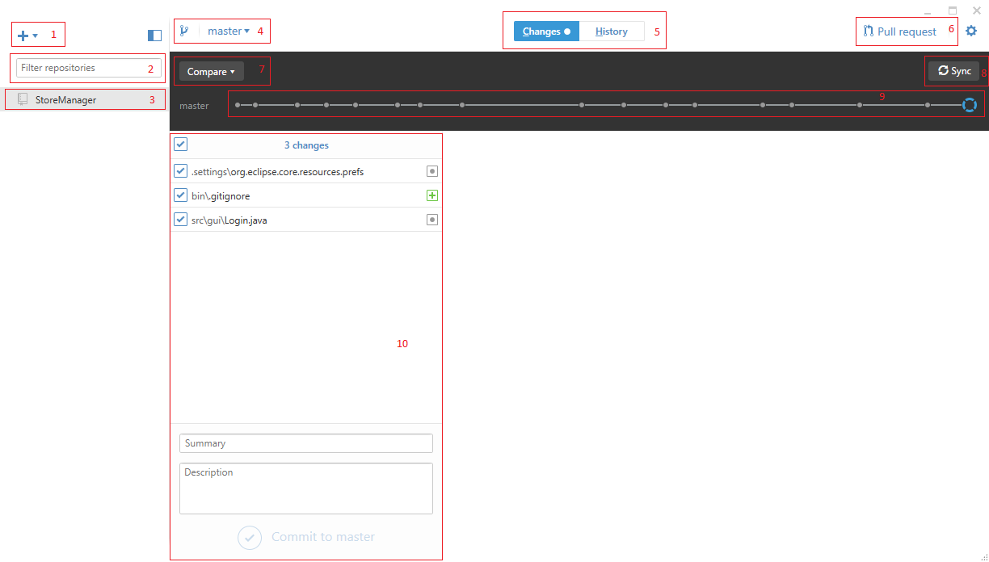
2. Overview

Slide 19
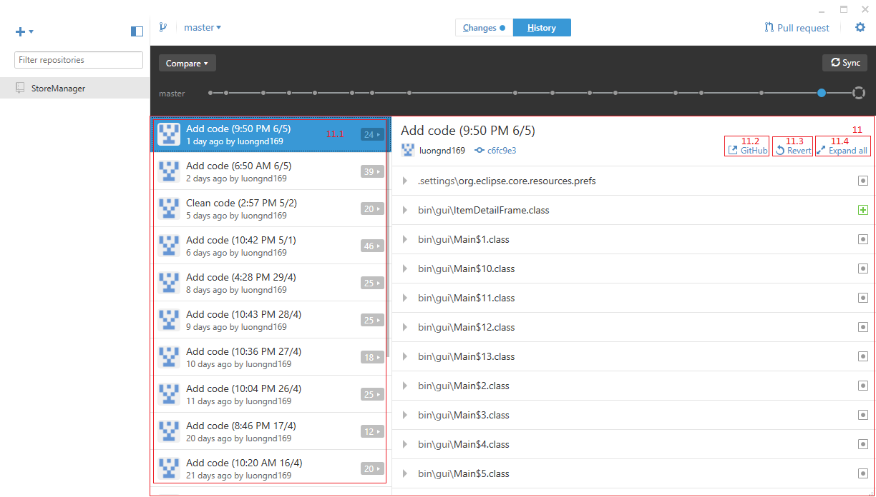

Slide 20
2.1. Explain
1- Add, create or clone new repository from your account to GitHub Desktop
2- Filter repositories there
3- Your repositories
4- Branch. You can create filter branch there
5- Changes and History tab of selected repository
6- Write and pull your request to any branch
7- Compare your changes with another branch
8- Sync your repository with GitHub repository
9- Change points
10- Your changes

Slide 21
11- History UI
11.1- Your committed
11.2- View selected commit in GitHub web
11.3- Create a new commit that reverts the changes in selected commit
11.4- Expand all file in selected commit

Slide 22

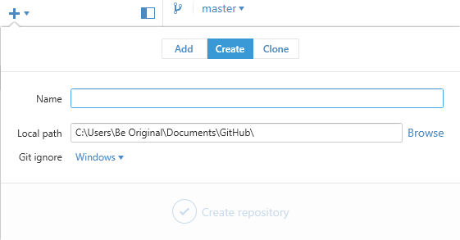
2.3. First use
Click and you will see
Now, you can add a local repository, create new GitHub repository or clone

Slide 23
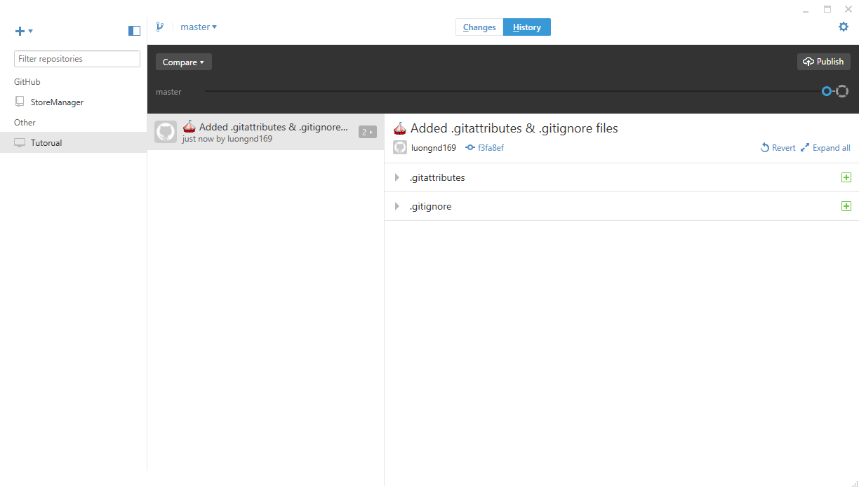
Tutorial repository was created
Now you can import this folder to your project
And publish that repository into GitHub

