Slide 1
Development of a Custom GenAI Solution for Conducting Health Data Analysis

Slide 2
Table of Contents
Objective
Flow diagram
Preliminary steps
Data audit report
Exploratory Data Analysis
Application of Generative AI

Slide 3
Objective
The challenge is to develop a GenAI solution that can effectively retrieve and generate relevant information from the dataset, providing valuable descriptive insights and recommendations based on the user's queries.
The model should be capable of understanding complex queries and integrating information from multiple data sources to generate accurate and coherent responses. Avoid consolidating the multiple datasets and retrieving information from the same. Instead, make the GenAI solution good enough to join the data on the fly temporarily and retrieve the information from the temporarily consolidated data.
The focus is on building a system that can integrate diverse data points, generate contextually relevant responses, and refine its performance through iterative enhancements.

Slide 4
Flow diagram
Data Loading
Data Cleaning
Exploratory Data Analysis
User Input
Generate Natural Language
Display Results
Execute SQL Query
Generate SQL Query

Slide 5
Preliminary Steps
Input provided : Two .xlsm files
Common column : Patient_Number
Merging two files into single one as it provides a better way to integrate and analyse data
Initial steps taken to merge both .xlsm includes
1. Convert both .xlsm into dataframes
2. Combine rows in physical activity data according to “Patient_Number”
3. Merge both the dataframes upon “Patient_Number”

Slide 6
Data Audit Report
Initial steps are highlighted in flow chart 1.1
After completing the basic pre-processing steps, statistical measures are calculated again to see if any further imputation can be done.
Column “Patient_Number” made as index as this data alone does not provide additional information required
Data Understanding
Understanding different columns and its data types
Checking for percentage of null values present in each column and validating their statistical measures
Data Cleaning
Removing rows with null values less than 10% in a column
Filling of missing rows using mode of the column value according to the scenario
Data Preprocessing
Checking for skewness if any.
Handling outliers by visually understanding the column through box plot
Flow chart 1.1

Slide 7
Exploratory Data Analysis (EDA)

Slide 8
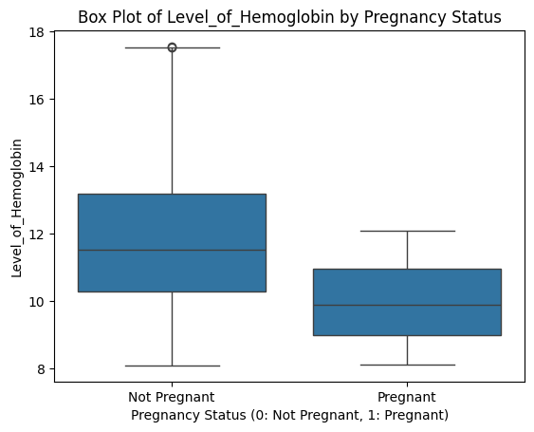
Feature Dynamics - Level_of_Hemoglobin and Pregnancy
Level_of_Hemoglobin and Pregnancy are 2 different features in the dataset. Upon visualizing using boxplot, it is observed that if pregnancy status is 1 (Pregnant), then level of hemoglobin is less compared to not pregnant samples.

Slide 9
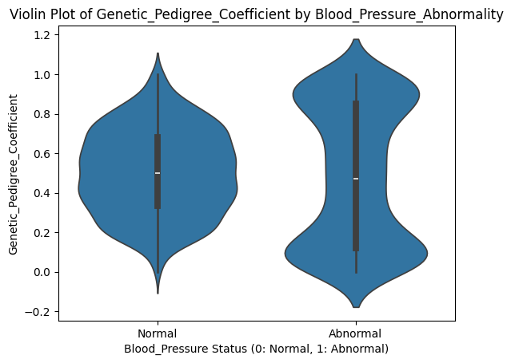
Feature Dynamics - GCP and Blood Pressure Abnormality
Genetic_Pedigree_Coefficient and Blood_Pressure_Abnormality columns were visualized in a violin plot. People who have abnormality in blood pressure has got either higher GCP or lower GCP compared to people with normal blood pressure

Slide 10
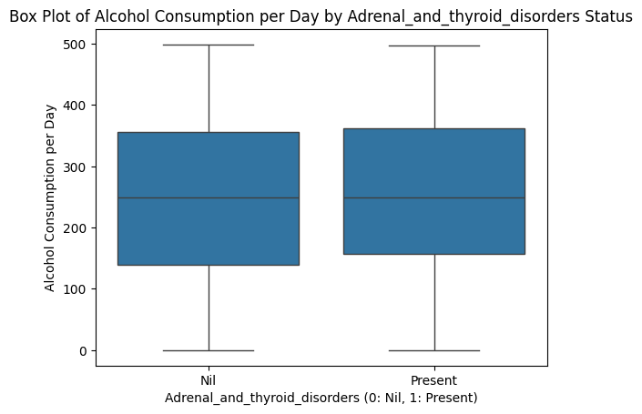
Feature Dynamics – Alcohol consumption and Adrenal and thyroid disorders
Alcohol consumption per day and Adrenal and thyroid disorders status shows almost similar natured boxes. No outliers and major differences in the whiskers are observed. Hence no dependence on these 2 features

Slide 11
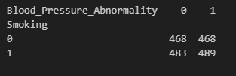

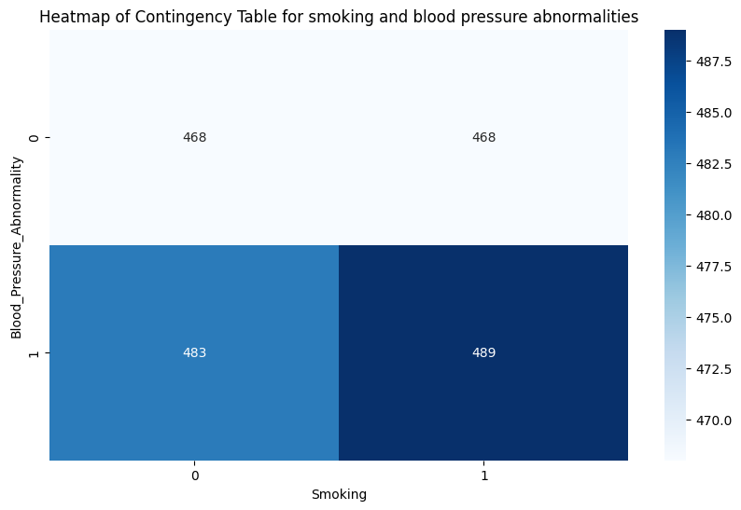
Feature Dynamics – Smoking and Blood Pressure Abnormalities
Smoking and blood pressure abnormalities were taken for understanding underlying relationship. Null hypothesis was that there is no relation between these. According to the p-value generated from the contingency table, null hypothesis is accepted i.e., there is no relation between smoking and blood pressure abnormalities.

Slide 12
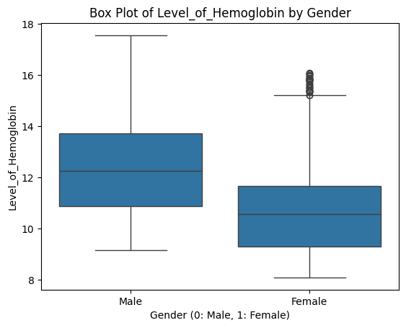
Feature Dynamics – Level of Hemoglobin by Gender
Level of Hemoglobin by Gender was taken into consideration and it is evident that Male has got more levels of hemoglobin compared to females.

Slide 13
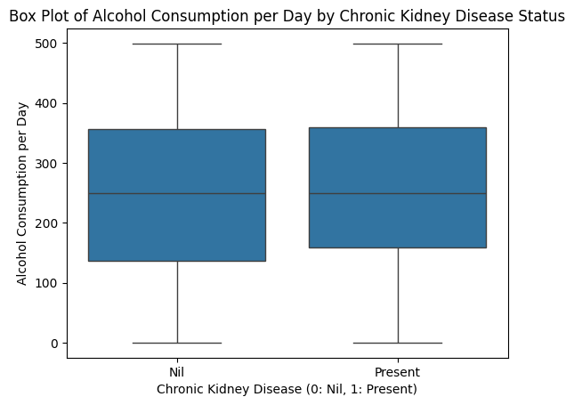
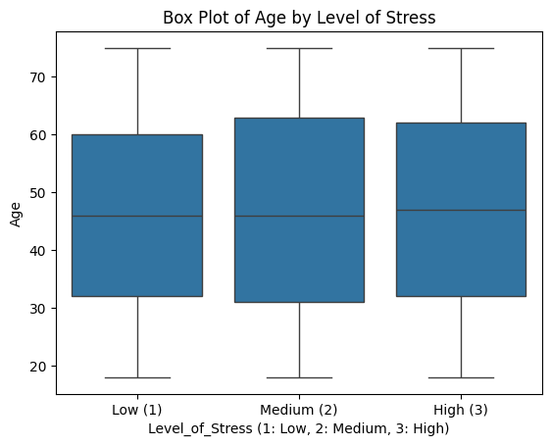
Feature Dynamics – Additional Relationships

Slide 14
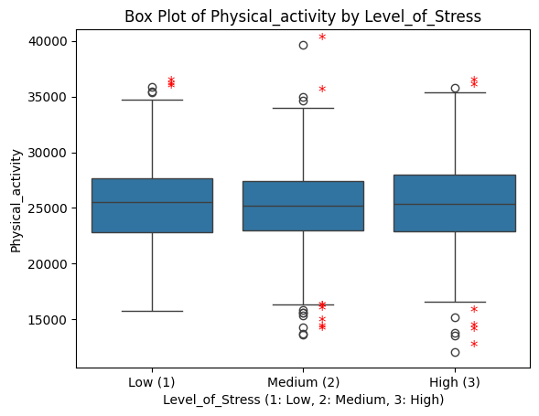
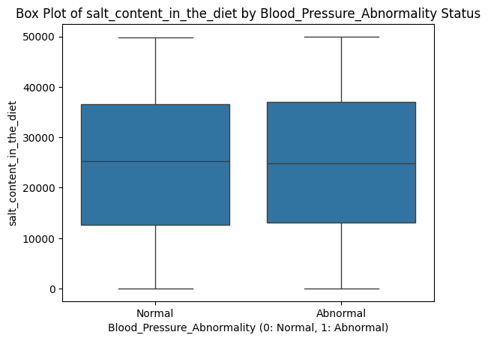
Feature Dynamics – Additional Relationships

Slide 15
Application of Generative AI
Model used : OpenAI GPT-3.5-Turbo
Establish an in-memory SQLite database and upload the DataFrame to create a table
Create a function to generate an SQL query based on user input, using a prompt to inform the OpenAI model about the dataset structure
Use the OpenAI API to generate a SQL query by sending a well-structured prompt that includes the user's question
Define a function to execute the generated SQL query against the SQLite database and return the results
Create a function to generate a natural language response based on the SQL query results and the user's original query

Slide 16
Generation of SQL queries using LLM
Retrieving subset from the csv that satisfies the query condition
Giving SQL query , subset and the user input to generate content

Slide 17
Streamlit App
Start the Streamlit app by setting the title and creating a text input field for the user to enter their health-related queries
Implement a button that, when clicked, triggers the SQL query generation and execution process based on the user's input
Show the generated SQL query on the app interface so that users can see what query was formed based on their input
Call the SQL execution function to get results from the database and handle any errors by displaying them on the app
If results are found, convert them into a Pandas DataFrame and display it on the Streamlit app for better visualization
After processing the results, generate a natural language response using the OpenAI API and display it to the user

Slide 18
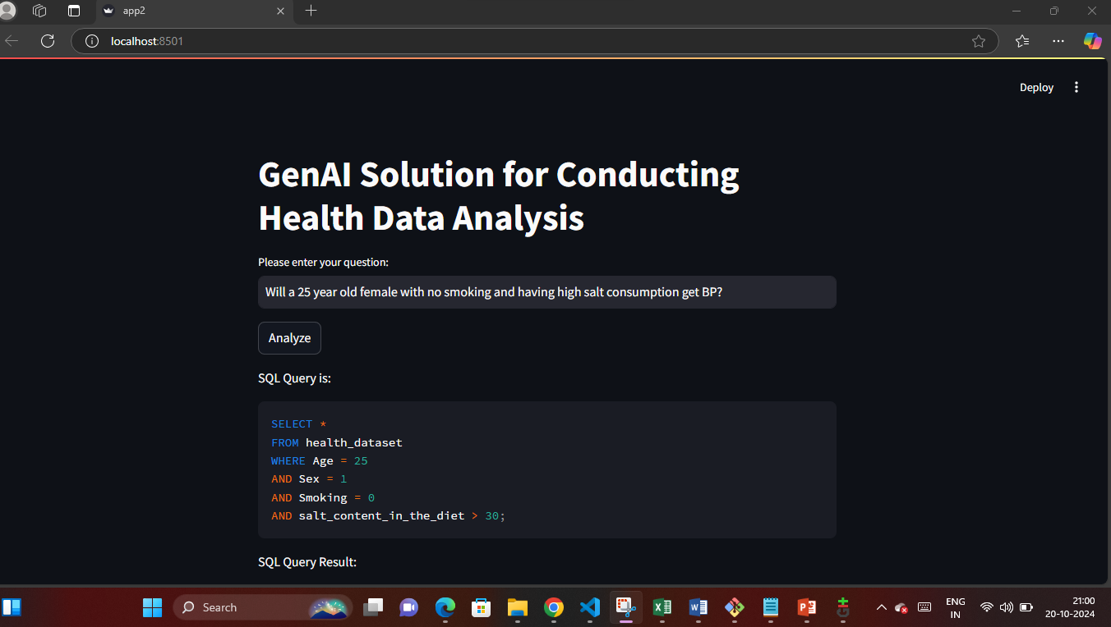
Workflow Screenshots

Slide 19
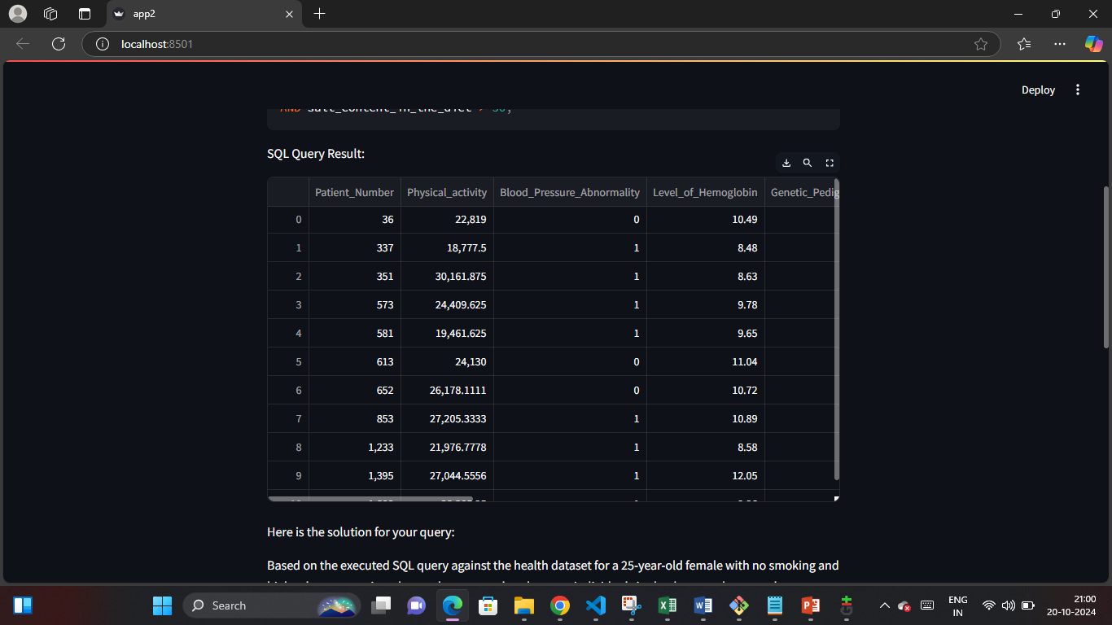
Workflow Screenshots

Slide 20
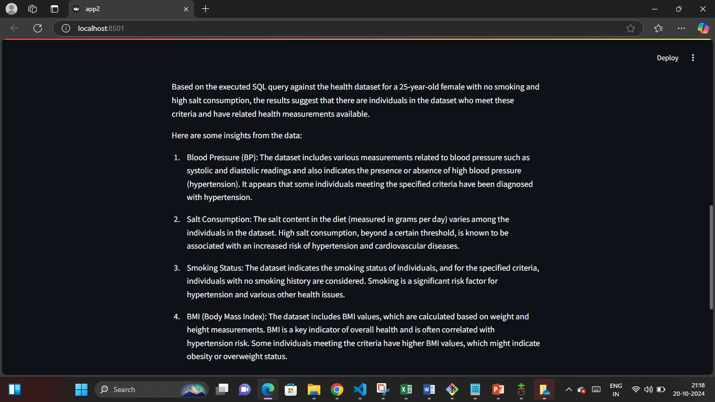
Workflow Screenshots

Slide 21
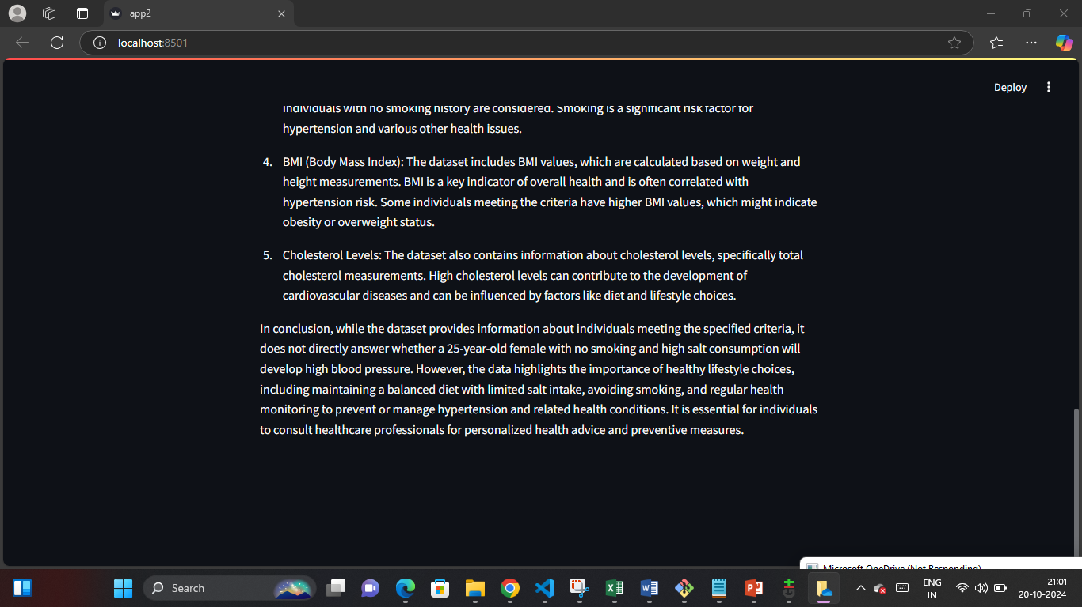
Workflow Screenshots

Slide 22

Git Repo URL - https://github.com/annvettoor/GenAIHealth-Data-Analysis

