Slide 1

.
Information Session for BUSI End-of-Summer Research Symposium
Leo Haolin Li

Slide 2

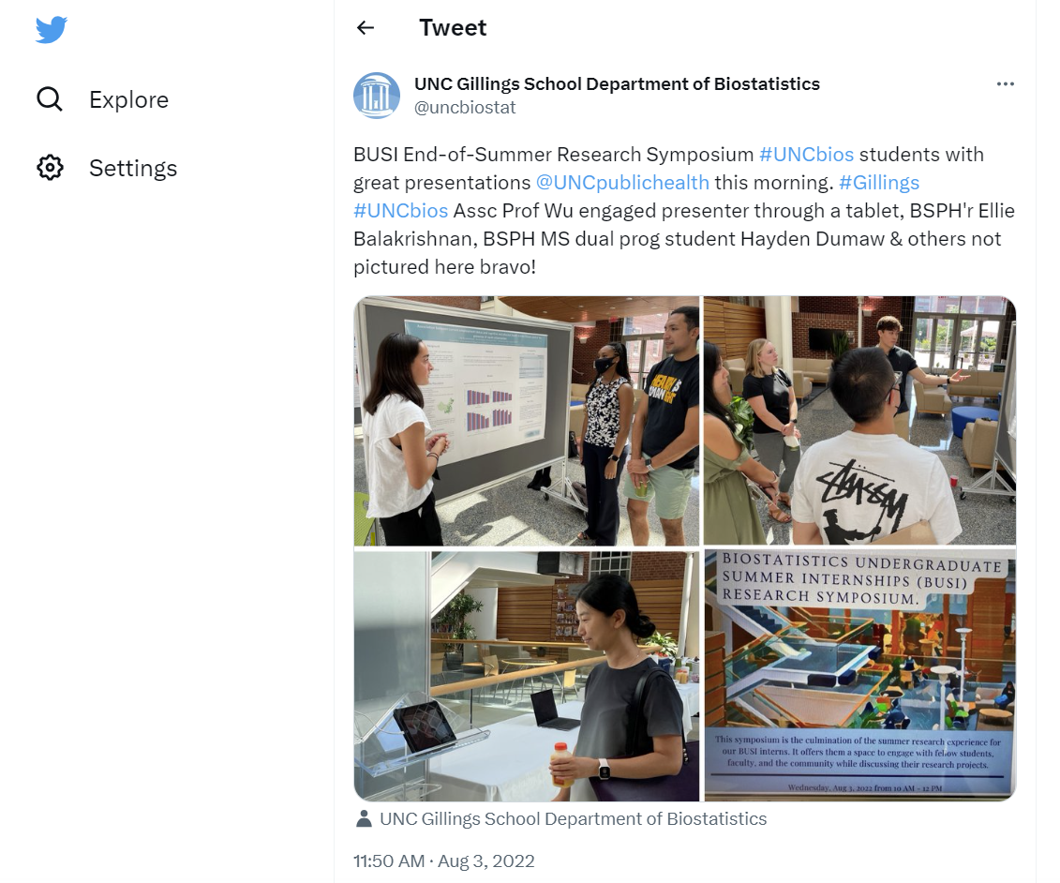
What the symposium will look like?

Slide 3
Timeline
Send your poster to Leo Li (haolin@live.unc.edu) in PowerPoint (do not convert to pdf) By Monday, August 7th at 11:59 PM.
We will review posters on August 8th and email you by the end of the day if modifications are needed.
If your poster needs to be modified, it must be sent back to us by 11:59 PM on Wednesday, August 9th in PowerPoint and pdf format.
Posters will be sent to the printer as soon as they are received.
We will pick up all posters on Tuesday, August 15th and bring them to the symposium on August 16th (10:00 AM – noon; Michael Hooker Research Center Lower Atrium).
There will be 1 winner (the Best Poster Award), unless there is a tie. The award winner will be announced by August 17th.

Slide 4

Poster Requirement
Size: 48 by 36 inches
Design Tab > Slide Size > Custom Slide Size > Set width to 48 inches and height to 36 inches > Select “OK”
List all co-authors.
If more than 4 authors, bold your name.
Make sure to include affiliations, e.g., Department of Biostatistics, University of North Carolina at Chapel Hill.
Include citations, if applicable.
Include funding source(s). If no funding source, write, “This work does not have any external funding to report.”
A few style notes:
Make sure no images or text run over the edge.
Don’t start text at the very edge of the page.
Text for section headers should be larger than main text.
Main text should be minimum 28-point font.
Choose a professional and readable font.
Include captions on tables and figures and number any equations.
Send your final poster to us in PowerPoint and pdf format.

Slide 5
Poster Templates and Examples
Poster templates: Poster Templates - Designing Effective Posters - LibGuides at University of North Carolina at Chapel Hill (unc.edu)
Poster examples:
Attached files: Ann Marie Poster Example & Taylor Poster Example
Poster Session – Duke Industry Statistics Symposium

Slide 6
Presentation Suggestions
Practice your presentation ahead of time with one of your peers
Wear professional attire
Introduce yourself and include your current position/student status
Maintain eye contact throughout your presentation
Your poster should support the story you are telling; you should not directly read from your poster
It is OK to bring supplementary materials
Be sure to pause for questions
Thank participants for attending your poster presentation
Bring water!
For further information, see attached rubric

Slide 7
Evaluation Rubric
Research Question: The research question/objective was clearly stated and connections to previous literature and broader issues were clear.
Methodology: The study design or procedures were described clearly, and a rationale for why the approach was selected was also stated.
Results/Anticipated Results: The results were presented clearly and sufficiently addressed the research question/objective.
Conclusion and Discussion: The conclusion & discussion were presented with a clear connection to the research question/objective and applicability to the field.
Oral Presentation & Q/A: The student spoke naturally with enthusiasm and presented strong knowledge of the project. They answered questions clearly and maintained good eye contact.
Poster Layout: The content was presented clearly, improved understanding of the project, and would have been easy to follow had the presenter been absent.

Slide 8

Thank You

