Slide 1


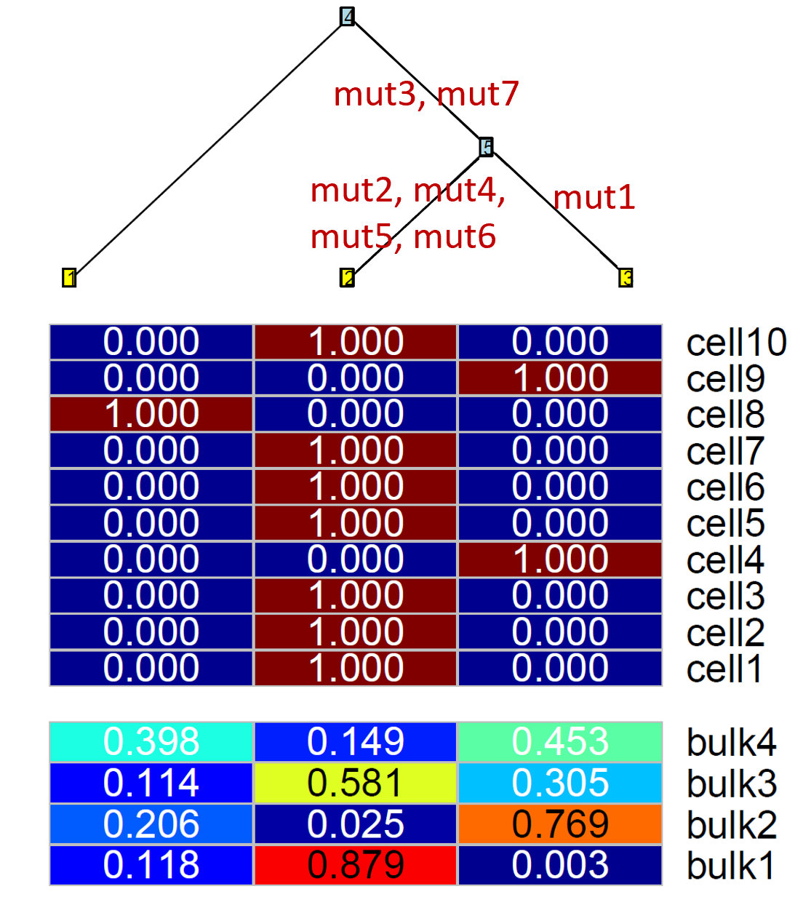
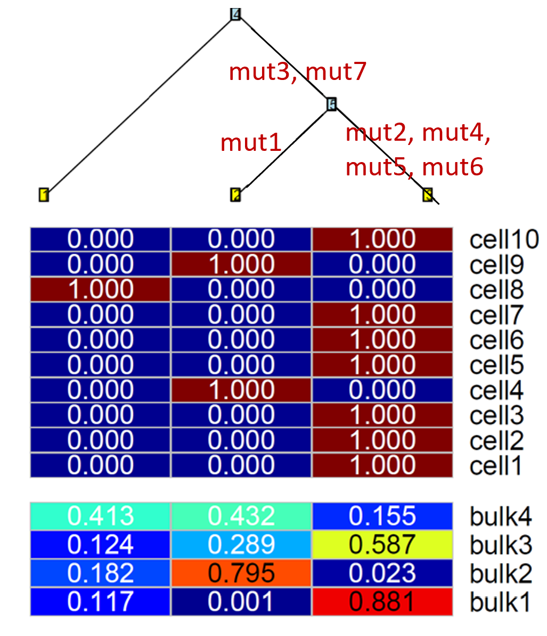
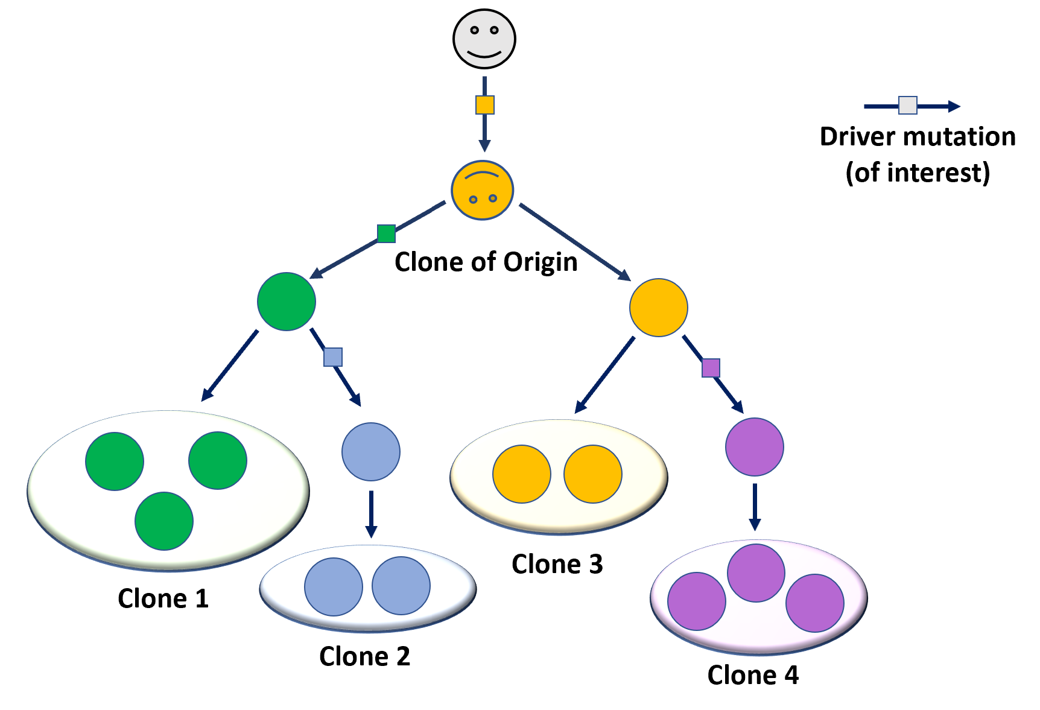
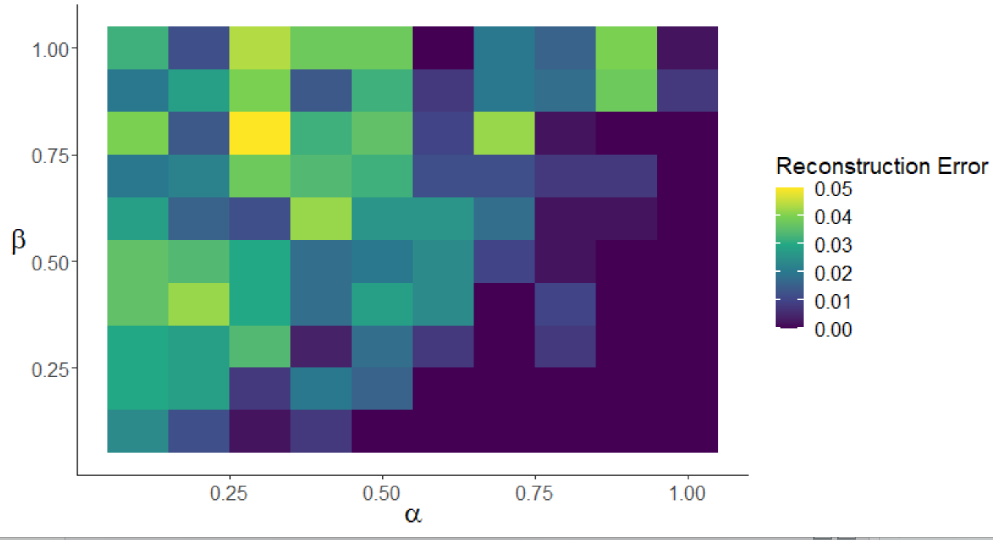
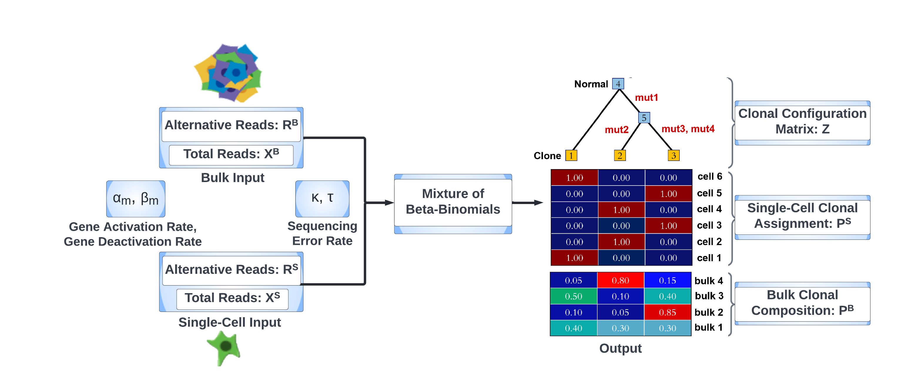

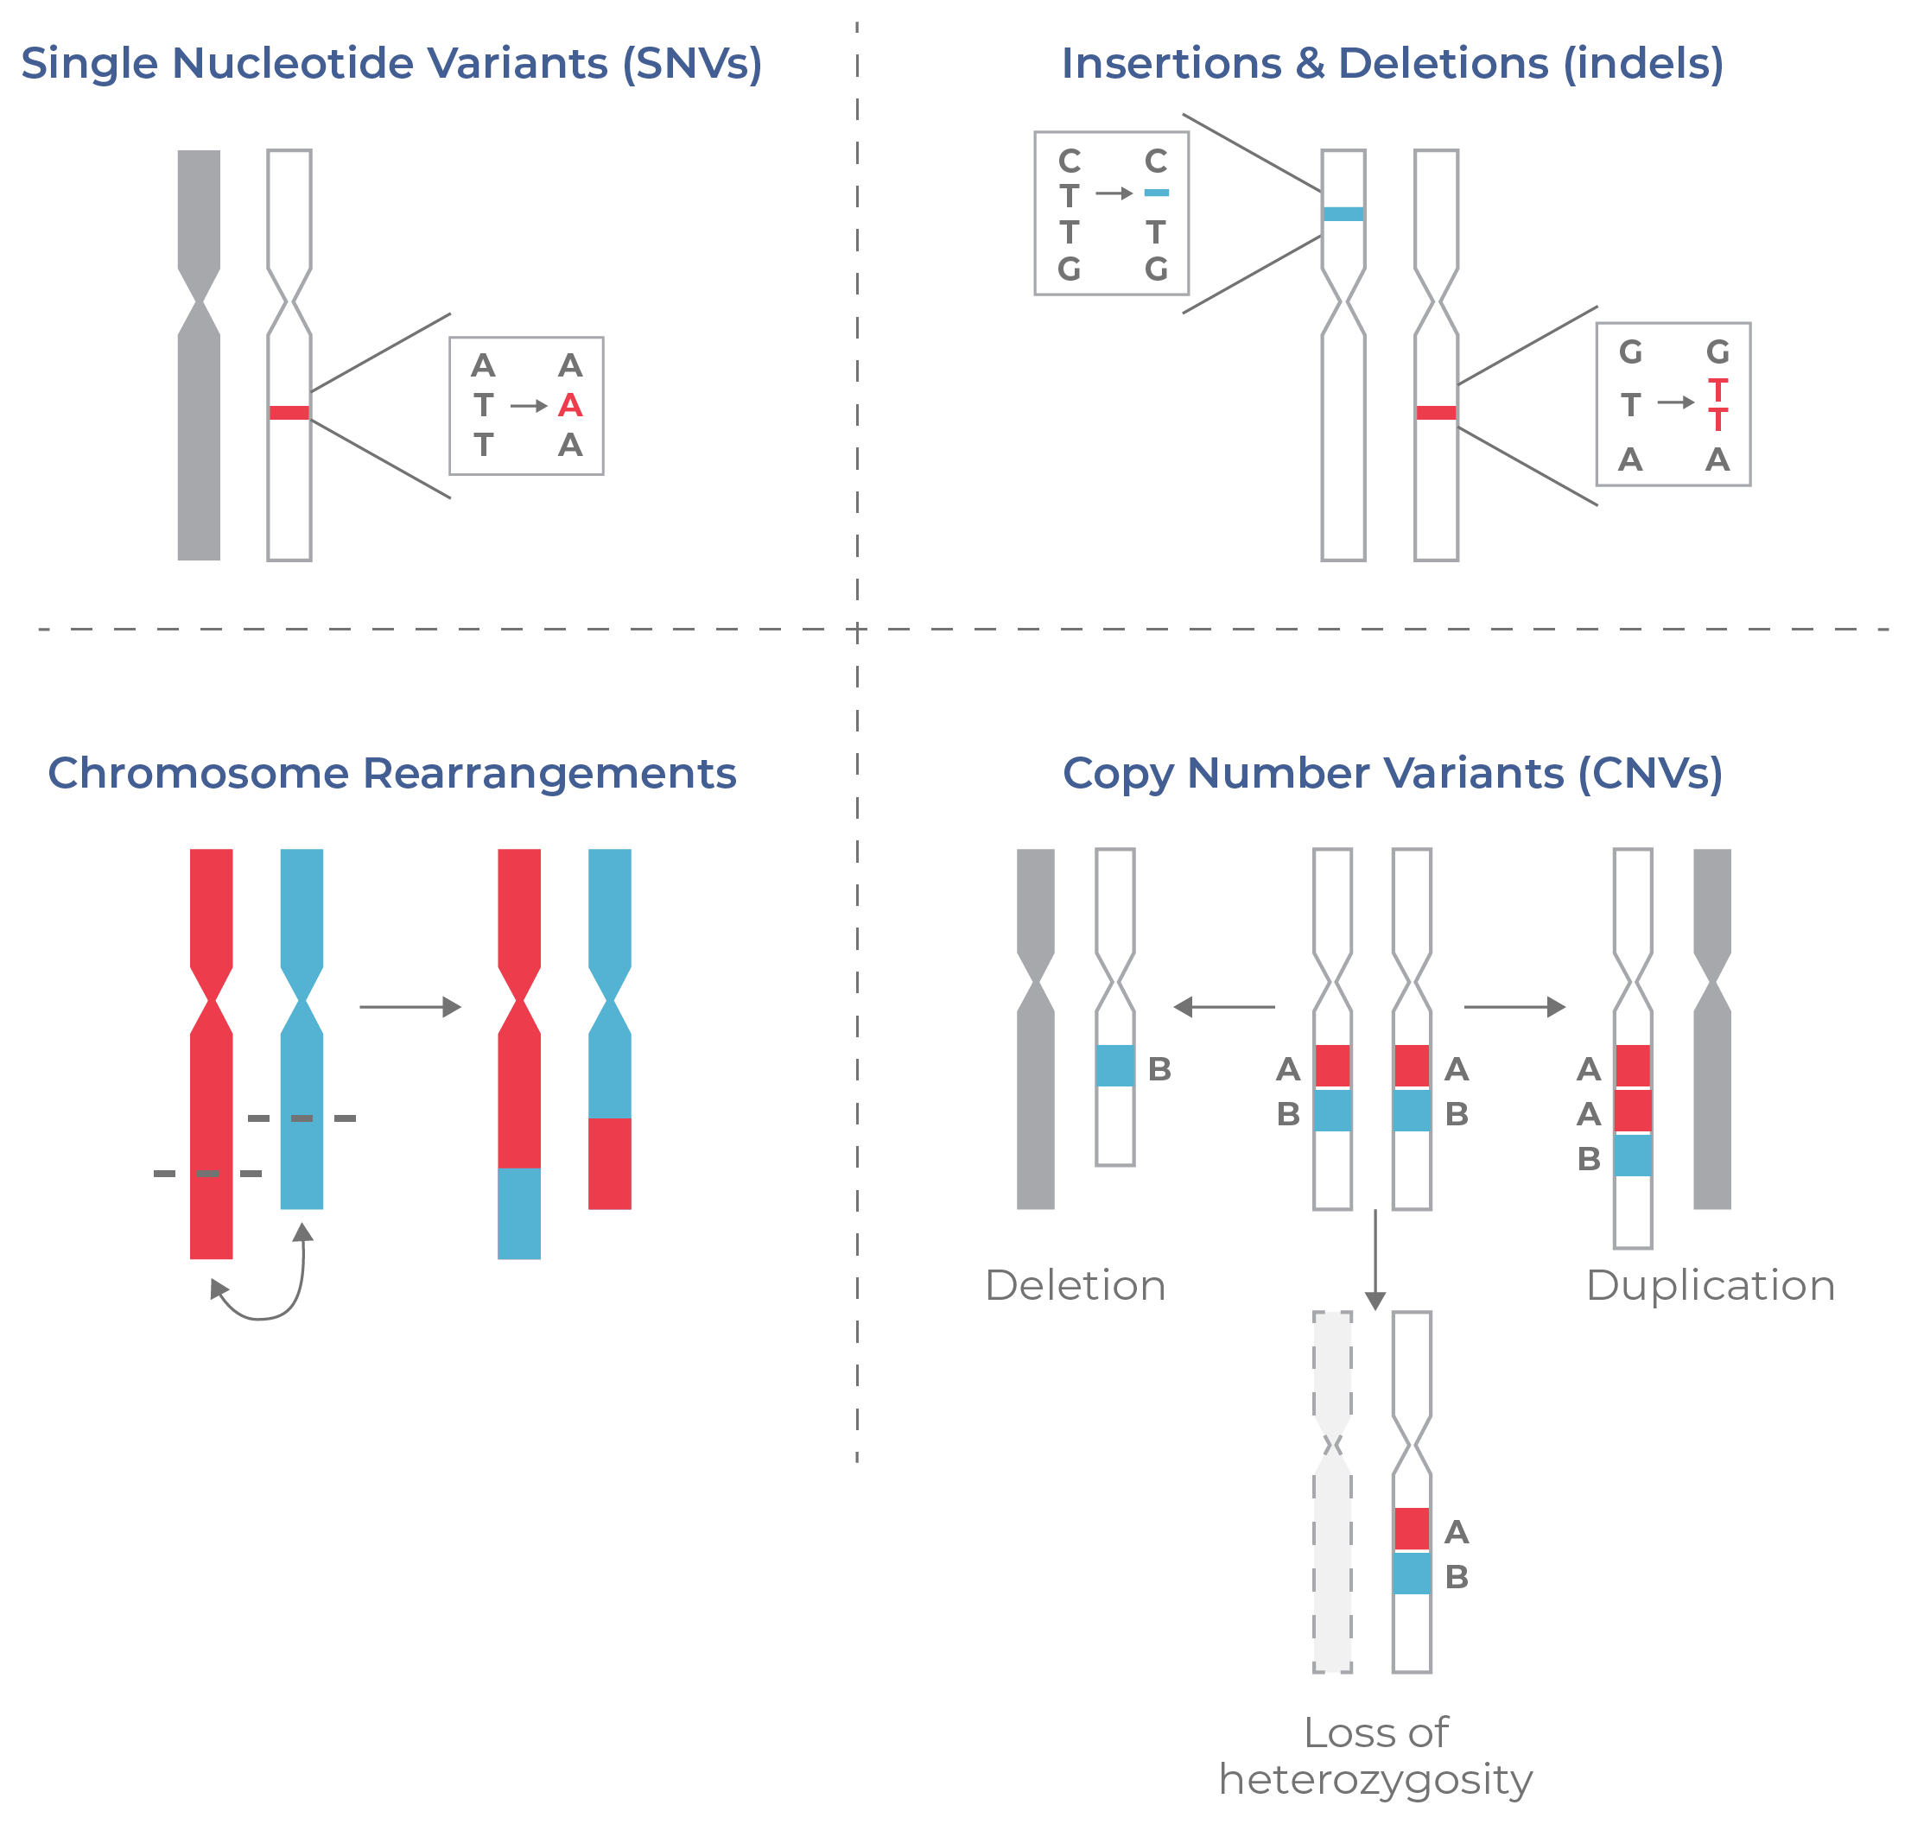
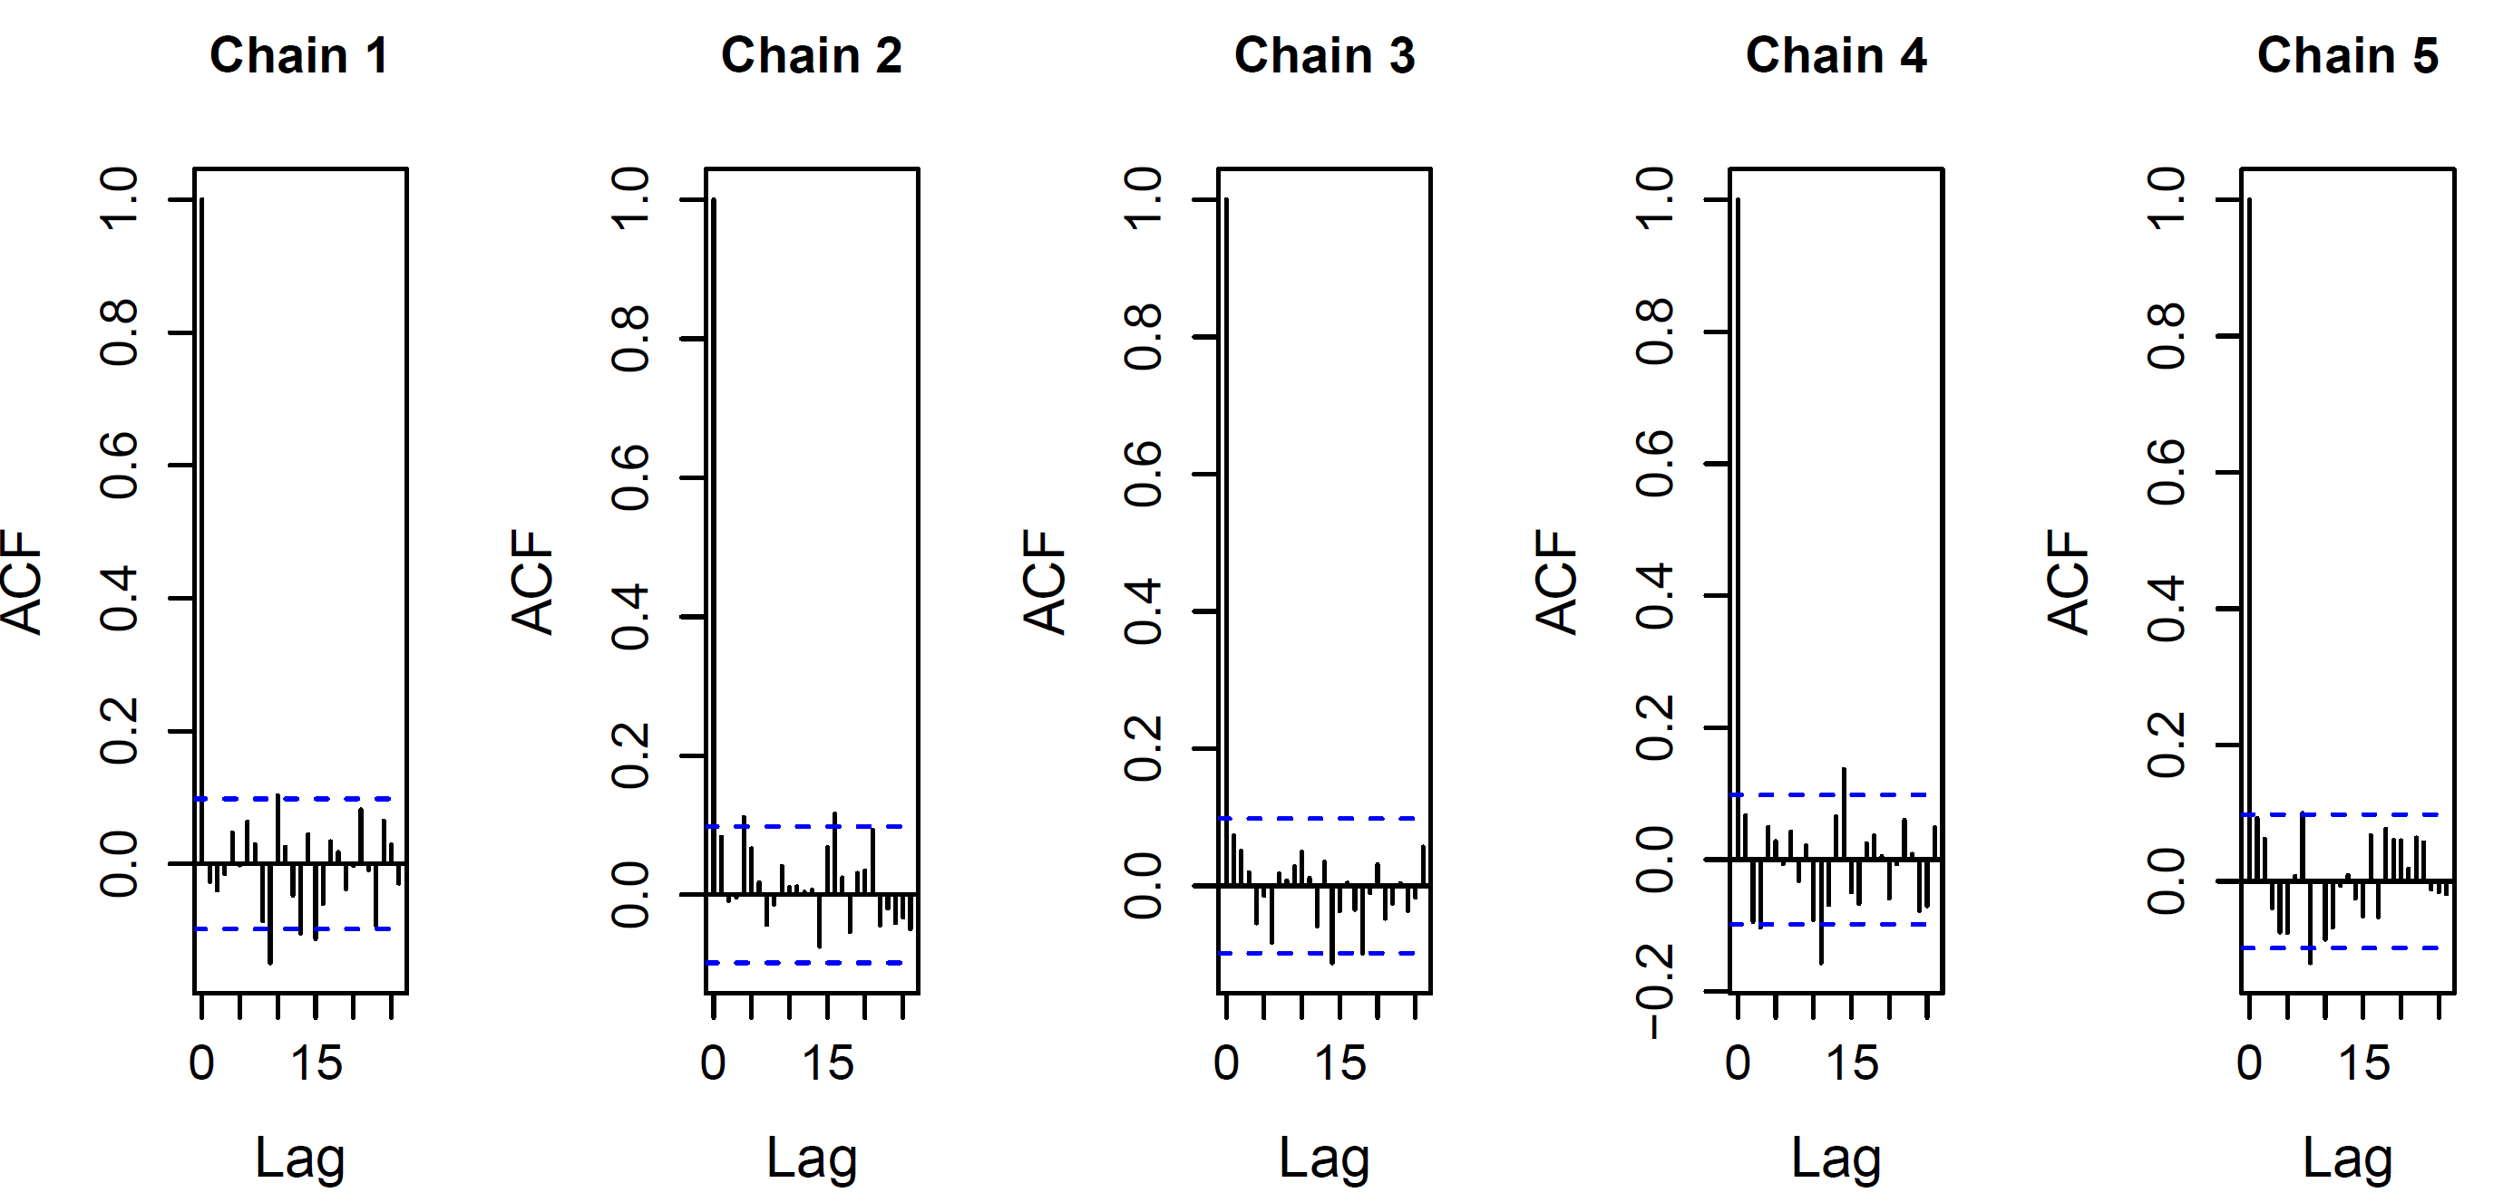
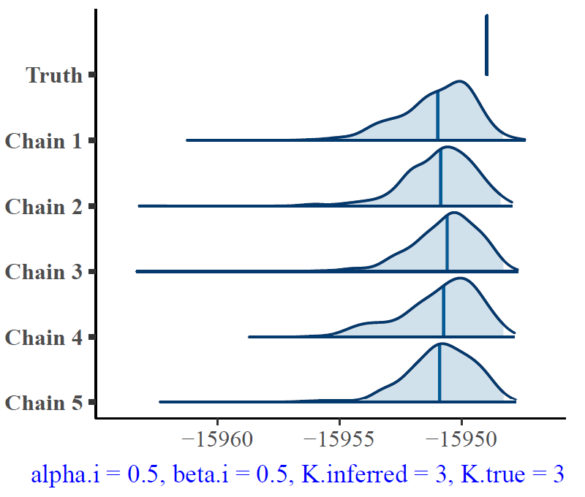
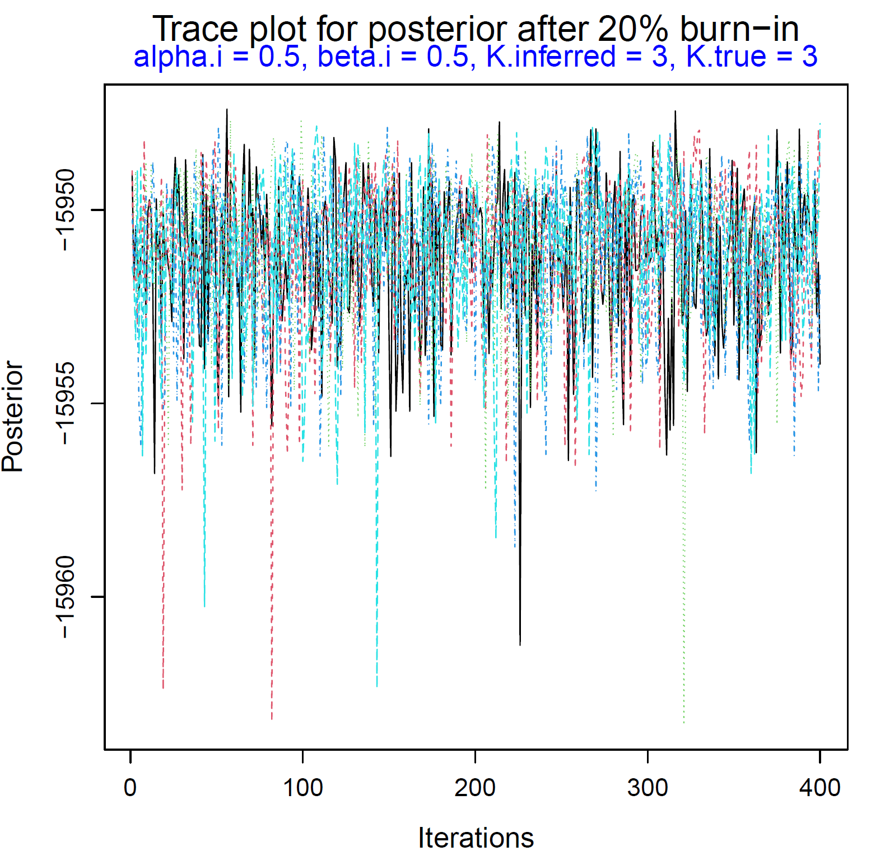
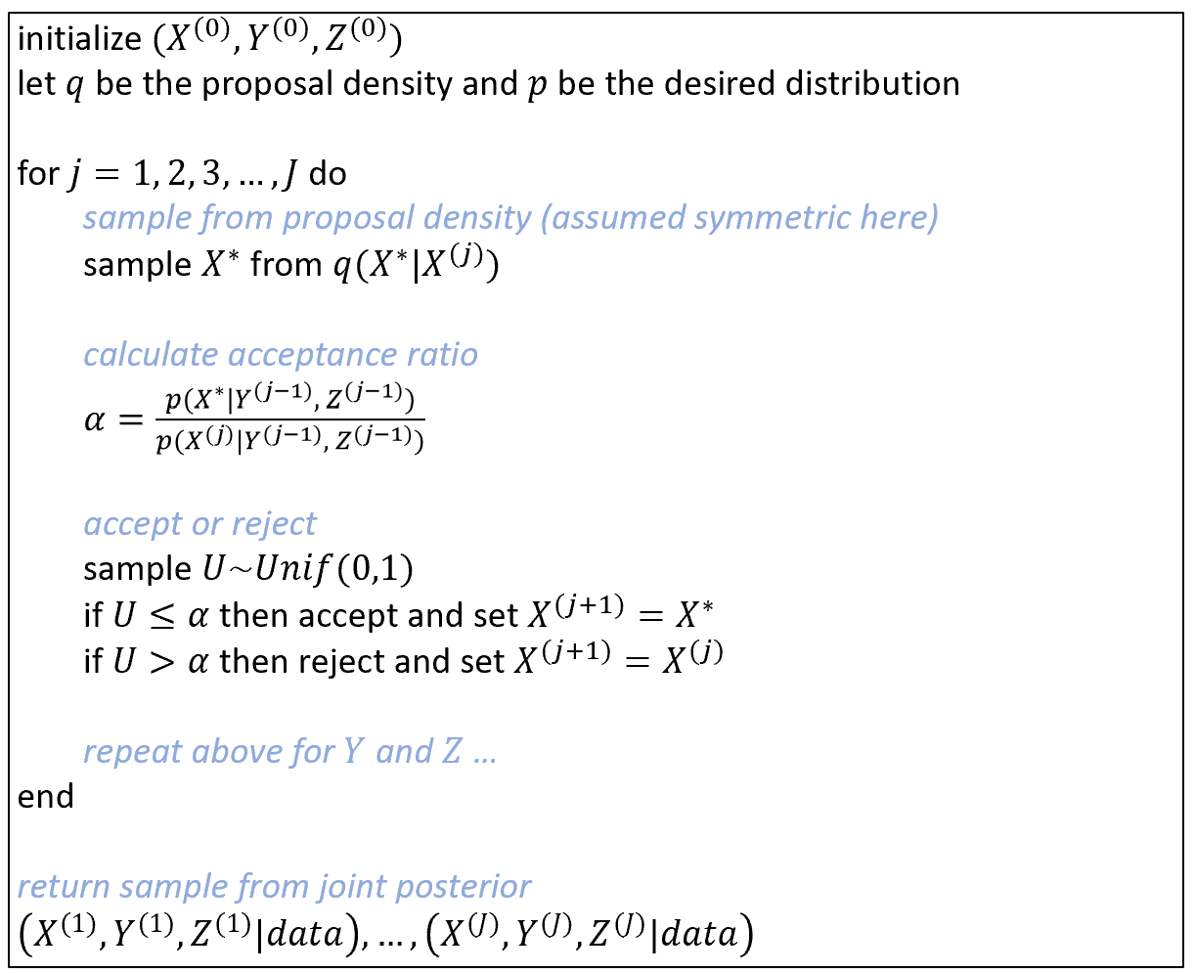
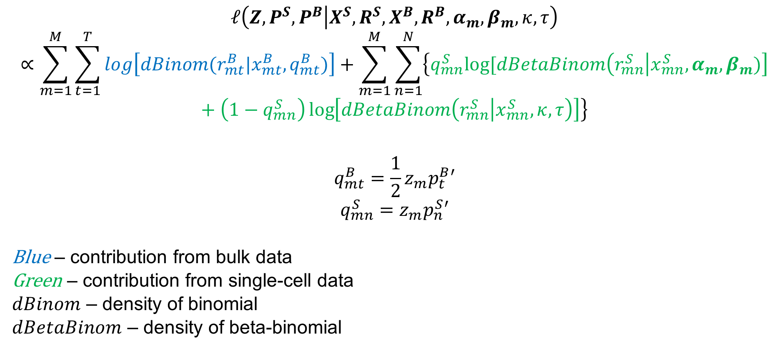
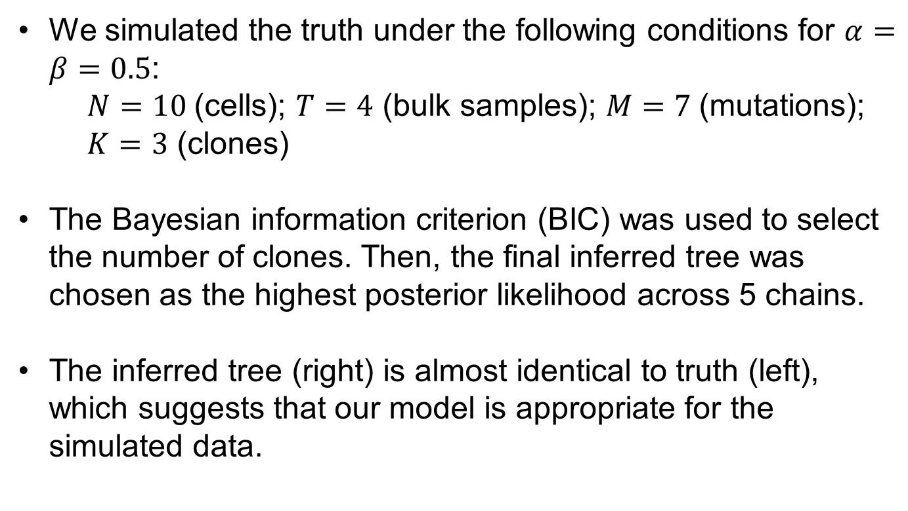
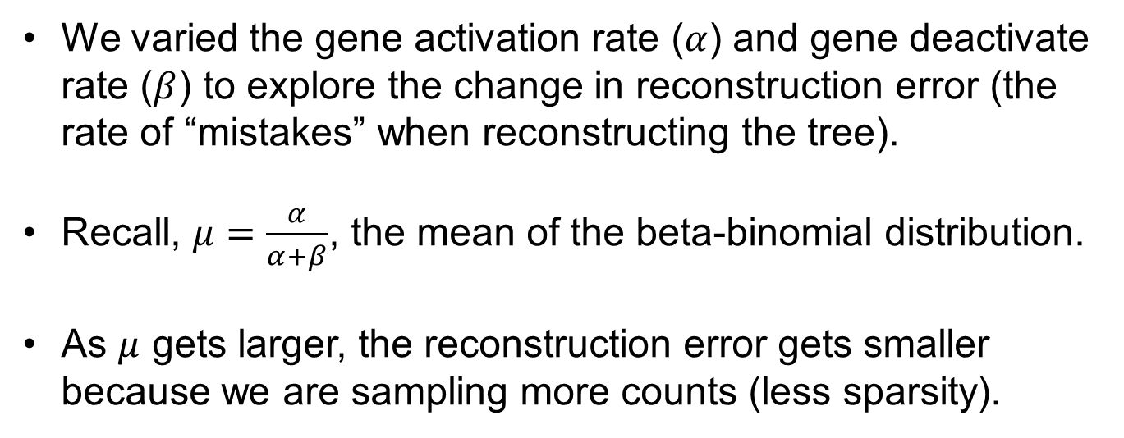
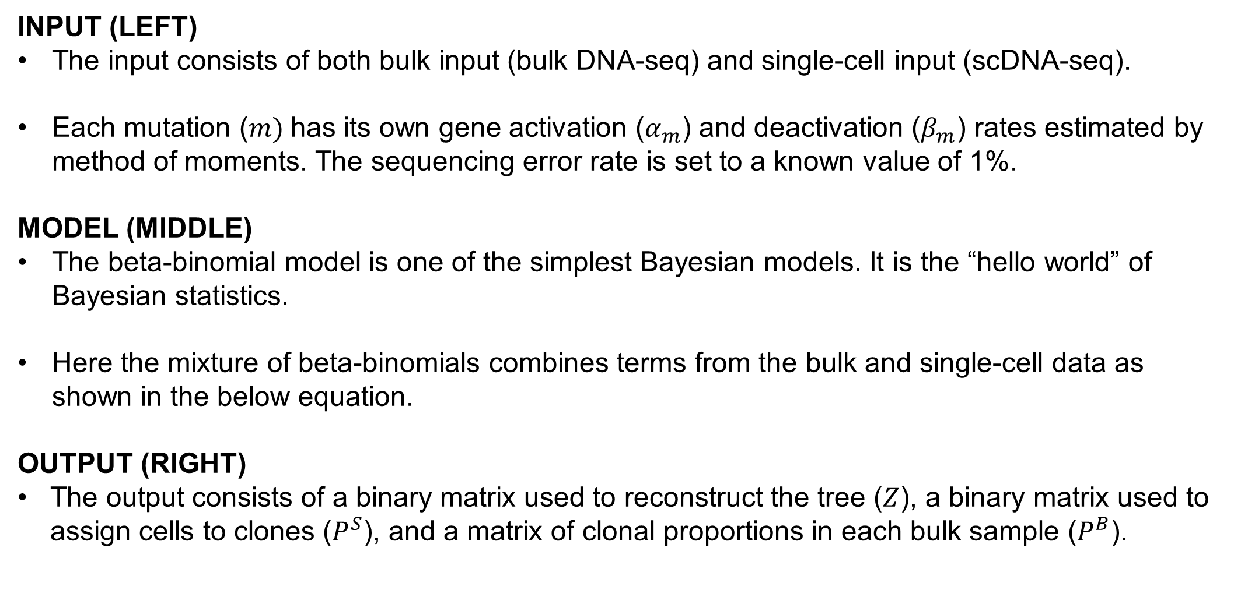
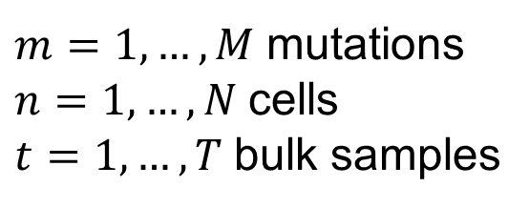
Tumor Phylogeny Inference from Bulk DNA & Single-Cell RNA Sequencing
Ann Marie Weideman¹, Rujin Wang¹, Joseph Ibrahim¹, Yuchao Jiang^{1,2}
¹Department of Biostatistics, University of North Carolina at Chapel Hill; ²Department of Genetics, University of North Carolina at Chapel Hill
GILLINGS SCHOOL OF PUBLIC HEALTH
1
Objective
5
Model: mixture of beta-binomials
7
Simulations: results
To infer the clonal tree configuration and clone of origin of cancerous tissue assayed using bulk DNA-sequencing (bulk DNA-seq) and single-cell RNA-sequencing (scRNA-seq).
INPUT (LEFT)
The input consists of both bulk input (bulk DNA-seq) and single-cell input (scDNA-seq).
Each mutation ($m)$has its own gene activation ($α_{m}$) and deactivation ($β_{m}$) rates estimated by method of moments. The sequencing error rate is set to a known value of 1%.
MODEL (MIDDLE)
The beta-binomial model is one of the simplest Bayesian models. It is the “hello world” of Bayesian statistics.
Here the mixture of beta-binomials combines terms from the bulk and single-cell data as shown in the below equation.
OUTPUT (RIGHT)
The output consists of a binary matrix used to reconstruct the tree ($Z$), a binary matrix used to assign cells to clones ($P^{S}$), and a matrix of clonal proportions in each bulk sample ($P^{B}$).
True Tree
Inferred Tree
We simulated the truth under the following conditions for $α=β=0.5$:
$N=10$(cells); $T=4$ (bulk samples); $M=7$(mutations); $K=3$ (clones)
The Bayesian information criterion (BIC) was used to select the number of clones. Then, the final inferred tree was chosen as the highest posterior likelihood across 5 chains.
The inferred tree (right) is almost identical to truth (left), which suggests that our model is appropriate for the simulated data.
2
Cancer Evolution: branched model
We varied the gene activation rate ($α$) and gene deactivate rate ($β$) to explore the change in reconstruction error (the rate of “mistakes” when reconstructing the tree).
Recall, $μ=\frac{α}{α+β}$, the mean of the beta-binomial distribution.
As $μ$ gets larger, the reconstruction error gets smaller because we are sampling more counts (less sparsity).
8
Simulations: convergence diagnostics
3
Types of mutations (variants)
We used 5k iterations, discarded the first 20% of the chains (20% burn-in), and thinned so that we retained only every 10th iteration to reduce correlation between iterations (also known as the lag autocorrelation factor, ACF). The top graph depicts the low lag ACF.
The joint posteriors (bottom left) and trace plots (bottom right) suggest that all 5 chains converged. The joint posteriors align well with the truth, and the trace plots appear as random noise.
Fun fact: At birth, children typically have 70 new genetic mutations compared to their parents.
Single nucleotide variants (SNVs): variants characterized by a substitution of one nucleotide at a specific genomic position.
Insertions/ deletions (indels): insertion or deletion of nucleotides into the genome.
$$ℓ\left(Z,P^{S}, P^{B} | X^{S}, R^{S},X^{B},R^{B},α_{m},β_{m}, κ,τ\right)∝\sum_{m=1}^{M}{\sum_{t=1}^{T}{log\left[dBinom(r_{mt}^{B}|x_{mt}^{B},q_{mt}^{B})\right]}+\sum_{m=1}^{M}{\sum_{n=1}^{N}{\left\{q_{mn}^{S}log⁡[dBetaBinom\left(r_{mn}^{S} | x_{mn}^{S},α_{m},β_{m})\right]+\left(1−q_{mn}^{S}\right)\log\left[dBetaBinom\left(r_{mn}^{S} | x_{mn}^{S}, κ,τ\right)\right]\right\}}}}$$
$$q_{mt}^{B}=\frac{1}{2}z_{m}p_{t}^{B}′$$
$$q_{mn}^{S}={z_{m}p}_{n}^{S}′$$
Blue – contribution from bulk data
Green – contribution from single-cell data
$dBinom$ – density of binomial
$dBetaBinom$ – density of beta-binomial
Lag ACF after 20% burn-in
Small mutations
Large mutations
chromosomal rearrangements: like translocations and gene fusions
Copy number variants (CNVs): variants characterized by the number of repeated sections of the genome (deletions/duplications, loss of heterozygosity).
$m=1,…,M$ mutations
$n=1,…,N$ cells
$t=1,…,T$ bulk samples
Joint posterior distributions
(medians and 95% HPD intervals)
Trace plot for posterior after 20% burn-in
6
Algorithm: Metropolis Hastings
4
https://missionbio.com/resources/learning-center/clonal-evolution-in-cancer/
Goal: Sample from a multivariate probability distribution when direct sampling is difficult.
Issue: Full conditionals may not have a closed form (only known up to a proportionality constant). Thus, we cannot directly sample from them.
Solution: Need to use an algorithm that incorporates rejection. One method is Metropolis-Hastings, which is presented in general form here.
Existing literature
Over the past 6 years, work in this field [1-5] has utilized Bayesian frameworks to incorporate the following:
Inputs: Bulk DNA-seq, scDNA-seq, and/or scRNA-seq
Mutations: Copy number variants (CNVs) or single nucleotide variants (SNVs)
With this work, we aim to develop a model that utilizes bulk DNA-seq and scRNA-seq to handle BOTH CNVs and SNVs.
In this poster, we present simulations from a partial model that handles SNVs, with plans to later incorporate CNVs.
9
Next steps
Currently pre-processing data from patients with glioblastoma (cancer of the brain).
Plan to run algorithm using real data to check performance.
If performance looks good, then will proceed with introducing copy number variants (CNVs) in the model.
Literature cited
Campbell, K. R., Steif, A., Laks, E., Zahn, H., Lai, D., McPherson, A., Farahani, H., Kabeer, F., O'Flanagan, C., Biele, J., Brimhall, J., Wang, B., Walters, P., IMAXT Consortium, Bouchard-Côté, A., Aparicio, S., & Shah, S. P. (2019). clonealign: statistical integration of independent single-cell RNA and DNA sequencing data from human cancers. Genome biology, 20(1), 54. https://doi.org/10.1186/s13059-019-1645-z
Jahn, K., Kuipers, J., & Beerenwinkel, N. (2016). Tree inference for single-cell data. Genome biology, 17, 86. https://doi.org/10.1186/s13059-016-0936-x
Jiang, Y., Qiu, Y., Minn, A. J., & Zhang, N. R. (2016). Assessing intratumor heterogeneity and tracking longitudinal and spatial clonal evolutionary history by next-generation sequencing. Proceedings of the National Academy of Sciences of the United States of America, 113(37), E5528–E5537. https://doi.org/10.1073/pnas.1522203113
4. McCarthy, D. J., Rostom, R., Huang, Y., Kunz, D. J., Danecek, P., Bonder, M. J., Hagai, T., Lyu, R., HipSci Consortium, Wang, W., Gaffney, D. J., Simons, B. D., Stegle, O., & Teichmann, S. A. (2020). Cardelino: computational integration of somatic clonal substructure and single-cell transcriptomes. Nature methods, 17(4), 414–421. https://doi.org/10.1038/s41592-020-0766-3
5. Zhou, Z., Xu, B., Minn, A., & Zhang, N. R. (2020). DENDRO: genetic heterogeneity profiling and subclone detection by single-cell RNA sequencing. Genome biology, 21(1), 10. https://doi.org/10.1186/s13059-019-1922-x
Further information
Please address questions or comments to Ann Marie Weideman at anndo1@live.unc.edu or anndo1@umbc.edu.
More information regarding laboratory interests, statistical modeling, and prior publications can be found at: https://yuchaojiang.github.io/
Funding
This work was supported by a grant from the National Institutes of Health, USA (NIH grant T32 CA106209).

