Slide 1
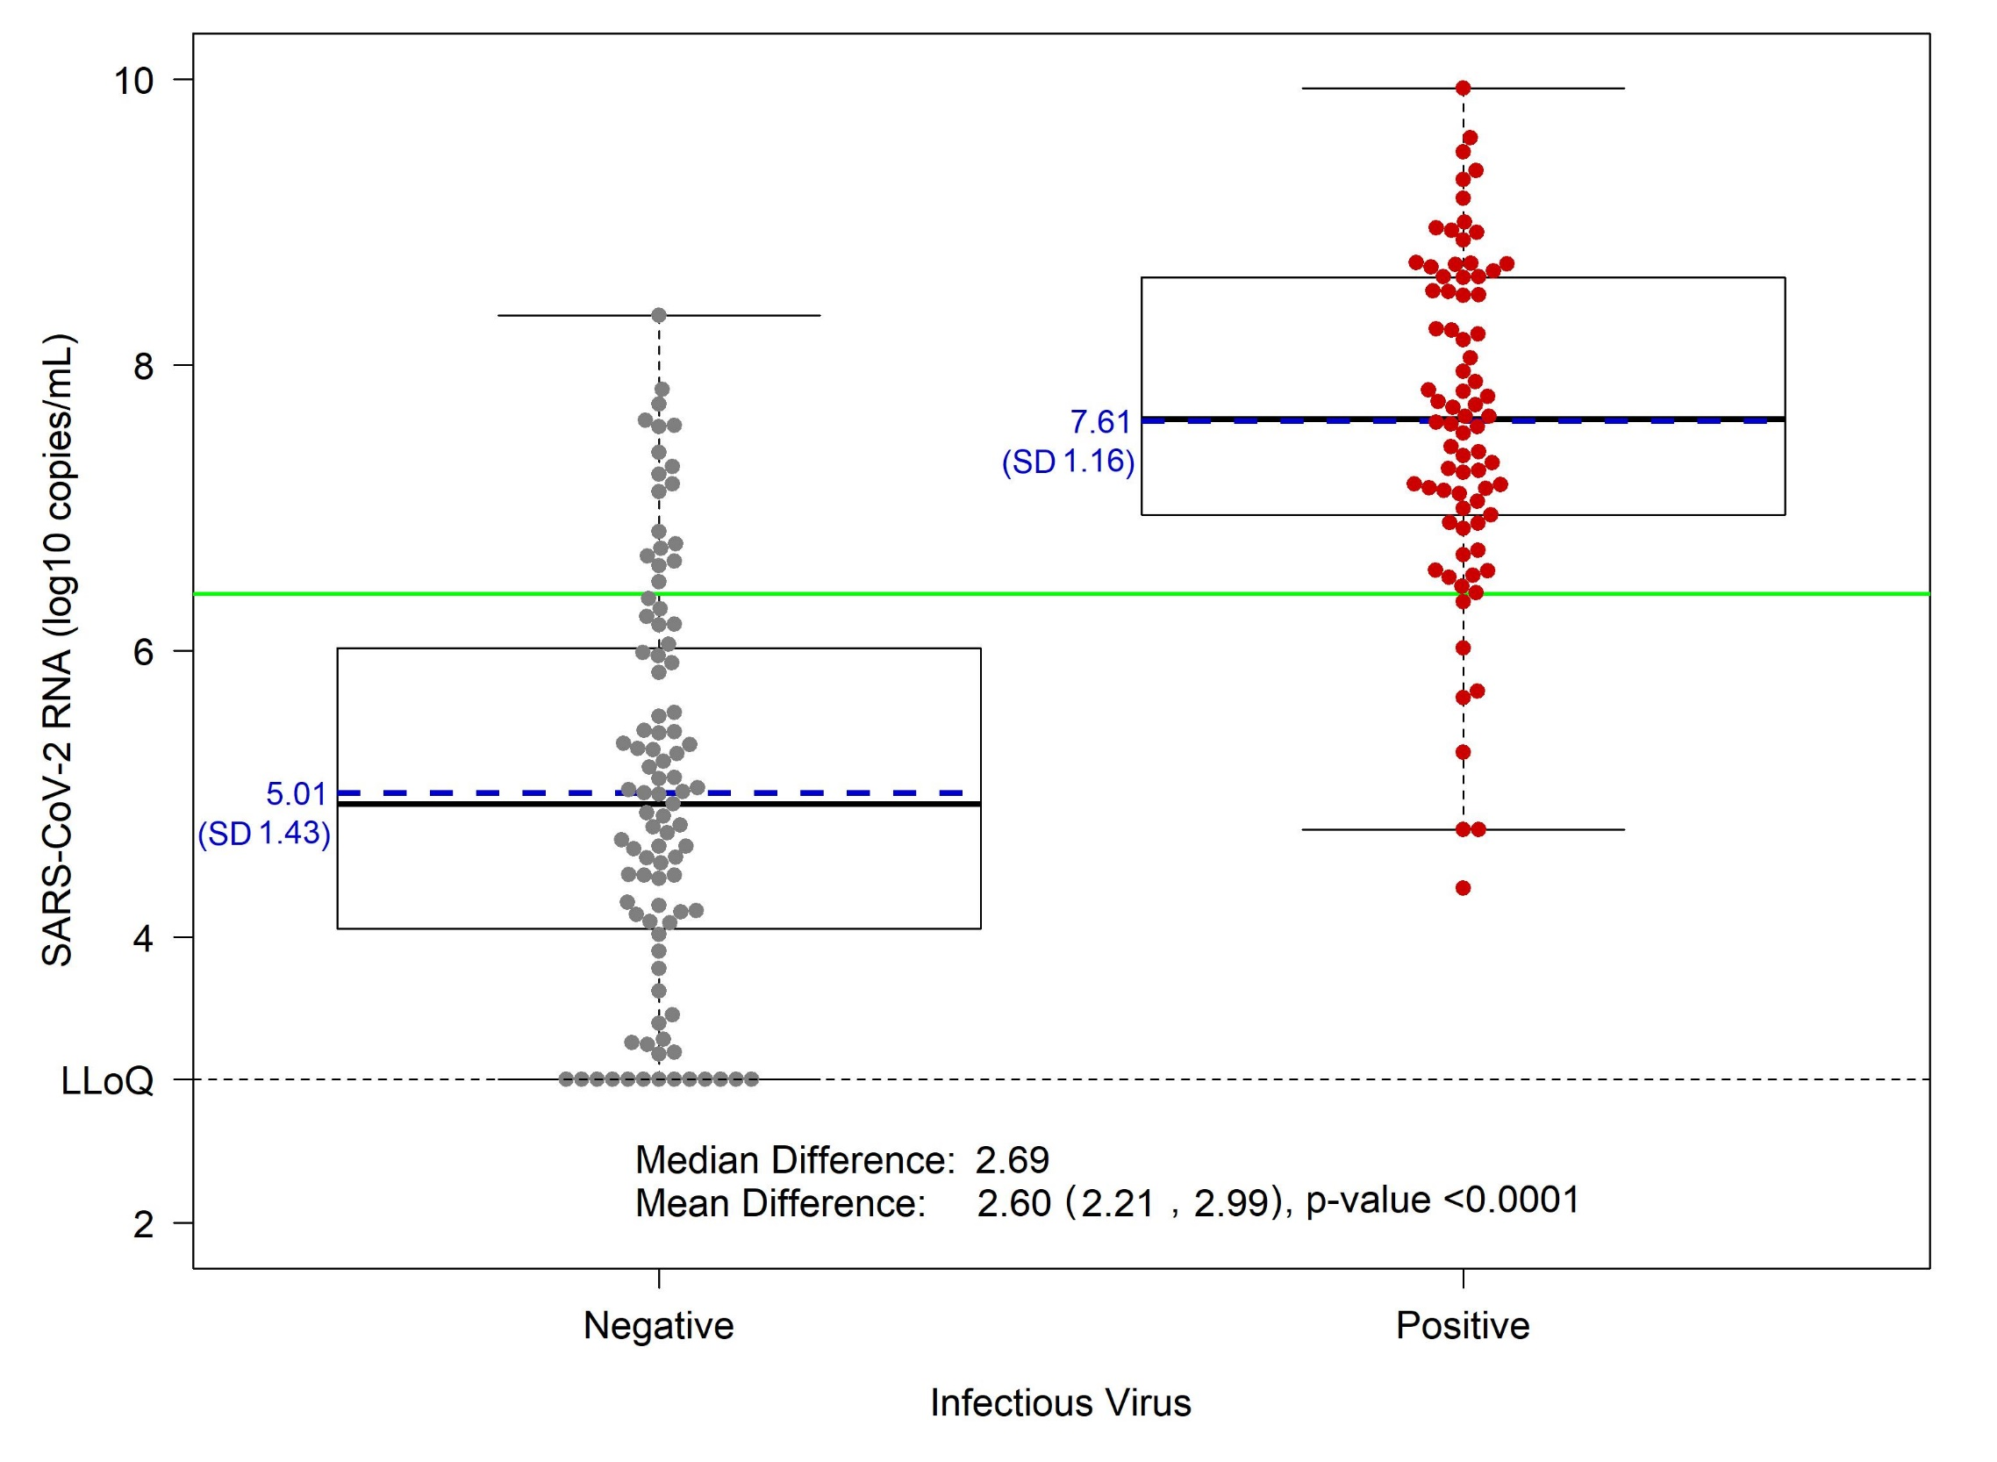
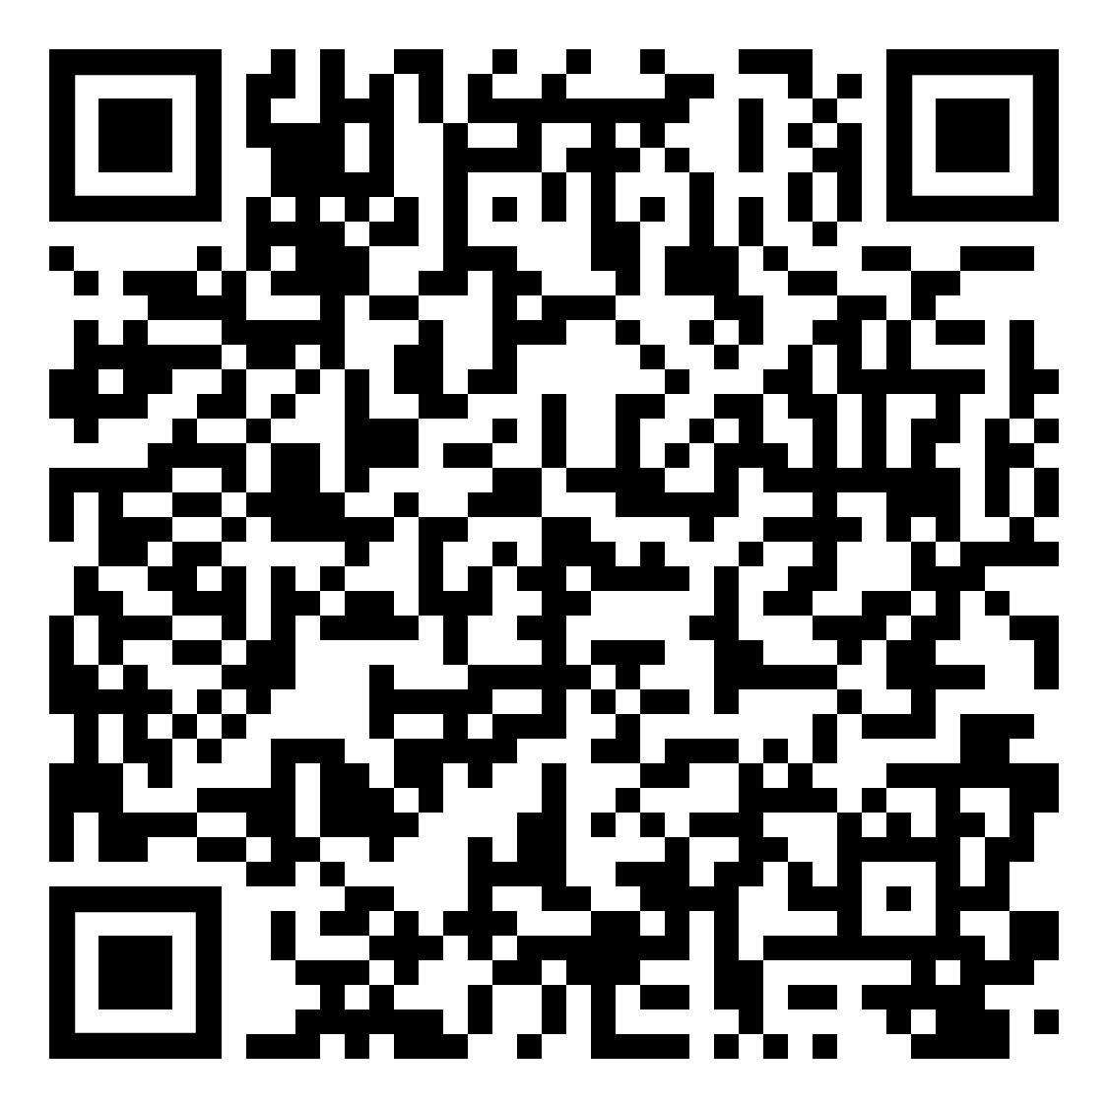

Infectious Severe Acute Respiratory Syndrome Coronavirus 2 (SARS-CoV-2) Virus in Symptomatic Coronavirus Disease 2019 (COVID-19) Outpatients: Host, Disease, and Viral Correlates
Katie R. Mollan, MS; Joseph J. Eron, MD; Taylor J. Krajewski, MA; Wendy Painter, MD; Elizabeth R. Duke, MD; Caryn G. Morse, MD; Erin A. Goecker, MS; Lakshmanane Premkumar, PhD; Cameron R. Wolfe, MBBS; Laura J. Szewczyk, BS; Paul L. Alabanza, BS; Amy James Loftis, BSc; Emily J. Degli-Angeli , BS; Ariane J. Brown, BS; Joan A. Dragavon, MLM; John J. Won, BS; Jessica Keys, PhD; Michael G. Hudgens, PhD; Lei Fang, MS; David A. Wohl, MD; Myron S. Cohen, MD; Ralph S. Baric, PhD; Robert W. Coombs, MD; Timothy P. Sheahan, PhD; William A. Fischer II, MD
See publication for affiliations. [1]
Objective
Results (continued)
To provide a comprehensive analysis of demographic, immunologic, virologic, and clinical disease factors associated with infectious virus isolation and levels of viral RNA in nasopharyngeal (NP) swab samples in the largest study of symptomatic outpatient adults with COVID-19.
Figure 1: SARS-CoV-2 virus isolation, viral RNA, and serostatus according to days since symptom onset
Figure 3: SARS-CoV-2 viral RNA, time since symptom onset, and infectious virus by SARS-CoV-2 specific antibody serostatus. A, Seropositive participants. B, Seronegative participants.
Study Design
204 COVID-19 unvaccinated adult outpatients enrolled in a Phase IIa clinical trial of the oral antiviral agent molnupiravir. [2, 3]
Participants enrolled within 7 days of symptom onset at ten sites across the US.
Clinical symptoms were recorded via patient diary.
NP swabs were collected to quantitate SARS-CoV-2 RNA by reverse transcriptase polymerase chain reaction and for infectious virus isolation in Vero E6-cells.
SARS-CoV-2 antibodies were measured in serum using a validated ELISA assay.
Analyses are cross-sectional, and thus causality should not be conferred without further mechanistic research.
Figure 4: Associations between infectious virus isolation and host characteristics
Demographics
Median age was 40 (IQR 27–52) years
51% Women
47% White non-Hispanic, 42% Hispanic/Latinx, 5% Black non-Hispanic, and 3% Asian non-Hispanic
Overall symptom severity was rated mild (48%), moderate (45%), or severe (7%)
Figure 2: SARS-CoV-2 viral RNA levels in nasopharyngeal swab by infectious virus status.
Results
SARS-CoV-2 antibodies, virus isolation, and viral RNA
26% (46/177) had detectable SARS-CoV-2 antibodies at baseline.
45% (78/175) were infectious virus positive at baseline.
Baseline median SARS-CoV-2 viral RNA from NP swabs was 6.5 (IQR 4.7-7.6) $\log_{10} copies/mL$ overall, and was highest within 3 days after symptom onset (Figure 1).
Mean viral RNA levels were higher among infectious virus positive participants (Figure 2).
A viral RNA threshold of ≥6.4 $\log_{10} copies/mL$ was predictive of infectious virus isolation (Figure 2, Table 1).
All participants with viral RNA measurements in the top quartile (>7.6 log₁₀) were seronegative (100%; 43/43) and 91% (39/43) had infectious virus isolated. Whereas, participants in the bottom viral RNA quartile (<4.7 log₁₀) were predominantly infectious virus negative (98%; 40/41) and 68% (28/41) were seropositive (Figure 3).
88% lower prevalence of infectious virus for those with SARS-CoV-2 antibodies (Prevalence Ratio = 0.12, 95% CI: 0.04, 0.36; P = 0.00016) (Figure 4).
Antibody status and NP viral RNA levels were strongly associated (Mean Difference = –2.4, 95% CI: –2.8, –1.9, P < .0001).
Conclusion
The presence of SARS-CoV-2 antibodies is strongly associated with clearance of infectious virus.
Seropositivity and viral RNA levels are likely more reliable markers of infectious virus clearance than subjective measures of COVID-19 symptom duration.
Virus-targeted treatment and prevention strategies should be administered as early as possible and ideally before seroconversion.
Table 1: Nasopharyngeal viral RNA threshold for infectious virus isolation
Viral RNA | Infectious Virus
 | Negative | Positive | Total
< 6.4 log₁₀ copies/mL | 77 NPV: 91% Specificity: 81% | 8 9% 10% | 85
≥ 6.4 log₁₀ copies/mL | 18 20% 19% | 70 PPV: 80% Sensitivity: 90% | 88
Total | 95 | 78 | 173
References
Mollan KR, Eron JJ, Krajewski TJ, et al. Infectious Severe Acute Respiratory Syndrome Coronavirus 2 (SARS-CoV-2) Virus in Symptomatic Coronavirus Disease 2019 (COVID-19) Outpatients: Host, Disease, and Viral Correlates. Clinical Infectious Diseases 2021. doi: 10.1093/cid/ciab968
Sheahan TP, Sims AC, Zhou S, et al. An orally bioavailable broad-spectrum antiviral inhibits SARS-CoV-2 in human airway epithelial cell cultures and multiple coronaviruses in mice. Sci Transl Med 2020; 12. doi: 10.1126/scitranslmed.abb5883.
Painter WP, Holman W, Bush JA, et al. Human safety, tolerability, and pharmacokinetics of molnupiravir, a novel broad-spectrum oral antiviral agent with activity against SARS-CoV-2. Antimicrob Agents Chemother 2021. doi: 10.1128/AAC.02428-20.
NPV = negative predictive value; PPV = positive predictive value
This work was supported in part by the National Institute of Health [P30 AI050410 & T32 ES007018]
Published in Clinical Infectious Diseases: 2021 November 23

