Slide 1
ResNet
崑山科技大學資訊工程所
深度學習Deep Learning課程
報告人:徐莨智
指導恩師:龍大大
繳交日期:2020.06.10

Slide 2
Agenda
ResNet Introduction
ResNet 比較
Resnet 50 example

Slide 3
ResNet Introduction
2015年提出
在ImageNet比賽classification任務上獲得第一名
有18、 34、50、101、152這幾種階層

Slide 4
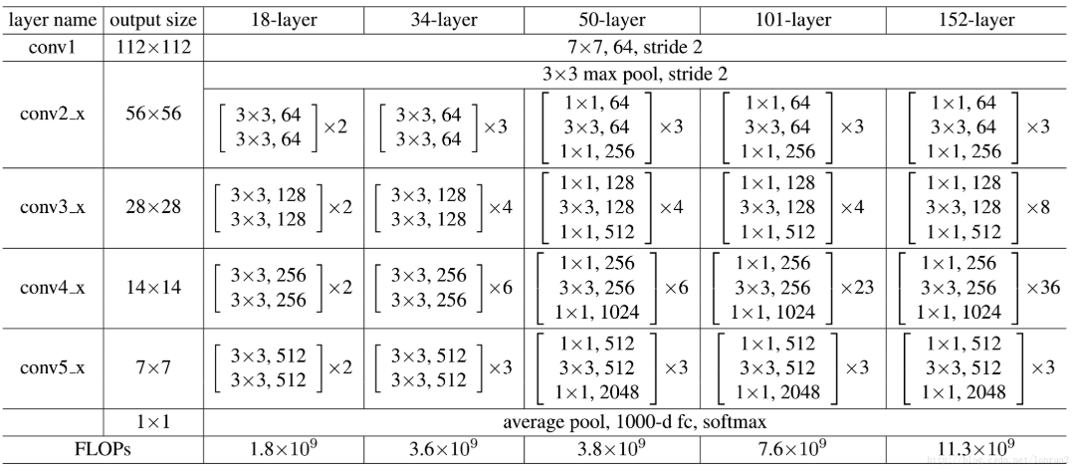
ResNet 50 & ResNet101比較

Slide 5
ResNet50 Example(一)
準備資料
選擇貓與狗各前 1000 張照片作為訓練資料集，另各取 400 張作為測試資料集
建立及訓練模型
辨識狗與貓

Slide 6
ResNet50 Example(二)
from tensorflow.python.keras import backend as K
from tensorflow.python.keras.models import Model
from tensorflow.python.keras.layers import Flatten, Dense, Dropout
from tensorflow.python.keras.applications.resnet50 import ResNet50
from tensorflow.python.keras.optimizers import Adam
from tensorflow.python.keras.preprocessing.image import ImageDataGenerator

Slide 7
ResNet50 Example(三)
# 資料路徑
DATASET_PATH = 'sample'
# 影像大小
IMAGE_SIZE = (224, 224)
# 影像類別數
NUM_CLASSES = 2
# 若 GPU 記憶體不足，可調降 batch size 或凍結更多層網路
BATCH_SIZE = 8

Slide 8
ResNet50 Example(四)
# 凍結網路層數
FREEZE_LAYERS = 2
# Epoch 數
NUM_EPOCHS = 20
# 模型輸出儲存的檔案
WEIGHTS_FINAL = 'model-resnet50-final.h5'

Slide 9
ResNet50 Example(五)
# 透過 data augmentation 產生訓練與驗證用的影像資料
train_datagen = ImageDataGenerator(rotation_range=40,
width_shift_range=0.2,
height_shift_range=0.2,
shear_range=0.2,
zoom_range=0.2,
channel_shift_range=10,
horizontal_flip=True,
fill_mode='nearest')

Slide 10
ResNet50 Example(六)
train_batches = train_datagen.flow_from_directory(DATASET_PATH + '/train',
target_size=IMAGE_SIZE,
interpolation='bicubic',
class_mode='categorical',
shuffle=True,
batch_size=BATCH_SIZE)

Slide 11
ResNet50 Example(七)
valid_datagen = ImageDataGenerator()
valid_batches = valid_datagen.flow_from_directory(DATASET_PATH + '/valid',
target_size=IMAGE_SIZE,
interpolation='bicubic',
class_mode='categorical',
shuffle=False,
batch_size=BATCH_SIZE)

Slide 12
ResNet50 Example(八)
# 輸出各類別的索引值
for cls, idx in train_batches.class_indices.items():
print('Class #{} = {}'.format(idx, cls))
# 以訓練好的 ResNet50 為基礎來建立模型，
# 捨棄 ResNet50 頂層的 fully connected layers
net = ResNet50(include_top=False, weights='imagenet', input_tensor=None,
input_shape=(IMAGE_SIZE[0],IMAGE_SIZE[1],3))
x = net.output
x = Flatten()(x)

Slide 13
ResNet50 Example(九)
# 增加 DropOut layer
x = Dropout(0.5)(x)
# 增加 Dense layer，以 softmax 產生個類別的機率值
output_layer = Dense(NUM_CLASSES, activation='softmax', name='softmax')(x)
# 設定凍結與要進行訓練的網路層
net_final = Model(inputs=net.input, outputs=output_layer)
for layer in net_final.layers[:FREEZE_LAYERS]:
layer.trainable = False
for layer in net_final.layers[FREEZE_LAYERS:]:
layer.trainable = True

Slide 14
ResNet50 Example(十)
# 使用 Adam optimizer，以較低的 learning rate 進行 fine-tuning
net_final.compile(optimizer=Adam(lr=1e-5),
loss='categorical_crossentropy', metrics=['accuracy'])
# 輸出整個網路結構
print(net_final.summary())
# 訓練模型
net_final.fit_generator(train_batches,
steps_per_epoch = train_batches.samples // BATCH_SIZE,
validation_data = valid_batches,
validation_steps = valid_batches.samples // BATCH_SIZE,
epochs = NUM_EPOCHS)
# 儲存訓練好的模型
net_final.save(WEIGHTS_FINAL)

Slide 15
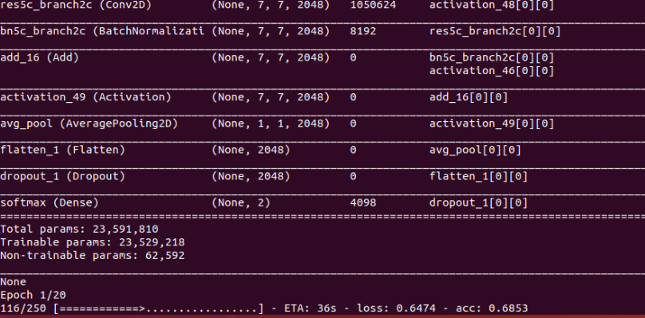
ResNet50 Example(十一)

Slide 16
ResNet50 Example(十二)
from tensorflow.python.keras import backend as K
from tensorflow.python.keras.models import load_model
from tensorflow.python.keras.preprocessing import image
import sys
import numpy as np
# 從參數讀取圖檔路徑
files = sys.argv[1:]
# 載入訓練好的模型
net = load_model('model-resnet50-final.h5’)
cls_list = ['cats', 'dogs']

Slide 17
ResNet50 Example(十三)
# 辨識每一張圖
for f in files:
img = image.load_img(f, target_size=(224, 224))
if img is None:
continue
x = image.img_to_array(img)
x = np.expand_dims(x, axis = 0)
pred = net.predict(x)[0]
top_inds = pred.argsort()[::-1][:5]
print(f)
for i in top_inds:
print(' {:.3f} {}'.format(pred[i], cls_list[i]))

Slide 18
ResNet50 Example(十三)
# 辨識每一張圖
for f in files:
img = image.load_img(f, target_size=(224, 224))
if img is None:
continue
x = image.img_to_array(img)
x = np.expand_dims(x, axis = 0)
pred = net.predict(x)[0]
top_inds = pred.argsort()[::-1][:5]
print(f)
for i in top_inds:
print(' {:.3f} {}'.format(pred[i], cls_list[i]))

Slide 19
Thank you for your Listening

