Slide 1
Machine Learning — Transfer Learning
崑山科技大學資訊工程所
深度學習Deep Learning課程
報告人:徐莨智
指導恩師:龍大大
繳交日期:2020.06.04

Slide 2
InceptionV3 & tensorflow hub
import os
os.chdir("");
改變資料夾 ex: cd XXX

Slide 3
InceptionV3 & tensorflow hub
from tensorflow.keras.applications import VGG16
model=VGG16()
model.summary()

Slide 4
InceptionV3 & tensorflow hub
model = tf.keras.applications.InceptionV3(include_top=True,weights='imagenet')
model.summary()
!wget https://ichef.bbci.co.uk/news/ws/410/amz/worldservice/live/assets/images/2016/05/04/160504082300__89466673_elephant2.jpg

Slide 5
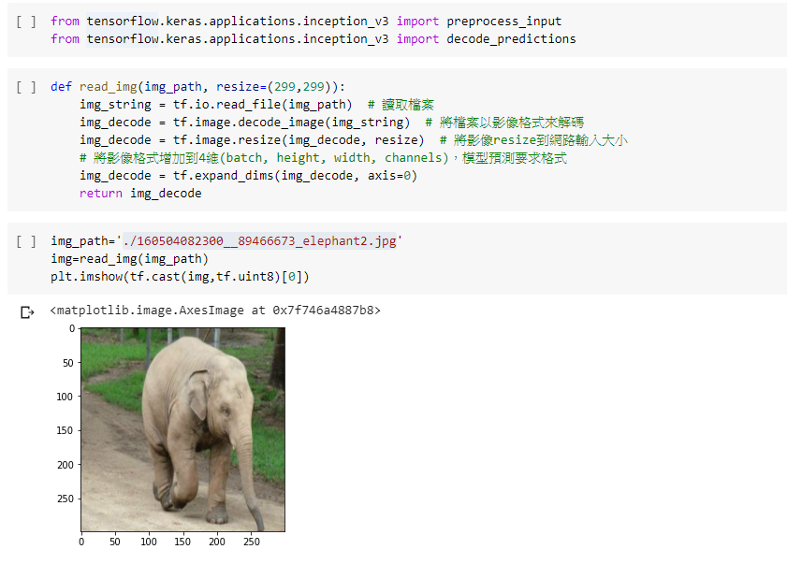
InceptionV3 & tensorflow hub

Slide 6
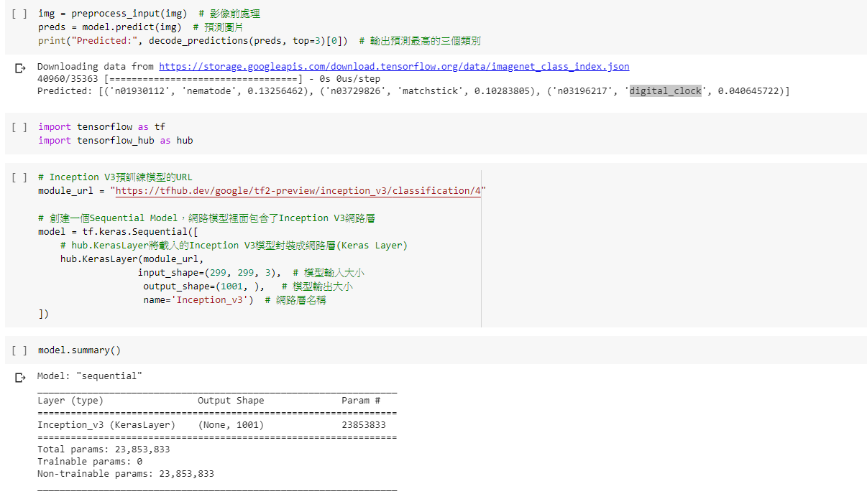
InceptionV3 & tensorflow hub

Slide 7
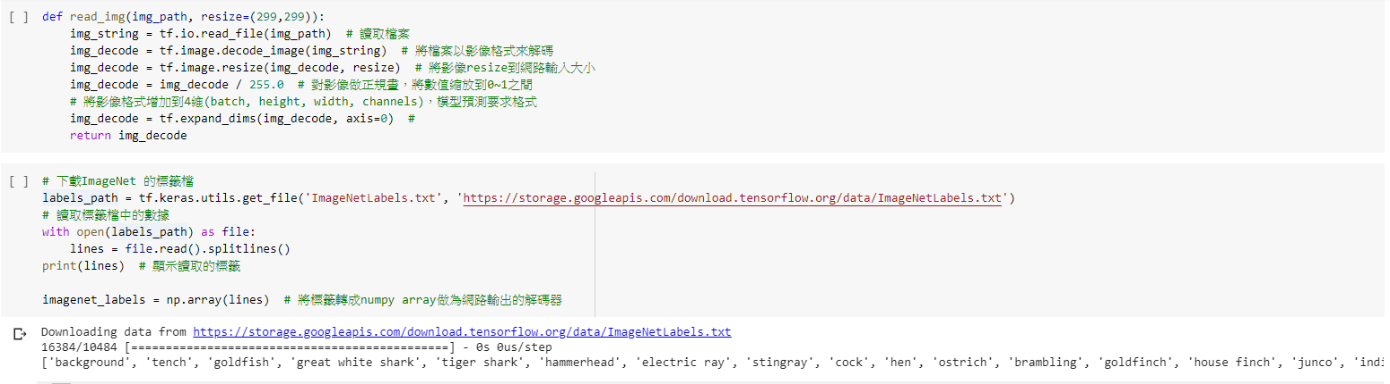
InceptionV3 & tensorflow hub

Slide 8
Thank you for your Listening

