Slide 1
Transfer_learning_with_hub
崑山科技大學資訊工程所
深度學習Deep Learning課程
報告人:徐莨智
指導恩師:龍大大
繳交日期:2020.06.11

Slide 2
Set up
import matplotlib.pylab as plt import tensorflow as tf
!pip install -U tf-hub-nightly
!pip install tfds-nightly
import tensorflow_hub as hub
from tensorflow.keras import layers

Slide 3
An ImageNet classifier(一)
classifier_url =https://tfhub.dev/google/tf2-preview/mobilenet_v2/classification/2
IMAGE_SHAPE = (224, 224)

Slide 4
An ImageNet classifier(二)
classifier = tf.keras.Sequential([
hub.KerasLayer(classifier_url, input_shape=IMAGE_SHAPE+(3,))
])

Slide 5
Run it on a single image
import numpy as np
import PIL.Image as Image
grace_hopper = tf.keras.utils.get_file('image.jpg','https://storage.googleapis.com/download.tensorflow.org/example_images/grace_hopper.jpg')
grace_hopper = Image.open(grace_hopper).resize(IMAGE_SHAPE)
grace_hopper

Slide 6
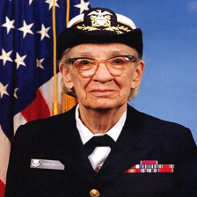
Run it on a single image
Grace Murray Hopper
Rear Admiral (then Commodore) Grace M. Hopper, 1984
Born:Grace Brewster Murray
December 9, 1906
New York City, U.S.
Died:January 1, 1992 (aged 85)
Arlington, Virginia, U.S.

Slide 7
Add a batch dimension, and pass the image to the model.
grace_hopper = np.array(grace_hopper)/255.0
grace_hopper.shape
result = classifier.predict(grace_hopper[np.newaxis, ...])
result.shape
predicted_class = np.argmax(result[0], axis=-1)
predicted_class

Slide 8
Add a batch dimension, and pass the image to the model.
labels_path = tf.keras.utils.get_file('ImageNetLabels.txt','https://storage.googleapis.com/download.tensorflow.org/data/ImageNetLabels.txt')
imagenet_labels = np.array(open(labels_path).read().splitlines())

Slide 9
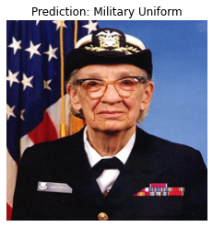
Decode the predictions
plt.imshow(grace_hopper)
plt.axis('off')
predicted_class_name = imagenet_labels[predicted_class]
_ = plt.title("Prediction: " + predicted_class_name.title())

Slide 10
Dataset(一)
data_root = tf.keras.utils.get_file(
'flower_photos','https://storage.googleapis.com/download.tensorflow.org/example_images/flower_photos.tgz',
untar=True)

Slide 11
Dataset(二)
image_generator = tf.keras.preprocessing.image.ImageDataGenerator(rescale=1/255)
image_data = image_generator.flow_from_directory(str(data_root), target_size=IMAGE_SHAPE)

Slide 12
Dataset(三)
for image_batch, label_batch in image_data:
print("Image batch shape: ", image_batch.shape)
print("Label batch shape: ", label_batch.shape)
break

Slide 13
Dataset(四)
result_batch = classifier.predict(image_batch)
result_batch.shape
predicted_class_names = imagenet_labels[np.argmax(result_batch, axis=-1)]
predicted_class_names

Slide 14
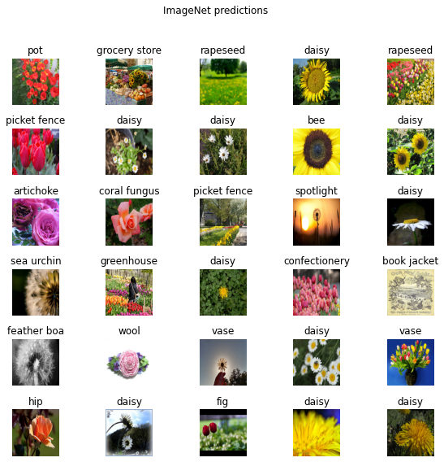
Dataset(五)

Slide 15
Download the headless model
feature_extractor_layer = hub.KerasLayer(feature_extractor_url,
input_shape=(224,224,3))
feature_batch = feature_extractor_layer(image_batch)
print(feature_batch.shape)
feature_extractor_layer.trainable = False

Slide 16
Attach a classification head
model = tf.keras.Sequential([
feature_extractor_layer,
layers.Dense(image_data.num_classes)
])
model.summary()
predictions = model(image_batch)
predictions.shape

Slide 17
Train the model(一)
model.compile(
optimizer=tf.keras.optimizers.Adam(),
loss=tf.keras.losses.CategoricalCrossentropy(from_logits=True),
metrics=['acc'])

Slide 18
Train the model(二)
class CollectBatchStats(tf.keras.callbacks.Callback):
def __init__(self):
self.batch_losses = []
self.batch_acc = []

Slide 19
Train the model(三)
def on_train_batch_end(self, batch, logs=None):
self.batch_losses.append(logs['loss'])
self.batch_acc.append(logs['acc'])
self.model.reset_metrics()

Slide 20
Train the model(四)
steps_per_epoch = np.ceil(image_data.samples/image_data.batch_size)
batch_stats_callback = CollectBatchStats()

Slide 21
Train the model(五)
history = model.fit_generator(image_data, epochs=2,
steps_per_epoch=steps_per_epoch,
callbacks = [batch_stats_callback])

Slide 22
Train the model(六)
plt.figure()
plt.ylabel("Loss")
plt.xlabel("Training Steps")
plt.ylim([0,2])
plt.plot(batch_stats_callback.batch_losses)

Slide 23
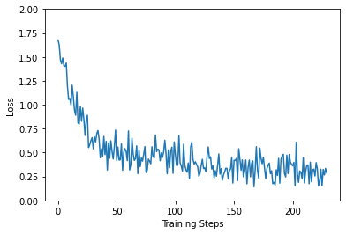
Train the model(七)

Slide 24
Train the model(八)
plt.figure()
plt.ylabel("Accuracy")
plt.xlabel("Training Steps")
plt.ylim([0,1])
plt.plot(batch_stats_callback.batch_acc)

Slide 25
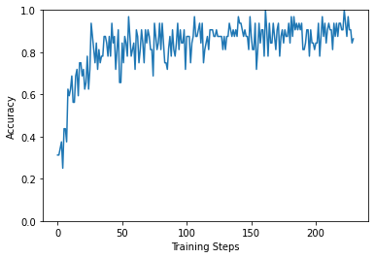
Train the model(九)

Slide 26
Check the predictions(一)
class_names = sorted(image_data.class_indices.items(), key=lambda pair:pair[1])
class_names = np.array([key.title() for key, value in class_names])
class_names
class_names = sorted(image_data.class_indices.items(), key=lambda pair:pair[1])
class_names = np.array([key.title() for key, value in class_names])
class_names

Slide 27
Check the predictions(二)
label_id = np.argmax(label_batch, axis=-1)
plt.figure(figsize=(10,9))
plt.subplots_adjust(hspace=0.5)
for n in range(30):
plt.subplot(6,5,n+1)
plt.imshow(image_batch[n])
color = "green" if predicted_id[n] == label_id[n] else "red"
plt.title(predicted_label_batch[n].title(), color=color)
plt.axis('off')
_ = plt.suptitle("Model predictions (green: correct, red: incorrect)")

Slide 28
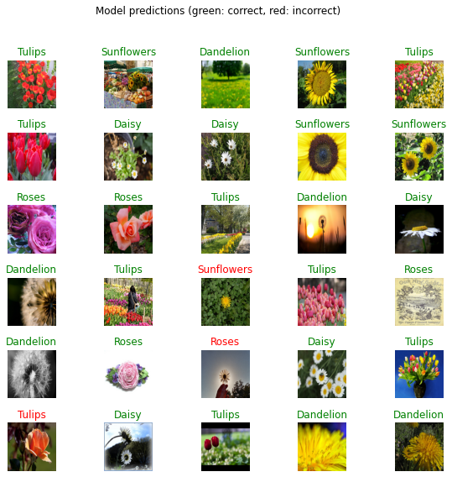
Check the predictions(三)

Slide 29
Export your model(一)
import time
t = time.time()
export_path = "/tmp/saved_models/{}".format(int(t))
model.save(export_path, save_format='tf')
export_path

Slide 30
Export your model(二)
reloaded = tf.keras.models.load_model(export_path)
result_batch = model.predict(image_batch)
reloaded_result_batch = reloaded.predict(image_batch)
abs(reloaded_result_batch - result_batch).max()

Slide 31
參考文獻
https://www.tensorflow.org/tutorials/images/transfer_learning_with_hub

Slide 32
Thank you for your Listening

