Slide 1

Heart Disease Prediction
Using Classification
Annya Gupta

Slide 2
Introduction
1. Heart disease remains one of the leading causes of death worldwide. Many patients fail to receive early warnings because identifying risk manually requires experience, time, and careful analysis of multiple health indicators.
2. Machine learning helps automate this process by learning patterns from historical medical data. This project builds a Heart Disease Classification Model that predicts whether a person is at risk of developing heart disease based on several medical attributes.
3. The dataset typically includes features such as:
(i) Age (ii) Sex (iii) Chest Pain Type
(iv) Resting Blood Pressure (v) Cholesterol Level (vi) Fasting Blood Sugar
(vii) ECG Results (viii) Max Heart Rate Achieved
This makes the model extremely useful for early screening and preventive healthcare.

Slide 3
AIM OF THE PROJECT
The primary goal of this project is to develop an accurate and reliable machine learning system that predicts the risk of heart disease using medical parameters.
1. Identify high-risk patients early
2. Support doctors in clinical decision-making
3. Reduce chances of misdiagnosis
4. Assist hospitals in preventive care
5. Provide quick and consistent predictions
The project trains multiple classification algorithms and compares their performance to determine the best-predicting model.

Slide 4

PROCESS
Load Dataset
Import Required Libraries
Data Cleaning & Preprocessing
Exploratory Data Analysis (EDA)
Feature Scaling
Train–Test Split
Apply Multiple Classification Algorithms
Model Evaluation using Accuracy, F1, AUC
Select Best Model
Make Predictions

Slide 5
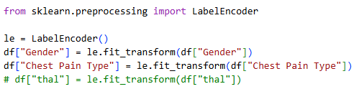

ENCODING
1. Label Encoding :Used for ordered or non-text categorical fields such as:
(i) Sex
(ii) Chest Pain Type (cp)
(iii) Thalassemia (thal)
2. One-Hot Encoding : Used for non-ordinal categories where each category should become a separate column.
(i) Chest Pain Type
(ii) Thalassemia types
(iii) Slope of ST segment

Slide 6
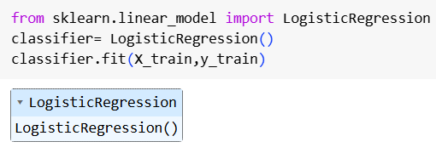
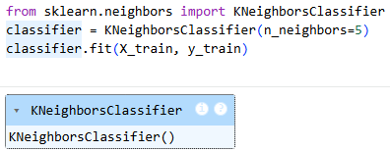
CLASSIFICATION MODELS
1. LOGISTIC REGRESSION
2. K-Nearest Neighbour
It is Simple and interpretable model for linear relationships in medical data.
KNN: Classifies based on nearest patients; sensitive to noise.

Slide 7
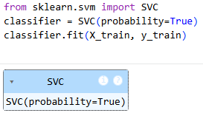
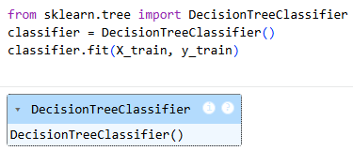
3. Support Vector Machine
4. Decision Tree
SVM: Finds the best boundary; works well for complex patterns.
Decision Tree: Uses simple rules; performs extremely well on this dataset.

Slide 8
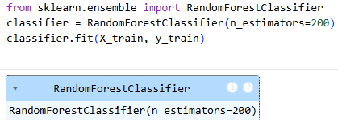
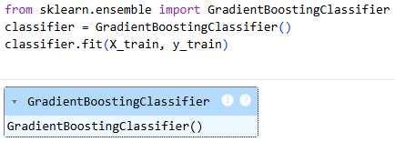
5. Random Forest
6. Gradient Boosting
Random Forest: Many trees combined; strong and stable accuracy.
Gradient Boosting: Sequentially improved trees; top-performing model.

Slide 9
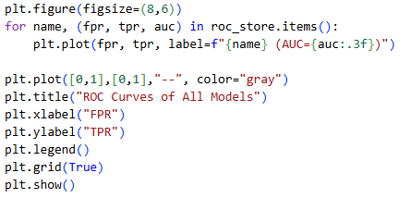
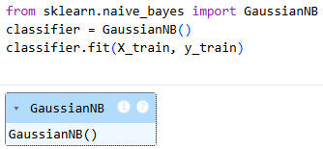
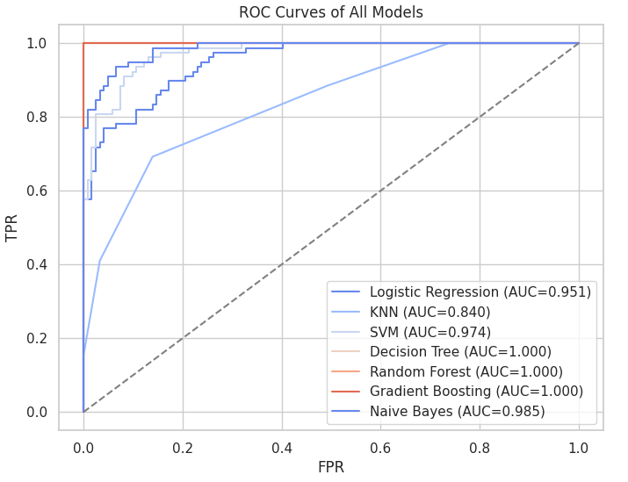
7. Naïve Bayes
Naive Bayes: Fast probabilistic model; performs surprisingly well.

Slide 10
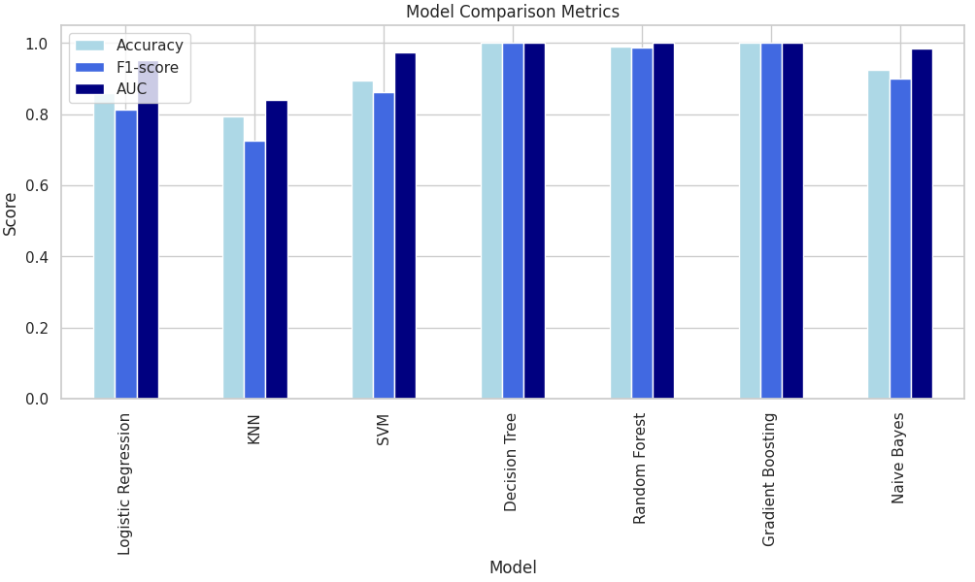
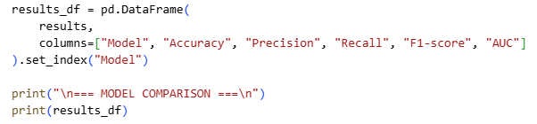
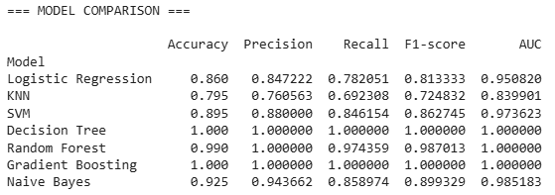
Model Comparison
Based on the results, Decision Tree and Gradient Boosting performed the best with perfect scores across all metrics. Random Forest also showed excellent performance with very high accuracy. Naive Bayes and SVM performed well, while Logistic Regression gave moderate results. KNN had the lowest accuracy, making it the weakest model in this comparison.

Slide 11
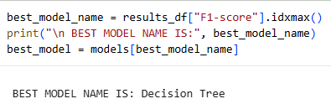
Conclusion
Best Model
From the results and F1-score comparison, the Decision Tree model achieved the highest score and was automatically selected as the best model. This means that the Decision Tree classifier provides the most accurate and balanced predictions for this dataset, making it the most suitable choice for heart disease prediction in this project.

Slide 12
Thank You !!

