Slide 1

Z-index and stacking context
Notes:
- first meetup speech: exclusive preview!
- picked well-known CSS selector; seems simple, can get complex
- how many of you had used z-index?
- how many had troubles with it?
What do you know about it?

Slide 2
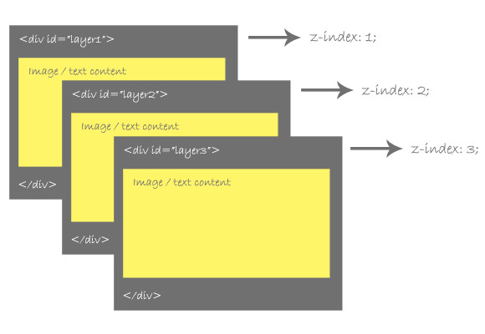
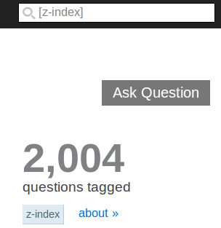
Before we start...
Notes:
How I came to the talk about z-index;
- stackoverflow: >2000 questions on ZI, while [positioning] has < 2000 questions
- cases where no matter how high you set the z-index on an element, it still stays under another element?
- stacking context is the reason behind many people's misunderstanding of z-index
- by the end of this talk you will be able to troubleshoot layout troubles involving stacking context and z-index

Slide 3
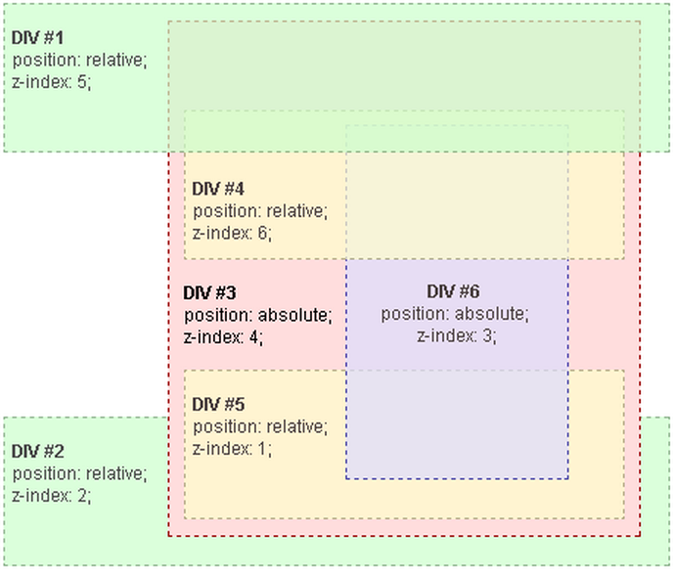
Why does z-index 'not work'?
Notes:
Simple cases of 2 divs work; complex DOM trees with z-index on multiple nodes leads to issues
- issues solvable, if understand why z-index does what it does

Slide 4
Agenda
What is z-index
What is stacking order?
What is stacking context?
Troubleshooting CSS layering tips
Quiz!

Slide 5
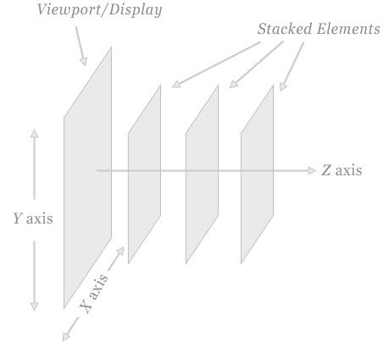
What's z-index used for?
Notes:
What does z-index do?
Used for dialog boxes and layering; makes CSS more like photoshop!
Z-index values
auto – (default) Sets the stack order of the element to be equal to the stack order of the element’s parent.
number – Can be a positive number, a negative number, or 0. Sets a local stack context, and
The box itself has the stack level 0 in this new context.
When you apply z-index to a positioned element, you do two things.
First, you say that the element is in front or behind other elements that share the same stacking context.
Second, you create a new stacking context for anything inside the positioned element. Once you've created a stacking context, any layering that happens inside that stacking context stays in that context.

Slide 6
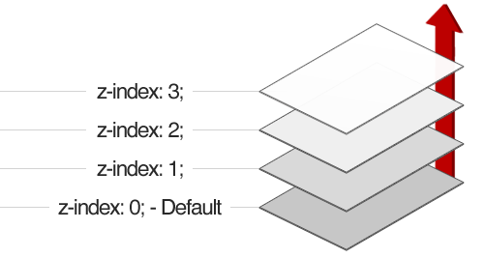
Z-index 101
elements with a higher z-index go on front of elements with a lower z-index
Notes:
All boxes in a page are positioned in a 3 dimensional space: appear closer/further from user
It gives developers flexibility to change layering of DOM elements without changing markup, to an extent
To understand the limits, need to understand 2 concepts: stacking order, and
Stacking context.
These concepts prescribe how elements are layered,

Slide 7


What is positioned?
Notes:
Normal document flow, without positioning, is like single-lane traffic: no overlap
With positioning, can put some elements above others. Positioning is dependent on element's chronological order
Without positioning, no point in using z-index
Z-index needs element be positioned to work

Slide 8
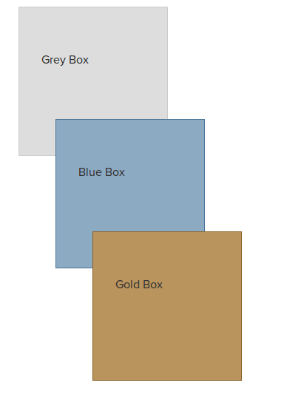
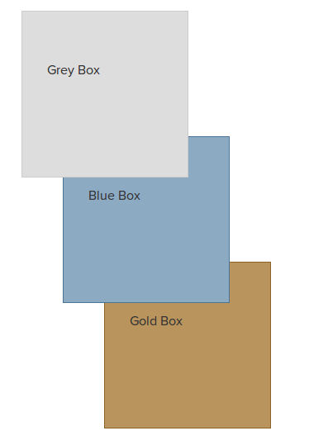
Z-index basic use
Notes:
Positioned elements can overlap, since they can be rendered at the same position.
z-index is useful to control layering against elements' chronological order
- more complex examples show z-index relationship with stacking context and stacking order

Slide 9
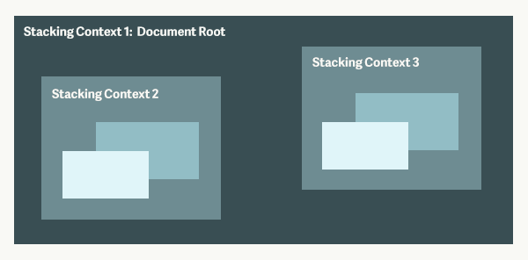
Z-index: integer creates new stacking context!
Notes:
When you add css positioning to an element and give it a z-index of an integer it creates new stacking context with new stacking level 0 inside the new context.
Stacking context is a Group of elements with a common parent that move forward or backward together in the stacking order
In this example, stacking context 1 is formed by the root of the document. Both stacking contexts 2 and 3 are stacking levels on stacking context 1. Each also forms a new stacking context with new stacking levels inside.

Slide 10
How to create a stacking context
root element of a document <html>
Positioned element with z-index:integer
Element's opacity < 1, transform, filter, … (not covered in this talk)
Notes:
A single default stacking context is created for every web page. The root of this context (the table) is the html element. Everything inside the html tag sits on a stacking level within this default stacking context (objects sitting on the table).
when developers create stacking context unexpectedly, cause for headaches
See people set impossibly high z-index and element still underneath elements with lower z-index
Why? Because z-index matters only within same stacking context.
Can see why example does 'not' work now?

Slide 11
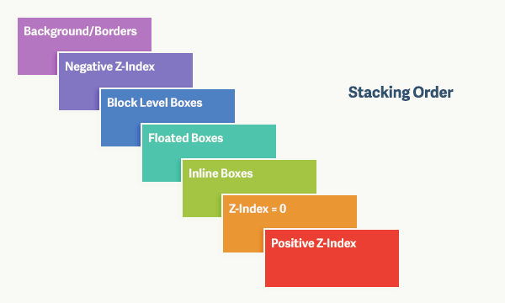
Z-index's real power
Notes:
ZI's real power is in changing layering within a stacking order
Stacking order describes seven possible levels within each stacking context.
Z-index: auto != z-index: 1
any positioned elements (and their children) are displayed in front of any non-positioned elements. (To say an element is "positioned" means that it has a position value other than static, e.g., relative, absolute, etc.)
Background and borders —same stacking context as html element. The lowest level in the stack.
Negative Z-Index —including descendants
Block Level Boxes — non-positioned
Floated Boxes — non-positioned floats
Inline Boxes — non-positioned descendants.
Z-index: 0 — positioned elements. These form new stacking contexts. the root of all root stacking contexts is the html element, also has z-index:0
Positive Z-index — positioned elements. The highest level in the stack.

Slide 12
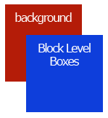
Basic example stacking order
<style>
html {
background: #4e80c4;
}
div {
width: 100px;
height: 100px;
background: #ea3f32;
}
</style>
<body>
<div></div>
</body>
Notes:
Let's use a simple example to apply our knowledge of stacking order
Why do you see the div on top of the html element? The reason is because both are following stacking order rules.
According to the stacking order, descendent blocks in the normal flow (the div) sit on a higher level than the backgrounds and borders of the root element (the html element);
div on top because it's on a higher stacking level.

Slide 13
Stacking context vs. stacking order
Notes:
Quick recap of terms we introduced:
Groups of elements with a common parent that move forward or backward together in the stacking order
Stacking order describes seven possible levels within each stacking context.

Slide 14
Why no work? Encapsulation
Notes:
The key to avoid getting tripped up is being able to spot when new stacking contexts are formed.
Z-index only useful within a stacking order;
Stacking orders are siloed.
If you're setting a z-index of a billion on an element and it's not moving forward in the stacking order, take a look up its ancestor tree and see if any of its parents form stacking contexts.
Share encapsulation analogy

Slide 15
Summary
Notes:
Z-index changes stacking context.
Every element is part of a stacking context, and follows stacking order

Slide 16
When troubleshooting layering issues
Is the element positioned?
Are elements you want to reorder are part of the same stacking context?
Did you transformed or 'opacified' element along the way?
Notes:
Always make sure your element has a position defined before applying z-index
Increment z-index by 10's between stack contexts
Make sure the elements you want to reorder are part of the same stacking context
Make sure clickable and draggable elements, such as links and pictures, do not have negative z-index
If you still have an issue, make sure you don’t have a transformed or opacified element along the way

Slide 17
Quiz time!
Does z-index need element be positioned to work? Why?
What is the stacking context?
What is the stacking order?

Slide 18
Z-index gives you wings!
annyh@sfu.ca
@annyhehe
Notes:
Hopefully by now you have a good understanding of what z-index is about and how it works. We covered a lot of ground in this talk, with the goal of troubleshooting layout troubles involving stacking context and z-index, I hope I have explained these concepts to make CSS more predictable. Feedback is welcome, you can reach me at the above links

Slide 19
References
Images:
Yellow z-index: http://www.onextrapixel.com/2009/05/29/an-indepth-coverage-on-css-layers-z-index-relative-and-absolute-positioning/1
Z-index on MDN: https://developer.mozilla.org/en-US/docs/Web/Guide/CSS/Understanding_z_index
Plate:http://www.tate.org.uk/art/images/work/AR/AR01127_10.jpg
Plates: http://www.goforwarddownsize.com/wp-content/uploads/2012/08/bigstock-Stack-Of-Plates-327697672.jpg
Content:
http://media.smashingmagazine.com/wp-content/uploads/2009/09/7_b.gif
W3C spec on stacking context http://www.w3.org/TR/CSS2/zindex.html
Smashing magazine: http://coding.smashingmagazine.com/2009/09/15/the-z-index-css-property-a-comprehensive-look/
Troubleshoting css http://tympanus.net/codrops/2013/07/17/troubleshooting-css/#article-z-index
Css wiki: http://css-discuss.incutio.com/wiki/Overlapping_And_ZIndex
Sitepoint: http://reference.sitepoint.com/css/stacking
Webstuts: http://webdesign.tutsplus.com/articles/what-you-may-not-know-about-the-z-index-property--webdesign-16892

