Slide 1
Методы нормализации
Анна Кондрашина

Slide 2
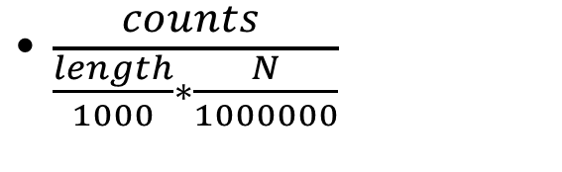
Simple
CPM: counts/total_number_of_reads
TPM: transcript per kilobase million
RPKM: reads per kb of exon
FPKM: fragments per mil reads
$\frac{counts }{\frac{length}{1000}∗\frac{N}{1000000}}$

Slide 3
TC & UQ & Med
Divide the read counts by a ratio of the library size for a given sample to that of the average library size across samples
Similar strategies are employed for the UQ and Med methods, where the ratios are the upper quartile and median read counts, respectively.
These values are computed after removing genes having zero read counts for all samples

Slide 4
DESeq2
Pseudo-reference across samples(geometric mean)
Ratio of a sample/geometric mean
Calculate norm factors across columns
Divide values for count norm factor

Slide 5
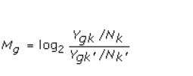

TMM
Scales read counts by the weighted log-fold-change values of a reference sample with genes that have extreme log-fold-changes (M values) and extreme absolute expression levels (A values) removed from the data.

Slide 6
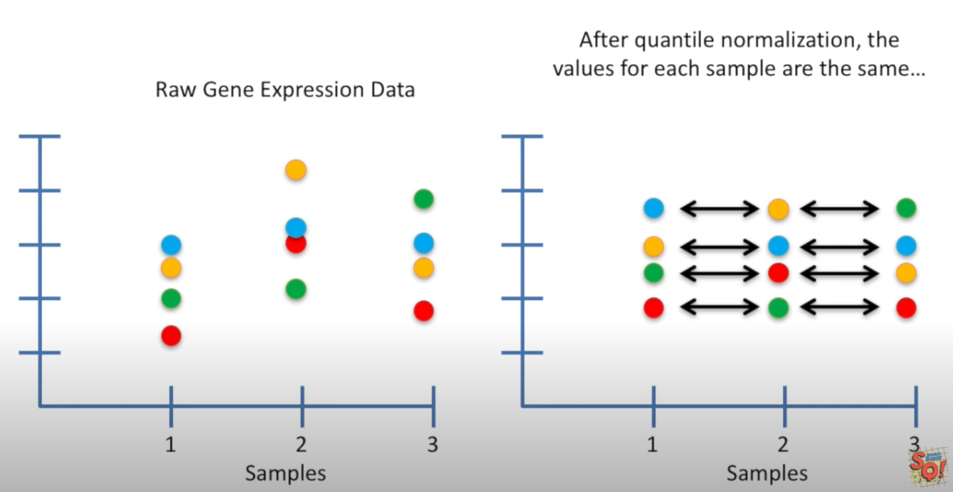
Quantile
Find maximally expressed gene in each sample
Calculate mean of this genes
Say that this mean is the new value for this gene
The same with all other genes

