Slide 1

CS850 - Database Security
DEPARTMENT OF COMPUTER SCIENCE AND ENGINEERING
NATIONAL INSTITUTE OF TECHNOLOGY KARNATAKA
Academic Year : 2021-2022
Course Guide
Dr. M.P. Singh

Slide 2

CS850 - Database Security
SQL Injection Attack & Prevention System in PHP
Ankit Srivastava
(212IS003)

Slide 3
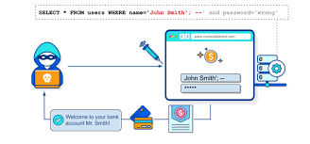
INTRODUCTION
SQL injection is a code injection technique that might destroy your database.
Most common web hacking techniques.
Placement of malicious code in SQL statements, via web page input.
Application of modified SQL Destruction.

Slide 4

PROBLEM STATEMENT
(Impact of SQL Injection in Industry)
SQL injections lead to the theft of critical information
Potential to be disastrous for any business, government, or institution

Slide 5
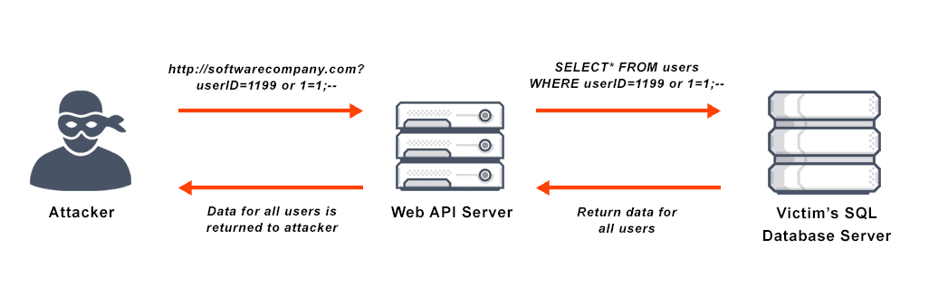
MOTIVATION & OBJECTIVE
(SQL Injection Attack & Prevention System in PHP)
Discover common cause and vulnerability in the system, such as insufficient validation of user input.
Encourage defensive coding approaches such as encoding user input and validation.

Slide 6
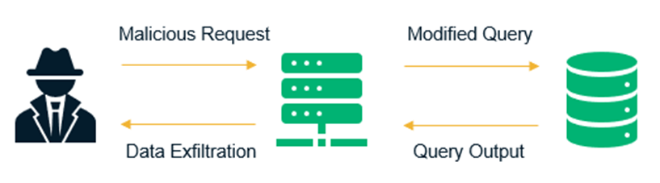
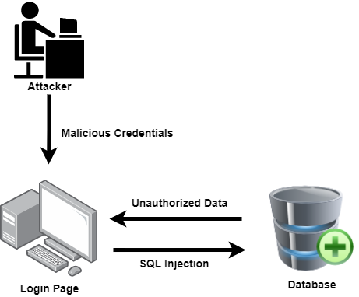
PROPOSED SOLUTION
(SQL Injection Attack & Prevention System in PHP)
Avoid Textbox on Login Page
Validate the User Data
Use Escaping String
Proper Authentication of Credentials
Escaping String
Validate the User Data

Slide 7
SEQUENCE OF EVENT TO RUN
(SQL Injection Attack & Prevention System in PHP)
SERVER & DATABASE SETUP
Open XAMPP Control Panel
Run Apache & MySQL module
Open login.php page in browser
(http://localhost/login/login.php)
Open PHPmyAdmin in browser
(http://localhost/phpmyadmin/index.php)
FRONTEND & BACKEND SETUP
USER INPUT
LOGIN PAGE
SERVER
DATABASE

Slide 8

STRUCTURAL FLOW
(SQL Injection Attack & Prevention System in PHP)

Slide 9
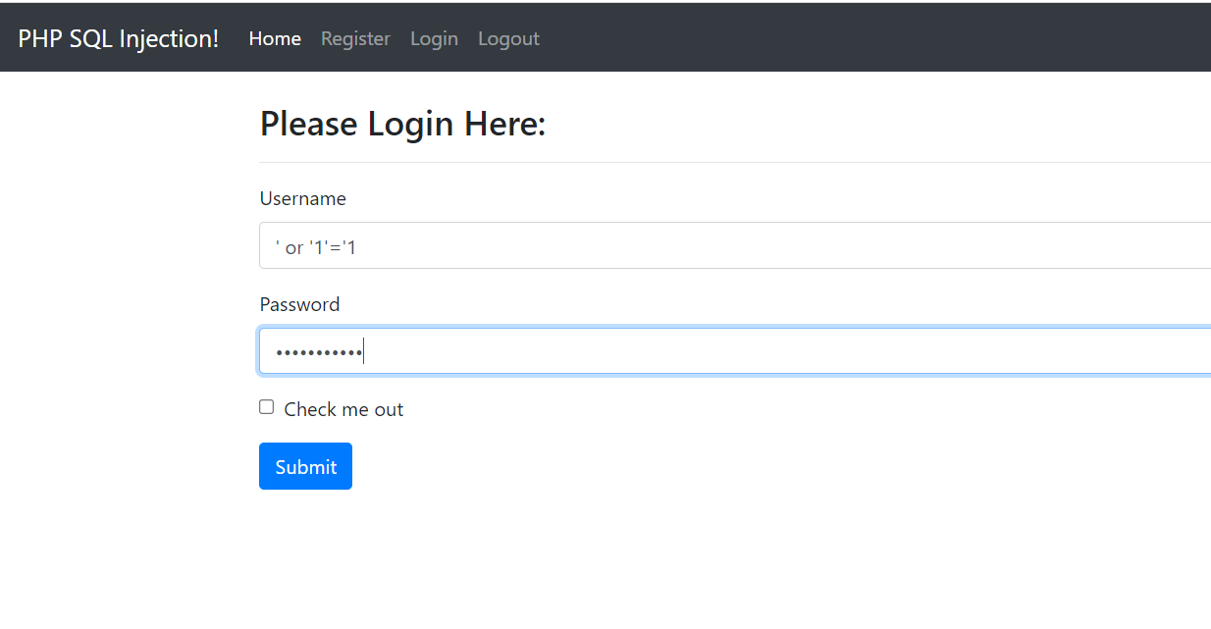
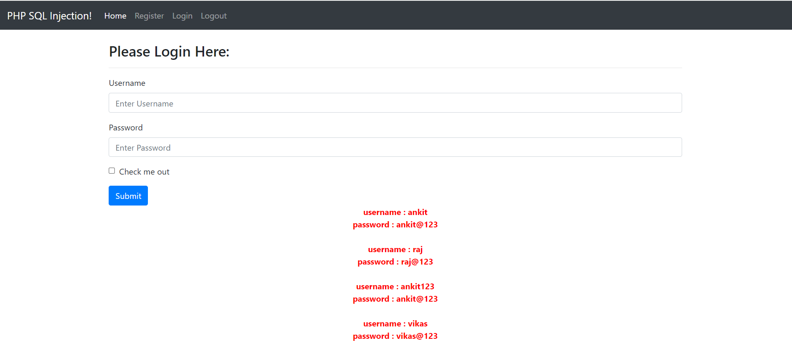
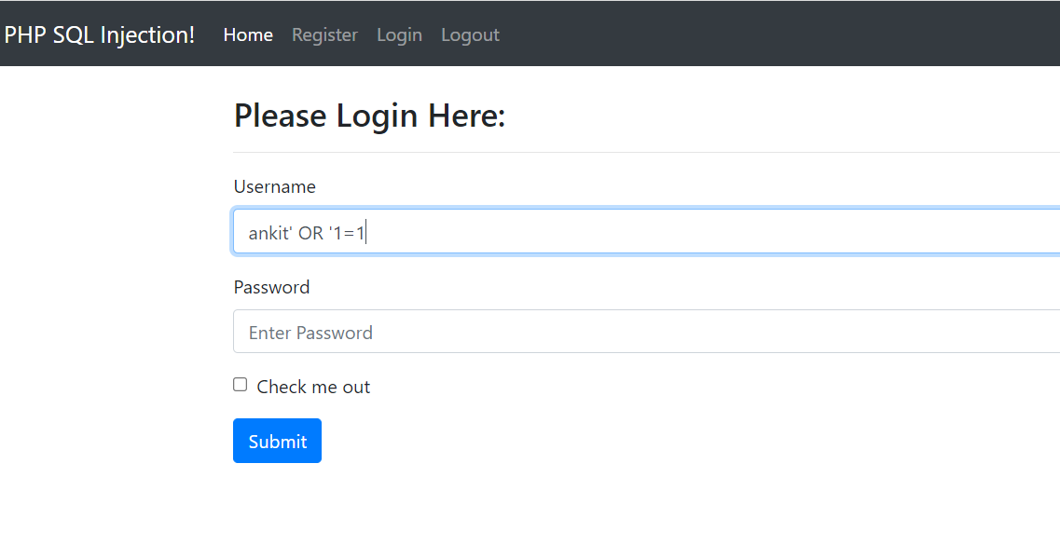
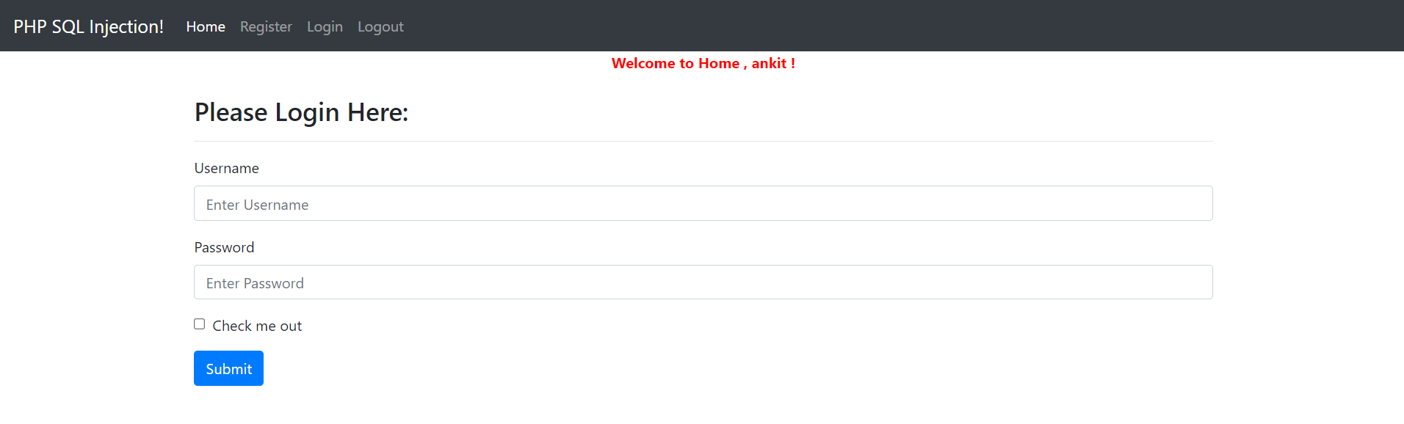
EXPERIMENTAL RESULT
INPUT
OUTPUT

Slide 10
TOOLS, LANGUAGES & PACKAGES USED
TOOLS
VS CODE : Visual Studio Code is a streamlined code editor with support for development operations like debugging, task running, and version control.
XAMPP SERVER : XAMPP helps a local host or server to test its website and clients via computers and laptops before releasing it to the main server.
PHPmyAdmin : phpMyAdmin is one of the most popular applications for MySQL database management. It is a free tool written in PHP.
PROGRAMMING LANGUAGE
PHP : PHP is a widely-used, open source scripting language. PHP scripts are executed on the server. PHP is free to download and use.
JS : Javascript is used by programmers across the world to create dynamic and interactive web content like applications and browsers.

Slide 11
THANK YOU

