Slide 1
FTMP: A Fault-Tolerant Multicast Protocol
Louise E. Moser
Department of Electrical and Computer Engineering
University of California, Santa Barbara

Slide 2
CORBA
Object Request Broker (ORB) intermediary between client and server that provides location transparency
Interface Definition Language (IDL) that provides language transparency (C++, Java, ...)
Portability of applications across different platforms (hardware architectures, operating systems, ...)
Interoperability between ORBs of different vendors using the Internet Inter-ORB Protocol (IIOP)
IIOP is the TCP/IP instantiation of CORBA’s Generalized Inter-ORB Protocol (GIOP)

Slide 3
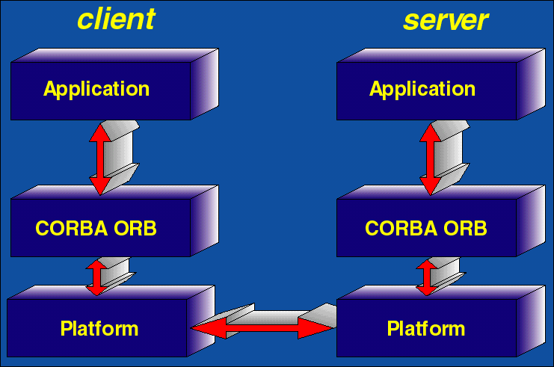
CORBA Client/Server Architecture
IIOP

Slide 4
Fault Tolerant CORBA
Over the past 18 months, we have worked with 12 companies (Eternal Systems, Sun Microsystems, Oracle, Lucent, Ericsson, Alcatel, Nortel, Lockheed Martin, Inprise, Iona, HighComm, Objective Interface Systems) to define a standard for Fault Tolerant CORBA
The Eternal System that we have developed with DARPA/AFOSR/ONR funding provides the first full implementation of Fault Tolerant CORBA

Slide 5
The Eternal System
Eternal
Resource
Manager
Object
Object
Eternal
Evolution
Manager
Eternal
Replication
Manager
Unmodified CORBA ORB or
Java Virtual Machine
Unmodified CORBA ORB or
Java Virtual Machine
I IOP
I IOP
Eternal
Replication
Mechanisms
Eternal
Interceptor
Eternal
Interceptor
Eternal
Replication
Mechanisms
Multicast Protocol
TCP/IP
Multicast Protocol
Multicast
Messages
Platform
Platform

Slide 6
The Need for FTMP
The Fault Tolerant Multicast Protocol (FTMP) is needed for Fault Tolerant CORBA where objects are replicated
  To maintain Consistency of the states of the replicas by delivering messages reliably and in the same causal and total order
  To provide Interoperability between the ORBs and Fault Tolerance Infrastructures of different vendors

Slide 7
Services That FTMP Provides
Reliable Delivery of Messages
Total Ordering of Messages
  Using Lamport Timestamps
Message Garbage Collection
  Using Timestamp Acknowledgments
Membership Services
Virtual Synchrony

Slide 8
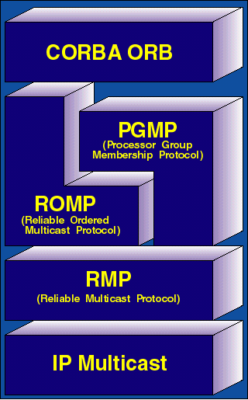
FTMP Protocol Stack

Slide 9
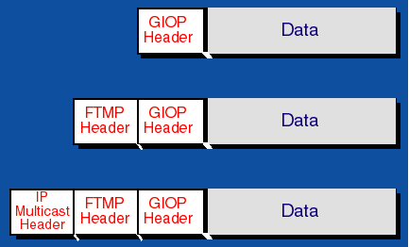
Encapsulation of an FTMP Message

Slide 10
FTMP Message Types and Delivery Characteristics
Message Type | Source Ordered | Ordered
Regular | Yes | Yes
RetransmitRequest | No | No
Heartbeat | No | No
ConnectRequest | No | No
Connect | Yes (except to client group) | Yes
AddHost | Yes (except to new member) | Yes
RemoveHost | Yes | Yes
Suspect | Yes | No
Membership | Yes | No

Slide 11
Reliable Multicast Protocol (RMP)
Reliable Delivery of Messages by Sequence Numbers
Receiver-initiated retransmission of messages triggered by Negative ACKs
Buffer Management using Timestamps
Message Size Minimality using Lamport Clocks
Participant Minimality using Timestamp ACKs

Slide 12
Reliable Ordered Multicast Protocol (ROMP)
Total Ordering of Messages based on Timestamps
Timestamps derived from
  Logical (Lamport) Clocks or
  Synchronized Physical Clocks
Heartbeat Messages to guarantee Liveness
Worst-case Delivery Latency equals the sum of
  Network Diameter
  Heartbeat Interval
assuming reliable delivery of underlying RMP

Slide 13
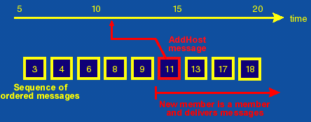
Adding a Host to a Group

Slide 14
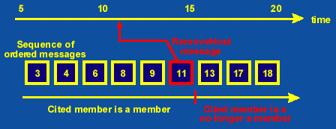
Removing a Host from a Group

Slide 15
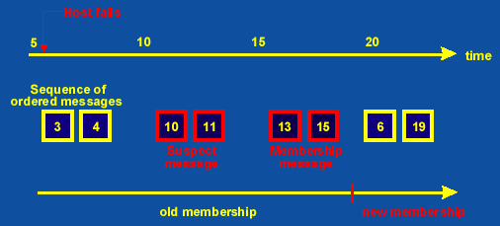
Excluding Failed Hosts from a Group

Slide 16
Summary and Future Work
Fault Tolerant Multicast Protocol (FTMP)
  Provides Reliable Totally-Ordered Multicasts for CORBA over IP multicast
  Maintains Consistency of the states of the object replicas
  Provides Interoperability for Fault-Tolerant CORBA
Investigate performance of FTMP over wide areas
  Message Overhead
  Message delivery Latency and Jitter
  Reliability
Integrate with the Eternal Fault Tolerance Infrastructure

Slide 17
CORBA’s GIOP
General Inter-ORB Protocol (GIOP) must map to a transport protocol that
  Is connection-oriented
  Is reliable
  Can be viewed as a byte stream
  Provides notification of disorderly connection loss
  A server object publishes a network address in an Interoperable Object Reference (IOR) which the client uses to initiate a connection

Slide 18
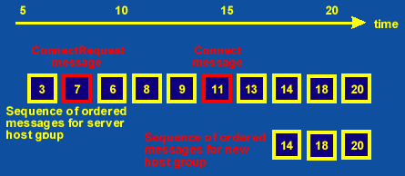
Connecting to a Server Group

Slide 19
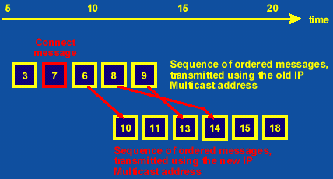
Changing the IP Multicast Address of a Group

Slide 20
Potential Collaboration
Wide-area experiments with other researchers who have Mbone connection
Use of simulation tools of other researchers
Use of test suites and performance benchmarks developed by other researchers
Use of verification tools of other researchers
Extensions of protocols to use security mechanisms developed by other researchers
Adaptation of protocols to wireless networks

Slide 21
Internet Multicast of Seminars
Internet Multicast Network Testbed
Large scale mobile wireless simulator
Protocols for analysis
Performance analysis
Evaluate protocols for CORBA fault tolerance

