Slide 1

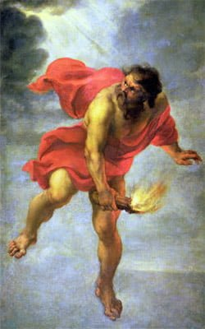
Acknowledgement
This course introduces fundamental concepts and principles of effective communication. Learners will get accustomed to various communication skills, strategies, and techniques applicable to personal , professional, and academic contexts. The unique contents of this course will not only inspire confidence in the learners , but will lead them onto being LEADERS. The curriculum has been planned with meticulous observation preluded by a period of thorough research. Anodiam believes in creating LEADERS for tomorrow , who would further pass on the fire of communication like Prometheus. This 12 weeks’ course will effectively translate new learners into the best of communicators. Upon completion of the curriculum there would be a final assessment serving as an evaluating paradigm.

Slide 2
Introduction
SENDER
CHANNEL
MEDIUM
RECEIVER
ACKNWOLEDGED
Overview of Complete Communication Process

