Slide 1

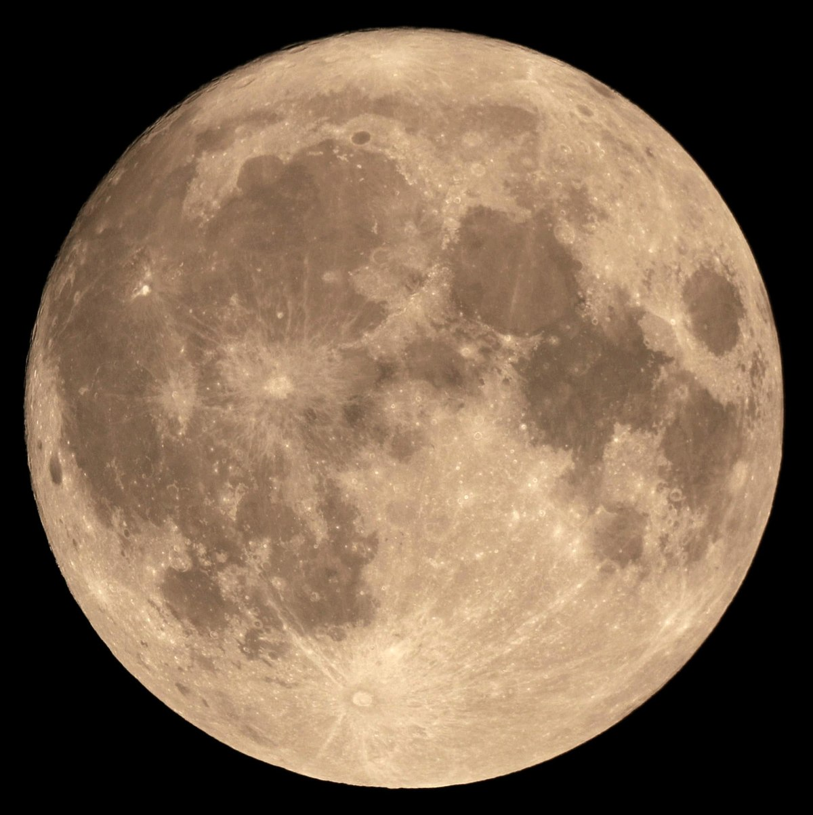
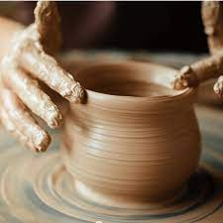

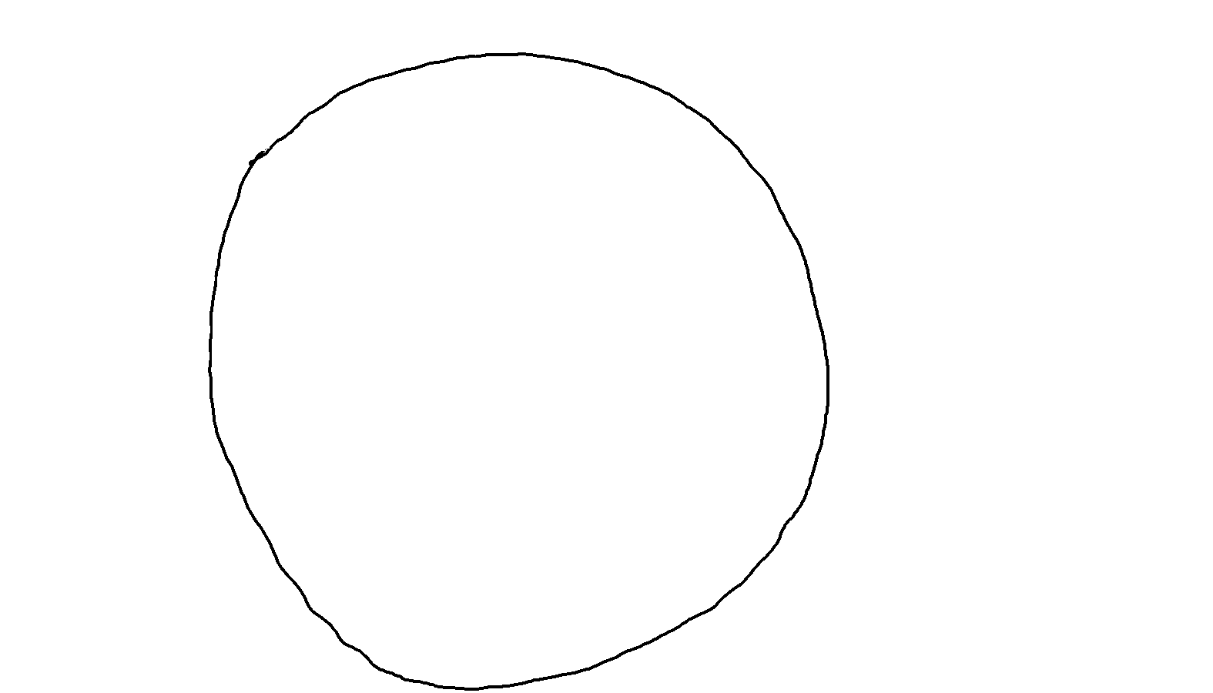
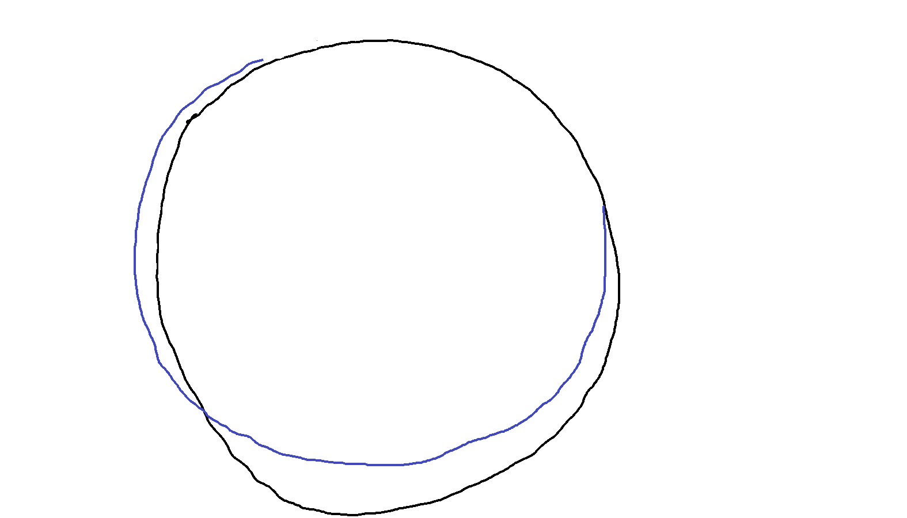
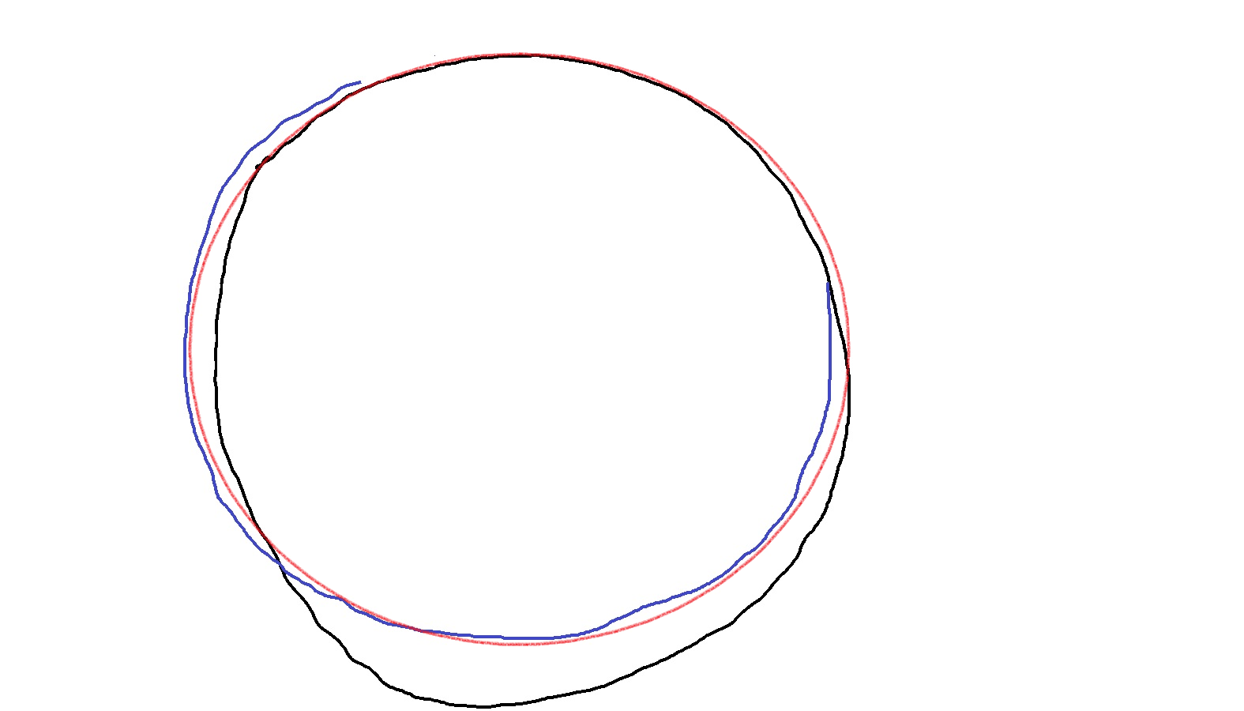
What is AI?
Intelligence that is Artificial
How intelligence works?
Circle is a closed 2D figure in which all points are equidistant from another point called center
But we just follow a pattern that we have learnt to draw a circle
We also know how to improve our accuracy to follow the pattern
AI makes computers learn and follow such patters without being specifically programmed

Slide 2


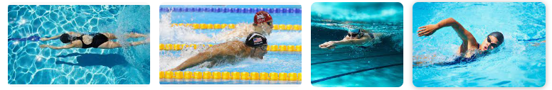
Power of Intelligence over Explicit Programming
App to detect activities like running, walking and swimming from video stream
Speed > Some speed => Running
Speed <= Above speed => Walking or Swimming?
If on water => Swimming
If on land => Walking
Human Intelligence Can Easily Differentiate
We have previously seen and learnt the patterns of running, walking & swimming
So does Artificial Intelligence from patterns of previous example images
How to differentiate water & land
Running Walking Swimming
Explicit Program
Previous Examples
AI Program
Input Parameters
Output
Output
Input Parameters

Slide 3
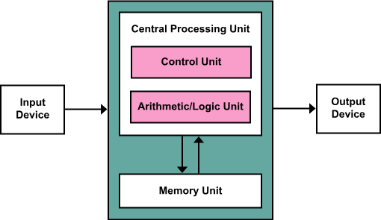
How Computers Compute?

