Slide 1

Contents
Spring framework
Spring Boot
Hibernate
Rest API Services, Postman
JWT
Refresh JWT
Kafka Messaging System, Zoo Keeper
Service Discovery(Eureka Server & Client)

Slide 2
Spring Framework
Spring is a lightweight framework.
Spring provides support to various frameworks such as Struts, Hibernate, Tapestry, EJB, JSF, etc.
The Spring framework comprises several modules such as IOC, AOP, DAO, Context, ORM, WEB MVC etc.
Advantages of Spring Framework
Predefined Templates: Spring provides templates for JDBC, Hibernate, JPA, etc., reducing the need for
writing boilerplate code.
2. Loose Coupling: Dependency injection ensures loose coupling between components.
3. Easy Testing: Spring makes it easier to test applications without requiring a server.
4. Lightweight: Spring’s POJO (Plain Old Java Object) implementation keeps it non-invasive and lightweight.
5. Fast Development: Dependency Injection and support for various frameworks facilitate rapid JavaEE application development.
6. Powerful Abstraction: Spring abstracts JavaEE specifications like JMS, JDBC, JPA, and JTA²³⁴⁵.

Slide 3
Spring Modules
The Spring framework comprises of many modules
Core
Beans
Context
Expression language
AOP
Aspects, Instrumentation
JDBC
ORM
OXM
JMS
Transaction
Web
Servlet
Struts

Slide 4
Spring Framework Runtime
Data Access/Integration
WEB (MVC\Remoting)
JDBC
ORM
Web
Servlet
OXM
JMS
Portlet
Struts
Transactions
AOP
Aspects
Instrumentation
Spring Core Container
Core
Beans
Context
Expression Language
Test

Slide 5
Spring Boot
Spring Boot is a project that is built on the top of the Spring Framework.
It is easy to set up, configure and run both simple and web-based applications.
It is a Spring module that provides the feature to the Spring Framework. RAD (Rapid Application Development).
Spring Boot is the combination of Spring Framework and Embedded Servers.
Prerequisite of Spring Boot Features
Java 1.8
Maven 3.0+
Spring Framework 5.0.0.BUILD-SNAPSHOT
An IDE (Spring Tool Suite) is recommended.
Spring Framework + Embedded HTTP Servers(Tomcat, Jetty) – XML<bean> Configuration or @Configuration = Spring Boot

Slide 6
Spring Boot Features
Web Development
Spring Application
Application events and listeners
Admin features
Externalized Configuration
Properties Files
YAML Support
Type-safe Configuration
Logging
Security

Slide 7
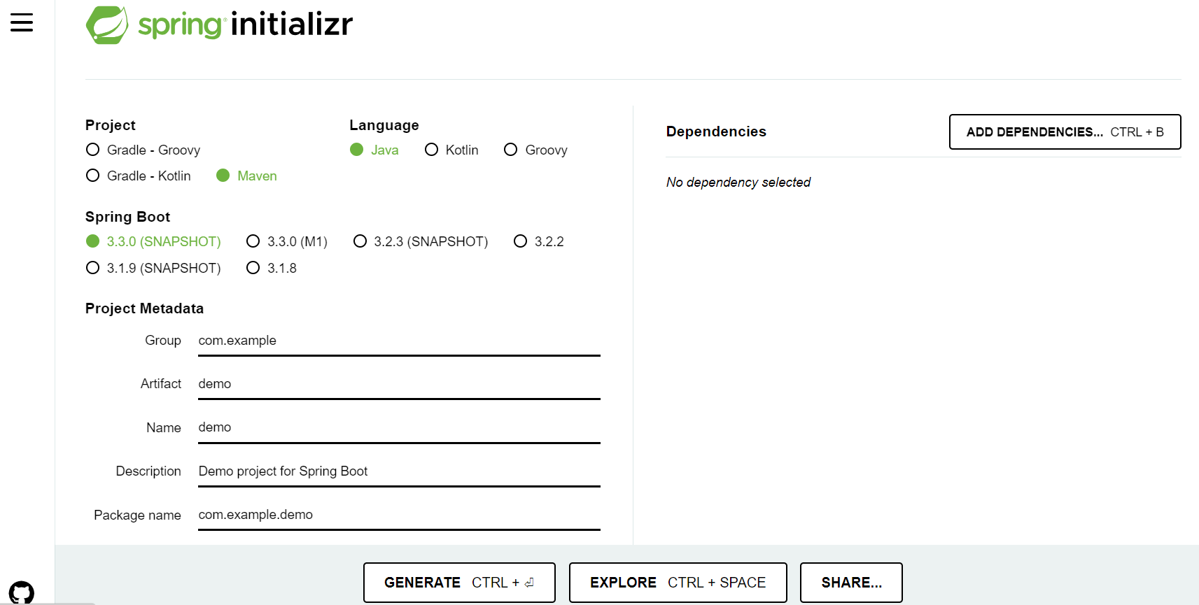
Spring Boot Initializr
In any web browser if we type https://start.spring.io/, we will get user interface of spring initializr

Slide 8
Hibernate
Hibernate is an Object-Relational Mapping (ORM) tool which bridges gap between object oriented features of Java and relational database.
Hibernate maps Java objects to database tables and vice versa.
Advantages of Hibernate Framework
Open Source and Lightweight
Fast Performance
Database Independent Query
Automatic Table Creation
Simplifies Complex Joins.
Query Statistics and Database Status.
How Does Hibernate Work?
Hibernate abstracts away many low-level details, such as establishing database connections, writing CRUD (Create, Read, Update, Delete) operations, and handling transactions.
It uses annotations or XML configuration to define the mapping between Java classes and database tables.
When you perform operations on Java objects (such as saving, updating, or retrieving data), Hibernate translates these actions into SQL queries and manages the database interactions behind the scenes

Slide 9
JPA (Java Persistence API)
JPA (Java Persistence API)
Java Persistence API (JPA) is a Java specification that provides certain functionality and standard to ORM tools. The javax.persistence package contains the JPA classes and interfaces.
JpaRepository
JpaRepository is a JPA (Java Persistence API) specific extension of Repository. It contains the full API of CrudRepository and PagingAndSortingRepository. So it contains API for basic CRUD operations and also API for pagination and sorting.
Methods of JpaRepository
save() → Saves the object in the database table
b) findAll() → fetches all the records of table
c) findById() → fetch a record by id
d) deleteById() → delete a record by id

Slide 10
Restful API
A RESTful API, or simply a REST API, is a web service that follows the principles of Representational State Transfer (REST) architecture.
Features of Rest API
Rest API is stateless, which means that the server does not store any information about the client's state. In the request itself all the information is included and server does not need to store any thing of client’s information.
Rest API is that it uses HTTP methods, such as GET, POST, PUT and DELETE, to indicate the type of operation the client requests.
GET request retrieves information from the server.
POST request is used to submit information to the server.
c) REST API is that it is platform-independent, which means that it can be used with any programming language or framework that supports HTTP.

Slide 11
API Method
To create API methods using Java, our computer system should have following prerequisites
Java Development Kit (JDK) 8 or later installed on your system.
An Integrated Development Environment (IDE) like Eclipse or IntelliJ IDEA.
Familiarity with Java programming, Spring and HTTP concepts.
Steps to create API methods
1. Set up the project.
The project can be set up by spring boot initialzr.
In any web browser if we type https://start.spring.io/, we will get user interface of spring initializr.
In the spring initializr select java language and maven project.
2. Define the model
The object model is a system or interface which is basically used to visualize elements in terms of objects in a software application.
@Entity
public class Employee
{
long empId,
string empName,
double salary
}
Inside the above class programmer need to write the setter and getter of properties of Employee class.

Slide 12
3. Implementing the repository
public interface EmployeeRepository extends JpaRepository<Employee, long>{}
4. Building the Service Layer
Service layer acts as a bridge between data access layer and controller layer.
public interface EmployeeService
{
void updateEmployee(Employee employee);
}
public class EmployeeServiceImpl implements EmployeeService
{
private final EmployeeRepository empRepository;
@Override
public void updateEmployee(Employee employee)
{
empRepository.save(employee);
}
}

Slide 13
5. Creating Controller
@RestController
@RequestMapping("/api/employee")
public class EmployeeController
{
private final EmployeeService employeeService;
@PostMapping
public void saveEmployee(@RequestBody Employee employee)
{
employeeService.save(employee);
}
}
6. Setting database configuration in application.properties file.
# Database Configuration
spring.jpa.properties.hibernate.dialect = org.hibernate.dialect.MySQL5Dialect
spring.datasource.url=jdbc:mysql://localhost:3306/employee_db?useSSL=false&allowPublicKeyRetrieval=true
spring.datasource.username=root
spring.datasource.password=dfT$89*#@
# Hibernate Properties
spring.jpa.hibernate.ddl-auto=update
spring.jpa.show-sql=true

Slide 14
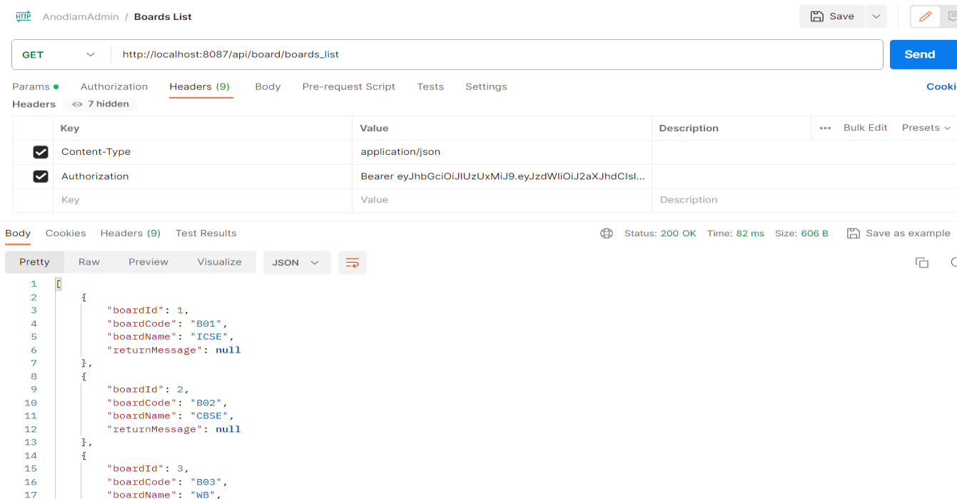
Testing API Method
Postman
Postman is an API platform for building and using APIs.
Through postman API methods are tested.

Slide 15
JWT (JSON Web Token)
JWT is an open standard for securely sharing JSON data between parties.
The data is encoded and digitally signed, which ensures its authenticity.
JWT is widely used in API authentication and authorization workflows, as well as for data transfer between clients and servers.
JWT provides secure way of transferring statements referred to as “claims” about an entity (typically the user) between two parties.
Claims in JWT are key-value pairs that are represented with either JWS (JSON Web Signature) or JWE (JSON Web Encryption).
JWS and JWE are standards for digitally signing and encrypting JWTs, which helps ensure their authenticity and integrity.
Structure of JWT
A JWT has three sections: a header, a payload, and a signature.
Each section is a Base64-encoded string, and the sections are separated by periods.
A typical JWT looks like this, where the X’s represent the header, the Y’s represents the payload, and the Z’s represents the signature:
xxxxxx.yyyyyy.zzzzzz
xxxxxx → Header
yyyyyy → Payload
zzzzzz → Signature

Slide 16
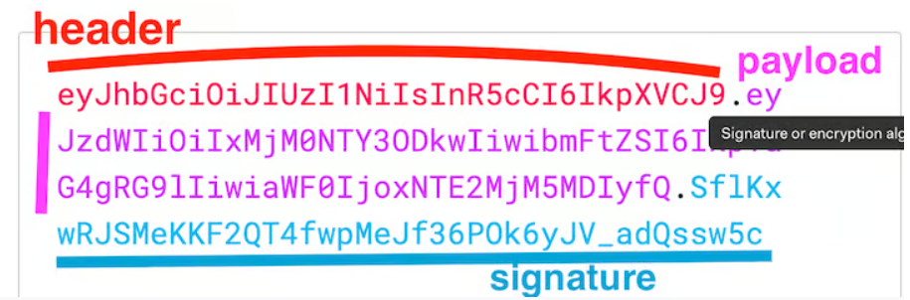
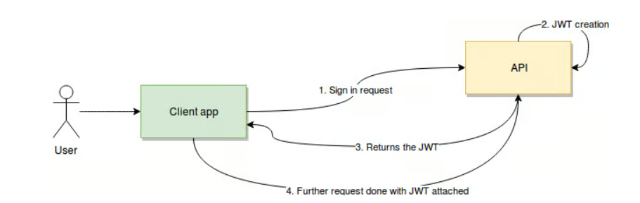
JWT will look this
How does JWT gets created ?
As shown above user sends login request to the server from the client application.
API on the server end creates JWT.
JWT is returned to the client application from the server end.
From the client’s end the further request is done with JWT attached.

Slide 17
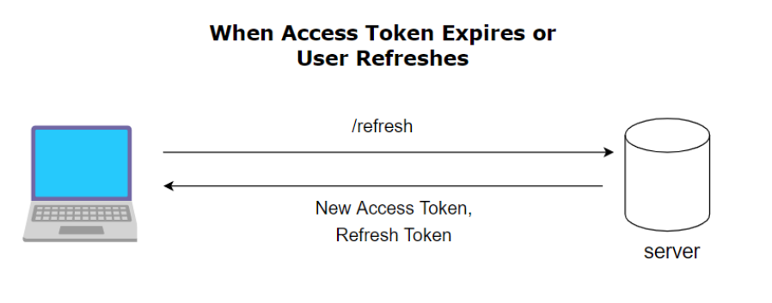
Refresh JWT (JSON Web Token)
Refresh token is a unique token that is used to obtain additional access tokens and it is obtained without having to collect credentials every time one expires.
In the application.properties file we need to write properties for generation of token and refresh token
anodiam.app.jwtSecret= mySecretKey-123456jsfwwrwsdfdssgsgeeeybvdgh
anodiam.app.jwtExpirationMs= 86400
anodiam.app.refreshExpirationDateInMs=9000000
anodiam.app.jwtRefreshExpirationMs=86400000

Slide 18
Spring boot – Eureka Server & Client
In order to communicate between services, the following components are required
microservices architectures
service registration
discovery
Eureka Server is a service registry that plays a central role in the automatic detection of devices and services on a network. It acts as the heart of your microservices ecosystem, allowing service instances to register themselves and facilitating service discovery. Key aspects of Eureka Server include:
Client Registration: Instances of microservices automatically register themselves with Eureka Server.
Service Discovery: Eureka Server maintains a registry of all client applications running on different ports and IP addresses.
Eureka Server operates on a simple “Register, Lookup, Connect” principle, making it an excellent choice for managing microservices in a Spring Boot environment. Here are some compelling reasons to use Eureka Server:
Centralized Service Registry: Eureka Server knows about all client applications and their locations. This centralization simplifies service discovery.
Automatic Registration: Microservices automatically register themselves with Eureka Server, reducing manual configuration efforts.
Load Balancing: Eureka Server can help implement load balancing among service instances.
Health Checks: Eureka Server can perform health checks on registered services, ensuring robustness and reliability.
Integration with Spring Cloud: Eureka Server seamlessly integrates with the Spring Cloud ecosystem, enabling easy scaling and deployment.

Slide 19
In the java project’s pom.xml on server and client side
<!-- For Eureka Server -->
<dependency>
<groupId>org.springframework.cloud</groupId>
<artifactId>spring-cloud-starter-netflix-eureka-server</artifactId>
</dependency>
<!-- For Eureka Client -->
<dependency>
<groupId>org.springframework.cloud</groupId>
<artifactId>spring-cloud-starter-netflix-eureka-client</artifactId>
</dependency>
To enable Eureka functionality, the programmer needs to enable annotation
@EnableEurekaServer: Use this annotation to designate a Spring Boot application as the central instance where other services will get registered.
@EnableEurekaClient: Services use this annotation to enable service registration and discovery with the central Eureka Server.

Slide 20
For marking a Spring Boot Application as an Eureka Server
@SpringBootApplication
@EnableEurekaServer
public class ServiceRegistryApplication {
public static void main(String[] args) {
SpringApplication.run(ServiceRegistryApplication.class, args);
}
}
For marking a Spring Boot Application as an Eureka Client to be used up by the server
@SpringBootApplication
@EnableEurekaClient
public class StudentApplication {
public static void main(String[] args) {
SpringApplication.run(StudentApplication.class, args);
}
}

Slide 21
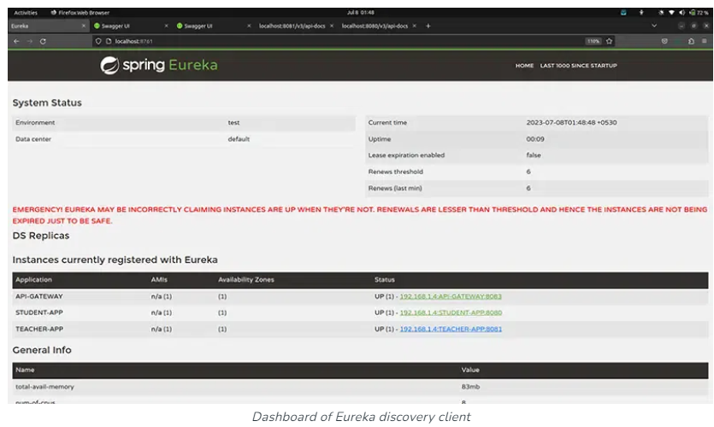
Eureka Dashboard
When the Spring Boot application is up and running, just hit the default URL – http://localhost:8761.
Dashboard will display the list of micro services

