Slide 1
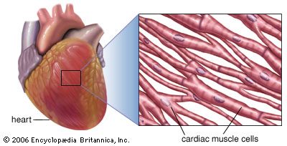
One more type of involuntary muscle is found in the walls of the heart.
They are called cardiac muscles.
Heart muscle cells are cylindrical, branched and uninucleate.
The muscles of the heart shows rhythmic contraction and relaxation through out the life.

Slide 2
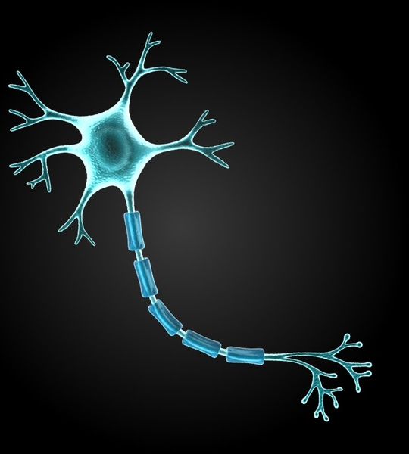
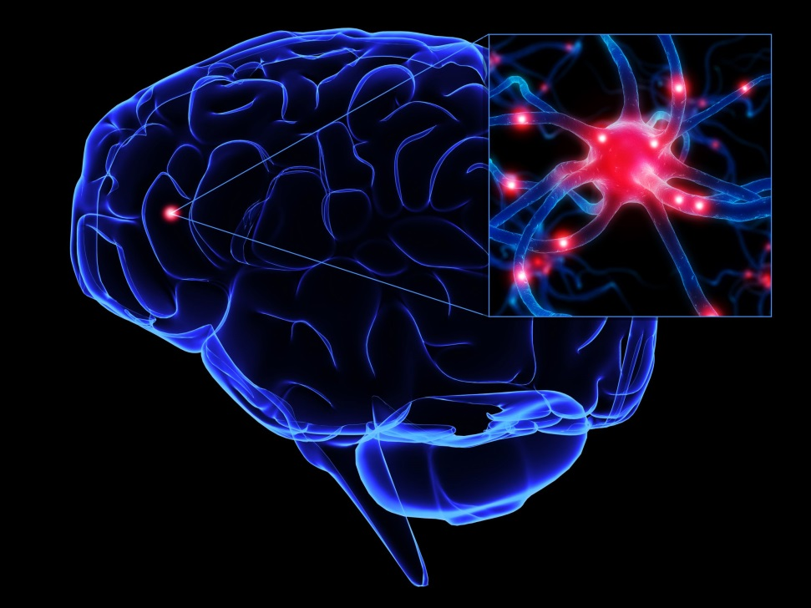
Nervous tissue :
The brain, spinal cord and nerves are all composed of nervous tissue.
The cells of this tissue are called nerve cells or neurons.
Neurons are highly specialized for being stimulated and then transmitting the stimulus very rapidly from one place to another.
A neuron consist of a cell body with a nucleus and cytoplasm.
Dendrites
From the cell body arises a long process called axon.
and many short branched processes called dendrites.
Many and an individual nerve cells may be up to 1metre long.
Nucleus
Excited
Cytoplasm
Signal
Cell body
Axon

Slide 3
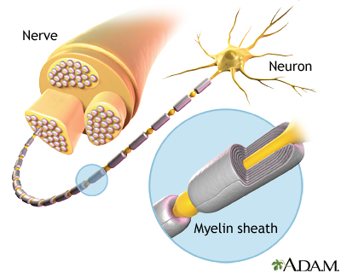
Nervous tissue :
Many nerve fibres bound together by connective tissue make a nerve.
Nerve impulse allow us to move our muscles according to our wish.
The combination of nerve and muscle tissue enables animal to move rapidly in response to stimuli.

