Slide 1


Introduction to Our Course
This course introduces fundamental concepts of effective communication
You will learn various skills and strategies for personal, professional and academic communication
The unique contents of this course will boost your confidence to be better in expressing yourself
The curriculum has been planned with meticulous observation preluded by a period of thorough research
We believe in creating LEADERS for tomorrow, who would pass on the fire of communication like Prometheus
Upon completion of this 12 weeks’ course, there would be a final assessment serving as an evaluating paradigm

Slide 2

Communication
DEFINITION: Communication can be defined as the process of transmitting, receiving and interpreting messages between senders and receivers. It involves the encoding, transmission, and decoding of information, which can take various forms including verbal, non-verbal, written, visual and digital communication.

Slide 3
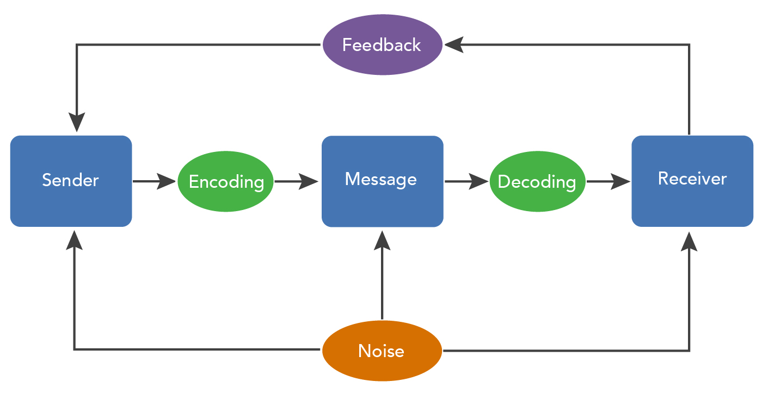
Elements of Communication
Sender- The entity initiating the communication by encoding a message
Message- The information, idea or meaning being conveyed through verbal or non verbal communication
Channel- The medium through which the message is transmitted.
Receiver- The entity receiving or decoding the message
Feedback- The response or reaction provided by the receiver, which completes the communication loop
Context- The situational, cultural and environmental factors that influence the communication procedure

Slide 4
Importance of Effective Communication
The Professional world thrives on effective communication.
Relationship Building- Effective communication fosters trust, respect and understanding, vital for healthy relationships
Goal Achievement- Clear communication helps express goals and collaborate effectively, both personally and professionally
Conflict Resolution- Communication is the key for resolving conflicts, fostering dialogue, and finding solutions
Teamwork- Enhances teamwork by facilitating coordination and cooperation among team members
Decision Making- Aids informed decision-making processes by exchanging information and perspectives
Productivity- Minimizes misunderstandings, leading to increased productivity and proficiency
Personal Development- Essential for personal growth and advancement in various fields
Empathy Building- Promotes empathy and understanding by connecting with others emotionally and intellectually
Cultural Awareness- Helps in creating the space for all-inclusive-cultural-diversity

