Slide 1
Visiting Card – Back Side

Slide 2



Visiting Card – CEO
e05a
Mr. Anirban Chakrabarty
C.E.O.
B.E.(Electronics), M.B.A. (Finance)
anirban@anodiam.com
+91 9073 700094
+61 470 142 229
N - 1/25 Patuli, Kolkata 700094
8/71 Wolseley Street
Bexley, Australia 2207
@
anodiam.com

Slide 3
Visiting Card – CIO
e05a
Mr. Debashish Nath
C.I.O.
anodiam.dn@gmail.com
+91 79759 42642
N – 1/25 Patuli
Near Krishi Bikash Kendra
Kolkata 700094
@
anodiam.com

Slide 4
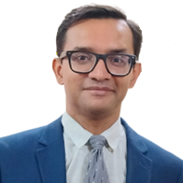
Identity Card – CEO
e05a
Mr. Anirban Chakrabarty
C.E.O.
B.E.(Electronics), M.B.A. (Finance)
anirban@anodiam.com
+91 9073 700094
+61 470 142 229
N - 1/25 Patuli, Kolkata 94
8/71 Wolseley Street
Bexley, Australia 2207
@
anodiam.com

Slide 5
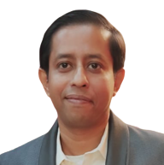
Identity Card – CIO
e05a
Mr. Debashish Nath
C.I.O.
anodiam.dn@gmail.com
+91 79759 42642
N – 1/25 Patuli
Near Krishi Bikash Kendra
Kolkata 700094
@
anodiam.com

Slide 6
Visiting Card – AI/ML Engineer
e05a
Mr. Sayan Basak
A.I./M.L. Engineer
B.Tech.(Electrical)
sayanb0978@gmail.com
+91 70035 97510
N - 1/25 Patuli, Kolkata 700094
@
anodiam.com

Slide 7
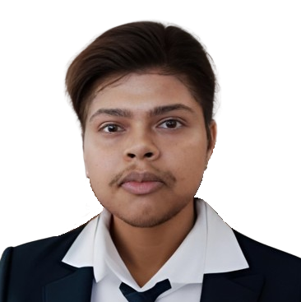
Identity Card – AI/ML Engineer
e05a
Mr. Sayan Basak
A.I./M.L. Engineer
B.Tech.(Electrical)
sayanb0978@gmail.com
+91 70035 97510
N - 1/25 Patuli, Kolkata 700094
@
anodiam.com

Slide 8
Visiting Card – HOD English
e05a
Mr. Rahul Dutta
H.O.D. English
M.A.(English), D.R.S.
remdutta13@gmail.com
+91 81004 36512
N - 1/25 Patuli, Kolkata 700094
@
anodiam.com

Slide 9
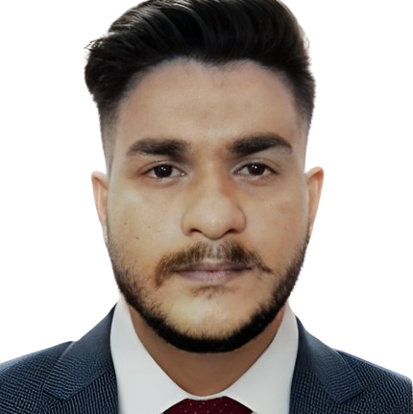
Identity Card – HOD English
e05a
Mr. Rahul Dutta
H.O.D. English
M.A.(English), D.R.S.
remdutta13@gmail.com
+91 81004 36512
N - 1/25 Patuli, Kolkata 700094
@
anodiam.com

