Slide 1
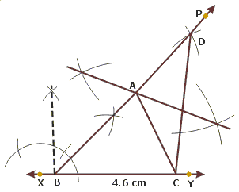
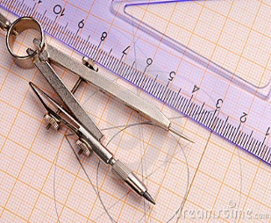
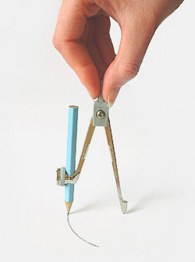
Constructions

Slide 2
Module 1

Slide 3
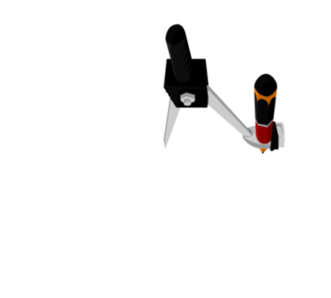

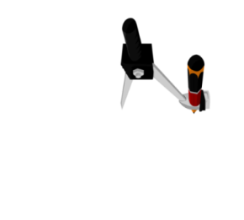
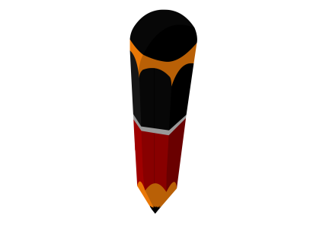
Q. Construct an angle of 90º at the initial point of a
given ray and justify the construction.
Rough fig.
With its initial point O as centre and any
radius, draw an arc intersecting OA at C.
P
With D as centre and the same radius, draw
an arc intersecting the arc CD at E.
With E as centre and same radius,
draw intersecting arcs
With centre C and same radius draw an arc, intersecting the previous arc at D.
With D as centre and radius more than half of DE, draw an arc
OP bisects ∠DOE,
so∠ POD =
ΔDOC is an equilateral triangle
ΔODE is an equilateral triangle
Join OP.
Draw a ray OA
Draw DE
30⁰
O
A
Justification :
ΔDOC is an equilateral triangle.
So, ∠COD = 60º.
P
E
D
ΔODE is also an equilateral triangle.
So, ∠DOE = 60º.
Since OP bisects ∠DOE,
So, ∠POD = 30º.
O
C
A
Now,
∠AOP =
∠ COD + ∠ POD
1
2
3
4
5
6
7
8
9
10
11
12
13
14
15
= 60º
+ 30º
= 90º

Slide 4
Module 2

Slide 5



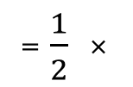
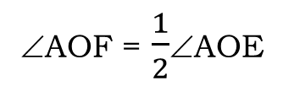
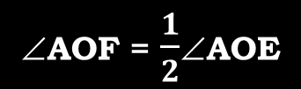
Q. Construct an angle of 45º at the initial point of a given
ray and justify the construction.
With O as the centre and same radius, draw intersecting arcs
With O as centre and any suitable radius, draw
an arc intersecting OA at B.
Soln.
With B as the centre and radius more than half of BO, draw an arc
With B as centre and same radius, draw an arc intersecting at C
Now, with C as
centre and same radius, draw an arc intersecting arc BC at D
1
2
3
4
5
6
7
8
9
10
11
With C as centre and radius more than half
of CD, draw an arc.
12
13
14
15
With D as centre and same radius, draw intersecting arcs
Join OE.
Draw the bisector of ∠AOE.
Justification :
Draw a ray OA.
So what can we say
about ∠AOF & ∠AOE ?
∠AOF = $\frac{1}{2}$∠AOE
∠AOF = $\frac{1}{2}$∠AOE
Draw CD
By construction, ∠AOE = 90⁰
Now, ∠AOE = 90º.
Draw BO
and OF is the bisector of ∠AOE
Rough fig.
= $\frac{1}{2}$ ×
45⁰
E
90⁰
F
O
F
D
C
= 45⁰
45⁰
∴ ∠AOF = 45⁰
O
A
45⁰
O
B
A
1
2
3
4
5
6
7
8
9
10
11
12
13
14
15

Slide 6
Module 3

Slide 7


Q. Construct the angles of the following measurements :
(i) 30⁰
With C as the centre and same radius, draw an arc intersecting the previous arc at D
With O as centre and any suitable radius, draw
an arc intersecting OA at C.
With C as the centre and radius more than half of CD, draw an arc
Draw CD
With D as the centre and same radius, draw intersecting arc
Justification :
[Construction]
So, what can we say about ∠AOB and ∠AOD ?
∠AOD = 60⁰
$\frac{1}{2}$
Draw OD
OB is the bisector of ∠AOD
1
∠AOB = ∠AOD
∠AOB =
∠AOD
2
1
30º
=
× 60
∠AOD = 60º
Rough fig.
2
Join OB.
Draw a ray OA
Then, ∠AOB = 30º
∴ ∠AOB = 30º
B
D
B
O
30⁰
60⁰
A
30⁰
O
C
A
1
2
3
4
5
6
7
8
9
10
11
12
13
14
15

Slide 8
Module 4

Slide 9


Q. Construct the angles of the following measurements :
Rough fig.
(ii) 22$\frac{ 1}{2}$
With B as the centre and same radius, draw an arc intersecting the previous arc at C.
With C as the centre and same radius, draw an arc intersecting arc BC at D.
With D as the centre and the same radius, draw an intersecting arc
R
With C as the centre and radius more than half of CD, draw an arc
Draw CD
With B as the centre and radius more than half of BY, draw an arc
With O as the centre and any suitable radius, draw an arc intersecting OA at B.
With Y as the centre and same radius, draw intersecting arc
1
2
3
4
5
6
7
8
9
With X as the centre and same radius, draw an intersecting arc
10
11
12
13
14
15
With B as the centre and radius more than half of BX, draw an arc
OR is the bisector of ∠AOQ
OQ is the bisector of ∠AOP
Draw the bisector of ∠AOQ
∠AOP = 90º
Let us first draw an angle of 90º
Draw OR
Draw OP
1
Draw a ray OA
Draw the bisector of ∠AOP
Draw BX
1
∠AOR =
∠AOQ
Draw BY
22.5⁰
∠AOQ =
Draw OQ
∠AOP
O
2
2
A
Justification
OR is the bisector of ∠AOQ
∠AOP = 90º
OQ is the bisector of ∠AOP
1
∠AOR =
∠AOQ
2
P
1
∠AOQ =
∠AOP
1
2
=
× 45
Q
1
2
X
C
D
Y
=
× 90
R
2
∴ ∠AOR = 22.5º
∴ ∠AOQ = 45º
O
B
A
1
2
3
4
5
6
7
8
9
10
11
12
13
14
15

Slide 10
Thank You

