Slide 1
Module 9

Slide 2
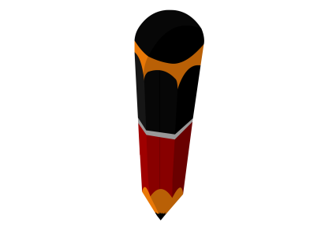
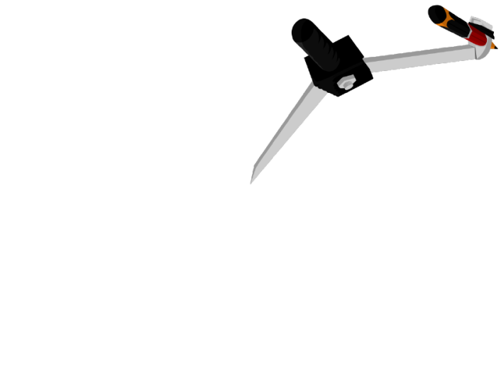
Q.
Construct an equilateral triangle, given its side and
justify the construction
Let us consider that side of an equilateral triangle is 4.5 cm
Rough fig.
A
Now, with C as centre and same radius (4.5cm),
Draw an intersecting arc
Draw BC = 4.5 cm.
Draw AB and AC
Justification
2
2
9
1
3
4
5
1
6
7
3
8
4
5
6
7
8
9
10
11
12
13
14
15
With B as centre
and r = 4.5cm,
Draw an arc
10
11
12
13
14
15
AB = BC = AC
ΔABC is an equilateral triangle
[by definition]
B
4.5 cm
C
A
B
4.5 cm
C
1
2
3
4
5
6
7
8
9
10
11
12
13
14
15

Slide 3
Module 10

Slide 4
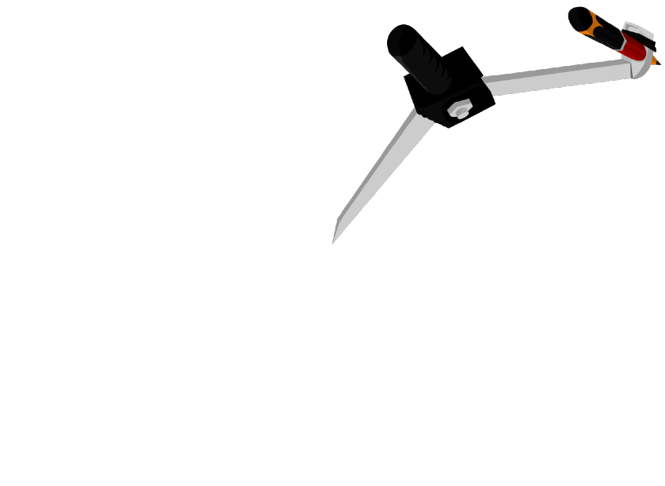
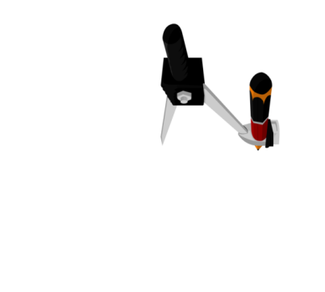

Q.
Construct a triangle ABC in which BC = 7 cm, ∠B = 75º
and AB + AC = 13 cm.
Justification
AB + AC = 13 cm
ΔAED ≅ ΔAEC
[SAS criterion]
Draw perpendicular
bisector of CD
But AD = AC
Rough fig.
D
Draw BC = 7 cm
With Q as the centre and same radius, draw an intersecting arc
Join CD
With R as the centre and radius more than half of TR, draw an arc
With R as the centre and radius more than half of QR, draw an arc
With B as the centre and any suitable radius, draw an arc
With P as the centre and same radius, draw an arc intersecting at R.
∴ AD = AC
[CPCT]
With T as the centre and same radius, draw an intersecting arc
With C as the centre and radius more than half of CD, draw arcs
With R as the centre and same radius, draw an arc.
AB + AD = 13 cm
Δ ABC is the required triangle
Construct
∠B = 75°
Draw QR
AB + AD = BD
BD = 13 cm
Draw TR
Join AC
∴ AB + AD = 13 cm
D
∴ AB + AC = 13 cm
l
A
l
1
2
3
13 cm
9
13 cm
2
4
5
6
7
8
10
11
12
13
14
15
1
3
4
5
6
7
8
9
10
11
12
13
14
15
E
E
1
2
3
4
5
6
7
8
9
10
11
12
13
14
15
A
B
75º
C
S
With D as the centre and same radius, draw intersecting arcs
7cm
V
Q
T
R
1
2
3
4
5
6
7
8
9
10
11
12
13
14
15
1
2
3
4
5
6
7
8
9
10
11
12
13
14
15
75⁰
B
P
7 cm
C
1
2
3
4
5
6
7
8
9
10
11
12
13
14
15

Slide 5
Module 11

Slide 6
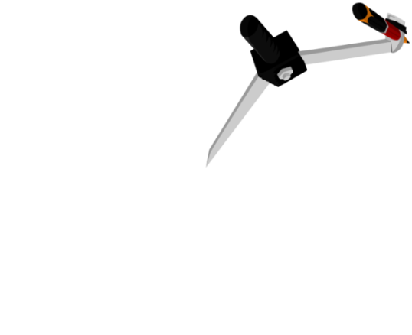
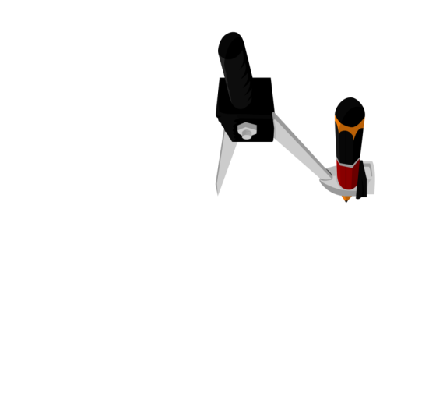


Q. Construct a triangle ABC in which BC = 8 cm,
∠B = 45º and AB – AC = 3.5 cm
ΔABC is a required triangle
l
With X as the centre and same radius, draw intersecting arc
A
Take a point D on AB such that BD = 3.5 cm; B-D-A
A
Rough fig.
With R as the centre and same radius, draw an arc intersecting at S
With R as the centre and radius more than half of RS, draw an arc
With B as the centre and any suitable radius, draw an arc
With D as the centre and same radius, draw intersecting arcs
2
With P as the centre and same radius, draw an arc intersecting at R
1
3
4
5
6
7
8
9
10
With C as the centre and radius more than half of CD, draw arc
11
12
13
14
15
With S as the centre and same radius, draw an arc
With P as the centre and radius more than half of XP, draw arc
Draw ∠B = 45º
Draw perpendicular
bisector of DC
Draw segment BC = 8 cm
Join XP
Join BY
Join CA
Join DC
D
Join RS
3.5
E
B
45º
C
8 cm
T
D
Justification
X
Y
S
R
ΔAED ≅ ΔAEC
[SAS criterion]
2
∴ AD = AC
[CPCT]
…(i)
1
3
4
5
6
7
8
9
10
11
12
13
14
15
AB = AD + DB
45⁰
∴ AB = AC + 3.5
[From (i)]
B
P
C
1
2
3
4
5
6
7
8
9
10
11
12
13
14
15
∴ AB – AC = 3.5

Slide 7
Module 12

Slide 8

Q. Construct a triangle PQR in which QR = 6 cm,
∠Q = 60º and PR – PQ = 2 cm.
Rough fig.
With S as the centre and same radius, draw intersecting arcs
With R as the centre and radius more than half of RS, draw arcs
l
With X as the centre and same radius, draw an arc intersecting at A
With Q as the centre and any suitable radius, draw an arc
Produce PQ and take a point ‘S’ on it such that QS = 2 cm, P-Q-S
Draw PR
Draw segment QR = 6 cm
P
l
Draw perpendicular bisector of SR
∠Q = 60º
Draw SR
P
Q
60º
R
2 cm
6 cm
A
E
S
60º
Q
X
Justification
1
2
3
4
5
R
7
8
9
6
10
11
12
13
14
15
2 cm
E
ΔPES ≅ ΔPER
[SAS criterion]
∴ PS = PR
[CPCT]
S
PS = PQ + QS
1
2
3
4
5
6
7
8
9
10
11
12
13
14
15
∴ PS = PQ + 2cm
PS – PQ = 2cm
PR – PQ = 2cm

Slide 9
Thank You

