Slide 1
No. 1

Slide 2
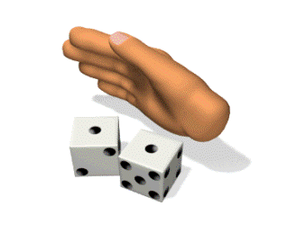
PROBABILITY
Probability word comes from the word Probably
We use the word probability only
when we are not sure
For Eg:
If it is rainy season we may say
probably it may rain today
But we are not sure about it.

Slide 3
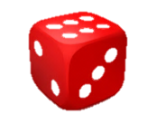
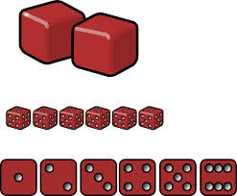
Random Experiment
: It is an experiment in which all the possible results
are known in advance but they cannot be predicted with certainty.
For eg : Rolling of a Die
1, 2, 3, 4, 5, 6
Possible Results
Outcome
- The result of a random experiment.
{
3
4
5
6
}
1
2
Set
,
,
,
,
,
Now let us understand Event with the help of a video

Slide 4
Event
- A set of Favourable outcomes.
Something that you wish should happen / should not happen
For example: Snakes and Ladders Video
Getting 2 was unfavourable outcome
But getting 3 was favourable outcome
In all the questions of Probability, there are three steps:
Step 1:
Find total number of trials
Step 2:
Find the number of elements favorable for the event
number of elements favorable for the event
Step 3:
Probability of any event
=
Total number of trails

Slide 5
No. 2

Slide 6
Q. In a cricket match, a batswoman hits a boundary 6 times out of 30 balls
she plays . Find the probability that she did not hit a boundary.
Sol.
No. of balls she played = 30
Since, she hit boundary 6 times
What do we need to find
Step 2: Find the number of elements favorable for the event
Number of times she did not hit a boundary =
30 – 6
= 24
Probablity of not hitting a boundary
Step 1: find the total number of trials
Number of times not hitting a boundary
=
Total number of trials (i.e., balls)
In this sum, the event is she did not hit a boundary
4
=
24
30
In this sum the total number of trials is the number of balls she played
5
A batswoman hits a boundary
6 times out of 30 balls she plays
=
4
5
Step 3:
Prob of
any event
No. of elements favorable for the event
The probability that a batswoman did not hit a boundary is
=
4
Total number of trails
5

Slide 7
No. 3

Slide 8
Q. 1500 families with 2 children were selected randomly, and the following data
were recorded:
Number of girls in a family
2
1
0
Total
Number of families
475
814
211
1500
Compute the probability of a family, chosen at random, having
(i) 2 girls
(ii) 1 girl
(iii) No girl
Also check whether the sum of these probabilities is 1.
Sol.
Let A be the event of family having
2 girls
(i)
∴
P(A)
=
Probability of a family having 2 girls
=
Number of families having 2 girls
Let us first calculate probability of a family having 2 girls
Total number of families
Divided both the no by 5
=
475
95
19
1500
300
60
=
19
60

Slide 9
Q. 1500 families with 2 children were selected randomly, and the following data
were recorded:
Number of girls in a family
2
1
0
Total
Number of families
475
814
211
1500
Compute the probability of a family, chosen at random, having
(i) 2 girls
(ii) 1 girl
(iii) No girl
Also check whether the sum of these probabilities is 1.
Sol.
Let B be the event of family having
1 girl
(ii)
∴
P(B)
=
Probability of a family having 1 girl
Number of families having 1 girl
Let us calculate probability of a family having 1 girl
=
407
Total number of families
814
=
1500
60
407
=
750

Slide 10
Q. 1500 families with 2 children were selected randomly, and the following
data were recorded:
Number of girls in a family
2
1
0
Total
Number of families
475
814
211
1500
Compute the probability of a family, chosen at random, having
(i) 2 girls
(ii) 1 girl
(iii) No girl
Also check whether the sum of these probabilities is 1.
Sol.
Let C be the event of family having
no girl
We have to check that sum of all three probabilities is 1
(iii)
∴
P(C)
=
Probability of a family having no girl
=
Number of families having no girl
Total number of families
=
211
Let us calculate probability of a family having no girl
1500
i.e we have to check P(A) + P(B) + P(C) = 1
∴
Sum of probabilities
=
P(A)
+ P(B)
+ P(C)
=
475
+
814
+
211
1500
1500
1500
=
475 + 814 + 211
1500
=
=
1
1500
1500

Slide 11
No. 4

Slide 12
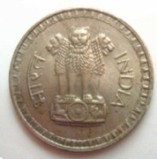
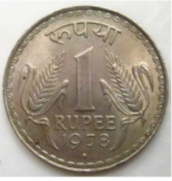
Q. Three coins are tossed simultaneously 200 times with the following frequencies
of different outcomes.
Outcome
3 heads
2 heads
1 head
No head
Total
Frequency
23
72
77
28
200
If the three coins are simultaneously tossed again, compute the probability of 2 heads
coming up.
Sol.
Since three coins are tossed 200 times,
so the total number of trials is 200.
Probability of getting 2 heads
No. of outcomes having 2 heads
=
What do we need to find
Total number of trials
How many results are there
What are the total number of trials
How many such options are there with 2 head
9
How many such results are with one head
=
72
How many results with no head
200
25
=
9
25
Probability of getting 2 heads is
9
25

Slide 13

Q. In a particular section of class IX, 40 students were asked about the months of
their birth and the following graph was prepared for the data so obtained. Find the
probability that a student of the class was born in August.
7
6
5
4
No. of students
3
2
1
Jan
Feb
Mar
Apr
May
June
July
Aug
Sep
Oct
Nov
Dec
Months of birth
We have to focus which month ?
Sol.
Total no. of students asked=
40
No. of students born in the month of Aug out of 40
= ?
= 6
Probability that a student of the class was born in August
=
Number of students born in August
6
3
3
=
=
40
20
Total number of students
20

Slide 14
Thank You

