Slide 1











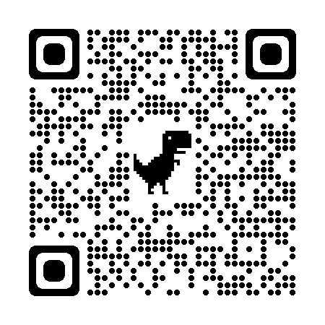
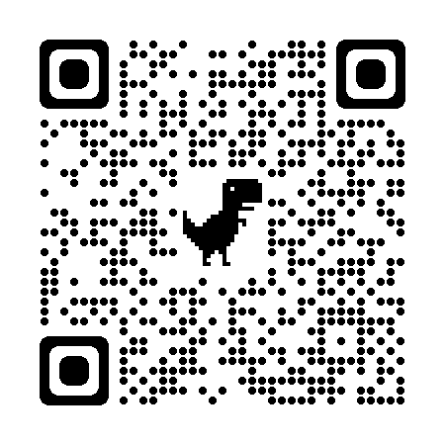


Artificial Intelligence for Class III to VII
N-1/25 Patuli, Kol 94, Near Fire Brigade & Krisi Vikas
9073 700094
Upto 50% Off
T&C Apply
Follow
for Discount
App Download
Coding Foundation:
C, Python, Linux
HTML, CSS, JavaScript
Cloud & Android Apps
AI & Data Science:
Board Syllabus - Concepts Made Lucid
Analytics & Data Visualization
Robotics & IoT:
Mechano, Lego
Raspberry Pie, Arduino, IoT
Maths Foundation:
Mental, Abacus & Vedic Techniques
Maths & Stats for Data Science
Communication Skills:
Presentation Skills, V-Blogging
Project Reporting & Demo
Ethics, Emotional Intelligence & Team Work
Experienced & Empathetic Faculty || Healthy Teacher Student Ratio || Fun & Easy Learning
Hand-Holding for Each Student || Project-Based, Hands-on || Smart Classrooms, Learning App, AC, CCTV
www.anodiam.com || anirban@anodiam.com

