Slide 1
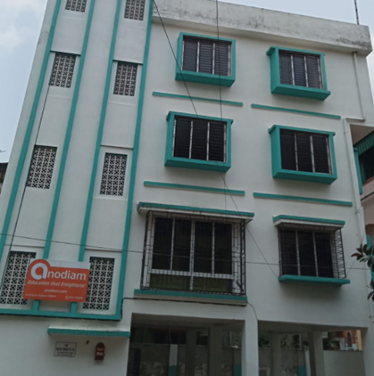


Connect with experts at our seminar.
Date : 24th September 2023
Time : 4 Pm To 6 Pm
Venue : N-1/25 PATULI, KOL -94
Call : 90737 00094
nodiam
Education that enlightens!

