Slide 1











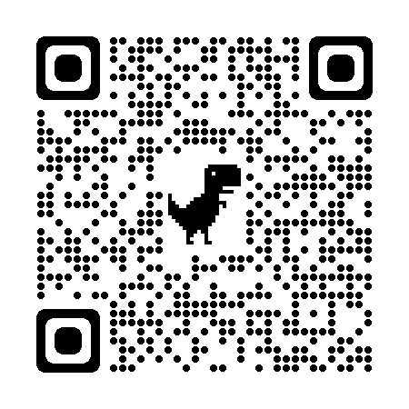
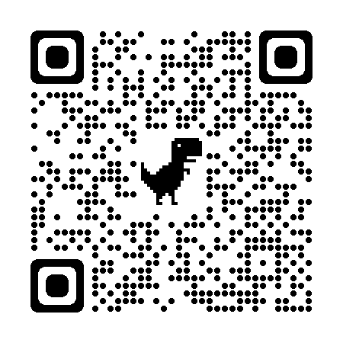


N-1/25 Patuli, Kol 94
9073 700094
AI Orientation Workshop
Date: __/__/2024
Time: __:__ _m to __:__ _m
Follow
for Discount
App Download
Dear students,
Come and explore the exciting world of AI and its myriad applications with Anodiam at our school. Please RSVP by __/__/2024 with _____________________ to secure your spot.
Thanks,
Experienced & Empathetic Faculty || Healthy Teacher Student Ratio || Fun & Easy Learning
Hand-Holding for Each Student || Project-Based, Hands-on || Smart Classrooms, Learning App, AC, CCTV
www.anodiam.com || anirban@anodiam.com

