Slide 1








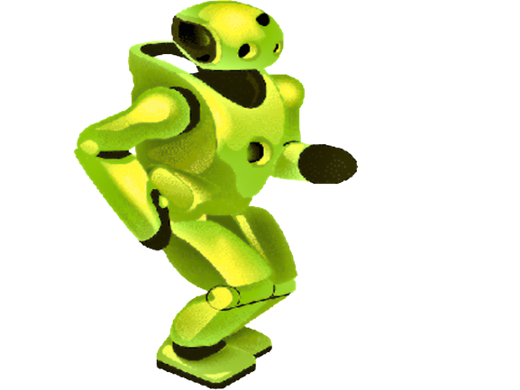



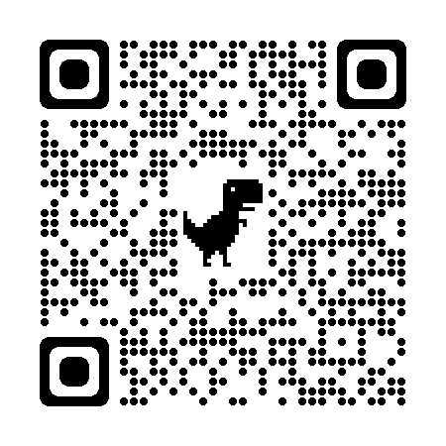
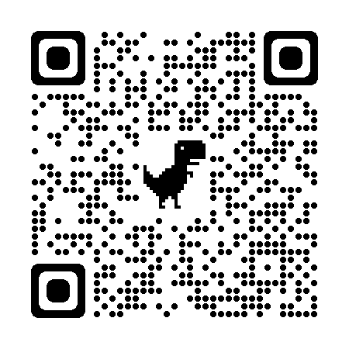


Gen AI
Artificial Intelligence for Class III to VII
N-1/25 Patuli, Kol 94, Near Fire Brigade & Krisi Vikas
9073 700094
₹4000 ₹2000 per/month
GST Applies
Follow
for Discount
App Download
AI, IoT, Robotics, Coding – Class III-XII
IT & AI Professional Training & Projects
Data Science, Computer Vision, NLP, DSP, Python
Data Analytics, C, C++, IoT, Robotics
Java, .NET, JavaScript, ReactJS, Native, PHP
DevOps, Docker, Kubernetes, Cloud
Database, Firebase, Cyber Security, Automation Testing
Pmp, Agile, Office, Adv Excel, Tally, Html, Css
experienced & empathetic faculty from prestigious organizations, fun & easy learning
Project-based, Hands-on, Smart Classrooms, AC, CCTV
www.anodiam.com || anirban@anodiam.com

