Slide 1
Performance Testing
Types

Slide 2
Types of Performance Testing
Load Testing
  Testing the service level when put under real world volumes of data
Stress Testing
  Testing the maximum load of transaction/users that can be handled until breakdown point
Spike Testing
  Testing by suddenly increasing the number of concurrent users logged on, to determine the server behavior
Endurance Testing
  To find problems that grow over a period of time, during continuous repetitive transactions
Volume testing
  Handling large amount of data

Slide 3
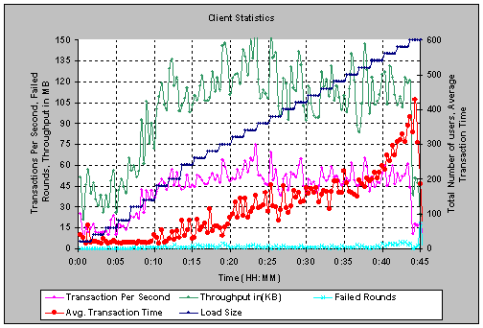
Load Testing
Test: Determine if an application can meet a desired service level under real world volumes

Slide 4
Load Test Assessments
To assess the Scalability of the system in terms of
  Transactions per seconds
  Throughput
  Average Transaction time
  Failed transactions
Use monitoring tools to identify the cause of the bottleneck constraining scalability

Slide 5
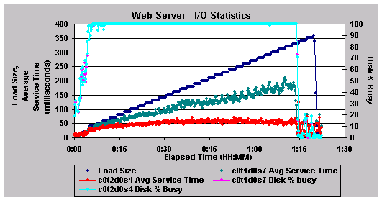
Stress Testing
Test: Determine the maximum load (typically number of concurrent users/transaction) that the application can service i.e. the application’s breaking point

Slide 6
Stress Test Assessments
Application stressed for a particular transaction which is I/O intensive
The disk showing high utilization was isolated and fixed for high service time

Slide 7
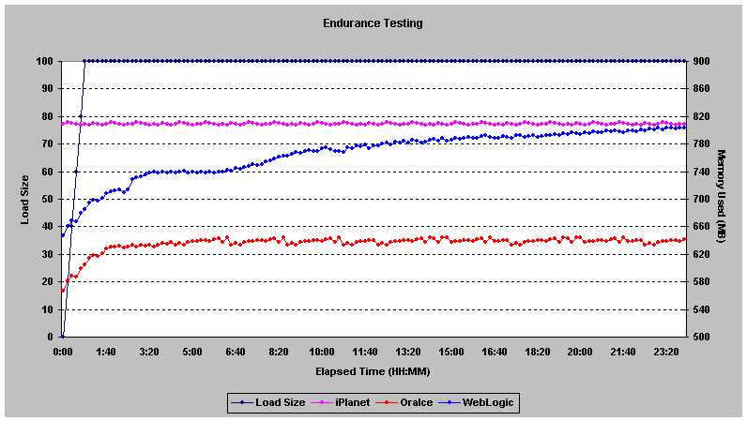
Endurance Testing
Test: Subject an application to a pre-defined set of transaction scenario continuously and repetitively for an extended period of time to find out the small problems that grow over a period of time (e.g. memory leaks)

Slide 8
Endurance Test Assessments
The resource utilization monitoring was performed with constant load for long duration
Vital results like memory leaks can be fished out using Endurance Testing

Slide 9
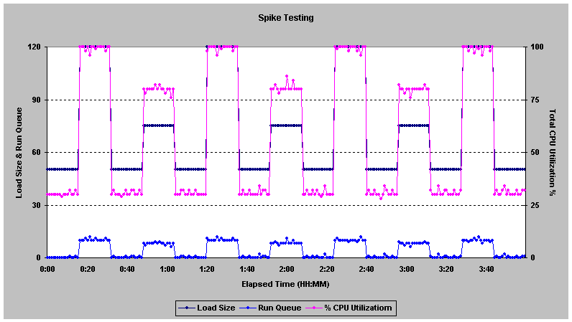
Spike Testing
Test: Simulate a sudden increase in the number of concurrent users performing a specific transaction to determine the server behavior under abnormal traffic conditions

Slide 10
Spike Test Assessments
Application tested for a spike of 70 users above a constant load of 50 when the system was performing well
Isolates the nature of the transactions to be CPU intensive

Slide 11
Types of Tests - Others
Timing testing
  Evaluate response times and the time to perform a function
Recovery testing
  Tests system’s response to presence of errors or loss of data
Configuration testing
  Testing configuration settings for hardware and software
Quality testing
  Test reliability, maintainability & availability of the system

Slide 12
Questions & Answers
Session

Slide 13
Thank You

