Slide 1





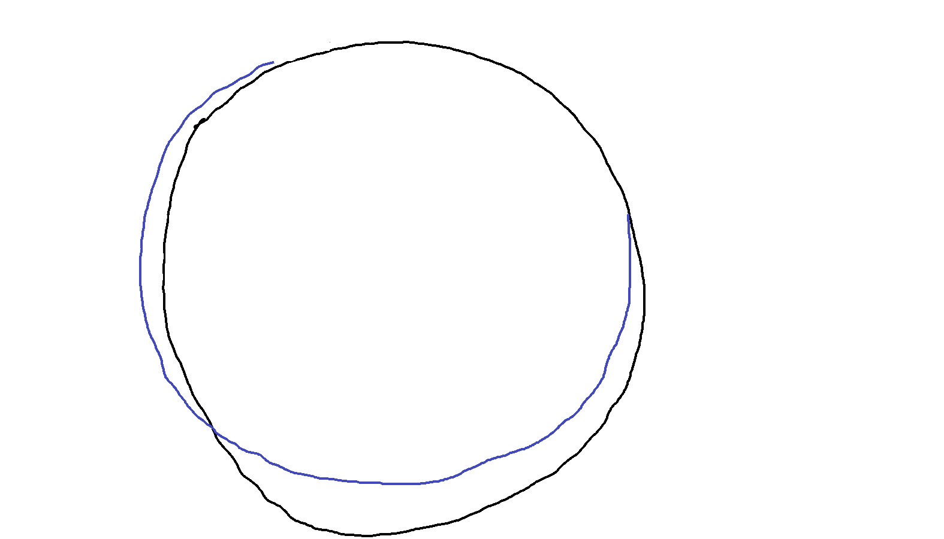
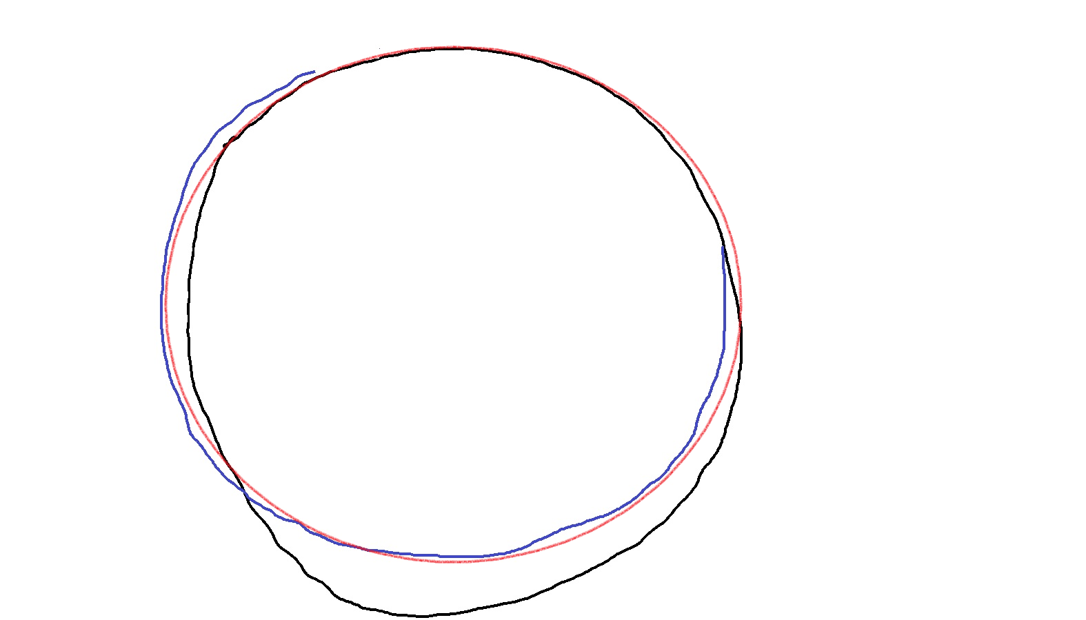
What is AI?
Intelligence that is Artificial
How intelligence works?
Circle is a closed 2D figure in which all points are equidistant from another point called center
But we just follow a pattern that we have learnt to draw a circle
We also know how to improve our accuracy to follow the pattern
AI makes computers learn patters without being specifically programmed

Slide 2
Conventional Program to Detect Activities
Speed > Some speed => Running
Speed <= Above speed => Walking or Swimming?
If on water => Swimming
If on land => Walking
But how does our program differentiate
between water & land?
Explicit Program
Logic
Input
Output

Slide 3




Power of Intelligence over Explicit Programming
Intelligence Can Easily Differentiate between Running, Walking and Swimming
Humans have previously seen and learnt the patterns of running, walking & swimming
Similarly, Artificial Intelligence can learn patterns if we train it with previous example images
Running
Walking
Swimming
Previous Examples
Detect Activity
AI Program
Input
Output
Swimming

Slide 4

Data Science Applications
Real Estate Price Prediction
Input params
Previous Examples
AI Program
Input
Output

Slide 5
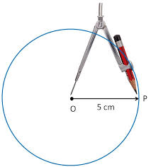
Recap: How Explicit Programs Work
Explicit Program
Input (Speed)
Speed > 5 kmph
No
Output (Activity)
Walking
Yes
Running
Explicit Program
Input
(Draw circle)
Circle is a closed 2D figure in which all points are equidistant from another point called center.
(x – h)² + (y – k)² = r²
Output

Slide 6
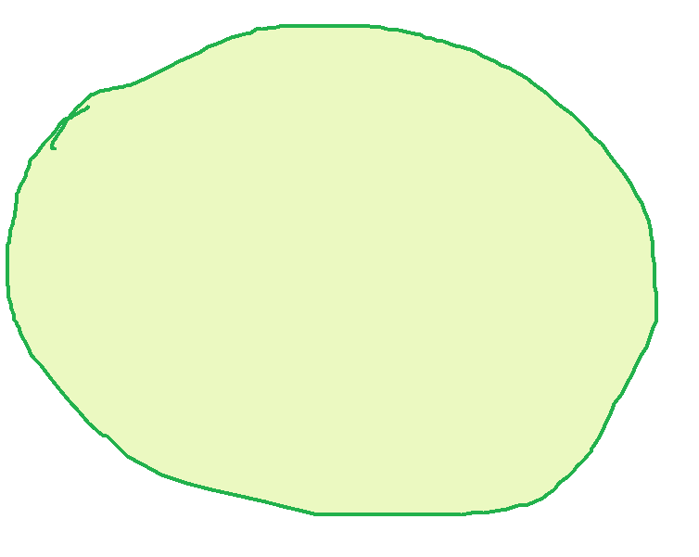
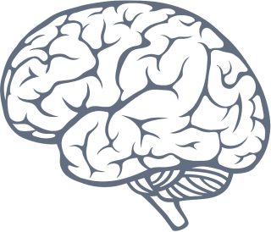
Recap: How Intelligent Systems Work
Circle
Pattern
Training
through
Previous Examples
Input
(Draw a circle)
Output

