Slide 1

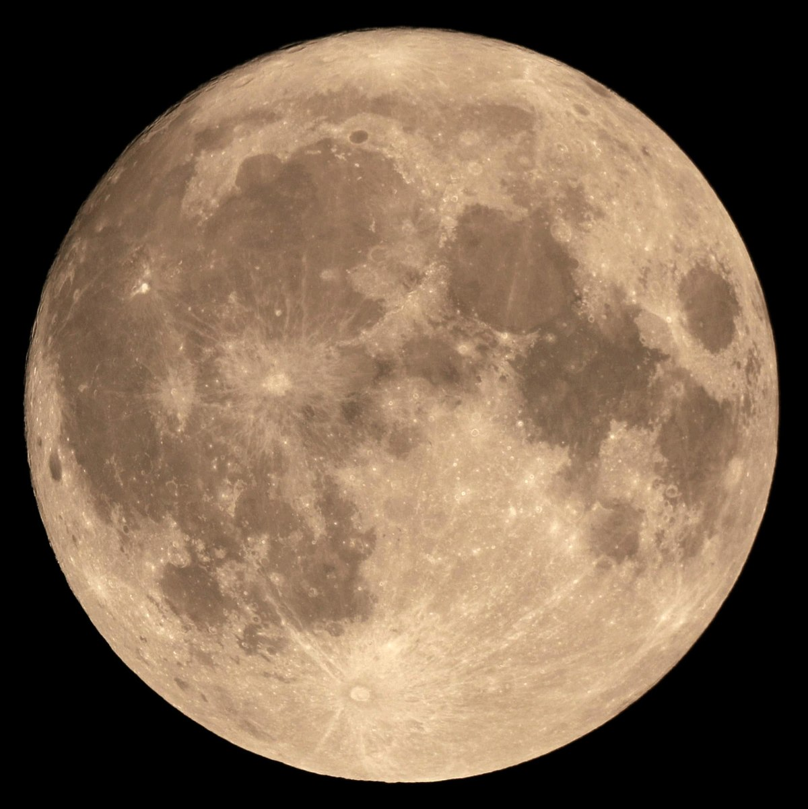
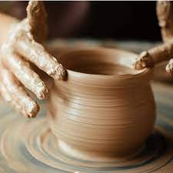

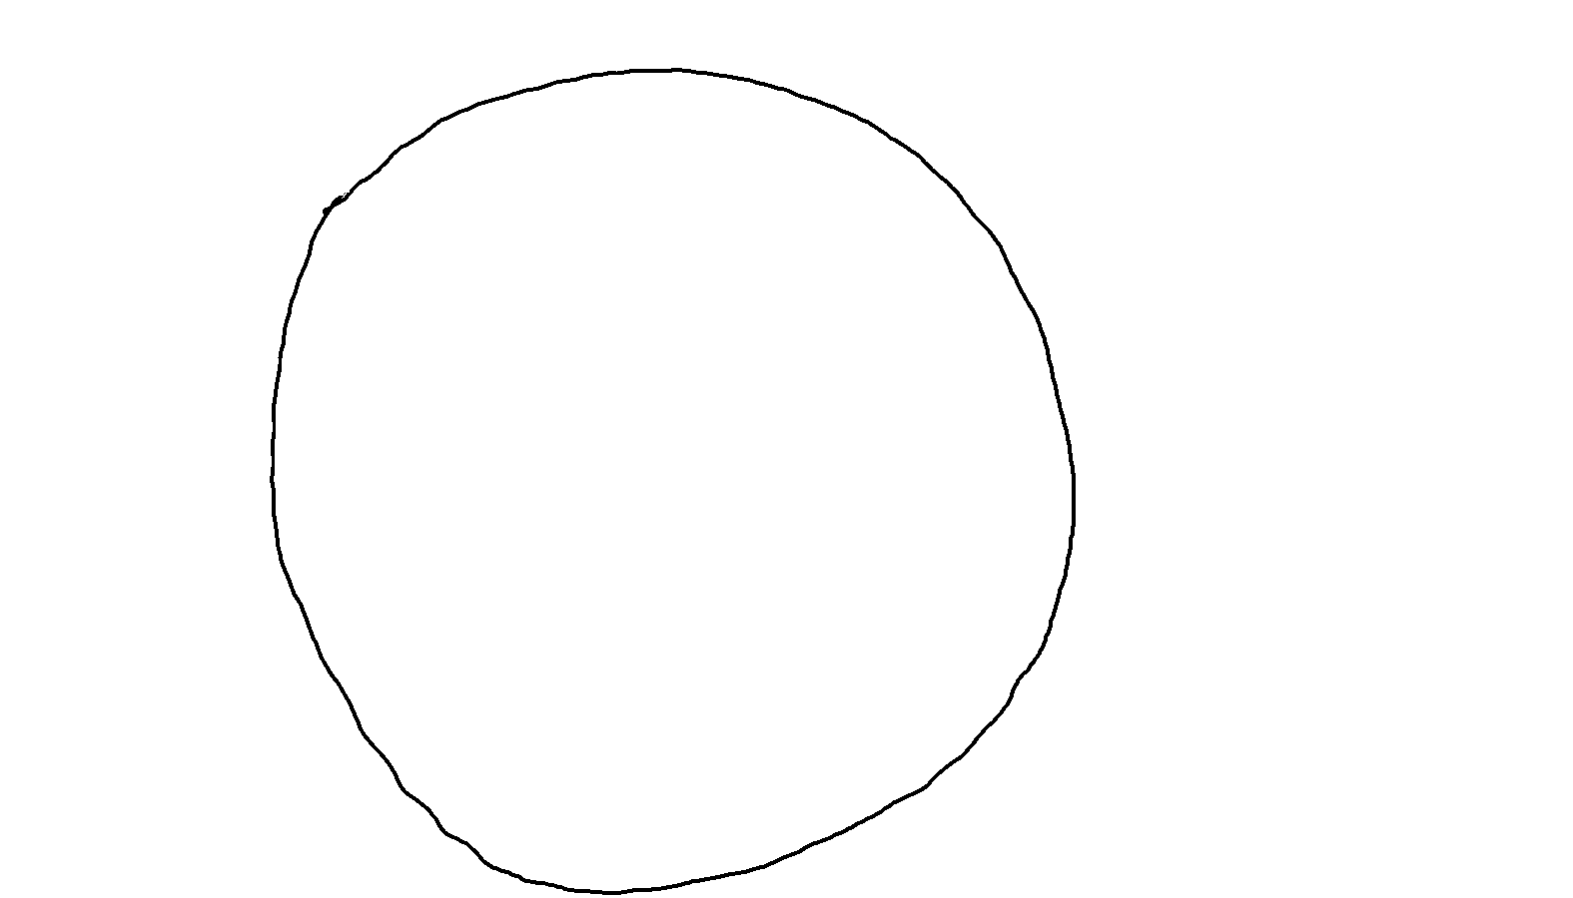
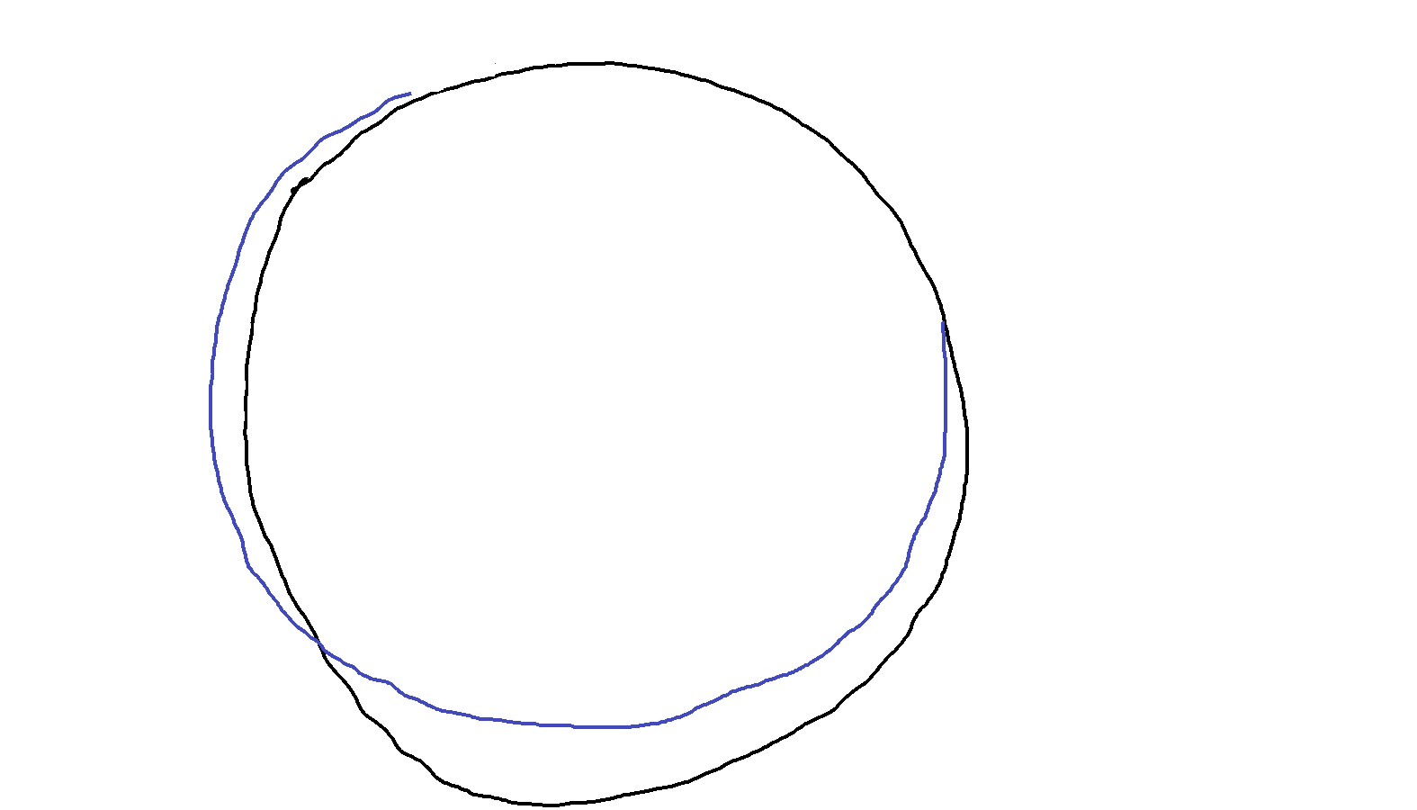
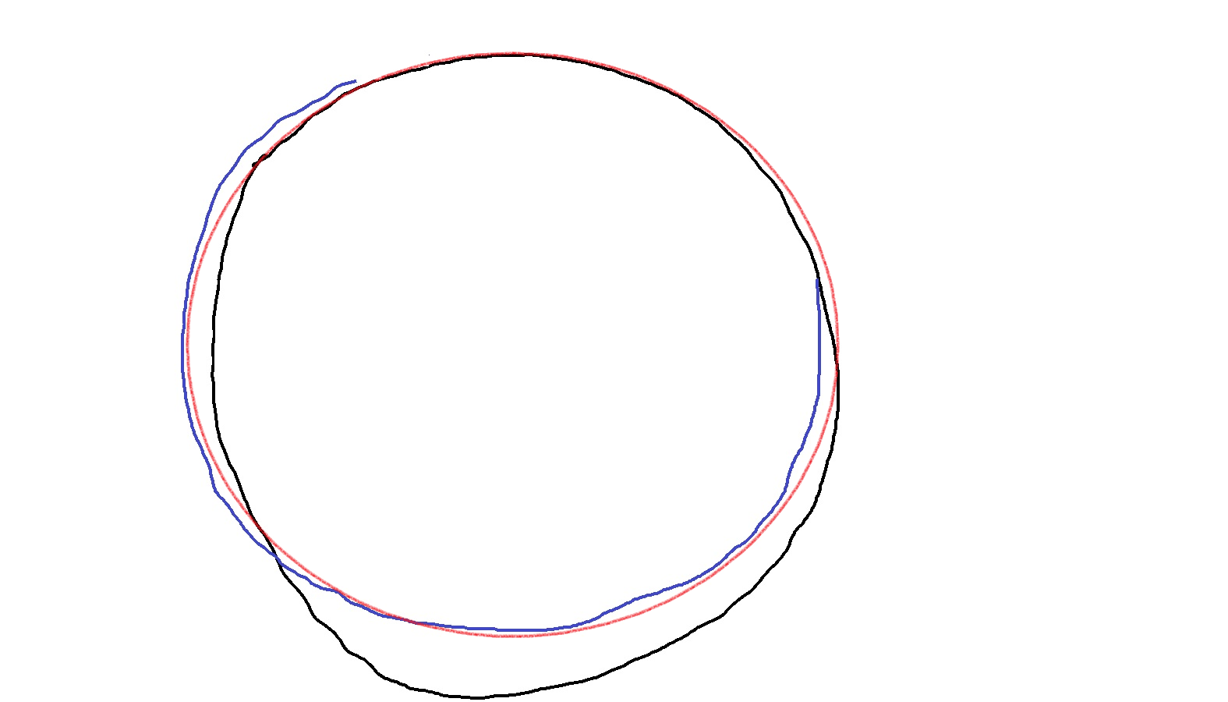
What is AI?
Intelligence that is Artificial
How intelligence works?
Circle is a closed 2D figure in which all points are equidistant from another point called center
But we just follow a pattern that we have learnt to draw a circle
We also know how to improve our accuracy to follow the pattern
AI makes computers learn patters without being specifically programmed

Slide 2
Conventional Program to Detect Activities
Speed > Some speed => Running
Speed <= Above speed => Walking or Swimming?
If on water => Swimming
If on land => Walking
But how does our program differentiate
between water & land?
Explicit Program
Logic
Input
Output

Slide 3




Power of Intelligence over Explicit Programming
Intelligence Can Easily Differentiate between Running, Walking and Swimming
Humans have previously seen and learnt the patterns of running, walking & swimming
Similarly, Artificial Intelligence can learn patterns if we train it with previous example images
Running
Walking
Swimming
Previous Examples
Detect Activity
AI Program
Input
Output
Swimming

Slide 4
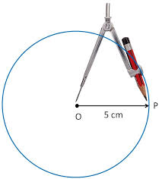
Recap: How Explicit Programs Work
Explicit Program
Input (Speed)
Speed > 5 kmph
No
Output (Activity)
Walking
Yes
Running
Explicit Program
Input
(Draw circle)
Circle is a closed 2D figure in which all points are equidistant from another point called center.
(x – h)2 + (y – k)2 = r2
Output

Slide 5
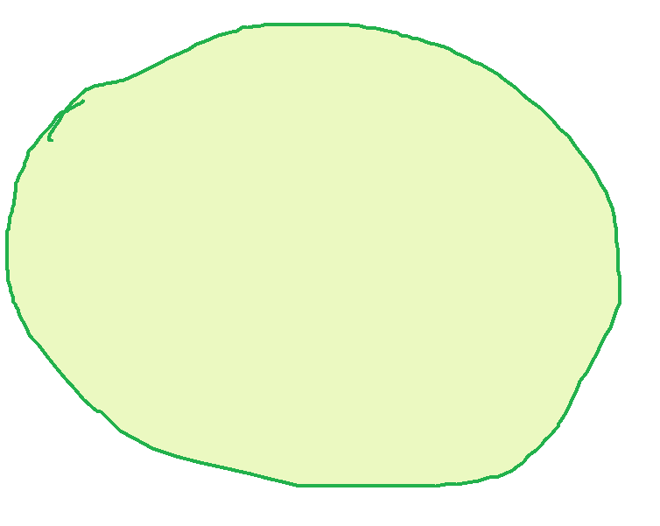
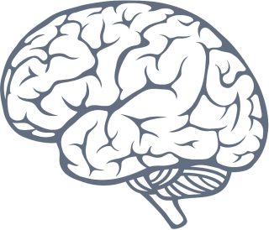
Recap: How Intelligent Systems Work
Circle
Pattern
Training
through
Previous Examples
Input
(Draw a circle)
Output

Slide 6
How Computers Compute?
Instructions
Processing Unit (CPU/GPU)
Program
Counter
Input / Output Device
Control Unit
Arithmetic Logic Unit
1 | 0 | 1 | 0 | 1 | 0 | 1 | 1
0 | 1 | 0 | 0 | 1 | 0 | 1 | 0
1 | 1 | 0 | 0 | 0 | 1 | 1 | 1
External Storage & Network
Memory Unit
Address
Data

Slide 7

How We Count?
Let us count these apples…
8
6
7
0
9
5
0
0
0
0
4
0
0
0
0
2
3
0
0
1
0
0
0
0
0
0
0
0
0
0
0
0
0
18
16
17
0
0
19
0
15
0
0
14
0
12
13
0
11
10
26
27
0
25
0
0
28
29
24
0
0
22
23
0
21
0
0
0
0
20
30
0
0
31
39
0
40
0
80
0
0
81
88
89
0
0
96
97
98
99
95
0
94
0
0
0
0
91
92
93
0
90
0
0
0
0
8
6
7
10
9
5
10
10
10
10
10
4
10
10
2
3
10
100
1
With the digits
110
111
112
113
114
115
116
117
118
119
0
1 2 3 4 5 6 7 8 9

