Slide 1

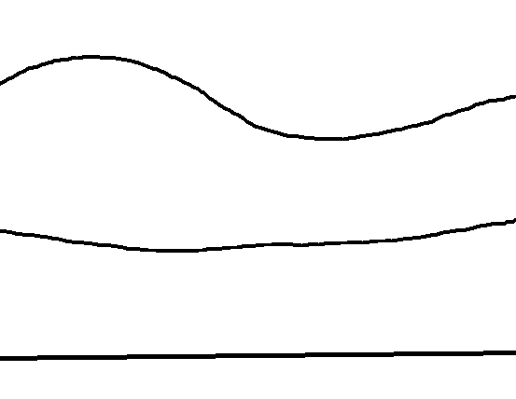
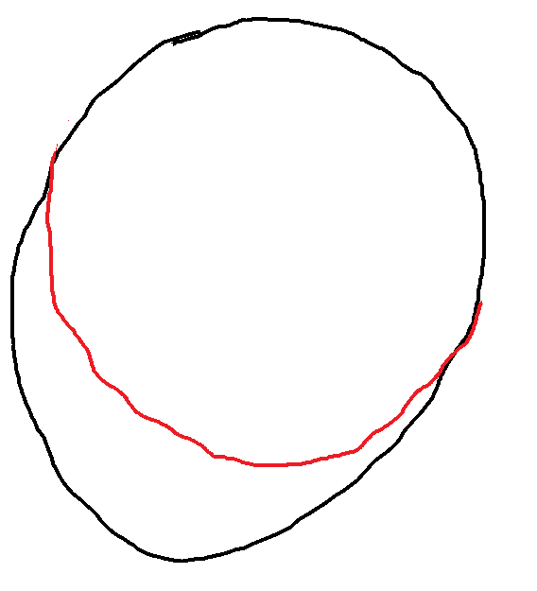
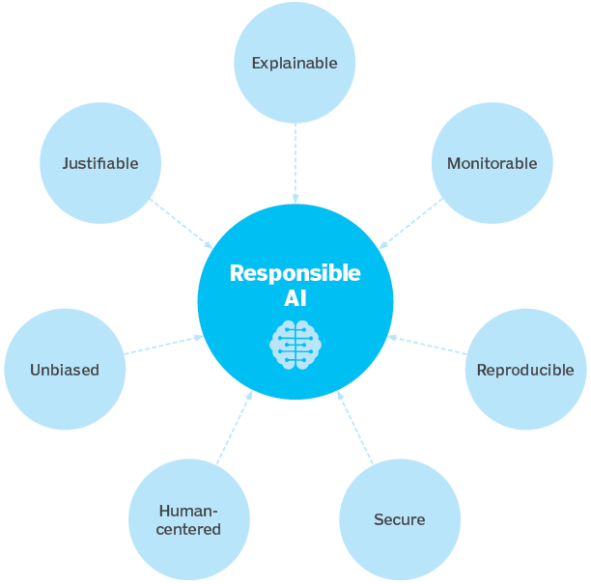
What is AI?
AI: simulation of human intelligence by machines
ML: Computer systems need to be trained (not programmed ) for a job. Performance improves with experience
Less Human Error, 24x7 Availability, Repetitive Jobs
Unbiased Decisions, Precision and repeatability
Easier to Train, Retrain & Improve
Risky, Hazardous Situations
Digital Assistance
No Ethics or Emotions
May Increase Unemployment
Lacks Human Judgement / Improvising
1950 - 1956: Birth of AI
Alan Turing
Arthur Samuel – prog to play checkers
John McCarthy - workshop on AI
1957 - 2011
AI boom & winter
1993-2011: IBM Deep Blue (chess) to Apple Siri
2012 onwards
2012: Jeff Dean & Andrew Ng from Google trained neural network to recognize cats
2015: Elon Musk, Stephen Hawking and others demilitarized AI
Hanson Robotics, Meta, Alphabet, Alibaba, OpenAI etc.

Slide 2
Examples of AI
Ranking of search pages in Google
Tagging of recognized faces on FB
Spam filter in gmail
Database mining
Large datasets from growth of automation/web.
Web click data, medical, biology, engineering
Applications that can’t program by hand.
NLP, Computer Vision
Autonomous helicopter, handwriting recognition
Self-customizing programs
E.g., Amazon, Netflix product recommendations
Understanding human learning (brain, real AI)

Slide 3
A Brave New World

Slide 4
A Brave New World

Slide 5
A Brave New World

