Slide 1


ANODIAM INSTITUTE – WELCOME OUR FACULTY
For Our Faculty Members
For Our Students
Most rewarding package
Astronomical growth
Best talents in the field
Teamwork & synergy
Professional & compassionate
Gratifying environment
Effective marketing support
Proficient management
Feature rich app support
About the Institution
Best teachers in town
Individual care for students
Best teaching techniques
Doubt clearing sessions
Extra makeup classes
Regular mock exams
Parent teacher meetings
All round feedback
Career counselling
ICSE/CBSE/WB VI-XII all subjects
NEET/IIT/JEE competitive exams
Great location, open 7 days
4 floors 4ksqft, 15 class rooms
Spoken English & grooming
Professional counselling
Edtech app by 2023
CONCEPTION >> PRACTICE >> CONFIDENCE >> HIGHEST GRADES © PROTECTED ANODIAM 2023 || PRIVATE & CONFIDENTIAL

Slide 2
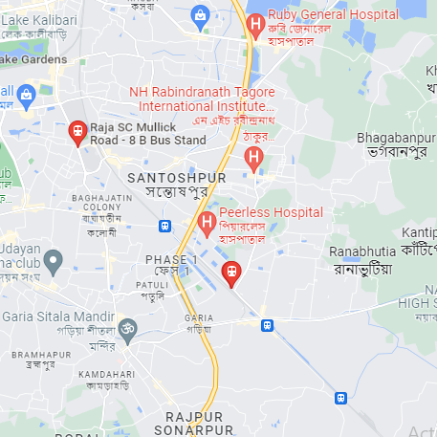
ANODIAM INSTITUTE – WELCOME OUR FACULTY
For Our Faculty Members
For Our Students
Most rewarding package
Astronomical growth
Best talents in the field
Teamwork & synergy
Professional & compassionate
Gratifying environment
Effective marketing support
Proficient management
Feature rich app support
About the Institution
Best teachers in town
Individual care for students
Best teaching techniques
Doubt clearing sessions
Extra makeup classes
Regular mock exams
Parent teacher meetings
All round feedback
Career counselling
ICSE/CBSE/WB VI-XII all subjects
NEET/IIT/JEE competitive exams
Great location, open 7 days
4 floors 4ksqft, 15 class rooms
Spoken English & grooming
Professional counselling
Edtech app by 2023
CONCEPTION >> PRACTICE >> CONFIDENCE >> HIGHEST GRADES © PROTECTED ANODIAM 2023 || PRIVATE & CONFIDENTIAL

Slide 3
FACULTY MEMBERS REQUIRED
Whom We Need?
You Are Expected To ...
Empathetic & inspiring
Adaptable & innovative
Confident & pleasing
In-depth subject knowledge
Aware of exam patterns
Experience in teaching
V-blogging is an add on
Teach with excellence
Take individual care
Clear doubts & build concepts
Take regular mock exams
Parent-teacher meetings
All round feedback
Prepare students for best results
About Anodiam
ICSE/CBSE/WB VI-XII all subjects
NEET/IIT/JEE competitive exams
Edtech app under construction
Open, flexible & innovative
Grooming, coding, holistic style
Dedicated multilevel building
Great location, open 7 days
What You Can Expect ...
Supportive leadership
Proficient & compassionate
Gratifying environment
Teamwork & synergy
Effective marketing support
Most rewarding package
Astronomical career growth
Email: 1120anirban@gmail.com || Phone: 9073 700094 || N-1/25 Patuli, Kolkata 700094

