Slide 1









Upto 50% Off
T&C Apply
Coaching Classes
9073 700094
N-1/25 Patuli, Kol 94
ARTIFICIAL INTELLIGENCE – Class III – XII
IT & AI Professional Training & Projects
VIII-XII - All Subjects & Boards
NEET, IIT-JEE (Mains & Advanced)
MBA, BBA, BCom, CA, CMA, CS, CFA, CLAT, LLB, LLM
Grooming, Ielts, Toefl, Foreign Languages

Slide 2

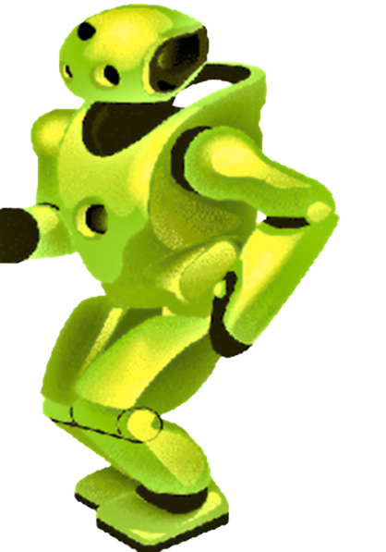
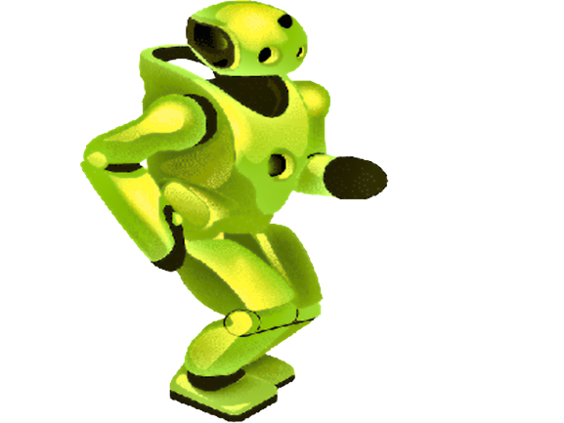
Upto 50% Off
T&C Apply
Artificial Intelligence
IT Training
9073 700094
N-1/25 Patuli, Kol 94
AI, IoT-Robotics, Coding – Class III-XII
IT & AI Professional Training & Projects
Data Science, Computer Vision, NLP, DSP, Python
Data Analytics, C, C++, IoT, Robotics
Java, .NET, JavaScript, ReactJS, Native, PHP
DevOps, Docker, Kubernetes, Cloud
Database, Firebase, Cyber Security, Automation Testing
Pmp, Agile, Office, Adv Excel, Tally, Html, Css

