Slide 1

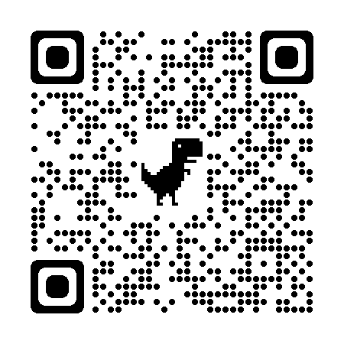


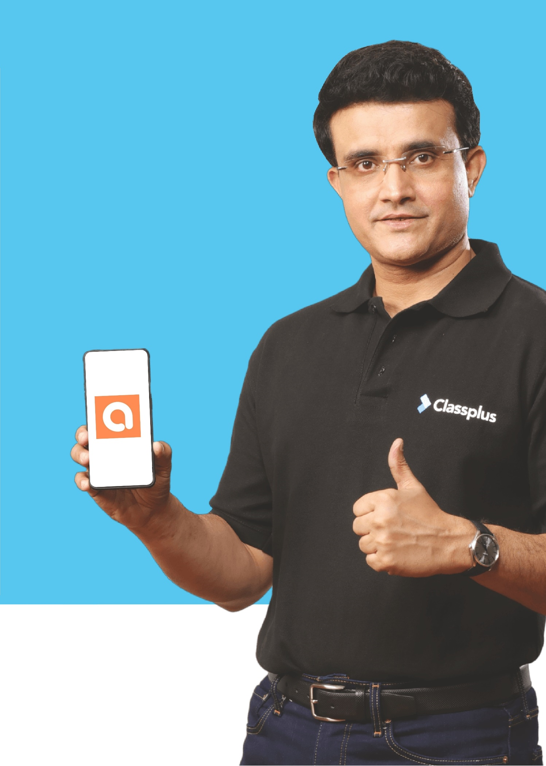

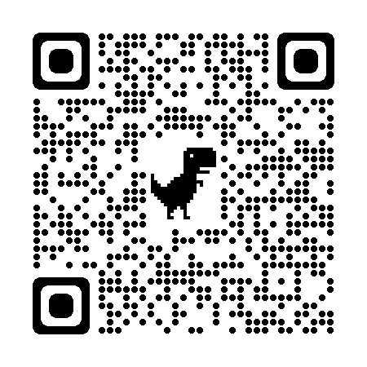



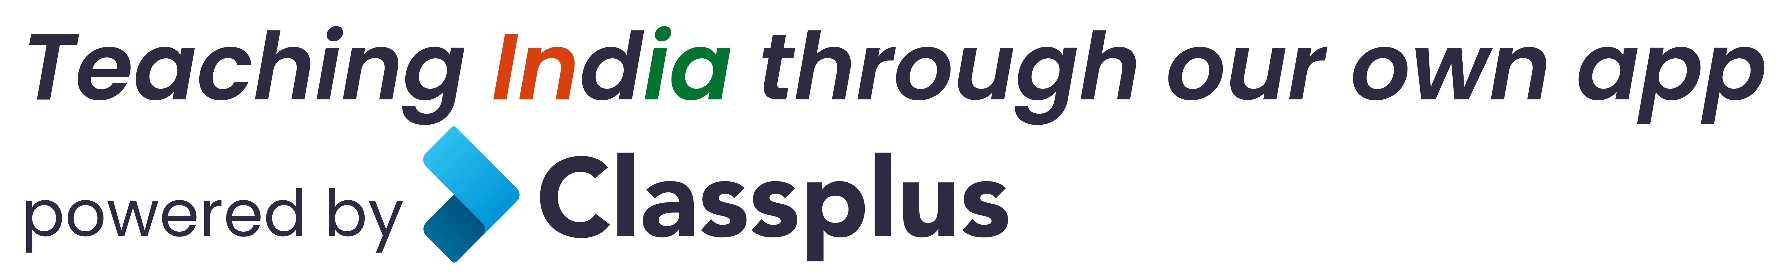
Upto 50% Off
T&C Apply
App Download
Follow
for Discounts
Coaching Classes
9073 700094
N-1/25 Patuli, Kol 94, Near Fire Brigade & Krisi Vikas
Artificial Intelligence - III-XII
IT & AI Training & Projects
Data Science, Computer Vision, NLP, DSP, Python
Data Analytics, C, C++, IoT, Robotics
Java, .NET, JavaScript, ReactJS, Native, PHP
DevOps, Docker, Kubernetes, Cloud
Database, Firebase, Cyber Sec, Automation Test
Pmp, Agile, Office, Adv Excel, Tally, Html, Css
VIII-XII - All Subjects & Boards
NEET, IIT-JEE (Mains & Advanced)
MBA, BBA, Bcom
CA, CMA, CS, CFA, CLAT, LLB, LLM
Grooming, Ielts, Toefl, Foreign Lang
Finest Teachers, Study Materials, Mock Tests, Doubt Clearing, PTM, Counselling
400+ Courses, 20 Smart Classrooms, AC, CCTV
Professional Courses are Project-Based, Certification-Oriented & Job-Focused
www.anodiam.com
anirban@anodiam.com

