Slide 1









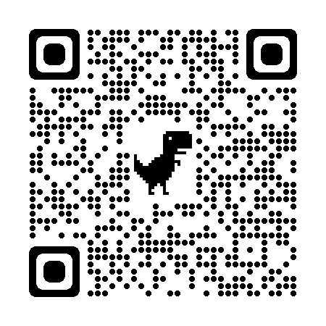
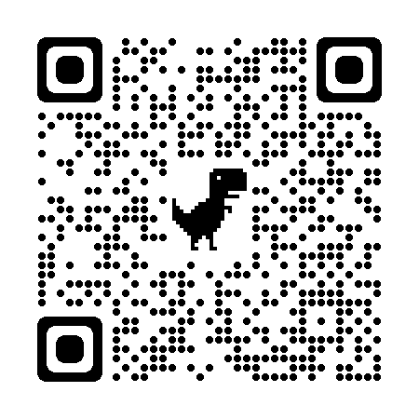


Coaching Classes
9073 700094
N-1/25 Patuli, Kol 94, Near Fire Brigade & Krisi Vikas
Upto 50% Off
T&C Apply
Follow
for Discount
App Download
VIII-XII - All Subjects & Boards
NEET, IIT-JEE (Mains & Advanced)
ARTIFICIAL INTELLIGENCE – Class III – XII
IT & AI Professional Training & Projects
MBA, BBA, BCom, CA, CMA, CS, CFA, CLAT, LLB, LLM
Grooming, IELTS, TOEFL, Foreign Languages
Finest Teachers, Study Mats, Mock Tests, Doubt Clearing, PTM, Counselling, Smart Classrooms, AC, CCTV
400+ Courses, Professional Courses are Project-Based, Certification-Oriented & Job-Focused
www.anodiam.com || anirban@anodiam.com

