Slide 1

Service
to the
Future
Community
Edtech Prospectus – 2023
Enlighten
Educate
Dependable
Professional
Futuristic
Innovate

Slide 2


Edtech Prospectus – Introduction
Mission: To be among 10 largest edtech companies in next 10 years!
Vision: To be the largest AI based education business globally!

Slide 3

Edtech Prospectus – Offline Launch
400+ Courses
53 Top-quality Teachers
6 Departments
6 Head of Departments
Edtech App for online Study Materials
PTM, Counselling, Mock Tests, Doubt Clearing
Individual care, Best teaching techniques
Proj-Based, Certification Help, Career Focused

Slide 4

Edtech Prospectus – Offline Phase I & II
Phase I
NEET, IIT-JEE
VIII-XII – All Subjects & Boards
AI, IT, Robotics, IoT – Junior Classes, School Syllabus to Engineers
Professional IT Courses – AI, Java, Python, Web, Project Management
BCom, BBA, CA, CMA, CS, CFA
Grooming, Interview Prep, Spoken English, IELTS, TOEFL
Teach AI/Robotics/IoT/Coding/Tech in Schools
Phase II
Co-curricular Activities
Junior Section
Other graduation courses
Vocational Trainings

Slide 5
Edtech Prospectus – Offline Facilities
Super Convenient Location
5 Floors
20 Classrooms
Open 7 Days
Team of 6 Efficient Managers
Smart Classrooms: Wi-Fi, Computer Based Displays
Air Conditioned
CCTV
Corporate Management

Slide 6
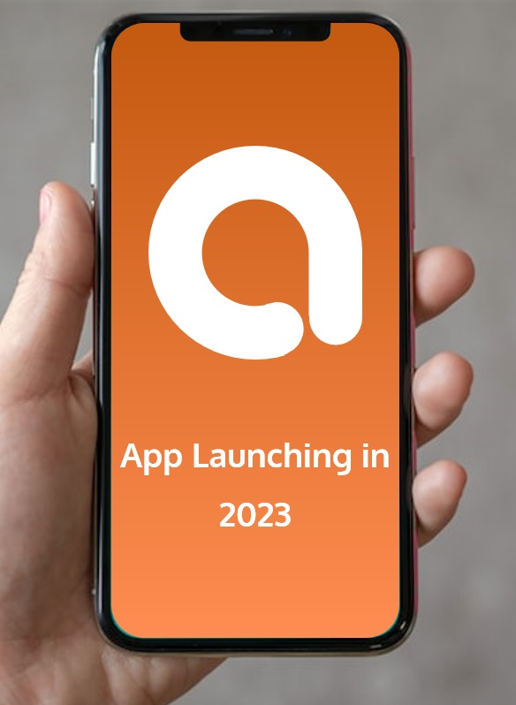
Edtech Prospectus – Online Bytes
Launching 15th of August, 2023
Student App
Teacher App
Teacher App
Admin & Super-admin App
Beyond Brick & Mortar
Sale pan-India
Prerecorded videos, Live classes
Study materials, Mock tests
AR / VR
Reporting & Predictive analytics
Behavioral analysis

Slide 7

Edtech Prospectus – Leadership
Direction & Emphasis
Handpick Teaching and Management Talents
Meticulous Digital & Conventional Marketing
Heavy Inaugural Discounts
Efficient Student Relationship Management
World Class Quality Control
Strategic Tech and AI Focus
Servant Leadership for Knowledge Workers
Professional & Gratifying Environment
Teamwork & Synergy
Effective Marketing & Tech Support
Growth Focused, Ambitious Career

Slide 8

Edtech Prospectus – AI Focus
Data is Key
Present currency vs Future currency
More profound than fire or electricity
Emphasis on Teaching AI
The disruption tsunami
Teacher Shortage: The Good, Bad, Ugly story
Serving the future community most effectively

Slide 9


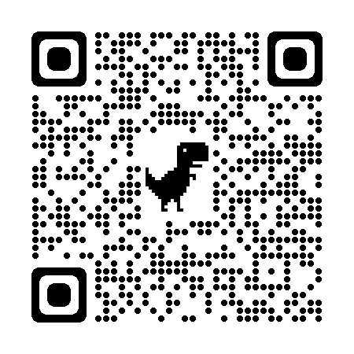




Edtech Prospectus – Contact Us
N-1/25 Kunal Road, Patuli, Kolkata 700094, Near Fire Brigade & Krishi Vikas
anirban@anodiam.com 9073700094 www.anodiam.com
Thank You!

