Slide 1
No. 18

Slide 2
Q.) A two digit number is 3 more than six times the sum of its
digits. If its unit’s and ten’s digit are x and y respectively, write the linear equation representing the above information.
Two digit no. consist of digit in tens place and a digit in units place
Sol.
Let the digit in tens place be 'x' and
the digit in the unit place be 'y'
Tens
Units
1
10
× x
× y
Two digit number is = 10x + y
As per the first condition,
10x + y
=
6
(x + y)
+ 3
10x + y = 6x + 6y + 3
10x – 6x + y – 6y = 3
4x – 5y = 3

Slide 3
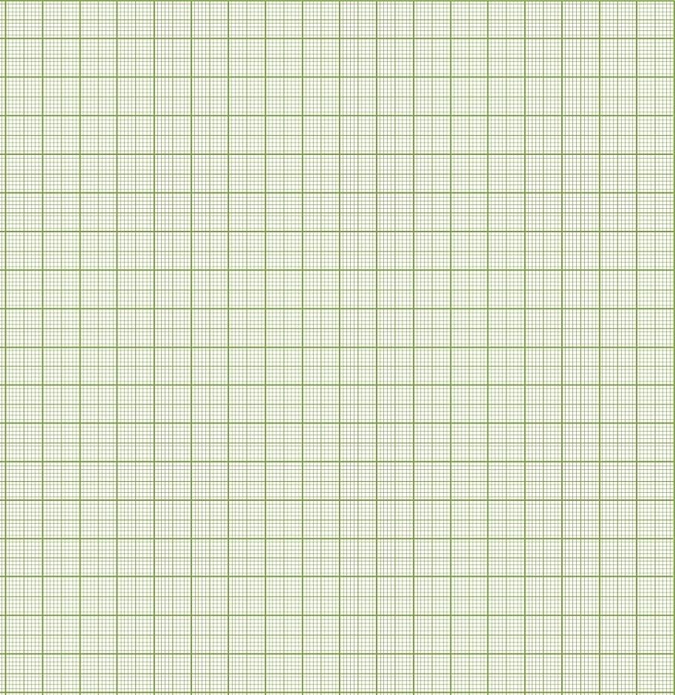





Q. Aarushi was driving a car with uniform speed of 60 km/h. draw distance-time graph. From the graph, find the distance travelled by Aarushi in
Draw a ⊥ from 30⁰C on X-axis till the line graph
(i) 2$\frac{1}{2}$ Hours (ii) $\frac{1}{2}$ Hour
Y
Soln.
We know that,
From the point of intersection drop a ⊥ on Y-axis
Distance = Speed × Time
Draw a ⊥ from 95⁰F on Y-axis till the line graph
210
When Time = 1
180
When Time = 2
From the point of intersection drop a ⊥ on X-axis
150
When Time = 3
Time
1
2
3
D₁
D = 60 × 1
150
D = 60 × 2
D = 60 × 3
Distance
60
120
180
120
D = 60 km
D = 120 km
D = 180 km
90
60
(i) 2$\frac{1}{2}$ Hours
30
D₂
30
2$\frac{1}{2}$ ^{hrs}
T₂
T₁
From graph, distance covered is 150 kms
-6
-5
-4
-3
-2
-1
0
1
2
3
4
5
6
X′
$\frac{1}{2}$ ^{hrs}
X
-30
(ii) $\frac{1}{2}$ Hours
-60
-90
From graph, distance covered is 30 kms
-120
-150
Y′

Slide 4
No. 19

Slide 5
Q. Give the geometric representations of y = 3 as an equation :
(i) in one variable (ii) in two variables
Sol.
(i) When y = 3 is treated as an equation in one variable,
The geometric representation will be on the number line.
Let us draw a number line
y = 3
3 on number line represent y=3
– 3
– 2
– 1
0
1
2
3
4

Slide 6













Q. Give the geometric representations of y = 3 as an equation :
(ii) in two variables
But for making this table,
We have to 1st write this
Equation in the form of
X = something
or Y =something
If we have to write this
Equation as x =
Then shift the term having
Variable y to the R.H.S
Now whichever variable is
in the R.H.S. we will
Assume the values for that
variable
Now let us substitute these
Assumed values of y in the
Equation y = 3 – 0x
Let us represent y = 3 with two variable
Now let us see,
How we do this….
y
We have to prepare
a table of coordinates
for this equation
Sol :
We know that,
y = 3
can be written as
Scale : 1 cm = 1 unit
on both the axes
10
9
8
∴ 0x + y = 3
7
When x = 0
y = 3 – 0( )
y = 3 - 0
y = $\text{3}$
6
When x = 2
y = 3 – 0( )
y = 3 – 0
y = 3
When x = -2
y = 3 – 0( )
y = 3 – 0
y = 3
y = 3
5
A($\text{0}$, 3)
∴
y =
3
- 0 x
4
3
C($−\text{2}$, 3)
2
B($\text{2}$, 3)
-2
2
x
0
x
x
1
x
$$\text{0}$$
$$\text{2}$$
$$\text{−2}$$
X′
–8
–7
–6
–5
–4
–3
–2
–1
0
1
2
3
4
5
6
7
8
X
–1
–2
y
3
3
3
–3
–4
–5
($\text{x}$, y)
($\text{0}$, 3)
($\text{2}$, 3)
($\text{−2}$, 3)
–6
Write the equation on the line
On graph paper 1st plot A($\text{0}$, 3) i.e
On X axis plot 0
and on Y axis plot 3
Now plot C($−\text{2}$, 2)
–7
Now draw a straight line passing through these points A,B and C
–8
Now plot B ($\text{2}$, 3)
–9
–10
Now let us plot the points
In these table on
a graph paper
Y′

Slide 7
Q. Give the geometric representations of 2x + 9 = 0 as an equation :
(i) in one variable (ii) in two variables
Let us solve this equation
Sol.
(i) 2x + 9 = 0
∴ 2x
= - 9
- 9
∴ x =
2
∴ x = - 4.5
∴ When x = - 4.5 is treated as an equation in one variable
Let us draw a number line
The geometric representation will be on the number line.
2x + 9 = 0
-4.5 on number line represent 2x + 9 = 0
– 5
– 4
– 3
– 2
– 1
0
1
2
3
4
5
x = – 4.5

Slide 8

















y
Q. Give the geometric representations of 2x + 9 = 0 as an equation :
(ii) in two variables
Scale : 1 cm = 1 unit
on both the axes
But for making this table,
We have to 1st write this
Equation in the form of
X = something
or Y =something
If we have to write this
Equation as x =
Then shift the term having
Variable y to the R.H.S
Now whichever variable is
in the R.H.S. we will
Assume the values for that
variable
We have to prepare
a table of coordinates
for this equation
10
Now let us substitute these
Assumed values of y in the
Equation x = $\frac{−9}{2}$ - 0y
Now let us see,
How we do this….
Let us represent 2x + 9 = 0
with two variable
9
Sol :
We know that,
2x + 9 = 0
can be written as
8
7
∴ 2x + 0y + 9 = 0
6
5
When y = 0
x = $\frac{−9 −0y}{2}$
x = $\frac{−9 −0}{2}$
x = $\frac{−9}{2}$
When y = 2
x = $\frac{−9 −0y}{2}$
x = $\frac{−9 −0}{2}$
x = $\frac{−9}{2}$
When y = -2
x = $\frac{−9 −0y}{2}$
x = $\frac{−9 −0}{2}$
x = $\frac{−9}{2}$
∴
2x =
- 9
- 0 y
2x + 9 = 0
4
- 9
- 0 y
3
∴
x =
B($\frac{−9}{2}$, 2)
2
2
A($\frac{−9}{2}$, 0)
1
$$\frac{−9}{2}$$
$$\frac{−9}{2}$$
$$\frac{−9}{2}$$
X′
X
x
–8
–7
–6
–5
–4
–3
–2
–1
0
1
2
3
4
5
6
7
8
–1
C($\frac{−9}{2}$, -2)
–2
y
0
2
-2
–3
Write the equation on the line
–4
On graph paper 1st plot A($\frac{−9}{2}$, 0) i.e
On X axis plot $\frac{−9}{2}$ and on Y axis plot 0
($\text{x}$, y)
($\frac{−9}{2}$, 0)
Now plot C($\frac{−9}{2}$, 2)
($\frac{−9}{2}$, 2)
($\frac{−9}{2}$, -2)
–5
Now draw a straight line passing through these points A,B and C
Now plot B ($\frac{−9}{2}$, 2)
–6
–7
–8
Now let us plot the points
In these table on
a graph paper
–9
–10
Y′

Slide 9
No. 20

Slide 10
Q.] Express the following linear equations in the form ax + by + c = 0 and
indicate the values of a, b and c in each case :
(vii)
y – 2 = 0
Sol.
y – 2 = 0
∴
0x
+
1y
–
2
=
0
On comparing with ax + by + c = 0, we have,
Comparing eq^{n} with ax + by + c = 0
a = 0,
b = 1,
and c = – 2.

Slide 11
Q.] Check which of the following are solutions of the equation x – 2y = 4
and which are not :
(ii)
(2, 0)
Sol.
x – 2y = 4
Putting x = 2, y = 0 in L.H.S. of x – 2y = 4,
We have
L.H.S.
=
x
–
2y
L.H.S.
=
2
–
2
(0)
=
2
–
0
=
2
≠
R.H.S.
∴
x = 2, y = 0 is not its solution.

Slide 12
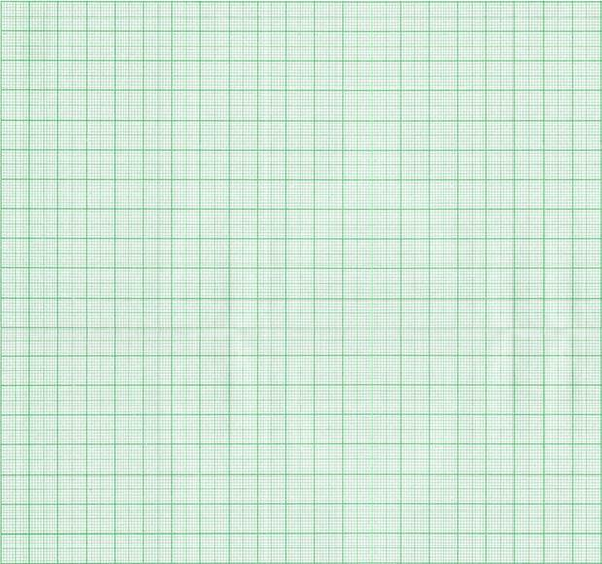
Q.] Draw the graph of each of the following linear equations in two variables :
We have to prepare
a table of coordinates
for this equation
(i)
y = 3x
Sol.
We have, y = 3x
y
Scale : 1 cm = 1 unit
on both the axes
4
x
0
1
–1
3
y
0
3
–3
y = 3x
B (1, 3)
2
(x, y)
(0, 0)
(1, 3)
(–1, –3)
1
When x = 0
When x = 1
A (0, 0)
y
y
=
3(0)
=
3(1)
X′
–3
–2
–1
0
1
2
3
X
=
0
=
3
–1
When x = – 1
C (-1,- 3)
–2
y = 3(–1) = – 3
–3
= – 3
Y′

Slide 13
No. 21

Slide 14
Q. Find a and b if the points P (3, 0) and Q lie on the graph
ax + by = 12.
Sol.
Since point P (3, 0) lie on graph ax + by = 12 it satisfies the equation.
Substituting x = 3, y = 0 in the equation ax + by = 12
a
×
(3)
+
b
×
(0)
=
12
∴
8
4b
=
12
+
∴
3a
3
+
0
=
12
12
∴
4b
=
12
∴
a
=
–
8
3
3
∴
a
=
4
∴
4b
=
4
3
Similarly Q lie on the graph ax + by = 12
∴
b
=
3
4
×
4
Hence it will also satisfy the equation.
∴
b
=
3
Substituting x = 2, y = , a = 4 in the equation ax + by = 12
4
×
(2)
+
b
×
=
12

Slide 15
Thank You

