Slide 1
CIRCLE
A
D
B
A
D
C
∠A+ ∠C = 180º
∠B+ ∠D = 180º
O
A
C
B
O
∠A = ∠D
B
C
∠O = 2∠A

Slide 2
MODULE 1

Slide 3
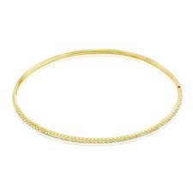
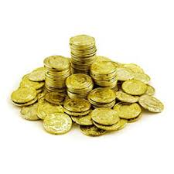

✗
✗
CIRCLE
Let us see some examples of circle from day-to-day life.
Bangle
Ball
Coins
Why are these
examples wrong ?
For this, let’s
understand the
definition of circle
Of these 4 examples,
2 are wrong
Boundary rope of a cricket ground

Slide 4
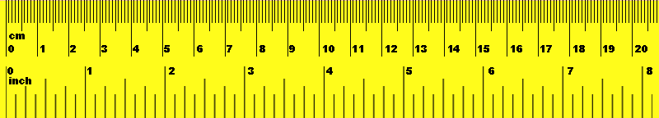

CIRCLE
Circle is the set of points in a given plane
which are at a fixed
distance from a fixed point.
Each of these points here satisfy a condition
No
What can you say about OA, OB, OC, OD and OE
B
OA = OB = OC = OD = OE
can any set of points in plane be called as a circle ?
All these points are equidistant from a fixed point O
Let us understand that
A circle with
centre O
What do you observe ?
Let us define circle
?
?
C
?
4 cm
A
4 cm
No
4 cm
Are these set of
points circles ?
O
4 cm
4 cm
This fixed distance is called a radius
D
E

Slide 5
CIRCLE
A segment joining two distinct points on a circle is called a chord.
Remember :
Radii of the same circle are EQUAL
D
Let us consider 2 distinct points C and D
How many such radii can we draw in a circle ?
Now let us understand few more elements of circle
Such a segment is called a chord
A segment
Infinite
Radius
How many chords can we draw in a circle ?
Infinite
What is OA ?
chord
What do we get ?
Join them
C
A
radius
O

Slide 6
CIRCLE
A chord passing through the centre of the circle is called a diameter.
P
D
But, this is a special chord
It is a chord
How many such diameters can we draw in a circle ?
Infinite
What is seg PQ ?
Because it passes through the centre
chord
C
A
radius
O
Such a chord is called a diameter
diameter
Q

Slide 7
MODULE 2

Slide 8
THEOREM
Equal chords of congruent circles subtend
equal angles at their centre
Given :
AB and CD are two equal chords
of congruent circles with centre
at O and P resp.
O
P
To prove :
=
∠AOB
∠CPD
A
B
C
D
Proof :
In Δ AOB and Δ CPD,
Angle subtended
by chord AB at the
centre is ______
Angle subtended
by chord CD at the
centre is ______
For proving angles equal,
Prove triangles congruent
CP
[Radii of the congruent circles]
AO =
BO =
[Radii of the congruent circles]
DP
∠CPD
∠AOB
?
?
AB =
[Given]
CD
∴
ΔAOB ≅
ΔCPD
[By SSS criterion]
∴
∠AOB =
∠CPD
[C.P.C.T.]

Slide 9
MODULE 3

Slide 10
THEOREM
If chords of congruent circles subtend equal
angles at their centre, then the chords are equal.
Given :
∠AOB
=
∠CPD
To Prove :
O
P
AB
=
CD
Proof :
A
B
C
D
In ΔAOB and ΔCPD,
AO =
CP
[Radii of the congruent circles]
Angle subtended
by chord CD at the
centre is ______
Angle subtended
by chord AB at the
centre is ______
For proving chords equal,
Prove triangles congruent
∠AOB =
∠CPD
[Given]
∠AOB
?
∠CPD
BO =
DP
?
[Radii of the congruent circles]
∴
ΔAOB ≅
ΔCPD
[SAS criterion]
∴
CD
AB =
[C.P.C.T]

Slide 11
MODULE 4

Slide 12
THEOREM
The perpendicular drawn from the centre of a circle to a chord
bisects the chord
Given :
In a circle with centre P,
PE ⊥ AB,
A–E–B
P
To prove :
AE = EB
Construction :
Draw PA and PB
Do we have triangles ?
A
E
B
For proving sides equal,
Prove triangles congruent
Proof :
Once triangles are congruent,
Remaining parts are automatically equal
By drawing
PA and PB
Will have to create..
NO
means Chord getting
divided into two equal parts
In ΔPEA and ΔPEB,
∠PEA = ∠PEB = 90º
hypt. PA = hypt. PB
PE = PE
ΔPEA ≅ ΔPEB
[Given]
[Radii of same circle]
[Common side]
[RHS rule]
∴ AE = EB
[c.p.c.t.]

Slide 13
MODULE 5

Slide 14
Q. The radius of a circle with centre P is 25 cm and length of
chord is 48 cm. Find the distance of the chord from centre P of the circle.
Given :
In a circle with centre P,
PM ⊥ AB, PA = 25 cm,
We know that,
Perpendicular drawn from the centre to the chord, bisects the chord
AB = 48 cm
P
To find :
PM
In ΔPMA,
∠PMA = 90º
25
Sol :
PM ⊥ AB,
?
PA² =
PM² +
AM²
A
24
M
B
1
[Pythagoras theorem]
∴ AM =
AB
48
2
∴ 25² =
PM² +
24²
[Perpendicular drawn from
centre of the circle to the
chord bisects the chord]
Consider ΔPMA
∴ 625 =
PM² +
576
∴ 625
– 576
= PM²
1
∴ PM² =
49
∴ AM =
x 48
∴ PM =
7 cm
[Taking square roots]
2
Distance of chord AB from centre P is 7 cm.
∴ AM = 24 cm

Slide 15
MODULE 6

Slide 16
Q. AP = 34, AM = 30. If AM ⊥ PQ, find the length of PQ.
Given :
In a circle with centre A,
AM ⊥ PQ,
AM = 30, AP = 34
Consider ΔAMP
A
To find :
PQ
34
30
Sol :
AM ⊥ PQ,
1
P
16
M
Q
In ΔAMP,
∠AMP = 90º
∴ PM =
PQ
2
[Perpendicular drawn from
centre of the circle to the
chord bisects the chord]
We know that,
Perpendicular drawn from the centre to the chord, bisects the chord
AP² =
AM² +
PM²
[Pythagoras theorem]
∴ 34² =
30² +
PM²
1
∴ 1156 =
900 +
PM²
∴ 16 =
PQ
∴ PM²
= 1156 - 900
2
∴ PM² =
256
∴ PQ = 32
∴ PM =
16
[Taking sq. roots]
Length of PQ is 32 units.

Slide 17
Thank You

