Slide 1
Module 5

Slide 2
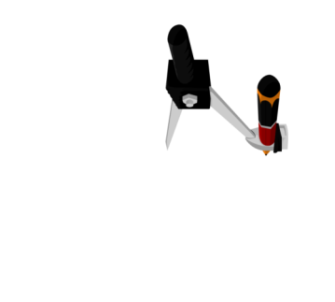
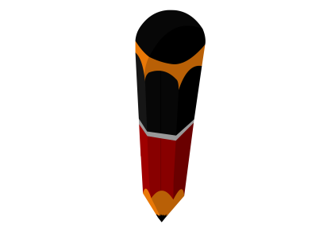
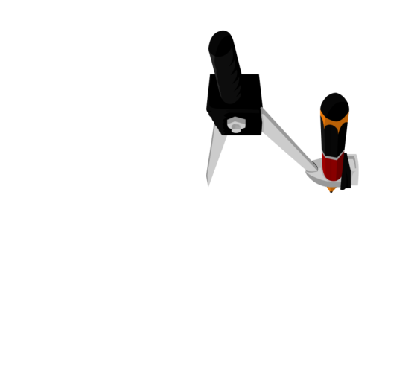

Q. Construct the angles of the following measurements :
Draw a ray OA
Rough fig.
(iii) 15⁰
With Y as the centre and same radius, draw intersecting arcs
So, what can we say about ∠AOD and ∠AOX ?
With C as the centre and same radius, draw an arc intersecting at B
With O as the centre and any suitable radius, draw an arc intersecting ray OA at C.
D
1
So, what can we say about ∠AOX and ∠AOB ?
With C as the centre and radius more than half of CY, draw an arc
1
Draw the bisector of ∠AOB
With C as the centre and radius more than half of CP, draw an arc
OD is the bisector of ∠AOX
OX is the bisector of ∠AOB
∠AOB = 60º
With P as the centre and same radius, draw intersecting arcs.
∠AOD =
∠AOX
Draw the bisector of ∠AOX
Draw CY
Draw OX
Draw CP
Draw OD
∠AOX =
∠AOB
∠AOB = 60º
2
∠AOX = 30º
2
15⁰
O
A
Justification
OD is the bisector of ∠AOX
B
∠AOB = 60º
OX is the bisector of ∠AOB
1
∠AOD =
∠AOX
2
1
P
∠AOX =
∠AOB
1
X
2
=
× 30
Y
1
2
D
=
× 60
Z
2
∴ ∠AOD = 15º
15⁰
∴ ∠AOX = 30º
O
C
A
1
2
3
4
5
6
7
8
9
10
11
12
13
14
15

Slide 3
Module 6

Slide 4
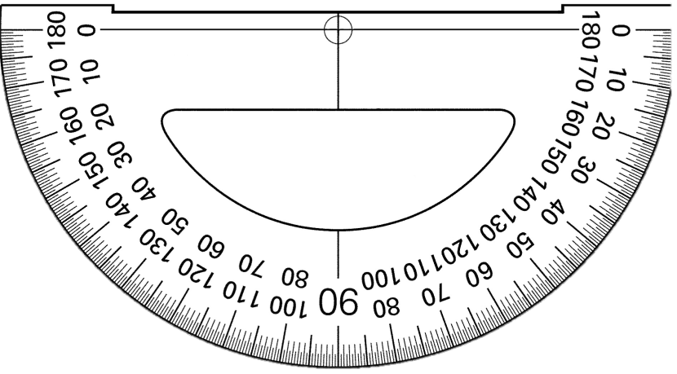
Q. Construct the following angles and verify by measuring
them by protractor :
Rough fig.
With E as the centre and same radius, draw an intersecting arc
(i) 75⁰
Justification
With P as the centre and same radius, draw an intersecting arc.
With D as the centre and radius more than half of DP, draw an arc
With C as the centre and same radius, draw an arc intersecting at D.
With D as the centre and radius more than half of DE, draw an arc.
With D as the centre and same radius, draw an arc intersecting at E.
With O as the centre and any suitable radius, draw an arc.
Draw PD
Draw ED
Draw OB
∠BOA = 75º
∠POA = 90º
Draw a ray OA.
B
∠QOA = 60º
∠POQ + ∠QOA = ∠POA
75⁰
Draw OF
O
Q
∴ ∠POQ + 60 = 90
A
∴ ∠POQ = 90 – 60
Ray OB bisect ∠POQ
B
F
∴ ∠POQ = 30º
1
∠BOQ =
∠POQ
2
P
1
E
=
× 30
D
2
∴ ∠BOQ = 15º
75⁰
∠BOA = ∠BOQ + ∠QOA
O
C
A
1
2
3
4
5
6
7
8
9
10
11
12
13
14
15
= 15 + 60
∴ ∠BOA = 75º

Slide 5
Module 7

Slide 6
Q. Construct the following angles and verify by measuring them
by protractor :
Rough fig.
Z
With P as the centre and same radius, draw an arc intersecting at R.
With Q as the centre and same radius, draw intersecting arcs
With R as the centre and same radius, draw an arc intersecting at Q.
With S as the centre and radius more than half of SQ, draw an arc
With Q as the centre and radius more than half of RQ, draw an arc
With R as the centre and same radius, draw an intersecting arc.
With Y as the centre and any suitable radius, draw an arc
1
Draw a ray XY
(ii) 105⁰
∠BYZ =
∠BYT
Draw YB
Draw RQ
105⁰
∠XYT = 120º
YZ is the bisector of ∠BYT
∴ ∠XYZ =
∠XYB = 90º
∠XYB
+ ∠BYZ
2
Draw SQ
∠BYT = ∠XYT – ∠XYB
X
Y
T
Justification
YZ is the bisector of ∠BYT
∠XYB = 90º
1
∠BYZ =
∠BYT
∠XYT = 120º
2
B
Z
∠BYT = ∠XYT – ∠XYB
1
= 120 – 90
=
× 30
2
S
= 30º
∴ ∠BYZ = 15º
R
Q
∠XYZ = ∠XYB + ∠BYZ
= 90 + 15
X
1
2
P
Y
9
= 105º
3
4
5
6
7
8
10
11
12
13
14
15

Slide 7
Module 8

Slide 8
Q. Construct the following angles and verify by measuring
them by protractor :
With O as the centre and any suitable radius, draw an arc intersecting line OA at B and L.
With L as the centre and same radius, draw an intersecting arc
With G as the centre and radius more than half of GL, draw an arc
Rough fig.
Draw a line
With B as the centre and same radius, draw an arc intersecting at C.
So, what can we say about ∠EOF and ∠EOL
With D as the centre and same radius, draw an intersecting arc
OF is the bisector of ∠EOL
With C as the centre and same radius, draw an arc intersecting at D.
With C as the centre and radius more than half of CD, draw an arc.
∴ ∠AOF =
1
(ii) 135⁰
∠EOF =
∠AOE
+ ∠EOF
∠EOL
2
F
Draw GL
Draw CD
Draw OE
135º
Justification
O
A
E
∠AOE = ∠EOL = 90º
OF is the bisector of ∠EOL
1
F
G
∴∠EOF =
∠EOL
D
2
C
1
=
× 90
2
∴ ∠EOF = 45º
L
O
B
A
1
2
3
4
5
6
7
8
9
10
11
12
13
14
15
∴∠AOF = ∠AOE + ∠EOF
= 90
+ 45
∴∠AOF = 135º

Slide 9
Thank You

