Slide 1
Module 13

Slide 2
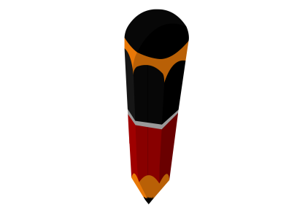
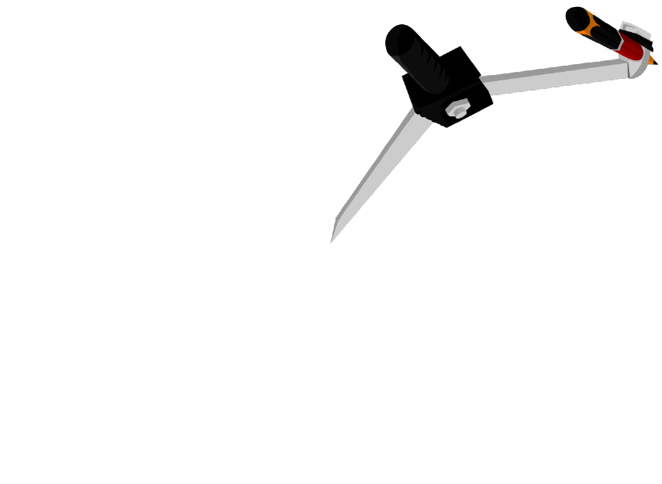
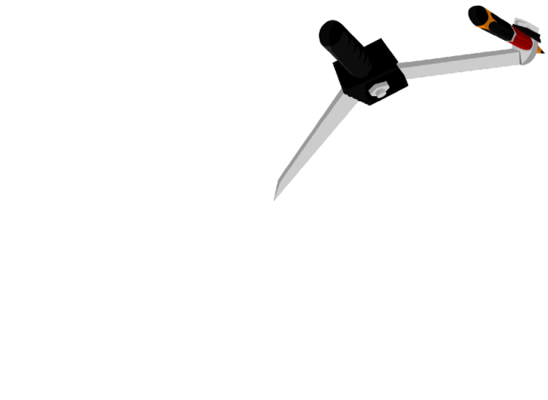
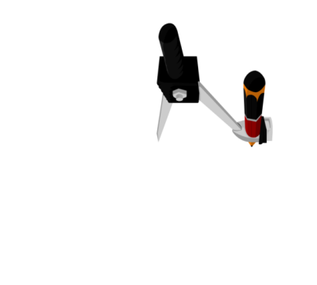
Q.
Construct a triangle XYZ in which ∠Y = 30º, ∠Z = 90º
and XY + YZ + ZX = 11 cm.
Let the intersection point be X
Rough fig.
Δ XYZ is the required triangle
m
X
n
Draw perpendicular
bisector of XQ
Draw line segment
PQ = 11 cm
n intersect PQ at Z
Draw perpendicular
bisector of PX
m intersect PQ at Y
Bisect ∠KPQ
Bisect ∠LQP
Draw ∠Q = 90°
Join XZ
With A as the centre and same radius, draw an arc intersecting at B
With G as the centre and radius more than half of GH, draw an arc
With X as the centre and same radius, draw arcs
With E as the centre and same radius, draw an arc intersecting at F
With Q as the centre and any suitable radius, draw an arc
With D as the centre and same radius, draw an arc intersecting at E
With P as the centre and any suitable radius, draw an arc
Draw PK
With P as the centre and radius more than half of PX, draw arcs
With X as the centre and radius more than half of QX, draw arcs
Draw QL
Join XY
With F as the centre and same radius, draw an arc
Draw PI
Draw ∠P = 15°
With C as the centre and same radius, draw an arc
With A as the centre and radius more than half of AC, draw an arc
With B as the centre and same radius, draw an arc
With A as the centre and radius more than half of AB, draw an arc
∠YPX = ∠ YXP
Let ∠YPX = ∠ YXP = a
∴ ∠XYZ = ∠XPY + ∠YXP
∴ 30 = a + a
∴ 2a = 30
∴ a = 15
∴ ∠P = 15º
Similarly,
∠Q =
=
∠Q = 45º
a
With H as the centre and same radius, draw an arc
With Q as the centre and same radius, draw arcs
With E as the centre and radius more than half EF, draw an arc
Draw AC
Draw AB
Draw QK
Draw GH
Draw EF
a
30º
P
15º
45º
Y
Z
Q
m
n
1
We know that exterior angle is equal to sum of two interior opposite angles.
∠XZY
We know that angles opposite to equal sides are equal.
2
∠XYZ is an exterior angle of ΔXYP
∴ ∠YPX = ∠YXP
Consider ΔXYP
1
× 90
X
2
XY = PY
K
L
XZ = ZQ
K
H
E
XY + YZ + XZ = 11 cm
B
I
F
C
PY + YZ + ZQ = 11 cm
PQ = 11 cm
15º
30⁰
1
2
3
4
5
6
7
8
9
10
11
12
13
14
15
P
A
Y
Z
G
Q
D
1
2
3
4
5
11 cm
7
8
9
1
2
3
4
5
6
6
7
8
9
10
10
11
12
13
14
15
11
12
13
14
15
1
2
3
4
5
6
7
8
9
10
11
12
13
14
15
1
2
3
4
5
6
7
8
9
10
11
12
13
14
15

Slide 3
Module 14

Slide 4
Q.
Construct a triangle XYZ in which ∠Y = 30º, ∠Z = 90º
and XY + YZ + ZX = 11 cm.
Let the intersection point be X
Rough fig.
Δ XYZ is the required triangle
m
X
n
Draw perpendicular
bisector of XQ
Draw line segment
PQ = 11 cm
n intersect PQ at Z
Draw perpendicular
bisector of PX
m intersect PQ at Y
Bisect ∠KPQ
Bisect ∠LQP
Draw ∠Q = 90°
Join XZ
With A as the centre and same radius, draw an arc intersecting at B
With G as the centre and radius more than half of GH, draw an arc
With X as the centre and same radius, draw arcs
With E as the centre and same radius, draw an arc intersecting at F
With Q as the centre and any suitable radius, draw an arc
With D as the centre and same radius, draw an arc intersecting at E
With P as the centre and any suitable radius, draw an arc
Draw PK
With P as the centre and radius more than half of PX, draw arcs
With X as the centre and radius more than half of QX, draw arcs
Draw QL
Join XY
With F as the centre and same radius, draw an arc
Draw PI
Draw ∠P = 15°
With C as the centre and same radius, draw an arc
With A as the centre and radius more than half of AC, draw an arc
With B as the centre and same radius, draw an arc
With A as the centre and radius more than half of AB, draw an arc
∠YPX = ∠ YXP
Let ∠YPX = ∠ YXP = a
∴ ∠XYZ = ∠XPY + ∠YXP
∴ 30 = a + a
∴ 2a = 30
∴ a = 15
∴ ∠P = 15º
Similarly,
∠Q =
=
∠Q = 45º
a
With H as the centre and same radius, draw an arc
With Q as the centre and same radius, draw arcs
With E as the centre and radius more than half EF, draw an arc
Draw AC
Draw AB
Draw QK
Draw GH
Draw EF
a
30º
P
15º
45º
Y
Z
Q
m
n
1
We know that exterior angle is equal to sum of two interior opposite angles.
∠XZY
We know that angles opposite to equal sides are equal.
2
∠XYZ is an exterior angle of ΔXYP
∴ ∠YPX = ∠YXP
Consider ΔXYP
1
× 90
X
2
XY = PY
K
L
XZ = ZQ
K
H
E
XY + YZ + XZ = 11 cm
B
I
F
C
PY + YZ + ZQ = 11 cm
PQ = 11 cm
15º
30⁰
1
2
3
4
5
6
7
8
9
10
11
12
13
14
15
P
A
Y
Z
G
Q
D
1
2
3
4
5
11 cm
7
8
9
1
2
3
4
5
6
6
7
8
9
10
10
11
12
13
14
15
11
12
13
14
15
1
2
3
4
5
6
7
8
9
10
11
12
13
14
15
1
2
3
4
5
6
7
8
9
10
11
12
13
14
15

Slide 5
Module 15

Slide 6
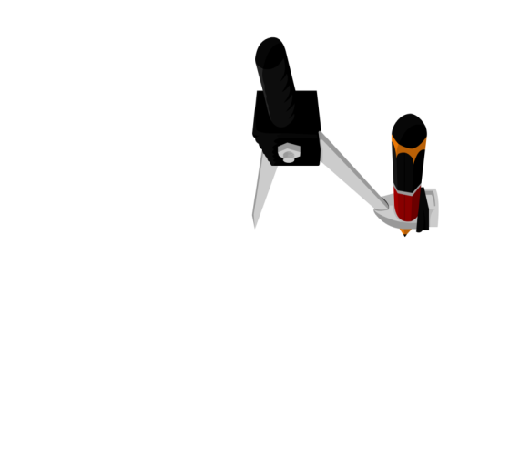

Q. Construct a right triangle whose base is 12 cm and sum of its hypotenuse and other side is 18 cm.
D
D
Rough fig.
l
AB + AC = 18 cm
[Given]
With F as the centre and same radius, draw an arc intersecting at G
With E as the centre and same radius, draw an arc intersecting at F
But AD = AC
With G as the centre and radius more than half of FG, draw an arc
With B as the centre and any suitable radius, draw an arc
ΔABC is a
required triangle
With F as the centre and same radius, draw an intersecting arc
Draw FG
AB + AD = 18 cm
E
∴ BD = 18 cm
A
1
2
3
4
5
6
7
8
9
10
11
12
13
14
15
16
17
18
1
2
3
4
5
6
7
8
9
10
11
12
13
14
15
16
17
18
18 cm
1
2
3
4
5
1
6
7
8
9
10
11
12
13
14
15
16
17
18
16
17
18
2
3
4
5
6
7
8
9
10
11
12
13
14
15
B
C
1
2
3
4
5
6
7
8
9
10
11
12
13
14
15
16
17
18
12 cm
Justification
A
Construct ∠B = 90°
ΔAED ≅ ΔAEC
[SAS criterion]
Draw perpendicular bisector of CD.
Draw AC
With C as the centre and radius more than half of DC, draw arcs
Draw CD
With D as the centre and same radius, draw arcs
BC = 12 cm
BD = 18 cm
∴ AD = AC
[CPCT]
F
AB + AD = BD
Draw BX
G
∴ AB + AD = 18 cm
1
2
3
4
5
6
7
8
9
10
11
12
13
14
15
16
17
18
∴ AB + AC = 18 cm
B
E
12 cm
C
X
1
2
3
4
5
6
7
8
9
10
11
12
13
14
15
16
17
18

Slide 7
Thank You

