Slide 1

STUDENTS’ DROP-OFF/PICK-UP
NO UNSOLICITED GUARDIANS/COHORTS BEYOND THIS POINT
Call 9073700094 / 9163685448
Serious learning upstairs

Slide 2

CCTV SURVEILLANCE NOTICE
THIS BUILDING IS UNDER 24-HOUR VIDEO SURVEILLANCE

Slide 3
NO UNSOLICITED ADMISSION
24-HOUR VIDEO SURVEILLANCE
TRESPASSERS WILL BE PROSECUTED

Slide 4
Level - 1

Slide 5

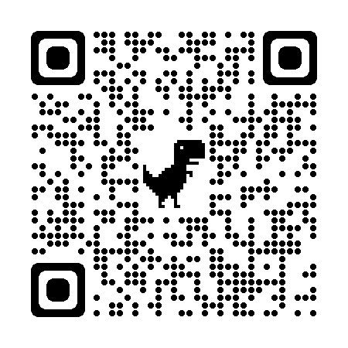
Sagittarius A*
This is supermassive black hole at the center of our Milky Way galaxy!
To know more, scan the QR code or visit https://en.wikipedia.org/wiki/Sagittarius_A*

Slide 6
- 1
TOILET
MEN

Slide 7

KEEP CALM
AND SHOW
DIGNITY & SELF-RESPECT
KEEP TOILET CLEAN & DRY
FOR NEXT USERS & CLEANERS

Slide 8

- 1
PANTRY

Slide 9

KEEP CALM
AND
CLEAN AFTER YOURSELF
WE AIN’T YOUR MOM

Slide 10
NOTICE BOARD

Slide 11
nirban hakrabarty

Slide 12

AUDIO & VIDEO RECORDING
LET US KNOW IF YOU DO NOT WANT YOUR VOICE TO BE RECORDED

Slide 13
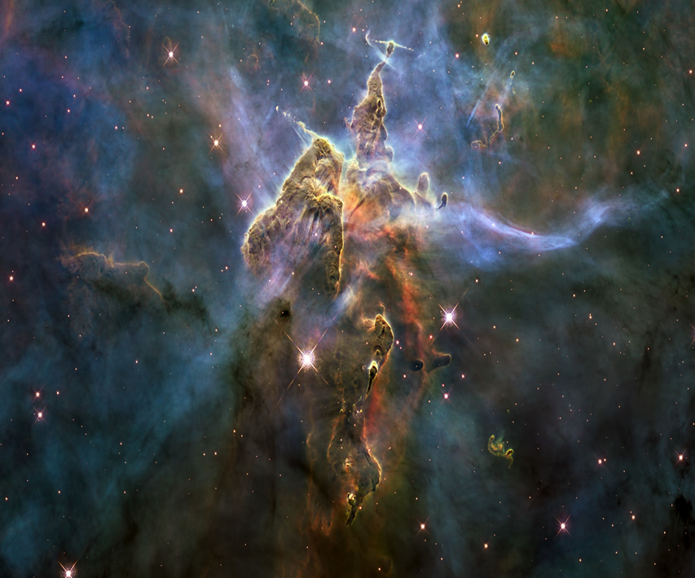
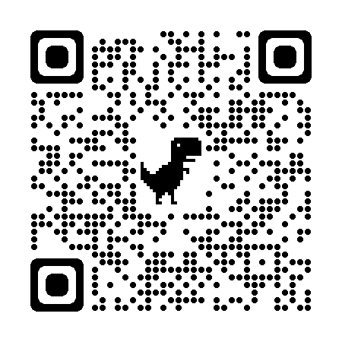
Carina Nebula
This is one of the largest stellar nurseries where new stars are being born!
To know more, scan the QR code or visit https://en.wikipedia.org/wiki/Carina_Nebula

Slide 14
FOCUS
CONCEPT
PRACTICE
SUCCESS

Slide 16
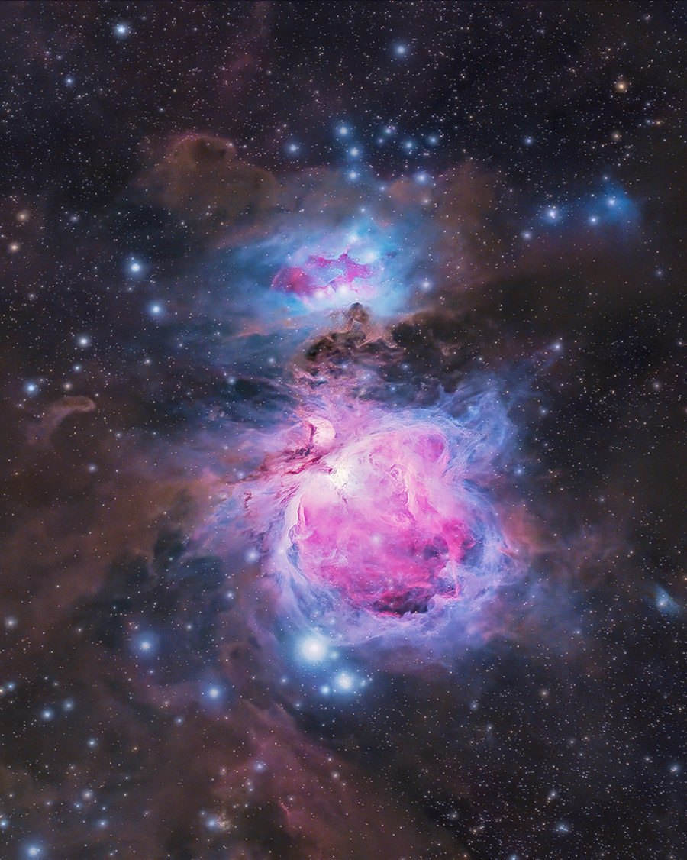
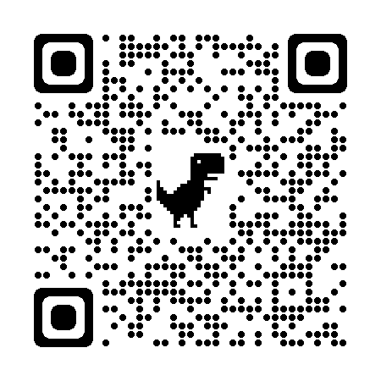
Orion Nebula
The "middle star" in Orion's Sword is a nebula, giving birth to new stars!
To know more, scan the QR code or visit https://en.wikipedia.org/wiki/Orion_Nebula

Slide 17
DREAM
LEARN
ENDURE
INNOVATE

Slide 18

HOUSE
KEEPING

Slide 19
- 1
PRIVATE
DO NOT ENTER

Slide 21
Level - 2

Slide 22
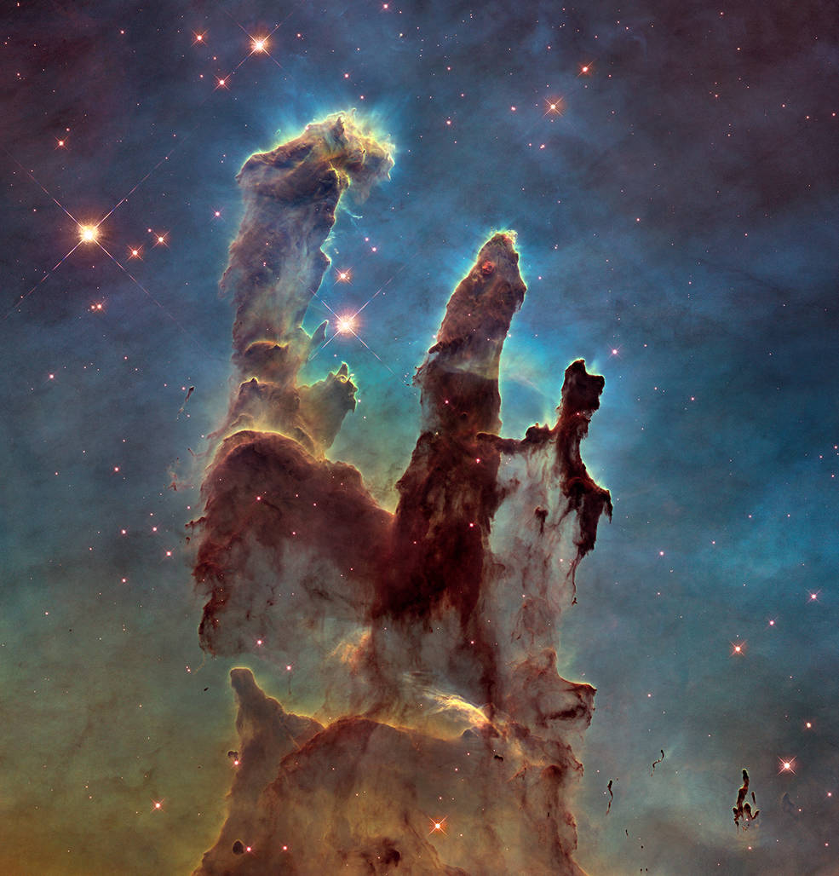
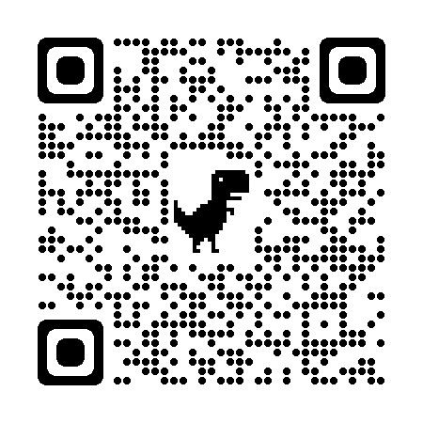
Eagle Nebula
This nebula contains the "Pillars of Creation“, an active star-forming gas & dust region!
To know more, scan the QR code or visit https://en.wikipedia.org/wiki/Eagle_Nebula

Slide 23
Level - 2
Return key to reception
Level - 2
Return key to reception
E
KEYS AT RECEPTION

Slide 24
TOILET
WOMEN

Slide 25
KEEP CALM
AND SHOW
DIGNITY & SELF-RESPECT
KEEP TOILET CLEAN & DRY
FOR NEXT USERS & CLEANERS

Slide 26
HOUSE
KEEPING

Slide 27
- 1
PRIVATE
DO NOT ENTER

Slide 28

NO ADMISSION
BEYOND THIS POINT
24-HOUR VIDEO SURVEILLANCE
TRESPASSERS WILL BE PROSECUTED
UNATTENDED AREA DANGER

Slide 29
Level - 3
NO ADMISSION
24-HOUR VIDEO SURVEILLANCE
TRESPASSERS WILL BE PROSECUTED
UNATTENDED AREA DANGER

Slide 30
HOUSE
KEEPING

Slide 31
- 1
PRIVATE
DO NOT ENTER

Slide 32
- 1
PRIVATE
DO NOT ENTER

Slide 33
NO ADMISSION
24-HOUR VIDEO SURVEILLANCE
TRESPASSERS WILL BE PROSECUTED
UNATTENDED AREA DANGER

Slide 34
NO ADMISSION
24-HOUR VIDEO SURVEILLANCE
TRESPASSERS WILL BE PROSECUTED
UNATTENDED AREA DANGER

Slide 35
NO ADMISSION
24-HOUR VIDEO SURVEILLANCE
TRESPASSERS WILL BE PROSECUTED
UNATTENDED AREA DANGER

Slide 36
NO ADMISSION
24-HOUR VIDEO SURVEILLANCE
TRESPASSERS WILL BE PROSECUTED
UNATTENDED TERRACE DANGER

Slide 37
UPSTAIRS Level - 2
E
KEYS AT L-1 RECEPTION
E
KEYS AT L-1 RECEPTION

Slide 38
LETTER BOX || SUGGESTION BOX
rati hakraborty
nirban hakrabarty

Slide 39


NO SMOKING
EDUCATIONAL INSTITUTION SMOKE FREE RULES
TOBACCO CONTROL ACT, GOVT OF INDIA

Slide 40
NO
CHEWING TOBACCO
NO BETEL, BETEL-NUT, CHEWING GUM POLICY
EDUCATIONAL INSTITUTION TOBACCO CONTROL ACT, GOVT OF INDIA

Slide 41


Slide 42



DO NOT FLUSH SANITARY WASTE
PLEASE USE THE BIN

Slide 43

No Mobile Phones
Beyond this point
Teachers & students must stow away devices in silent mode
Emergency Usage Allowed only after permission from Anodiam office
Corporate permit-holders excepted for official usage only
No recreational use
Respect– Pay it to earn it

Slide 44
Zero Tolerance for Threats and Disruptive Behavior!
You Deserve Good!
We Deserve Good!
All Violent and Threatful Actions and Beauvoir Will Be Reported to Police Under Section 504 of Indian Penal Code, 1860

Slide 45

EMERGENCY
EMERGENCY
POLICE - 100, 109
FIRE - 101
AMBULANCE - 102
POLICE - 100, 109
FIRE - 101
AMBULANCE - 102
Lal Bazar: 033 2214 3230/3024
Patuli PS (L): 629 225 8606
(M): 8100976502
Patuli Fire Station: 033 2436 0685
Rai Ambulance: 94320 59771
Child Help Line: 1098
Women Help Line: 1091
Emergency Response: 112
Lal Bazar: 033 2214 3230/3024
Patuli PS (L): 629 225 8606
(M): 8100976502
Patuli Fire Station: 033 2436 0685
Rai Ambulance: 94320 59771
Child Help Line: 1098
Women Help Line: 1091
Emergency Response: 112

Slide 46



Serious Educational Institution
Never Jump
a Queue
Never Jump
a Queue
Respect– Pay it to earn it

Slide 47
Press The Bell

Slide 48

e05a

Slide 49
Seminar on Ist Floor

