Slide 1

Artificial Intelligence
& Data Science
Make India
an AI
Super Power
Artificial Intelligence
nodiam, Education that enlightens!
Dependable Competency Partners
Expert Industry Veterans
Lucid & Practical
IT
Competency
Scientific
Knowledge

Slide 2
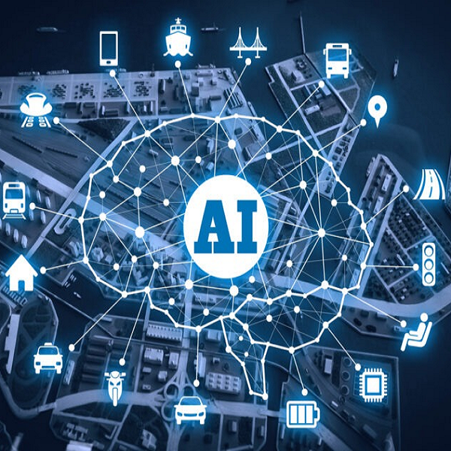
AI-ML & Data Science Boot Camp: Iron Shield 2024
Weekend 1
Artificial Intelligence Basics
LLM & GAN
ChatGPT
Python for Data Science
Vectorization
NumPy & Pandas
Matplotlib & Seaborn
TensorFlow, Keras & PyTorch
Weekend 2
Hands-on OpenCV
Facial Recognition (Computer vision)
Video Processing
Make your Own Chat Bot
NLP Cloud Service
Weekend 3
Computer Vision CNN
CNN Deep Dive
Keras Features
Hands on DSP Alive
Making Digital Signal Processing Lucid
Acoustics Project
Weekend 4
Natural Language Processing
NLP
LLM
GAN
ML Project Organization
Accuracy & Optimization
ML Ops,
Cloud Services

