Slide 1





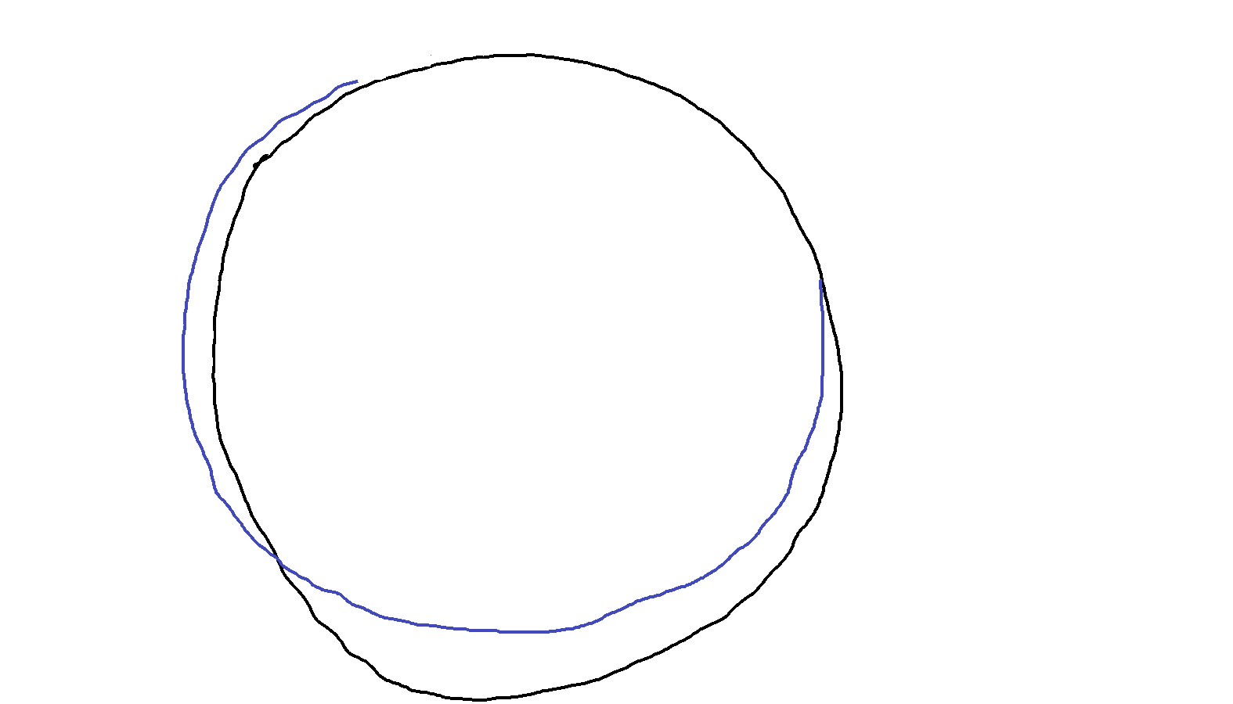
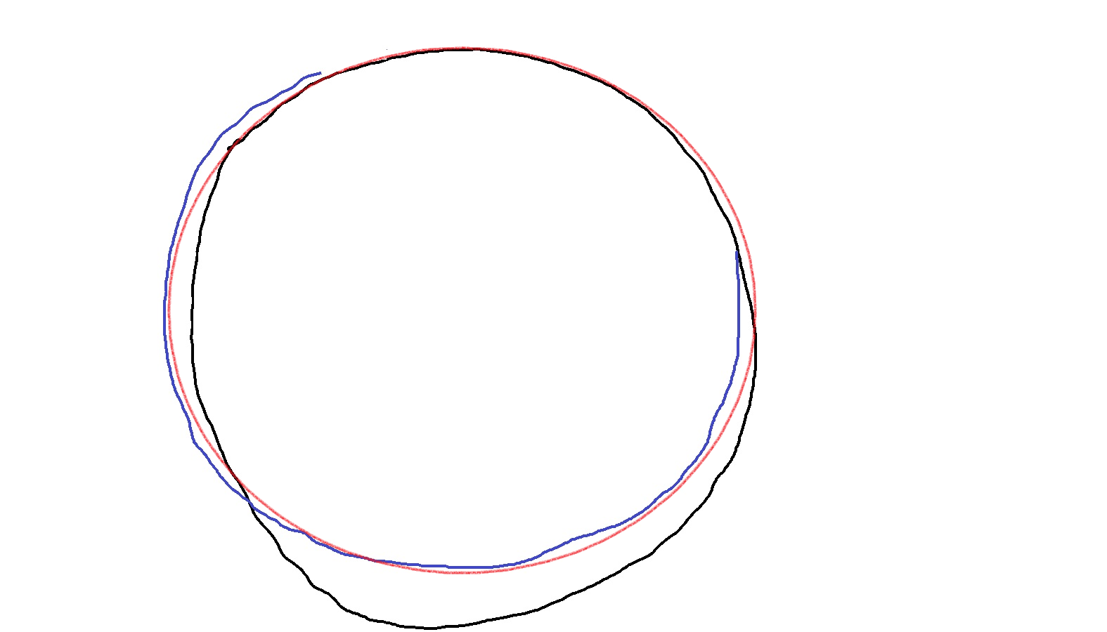
What is AI?
Intelligence that is Artificial
How intelligence works?
Circle is a closed 2D figure in which all points are equidistant from another point called center
But we just follow a pattern that we have learnt to draw a circle
We also know how to improve our accuracy to follow the pattern
AI makes computers learn patters without being specifically programmed

Slide 2
Conventional Program to Detect Activities
Speed > Some speed => Running
Speed <= Above speed => Walking or Swimming?
If on water => Swimming
If on land => Walking
But how does our program differentiate
between water & land?
Explicit Program
Logic
Input
Output

Slide 3




Power of Intelligence over Explicit Programming
Intelligence Can Easily Differentiate between Running, Walking and Swimming
Humans have previously seen and learnt the patterns of running, walking & swimming
Similarly, Artificial Intelligence can learn patterns if we train it with previous example images
Running
Walking
Swimming
Previous Examples
Detect Activity
AI Program
Input
Output
Swimming

Slide 4
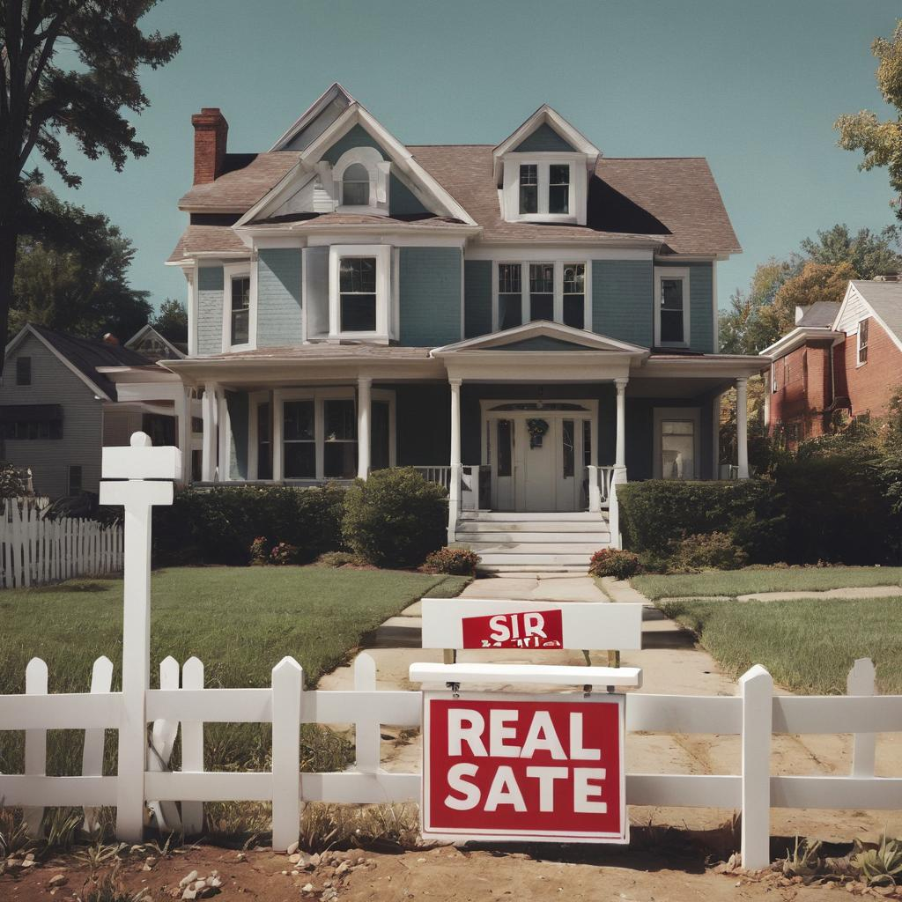
Data Science Applications
Real Estate Price Prediction
Floor Area (sqft) | Plot Area (sqft) | House Type | Town | Suburb | Public Transport Proximity | Number of floors | Age in Years | Number of Bed Rooms | Number of Garages | Number of Baths | Distance from School | Nearest School Quality | Distance from Hospital | ... | Price (₹100k)
2000 | 3000 | House | Kol | Garia | 200 | 2 | 0 | 6 | 3 | 3 | 200 | 5 | 200 | ... | 48
1500 | 2000 | Flat | Mum | Malad | 150 | 1 | 2 | 4 | 2 | 2 | 200 | 4 | 220 | ... | 73
1400 | 1800 | House | Del | Noida | 20 | 3 | 12 | 3 | 1 | 2 | 1500 | 5 | 10 | ... | 62
1800 | 2500 | Duplex | Hyd | Koti | 300 | 2 | 2 | 5 | 3 | 2 | 1000 | 4 | 1000 | ... | 53
... | ... | ... | ... | ... | ... | ... | ... | ... | ... | ... | ... | ... | ... | ... | …
... | ... | ... | ... | ... | ... | ... | ... | ... | ... | ... | ... | ... | ... | ... | …
... | ... | ... | ... | ... | ... | ... | ... | ... | ... | ... | ... | ... | ... | ... | …
Previous Examples
AI Program
Price of this house?
Input
Output
52
x (₹100k)
Floor Area | Plot Area | House Type | Town | Suburb | Public Trnx | # of floors | Age | # of Bed Room | # of Garage | # of Baths | Distanc from School | School Qlty | Distanc Hosptl | ...
1600 | 2500 | House | Del | Dwarka | 20 | 2 | 10 | 4 | 2 | 2 | 900 | 4 | 2000 | ...

Slide 5
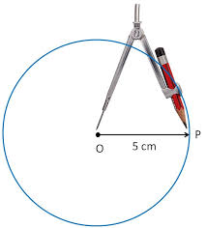
Recap: How Explicit Programs Work
Explicit Program
Input (Speed)
Speed > 5 kmph
No
Output (Activity)
Walking
Yes
Running
Explicit Program
Input
(Draw circle)
Circle is a closed 2D figure in which all points are equidistant from another point called center.
(x – h)² + (y – k)² = r²
Output

Slide 6
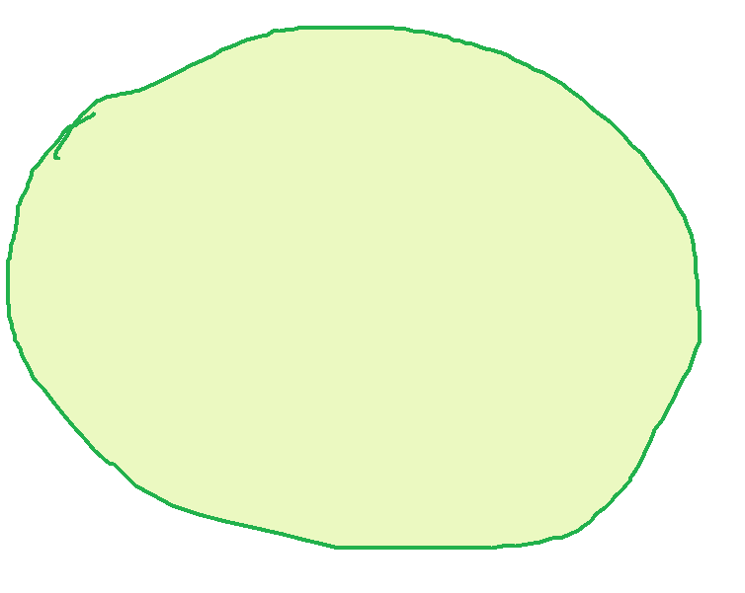
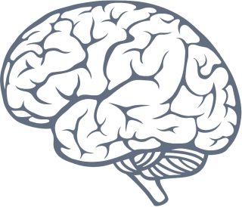
Recap: How Intelligent Systems Work
Circle
Pattern
Training
through
Previous Examples
Input
(Draw a circle)
Output

