Slide 1
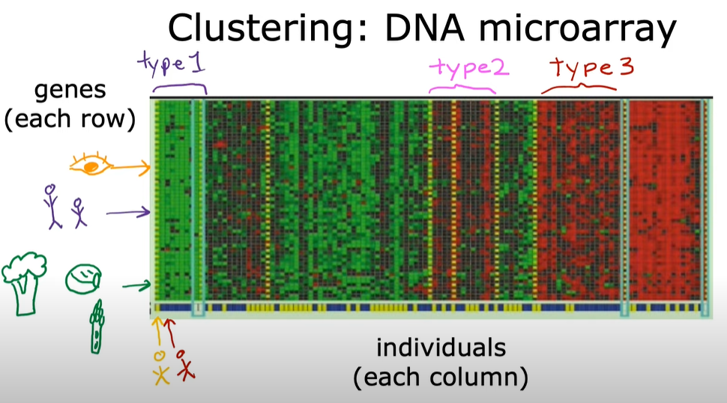
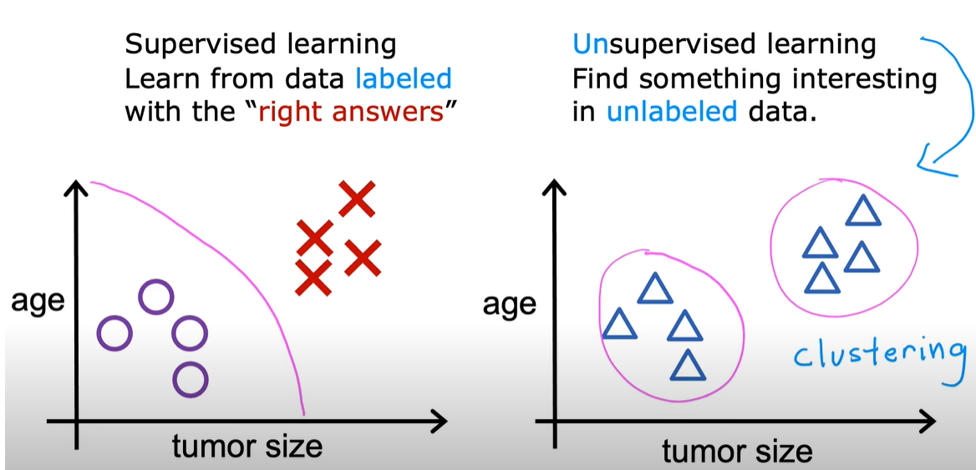
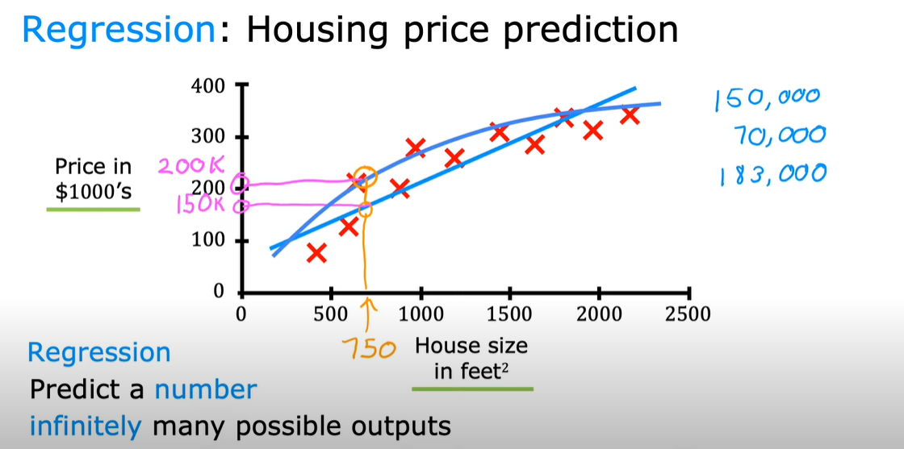
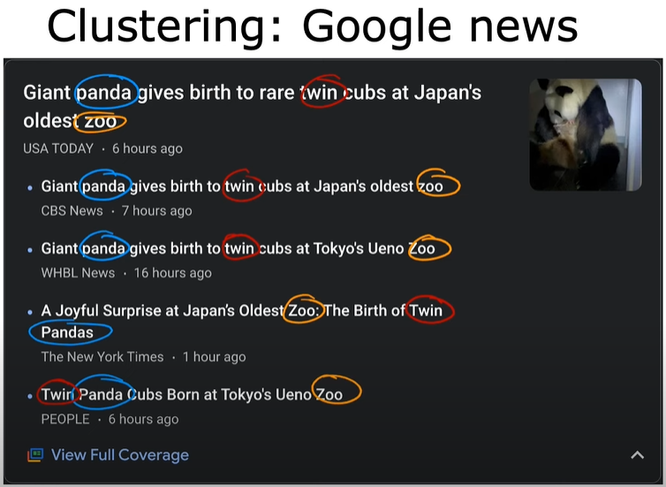
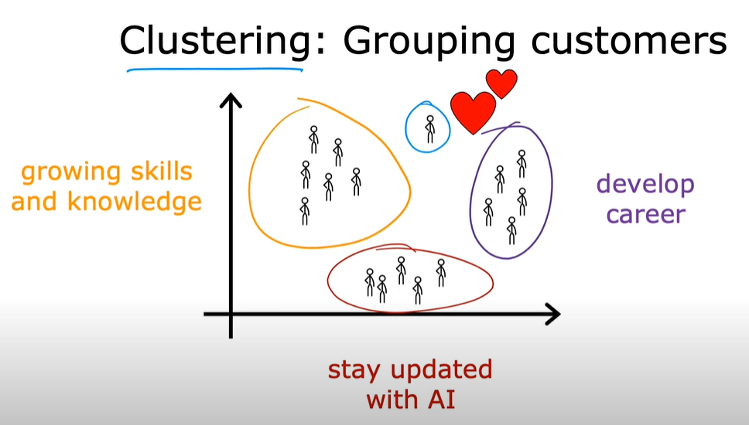
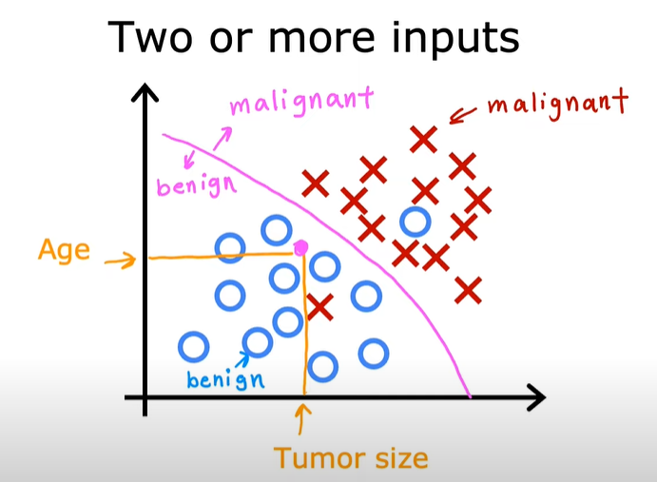
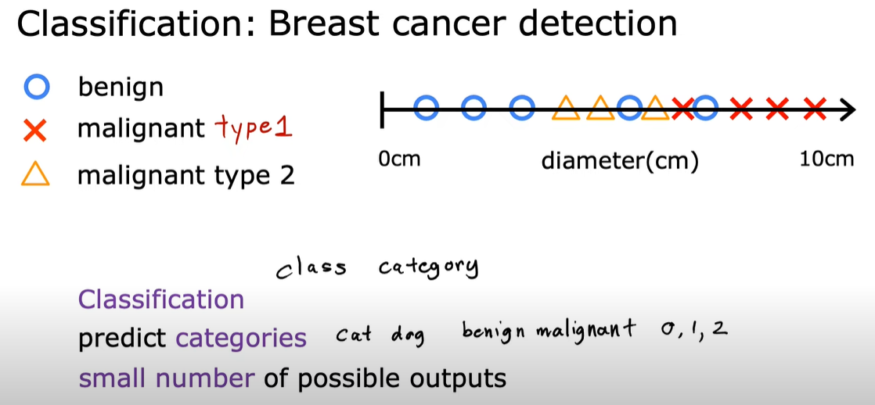
https://www.youtube.com/@Deeplearningai
Science that gives computers the ability to learn without being explicitly programmed
- Arthur Samuel 1959
Learns from both positive and negative feedbacks.
More the inputs, accurate the learning.
Supervised: 99%: Input to Output (both correct and wrong) mapped while learning
e.g. input=Ad, Output=User clicks (yes/no)
input=Hand drawn graphics, Output=can the be called a circle? y/n
input=Autonomous car video stream, Output=Position of other cars
Types: Regression (O/P is continuous var e.g. house price), Classification (O/P is discrete var or categories e.g. benine/malignant breast cancer)
Unsupervised: e.g. Google News, clustering DNA microarray, (Input x but Not output labels Y marked); Algo has to find patterns in data.
clustering, Anomaly Detection, Dimensionality Reduction (compresses data using fewer numbers)
Recommender Systems
Reinforced Learning

