Slide 1

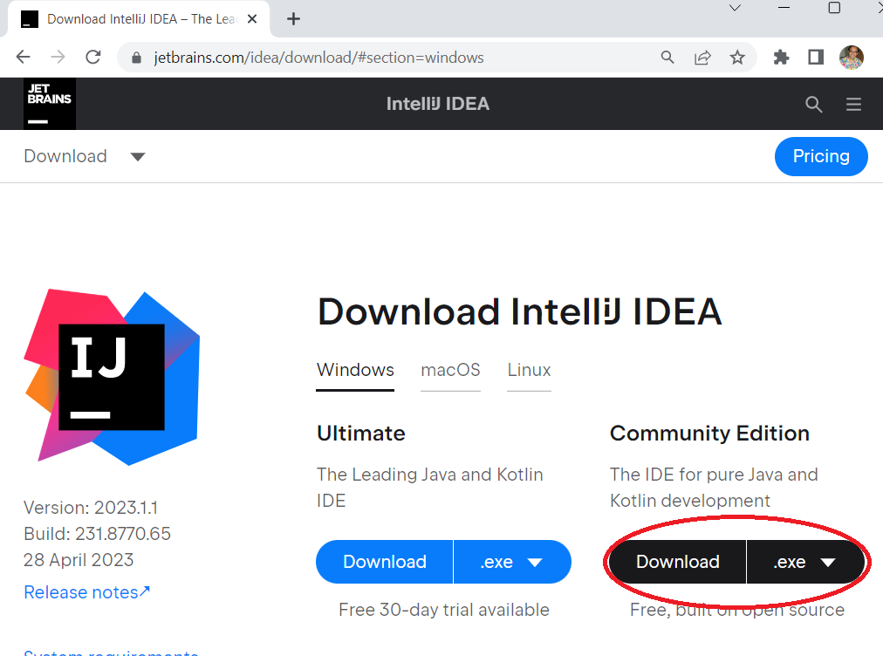
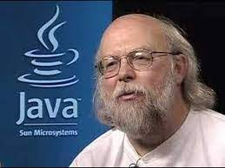
INTRODUCTION TO JAVA
Why Java?
Open source, free
Easy to implement
Secure, robust & powerful
Object oriented
High-level language
Platform-independent, Portable
Environment & Tools
Processor speed 3.6 GHz +
8 GB + RAM
JDK (Java Development Kit)
IDE (Integrated Dev Tool) (IntelliJ /Eclipse/ Net Beans)
JVM (Java Virtual Machine)
Java was created by
James Arthur Gosling - 1995
CONCEPTION >> PRACTICE >> CONFIDENCE >> HIGHEST GRADES © PROTECTED ANODIAM 2023 || PRIVATE & CONFIDENTIAL

Slide 2
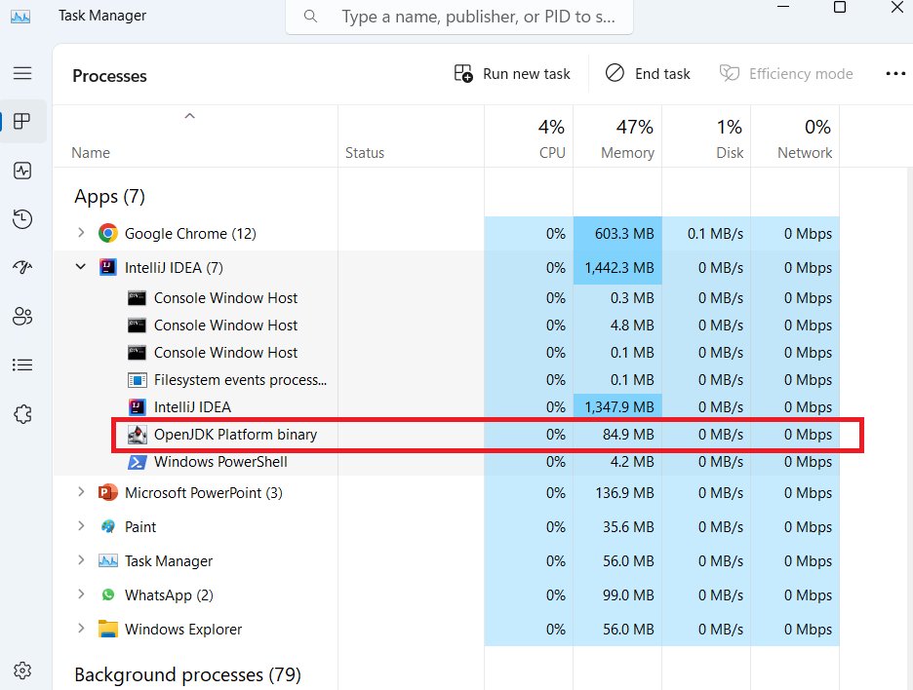
JVM (Java Virtual Machine)
IDE
JVM Running as Windows Process
Main.java
public class Main { public static void main(String[] args){ System.out.printf("Hello and welcome!"); } }
JDK
Compile
Main.class
> Byte code (o’s and 1’s)
> Portable to any OS (Win/Linux/Android/Mac)
Port to Any Device Running Java
JVM
Run
OUTPUT
> Hello and welcome!
CONCEPTION >> PRACTICE >> CONFIDENCE >> HIGHEST GRADES © PROTECTED ANODIAM 2023 || PRIVATE & CONFIDENTIAL

Slide 3
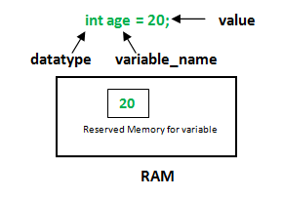
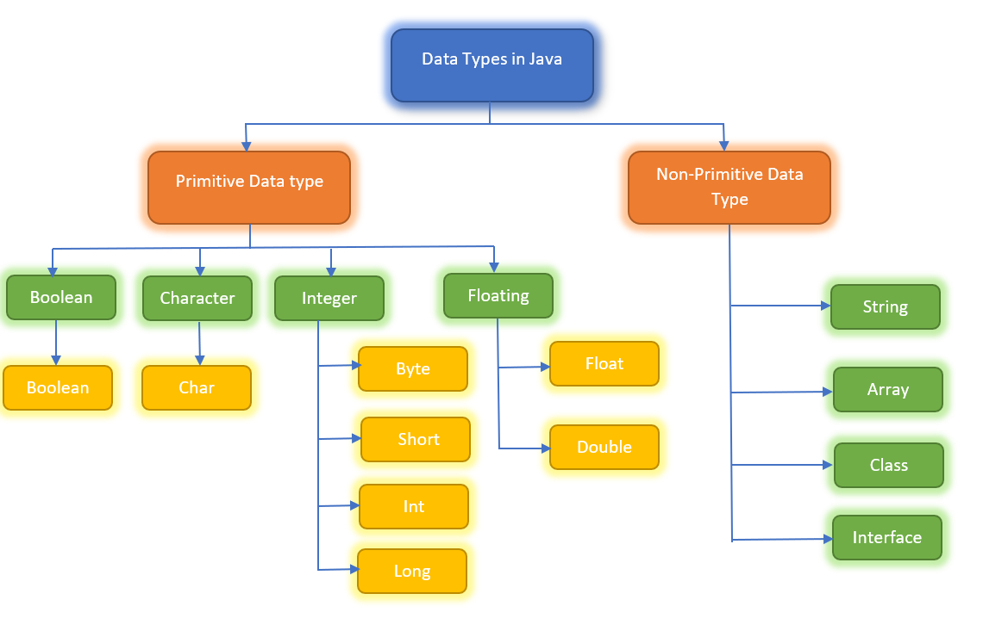
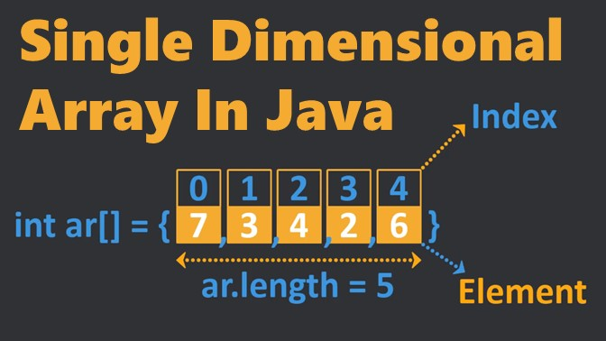
Variables, Data Types and Arrays
CONCEPTION >> PRACTICE >> CONFIDENCE >> HIGHEST GRADES © PROTECTED ANODIAM 2023 || PRIVATE & CONFIDENTIAL

Slide 4
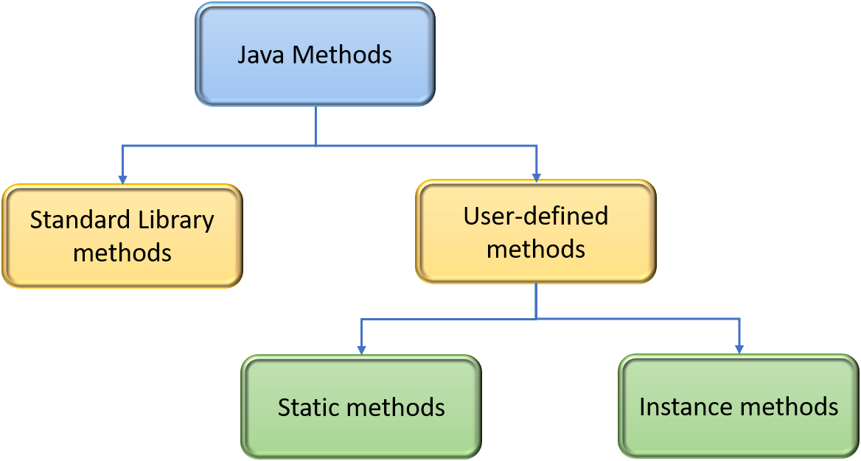
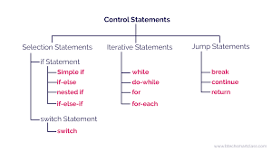
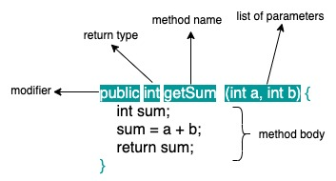
Control Flow Statements and Methods
CONCEPTION >> PRACTICE >> CONFIDENCE >> HIGHEST GRADES © PROTECTED ANODIAM 2023 || PRIVATE & CONFIDENTIAL

Slide 5
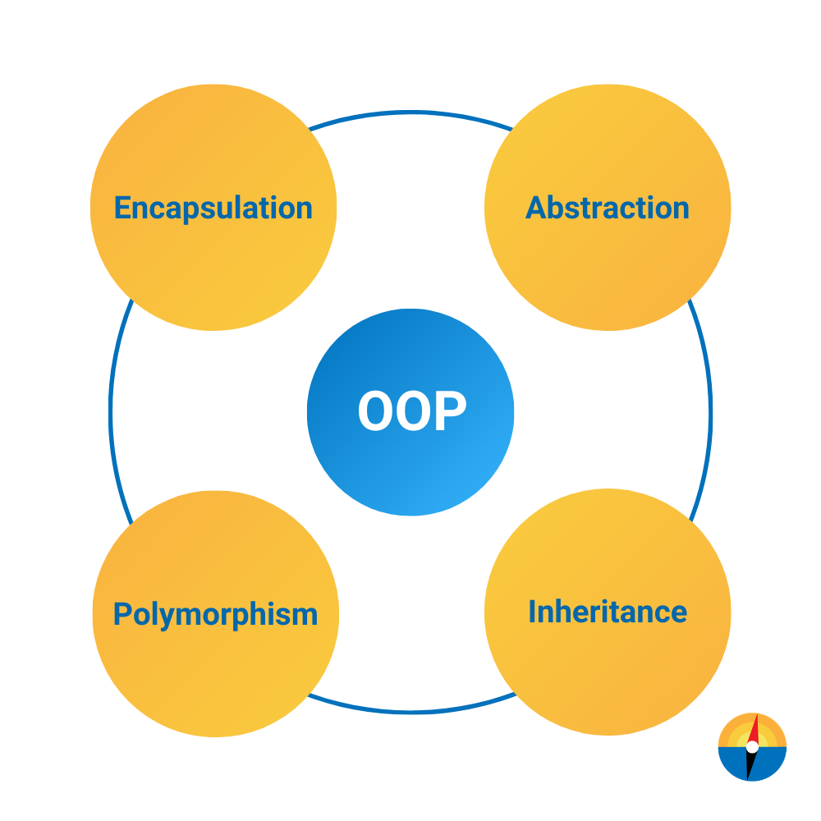
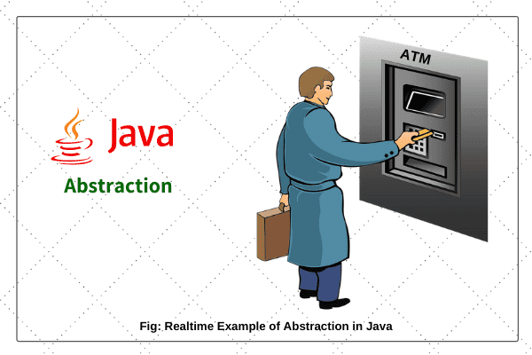
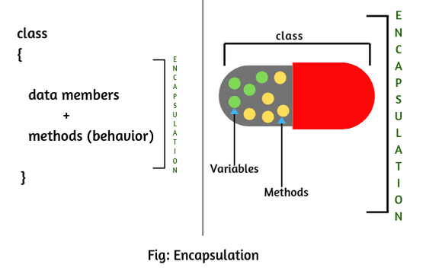
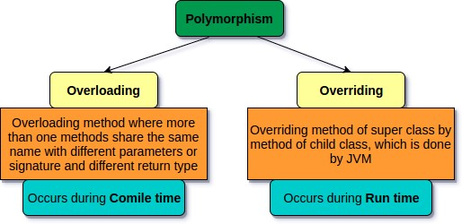
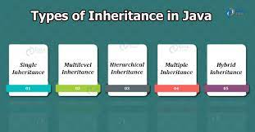
OOPS
CONCEPTION >> PRACTICE >> CONFIDENCE >> HIGHEST GRADES © PROTECTED ANODIAM 2023 || PRIVATE & CONFIDENTIAL

Slide 6
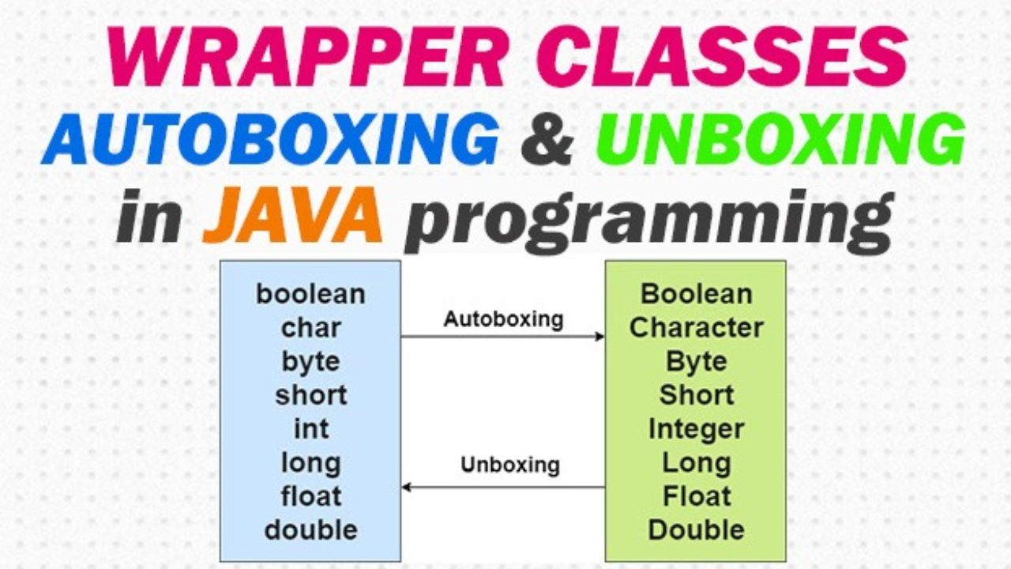
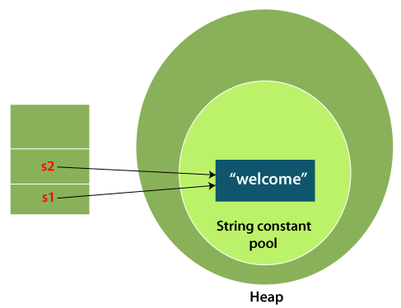
Strings and Wrapper Classes
CONCEPTION >> PRACTICE >> CONFIDENCE >> HIGHEST GRADES © PROTECTED ANODIAM 2023 || PRIVATE & CONFIDENTIAL

Slide 7
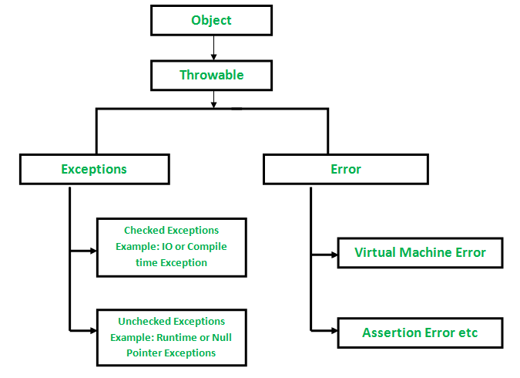
Exceptions in Java
CONCEPTION >> PRACTICE >> CONFIDENCE >> HIGHEST GRADES © PROTECTED ANODIAM 2023 || PRIVATE & CONFIDENTIAL

Slide 8
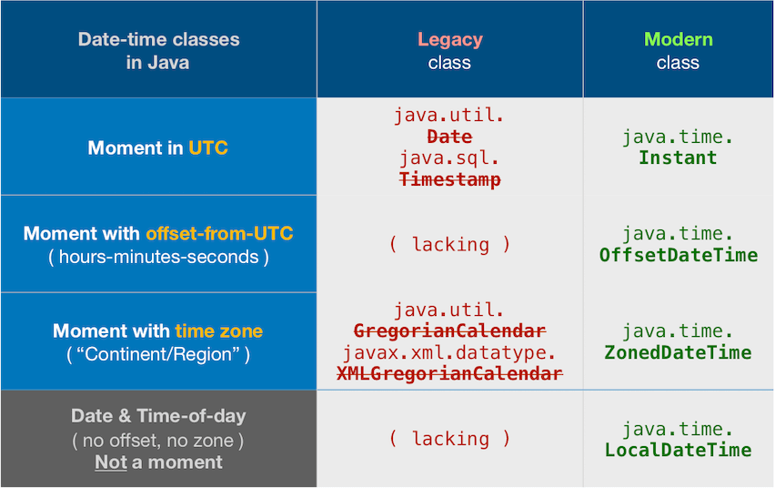
Java Date and Time
CONCEPTION >> PRACTICE >> CONFIDENCE >> HIGHEST GRADES © PROTECTED ANODIAM 2023 || PRIVATE & CONFIDENTIAL

Slide 9
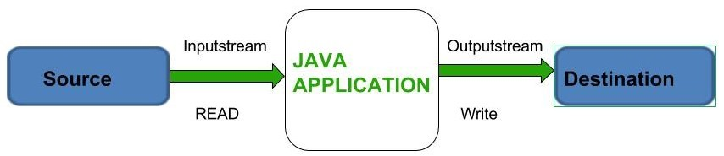
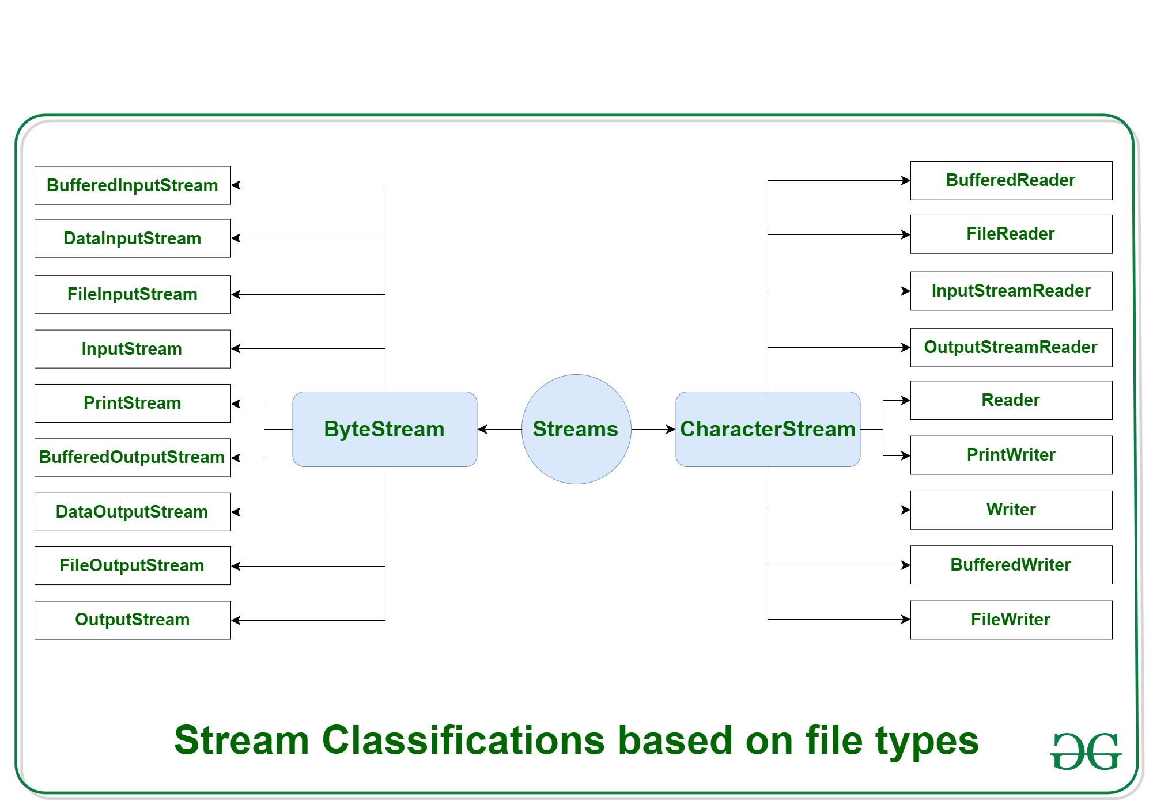
Java Input/Output
CONCEPTION >> PRACTICE >> CONFIDENCE >> HIGHEST GRADES © PROTECTED ANODIAM 2023 || PRIVATE & CONFIDENTIAL

Slide 10
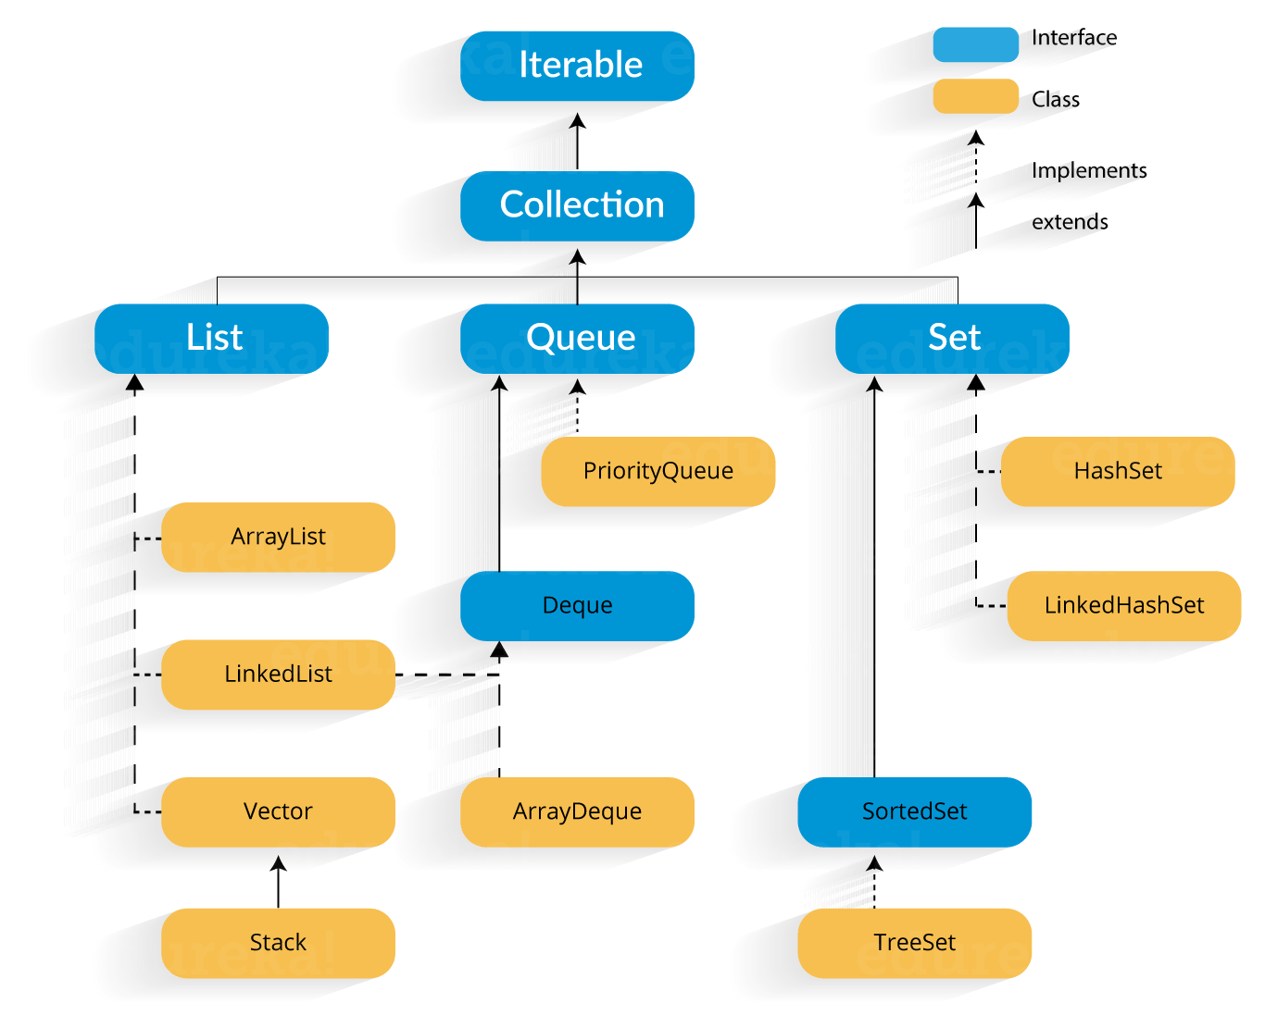
Collections
CONCEPTION >> PRACTICE >> CONFIDENCE >> HIGHEST GRADES © PROTECTED ANODIAM 2023 || PRIVATE & CONFIDENTIAL

Slide 11
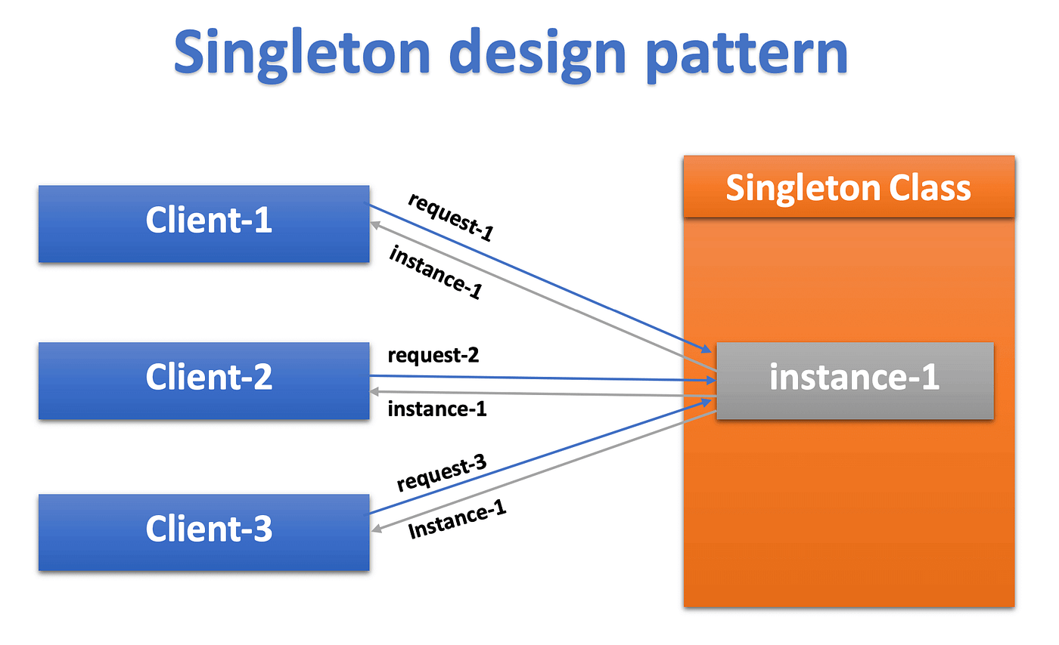
Design Patterns
Singleton pattern is a design pattern which restricts a class to instantiate its multiple objects. It is nothing but a way of defining a class. Class is defined in such a way that only one instance of the class is created in the complete execution of a program or project. It is used where only a single instance of a class is required to control the action throughout the execution. A singleton class shouldn’t have multiple instances in any case and at any cost. Singleton classes are used for logging, driver objects, caching and thread pool, database connections.
CONCEPTION >> PRACTICE >> CONFIDENCE >> HIGHEST GRADES © PROTECTED ANODIAM 2023 || PRIVATE & CONFIDENTIAL

Slide 12
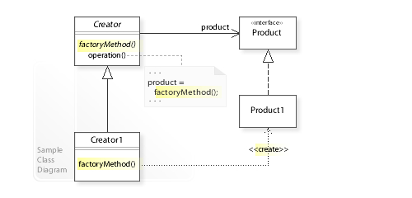
Design Patterns
Factory Pattern
Creating an object often requires complex processes not appropriate to include within a composing object. The object's creation may lead to a significant duplication of code, may require information not accessible to the composing object, may not provide a sufficient level of abstraction, or may otherwise not be part of the composing object's concerns. The factory method design pattern handles these problems by defining a separate method for creating the objects, which subclasses can then override to specify the derived type of product that will be created.
The factory method pattern relies on inheritance, as object creation is delegated to subclasses that implement the factory method to create objects.
CONCEPTION >> PRACTICE >> CONFIDENCE >> HIGHEST GRADES © PROTECTED ANODIAM 2023 || PRIVATE & CONFIDENTIAL

Slide 13
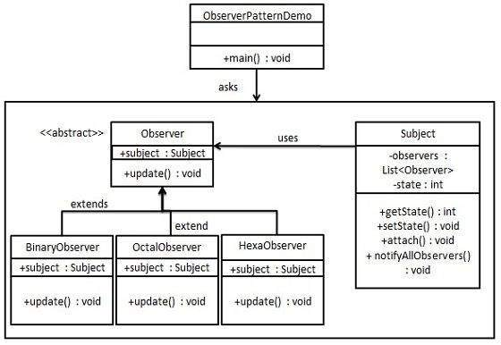
Design Patterns
Observer Pattern
The observer design pattern is a behavioural pattern listed among the 23 well-known "Gang of Four" design patterns that address recurring design challenges in order to design flexible and reusable object-oriented software, yielding objects that are easier to implement, change, test and reuse.
In software design and engineering, the observer pattern is a software design pattern in which an object, named the subject, maintains a list of its dependents, called observers, and notifies them automatically of any state changes, usually by calling one of their methods.
It is often used for implementing distributed event-handling systems in event-driven software. In such systems, the subject is usually named a "stream of events" or "stream source of events" while the observers are called "sinks of events." The stream nomenclature alludes to a physical setup in which the observers are physically separated and have no control over the emitted events from the subject/stream source. This pattern thus suits any process by which data arrives from some input that is not available to the CPU at startup, but instead arrives seemingly at random (HTTP requests, GPIO data, user input from peripherals, distributed databases and blockchains, etc.).
CONCEPTION >> PRACTICE >> CONFIDENCE >> HIGHEST GRADES © PROTECTED ANODIAM 2023 || PRIVATE & CONFIDENTIAL

